Slide 1
Third Sprint presentation
Group n. 04

Slide 2
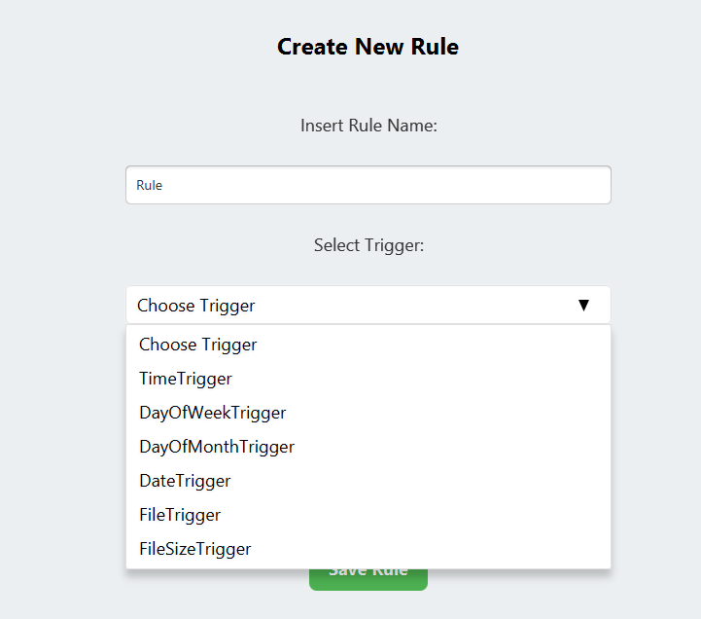
More triggers
User stories (10 story pts)
As a User I want to be able to select a Trigger based on the day of week from a list of triggers to fire an Action at a specified day of the week. (2 SP)
As a User I want to be able to select a Trigger based on the day of month from a list of triggers to fire an Action at a specified day of the month. (2 SP)
As a User I want to be able to select a Trigger based on the date from a list of triggers to fire an Action at a specified date. (2 SP)
As a User I want to be able to select a Trigger based on the name of a specified file in a specified directory from a list of triggers to fire an Action at a specified name. (2 SP)
As a User I want to be able to select a Trigger based on the size of a file from a list of triggers to fire an Action when the size of the file is larger than a specified value. (2 SP)

Slide 3
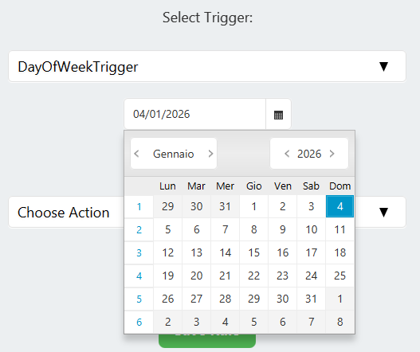
Triggers related to dates
TASKS
US 1: Select DayOfWeekTrigger
Create the DayOfWeekTrigger class implementing the Trigger interface.
Implement a logic that allows the user to insert the day of week in which he wants to fire the related action.
Create the corresponding method in the TriggerFactory to create the instance of the Trigger.
Create DayOfWeekTriggerController implementing the TriggerControllerInterface for the creation of the method useful for creating the Trigger and for the modify functionalities.
Create a new FXML file DayOfWeekTrigger.fxml containing the UI related to this section.
Define a consistent persistence format for saving and loading the DayOfWeektrigger.
US 2: Select DayOfMonthTrigger
US 3: Select DateTrigger
(US 2 and US 3 tasks are similar to the US 1 ones)

Slide 4
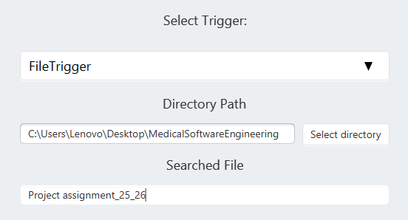
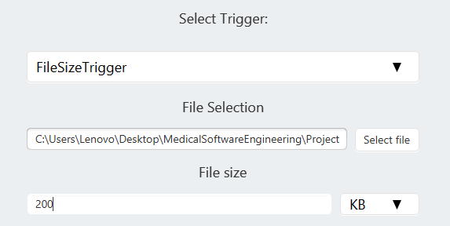
Triggers related to files
TASKS
US 4: Select FileTrigger
Create the FileTrigger class implementing the Trigger interface.
Implement a logic that allows the user to insert the name of a file to search in a directory and fire the related action if the file is found.
Create the corresponding method in the TriggerFactory to create the instance of the Trigger.
Create FileTriggerController implementing the TriggerControllerInterface for the creation of the method useful for creating the Trigger and for the modify functionalities.
Create a new FXML file FileTrigger.fxml containing the UI related to this section
Define a consistent persistence format for saving and loading the Filetrigger.
US 5: Select FileSizeTrigger
(US 5 tasks are similar to the US 4 ones)

Slide 5
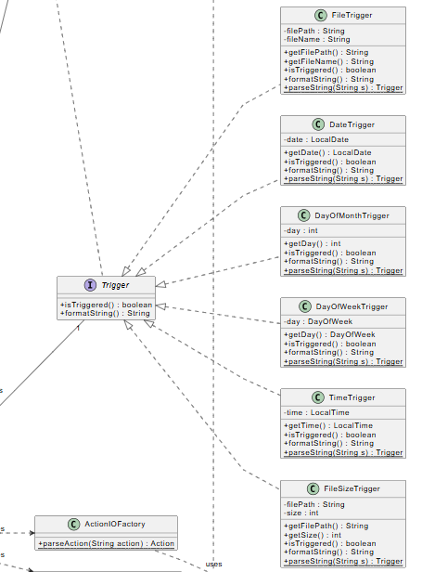

Strategy pattern
Concept: Defines a family triggers (Time, File, Date) with different behaviour.
Benefit: It allows the Rule class to verify conditions without knowing the specific logic, eliminating the need for complex conditional statements (large if-else blocks) and adhering to the Open/Closed Principle.

Slide 6
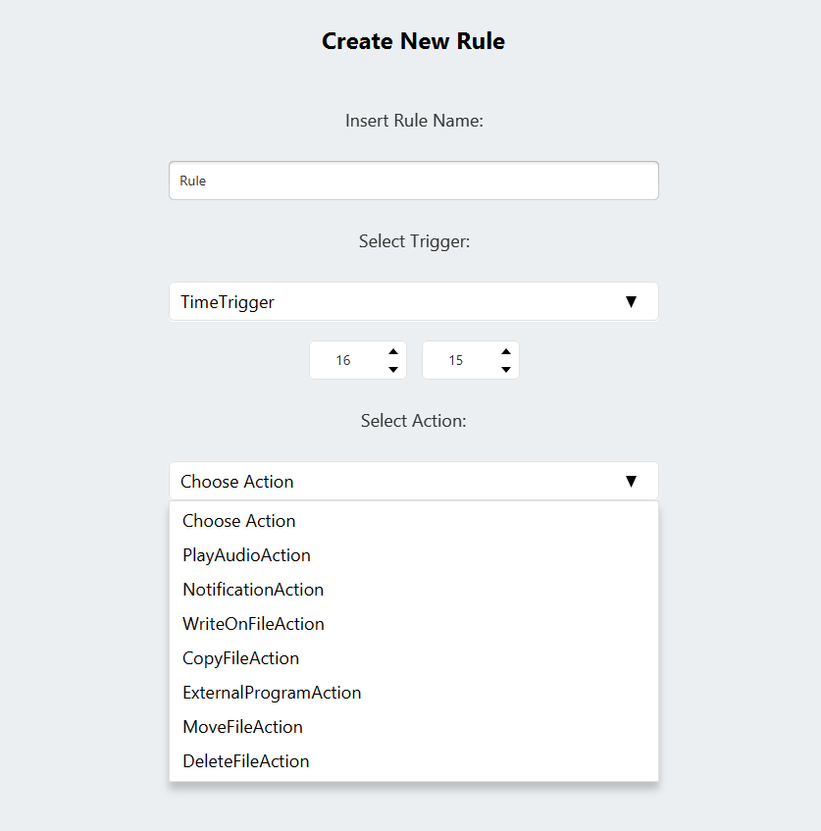
More Actions
User stories (6 story pts)
As a User I want to be able to select an action to move a specified file from a specified source directory to a specified destination directory from a list of actions when the rule is triggered. (3 SP)
As a User I want to be able to select an action to delete a specified file from a specified directory from a list of actions when the rule is triggered. (3 SP)

Slide 7
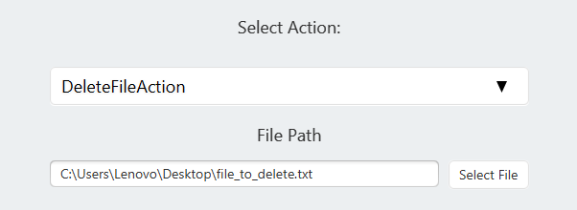
Delete Specified File
TASKS
US 10: Delete Specified File
Implement the DeleteFileAction class by inheriting from the Action interface.
Implement a logic that allows the user to delete a file in a directory.
Define a consistent persistence format for saving and loading the move action data.

Slide 8
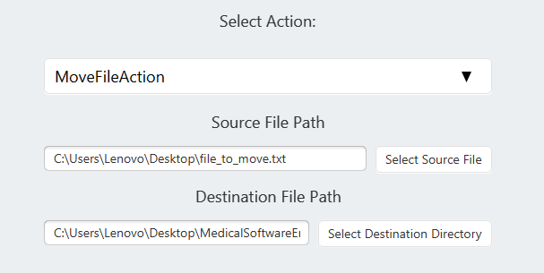
Move File Between Directories
TASKS
US 9: Move File Between Directories
Implement the MoveFileAction class by inheriting from the Action interface.
Implement a logic that allows the user to select a source file and a destination directory.
Ensure the action moves the file to the target directory.
Define a consistent persistence format for saving and loading the move action data.

Slide 9
More Actions
User stories (9 story pts)
As a User I want to be able to select an action to write a specified string at the end of a specified text file from a list of actions when the rule is triggered. (3 SP)
As a User I want to be able to select an action to copy a specified file from a specified source directory to a specified destination directory from a list of actions when the rule is triggered. (3 SP)
As a User I want to be able to select an action to execute a specified external program
from a list of actions when the rule is triggered. (3 SP)

Slide 10
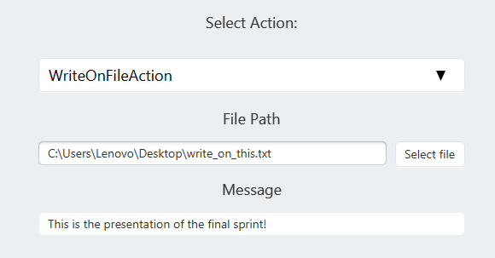
Append String to File
TASKS
US 6: Append String to File
Implement the WriteOnFileAction class by inheriting from the Action interface.
Implement a logic that allows the user to select a target file and input a specific string.
Ensure the action appends the string to the existing file content without overwriting it.
Define a consistent persistence format for saving and loading this action.

Slide 11
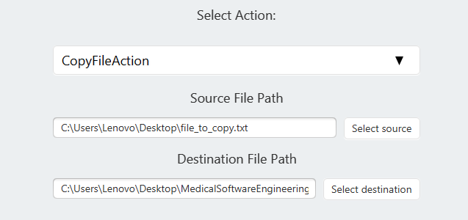
Copy File Between Directories
TASKS
US 7: Copy File Between Directories
Implement the CopyFileAction class by inheriting from the Action interface.
Implement a logic that allows the user to select a source file and a destination directory.
Ensure the action copies the file to the target directory, overwriting it if it already exists.
Define a consistent persistence format for saving and loading the copy action data

Slide 12
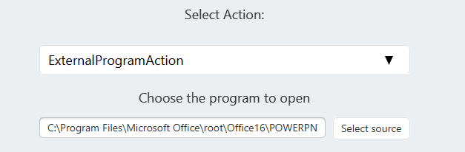
Execution of an External Program
TASKS
US 8: Execution of an External Program
Implement the ExternalProgramAction class by inheriting from the Action interface.
Implement a logic that allows the user to select an executable file from the file system.
Ensure the action launches the external program using its path.
Define a consistent persistence format for saving and loading the external program action.

Slide 13
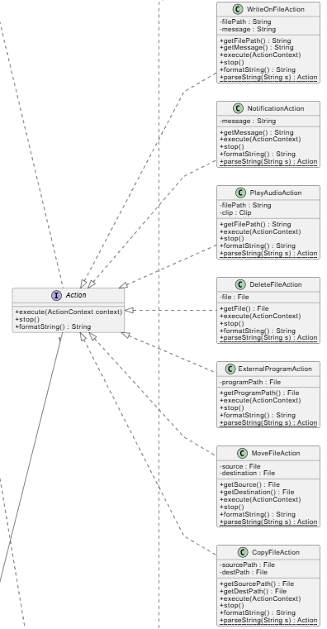
Command pattern
Concept: Encapsulates a request as an object (Action), allowing the Invoker (RuleEngine) to execute operations without knowing the details of the request or the receiver.
Benefit: It strictly decouples the execution logic from the business logic. The RuleEngine can simply call .execute() on any action, treating file operations, audio, and notifications uniformly.

Slide 14
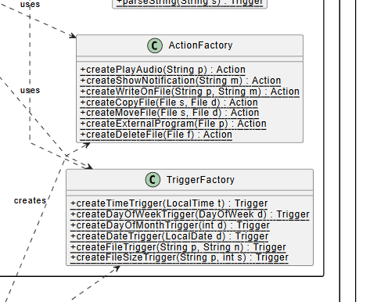
Factory pattern
Concept: Centralizes the object creation logic, providing a strict interface (ActionFactory, TriggerFactory) for instantiating complex objects.
Benefit: It hides the instantiation complexity (like parsing strings in IOFactory) from the client. This ensures the client code remains clean and independent of specific concrete classes constructors.

Slide 15
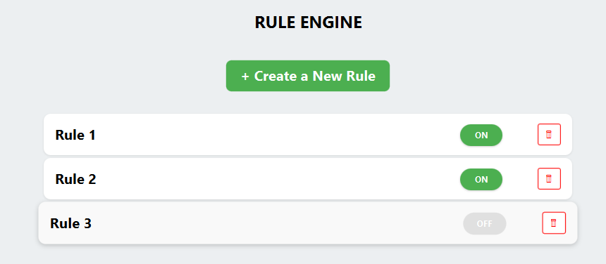
Details section and Modify Rule
User stories (8 story pts)
As a User I want to be able to see details of a selected rule. (3 SP)
As a User I want to be able to modify a Rule already created. (5 SP)

Slide 16
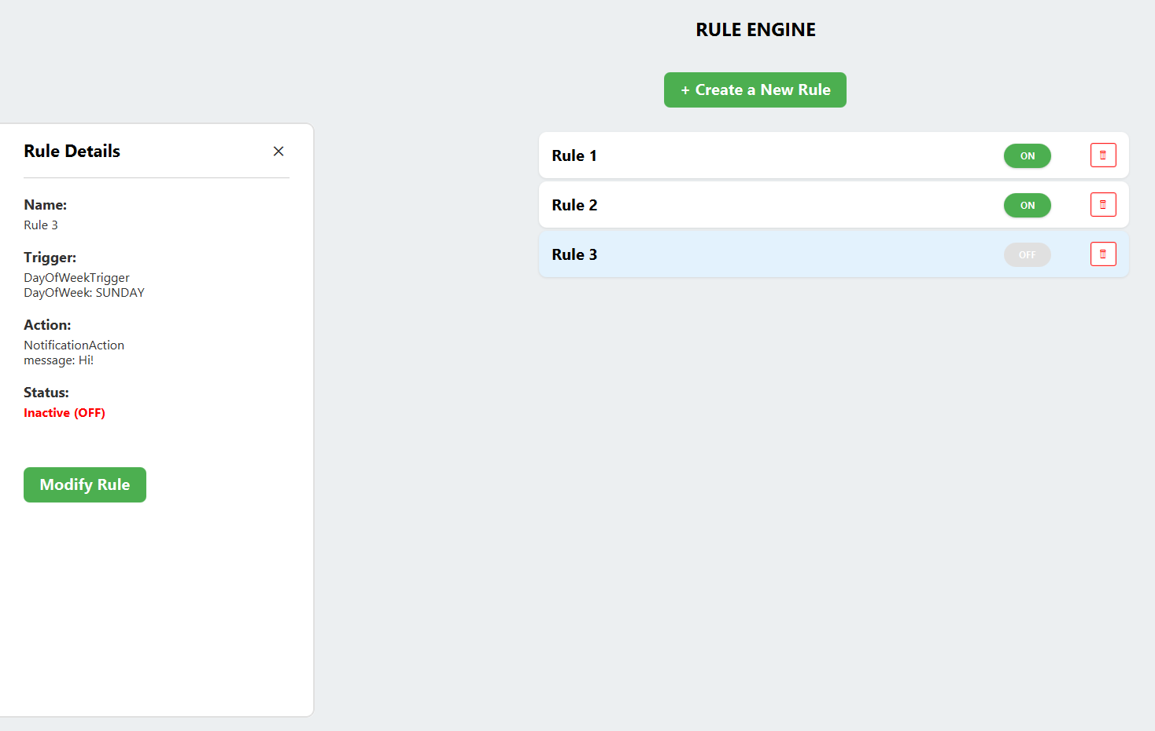
Details section
TASKS
US 11: Details Section
Create the RuleDetailsController class to manage the logic for displaying the specific information of a selected rule.
Create the RuleDetails.fxml (embedded in the Home view) containing the UI elements for Name, Trigger description, Action description, and Status.
Implement a setRule(Rule rule) method in the controller to bind the UI labels to the data of the selected Rule object.
Implement a listener in the main list view (Home) to invoke the details view when a rule is selected.

Slide 17
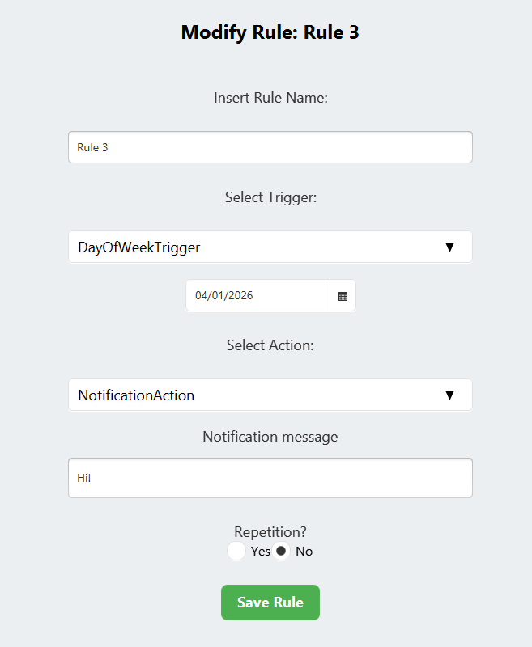
Modify Rule
TASKS
US 12: Modify Rule
Refactor the creation logic into CreateOrModifyRuleController to handle both "Creation" and "Modification" states.
Implement an initData(Rule rule) method in CreateOrModifyRuleController to receive the rule to edit and pre-fill the Name field.
Update TriggerControllerInterface and ActionControllerInterface by adding a method (setTriggerData, setActionData) to allow populating UI fields from an existing model object.
Implement the setTriggerData and setActionData methods in all specific sub-controllers (all triggers and action controllers) to map model data back to UI components.
Implement logic in the parent TriggerController and ActionController to dynamically load the correct FXML based on the existing rule's type and delegate data population to the specific sub-controller.
Implement the setRepetition method in RepetitionController to restore the state of RadioButtons and Spinners based on the existing Repetition object.
Implement the "Save" logic for modification: ensure the rule instance is updated with new ones.

Slide 18
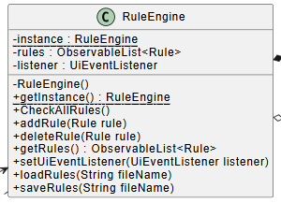
Singleton pattern
Concept: Ensures that the RuleEngine class has exactly one instance throughout the application lifecycle and provides a global access point (getInstance()) to it.
Benefit: It guarantees centralized control over the entire system state. This prevents data inconsistencies and provides a shared access point for Controllers to manage rules.

Slide 19
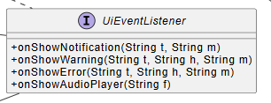
Observer pattern
Concept: Defines a subscription mechanism where the Model (RuleEngine) notifies attached Observers about state changes. This is implemented via the custom UiEventListener interface for execution logs and natively via JavaFX ObservableList for the rule list.
Benefit: It ensures a reactive User Interface that automatically synchronizes with the underlying data. The Model does not need to know the details of the View, resulting in loose coupling between the application logic and the JavaFX components.

Slide 20
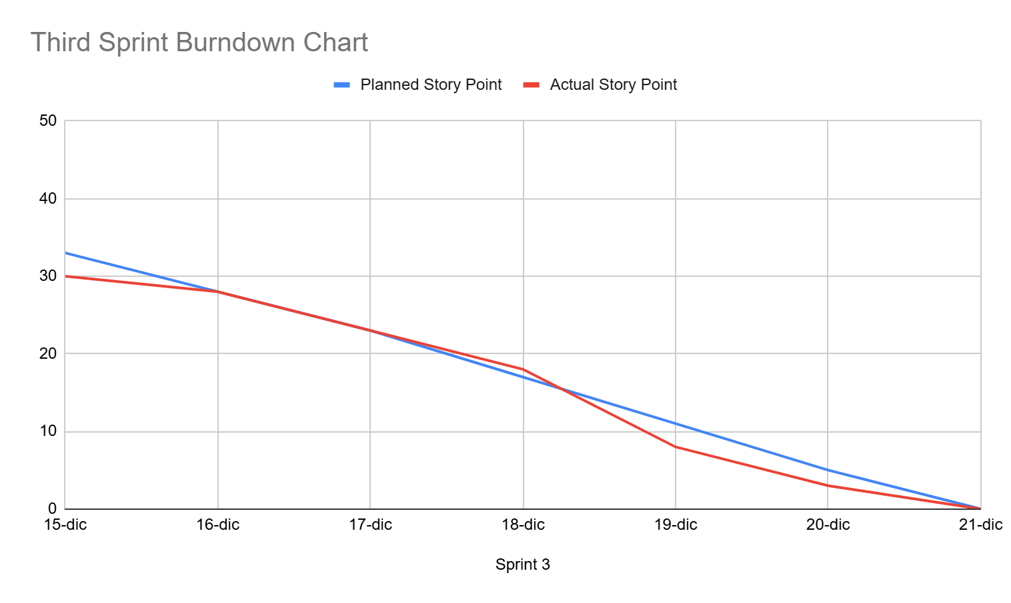
Sprint Burndown Chart

Slide 21



Sprint review report
All tasks completed successfully
Any user stories rejected by the Product Owner:
None
Project Velocity measured and respected:
33

Slide 22
Third sprint retrospective
Advices for future projects
Stop
(things to stop doing)
Overestimate the work of a single member, everyone during the work surely will find bugs and problems that will slow them down.
Keep doing
Many test methods on the newly implemented code. Doing a lot of tests can require a lot of time, but in the end there won’t be any bugs and not working functionalities.
Write always acceptance criteria and reasonable tasks, in this way the person that is working on these user stories knows what to do and the time that requires to do it.
Less of
None.
More of
(more things to do)
None.
Start
(things to start doing)
None.

Slide 23
Project recap
Patterns used
Singleton
RuleEngine
SimpleFactory
TriggerFactory
ActionFactory
MVC
Strategy
Trigger
Command
Action
Observer
UIEventListener

Slide 24
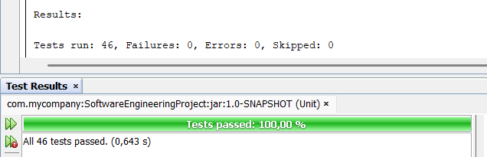
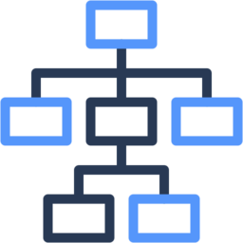
Project recap
All tests successfully passed
Complete UML diagram
Click here!

Slide 25
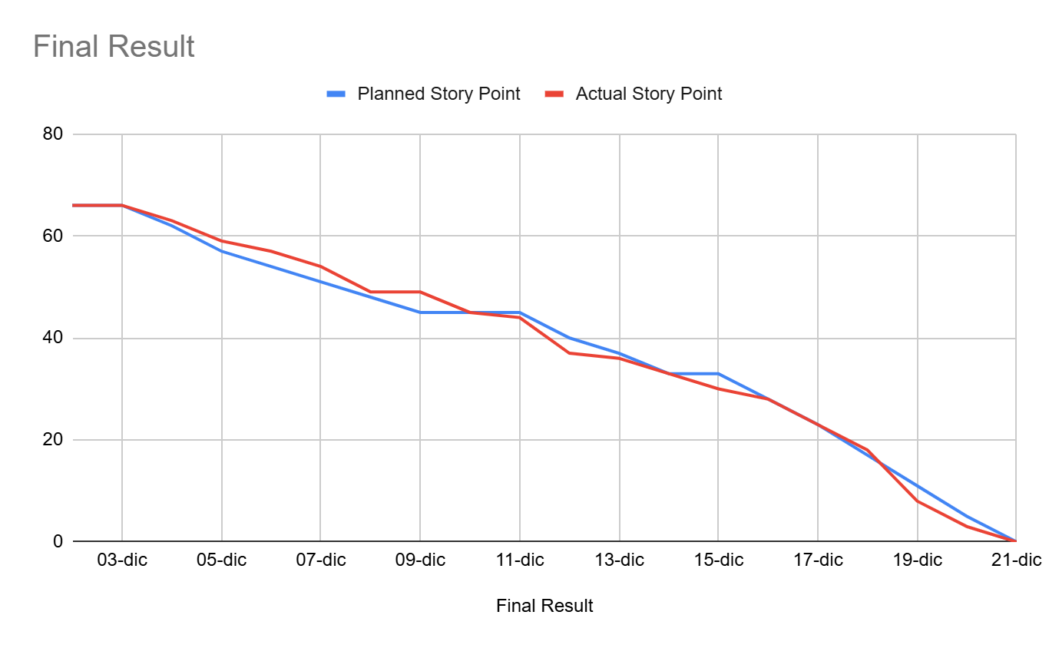
Final Burndown Chart
Project Win:
The biggest success of this project was the alignment between the planning phase and the final delivery. We proved that a well-refined backlog leads to a predictable and successful outcome.

