Slide 1


Fundamentals of Robotics project
Group K
Authors:
Conti Filippo [218297]
Gianuzzi Nicola [209309]
Meneghin Mattia [210561]
GitHub repository click here
University of Trento

Slide 2
Fundamentals of Robotics project
Project Overview - Proposal 1
A number of objects are stored randomly on a stand located within the workspace of a robotic manipulator (UR5), an anthropomorphic arm, with a spherical wrist and a three-fingered gripper as end-effector. The objects can belong to different classes but have a known geometry. The goal of the project is to pick the objects using in sequence and to position them on a different stand using a calibrated 3D sensor to locate the different objects and to detect their mutual position in the initial stand. The project is organised as a sequence of assignments of increasing complexity.
University of Trento

Slide 3


Fundamentals of Robotics project
Tool used
Programming Languages used
ROS noetic
Locosim
C++
Gazebo & Rviz
Python
Catkin
Bash
Yolov5 & Pytorch
University of Trento

Slide 4
Fundamentals of Robotics project
Structure of the Project
We decided to split the project into 3 packages:
Environment 3. Vision
Spawner Lego 3.1 Vision.py
Lego models 3.2 RecogniseLego
3.3 RecogniseArea
Motion
Planner
Movement Locosim (light version)
University of Trento

Slide 5
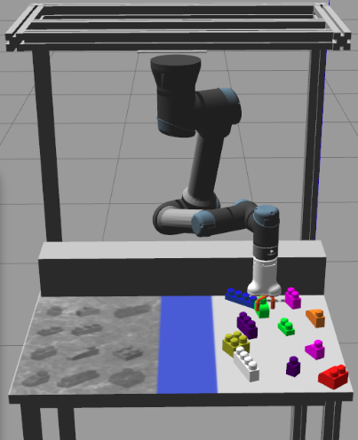
Fundamentals of Robotics project
1 Environment
This module is in charge of launch all the environment. It will open Gazebo and Rviz using the didactic framework Locosim.
In this way the UR5 is ready to do the tasks that will be assigned from the planner module. This module is mostly done by the author of this framework, we edit the models in the worlds folder in order to customize the world
different version of the lego models
from 1.4 to 1.6
Mesh on the table with the object silhouette
Custom lego.world
University of Trento

Slide 6
Fundamentals of Robotics project
1.1 Spawn Lego
Generates the lego objects on the table
Possibility to set position, orientation and distances between objects)
Capability to select the assignment number and also special features
Parameters:
No parameter
-a[assignment] where [assignment] = {1, 2, 3, 4} (e.g. -a2)
-s1 (beta)
Wait for some external spawn commands (for testing)
-s2 (beta)
Spawns lego and removes them after a certain delay
Used to take pictures
University of Trento

Slide 7

Fundamentals of Robotics project
2 Motion
It is the package in charge of handle the movement and tasks to do of the Universal Robot 5, it is composed by several modules and systems:
Planner
Movement
Kinetics
Task Waiting System
Acknowledgement System
University of Trento

Slide 8
Fundamentals of Robotics project
2.1 Planner
Communicates with the vision module with acknowledgements capability:
vision publisher → planner subscriber
Get info about the object detected through legoFound.msg
(e.g. Coordinates, orientation, class)
3 available commands from vision
0 - No Command
1 - Detect
2 - Quit planner
With a given class, it defines the final coordinates and orientation
University of Trento

Slide 9
Fundamentals of Robotics project
2.2 Movement
Communicates with the planner module with acknowledgement and authorization capability.
planner publisher → Movement subscriber
It receives the legoTask.msg from the Planner and gets the info about:
command to execute without caring about the class
most frequent is the 0: catch_obj
Initial coordinates and final coordinates
Diameter gripping and the final object position [optional]
It answers to the planner through a eventResult.msg
Inside the movement.cpp there are basic instructions to move the UR5 robot referring to a library called Kinetics
University of Trento

Slide 10

Fundamentals of Robotics project
2.2 Movement commands from the planner module
0 - No Command Security system commands:
1 - Test
2 - Wait 9 - Handshake
3 - Move 10 - Auth key
4 - Grasp
5 - Ungrasp
6 - Default position
7 - Fast catch
8 - Catch
University of Trento

Slide 11
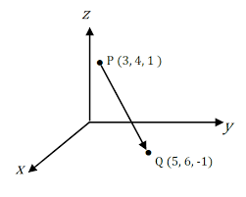
Fundamentals of Robotics project
2.3 Kinetics
Kinetics is the library that contains all the primitive instructions in order to calculate angles, spatial displacement, matrix and all the mathematical functions related.
It includes the necessary classes and functions for dense matrix operations, it provides a wide range of functionalities, including matrix algebraic operations.
We handled the Euler’s singularities by avoiding the arm to pass in these critical areas with specific commands.
University of Trento

Slide 12
Fundamentals of Robotics project
2.4 Acknowledgement system
It allows you to choose the operating mode
Since the communication between two different modules is done through messages with a certain command IDs, each of these is defined in order to give back a variable called send_ack.
If you want an execution results back to the caller module
send_ack must be equal to 1.
It enforces the called module to complete the requested command and send back the results via event message.
If you just need the execution without caring about its completions,
leave "send_ack" equal to 0
University of Trento

Slide 13
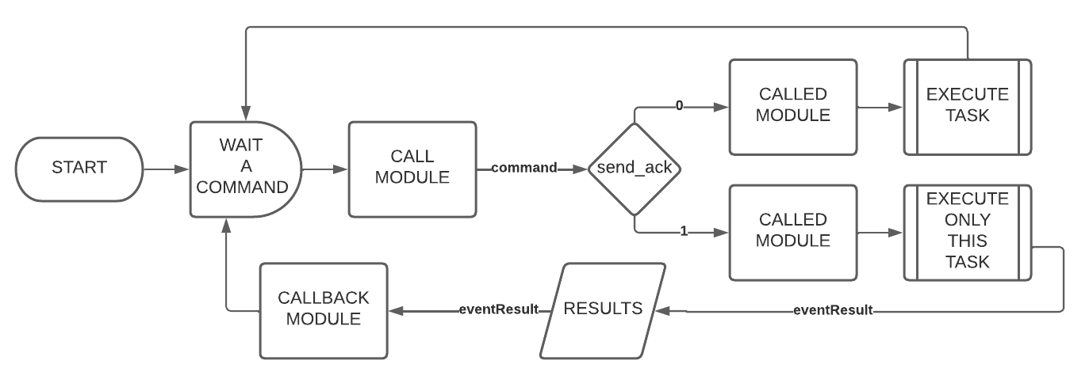
Fundamentals of Robotics project
2.4 Acknowledgement system flow
University of Trento

Slide 14


Fundamentals of Robotics project
2.5 Secure communication system
The planner can be rosrun with the -s parameter which enables the authorization system: In the first time will be an handshake procedure where the planner and the module share their keys in a encoded channel. One ready, this system prevents to send commands to the movement module without a valid authorization code that changes over the time.
University of Trento

Slide 15
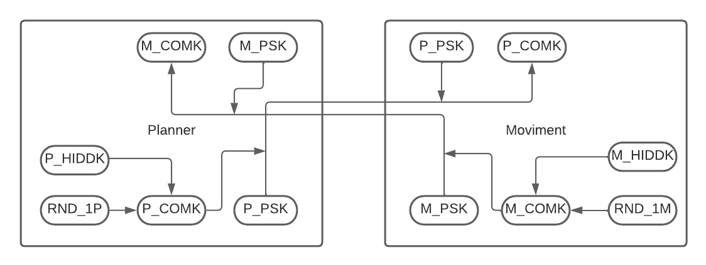
Fundamentals of Robotics project
2.5 Secure communication system diagram: Handshake part 1
University of Trento

Slide 16
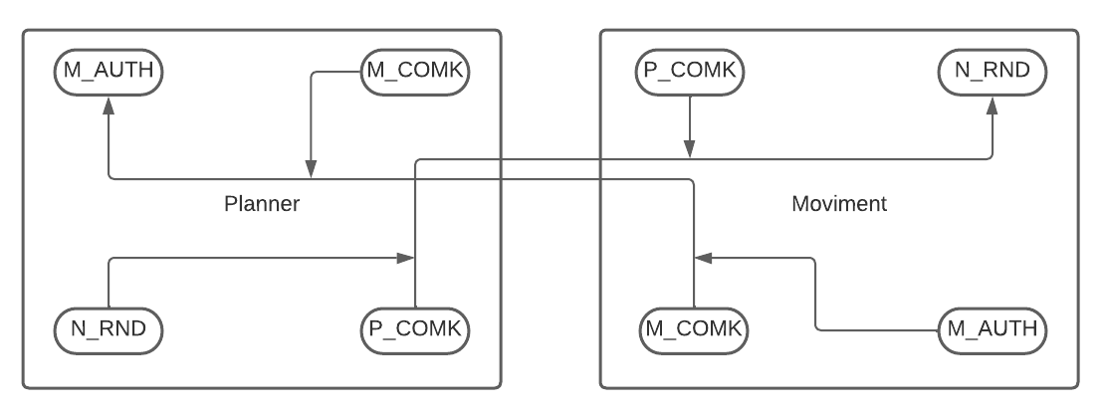
Fundamentals of Robotics project
2.5 Secure communication system diagram: Handshake part 2
University of Trento

Slide 17
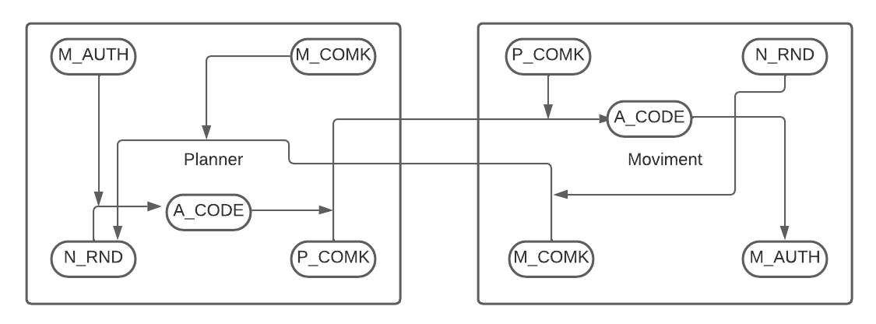
Fundamentals of Robotics project
2.5 Secure communication system diagram: On work
University of Trento

Slide 18
Fundamentals of Robotics project
3 Vision
In charge of practice the deep learning to create an “artificial neural network” that can learn and make intelligent decisions on its own
The goal is to make ZED-Camera able to recognize the 11 different models (legos) starting from a dataset (pool of ~2500 images).
Tool used:
MakeSense AI Get annotations
Roboflow Create and refine the dataset
Yolov5 (Ultralytics) in Colab Train
Pythorch Test in practice
University of Trento

Slide 19
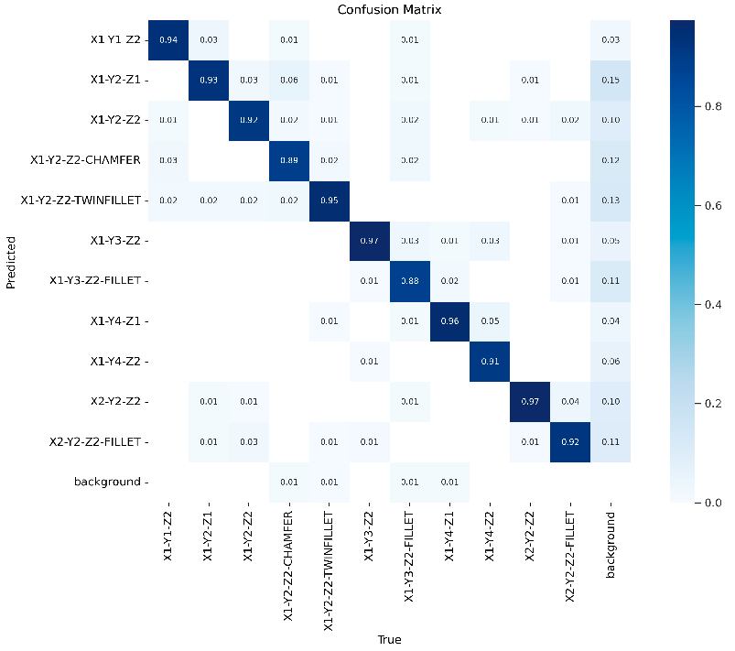
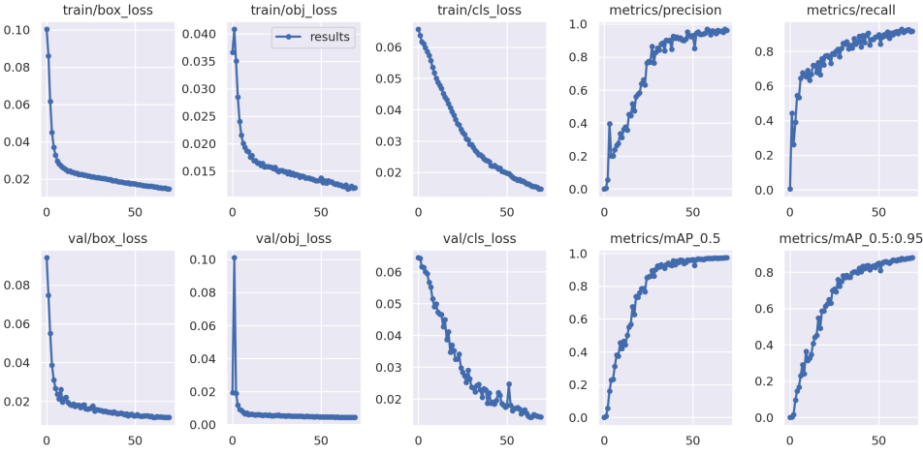
Fundamentals of Robotics project
Vision Results
University of Trento

Slide 20
Fundamentals of Robotics project
Vision detection misses
We noticed that there are some misses during the detection, in particular running the assignment 2
Rarely it misses the objects (no detection)
sometimes it recognizes the wrong class
especially in case of similar geometry shapes (i.e. class 3 - 6)
The main reason is the point of view of the camera
Of course it is quite impossible to get 100% of precision detection
The solution is to increase the number of annotations of the most frequent objects missed in the dataset
As shown in the previous slide, we got ~97% of accuracy
so that we decide to keep this acceptable values
University of Trento

Slide 21
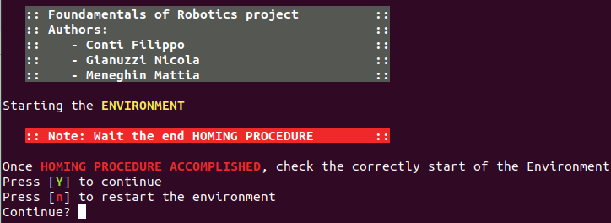
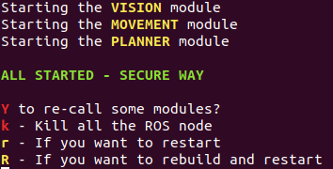
Fundamentals of Robotics project
Run The Project
Move into the repository folder, then catkin_ws
cd Robotics_ICE23_UNITN/catkin_ws/
Build the packages
catkin_make install
Run the start.sh script using
bash ~/Robotics_ICE23_UNITN/start.sh
Note: Necessary to wait the accomplishment of the homing procedure in the “environment” terminal
University of Trento

Slide 22
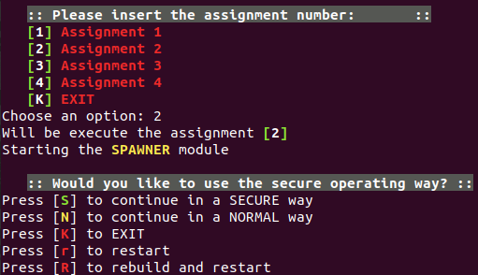
Fundamentals of Robotics project
Run The Project
Select the number of the assignment or EXIT
Select the operating way [S/N]
Otherwise you can
EXIT
Restart
Rebuild and then restart
University of Trento

Slide 23
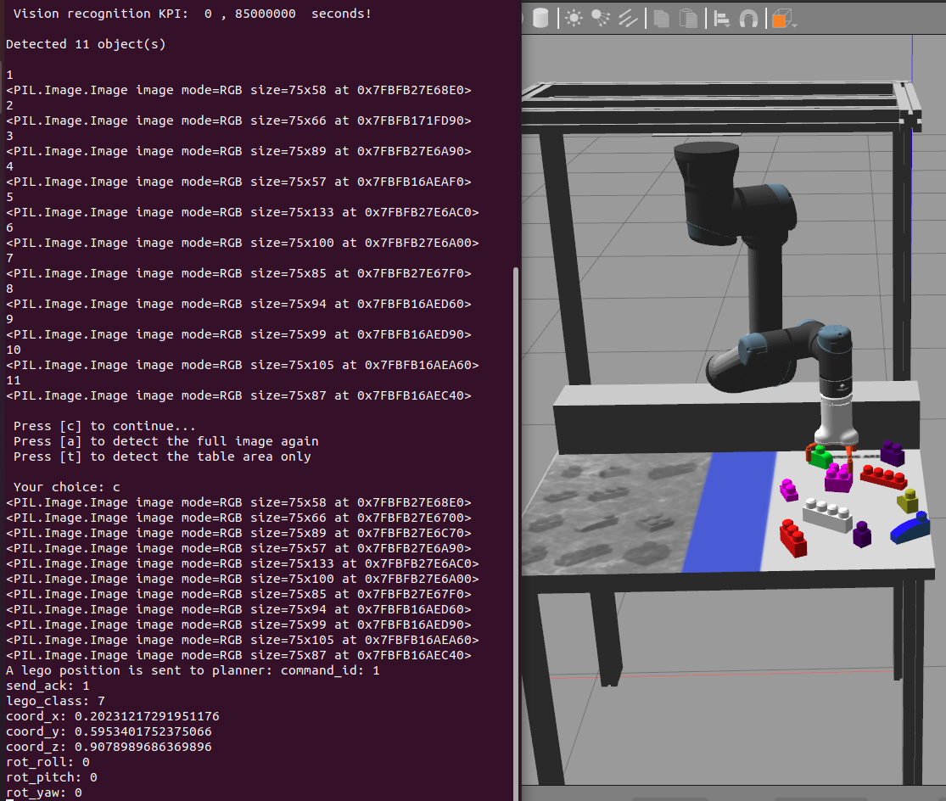
Fundamentals of Robotics project
Make the robot move
Vision module will wait until it receives a command:
c - continue and sends coordinates to the planner
a - Detect again the objects normally
t - Detect the objects only referring to the table area
Note: the c command is necessary to go on
University of Trento

Slide 24
Fundamentals of Robotics project
Results
We measured the KPI for each modules of this project. The performances vary from a computer to another. In one test we had:
In all the terminal referring to each module is possible to see the KPIs - less than 1 second to detect legos by vision module - about 32 seconds to execute the 1° assignment - about 363 seconds to execute the 2° assignment
- about 204 seconds to execute the 3° assignment
KPI refers at the time in the simulation and may differ from real time
University of Trento

