Slide 1
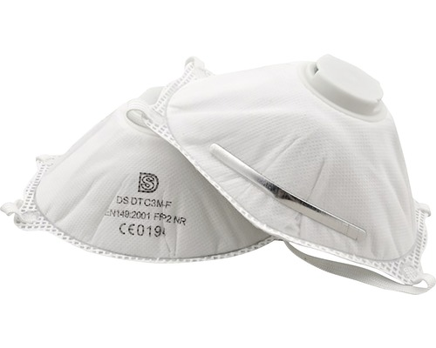


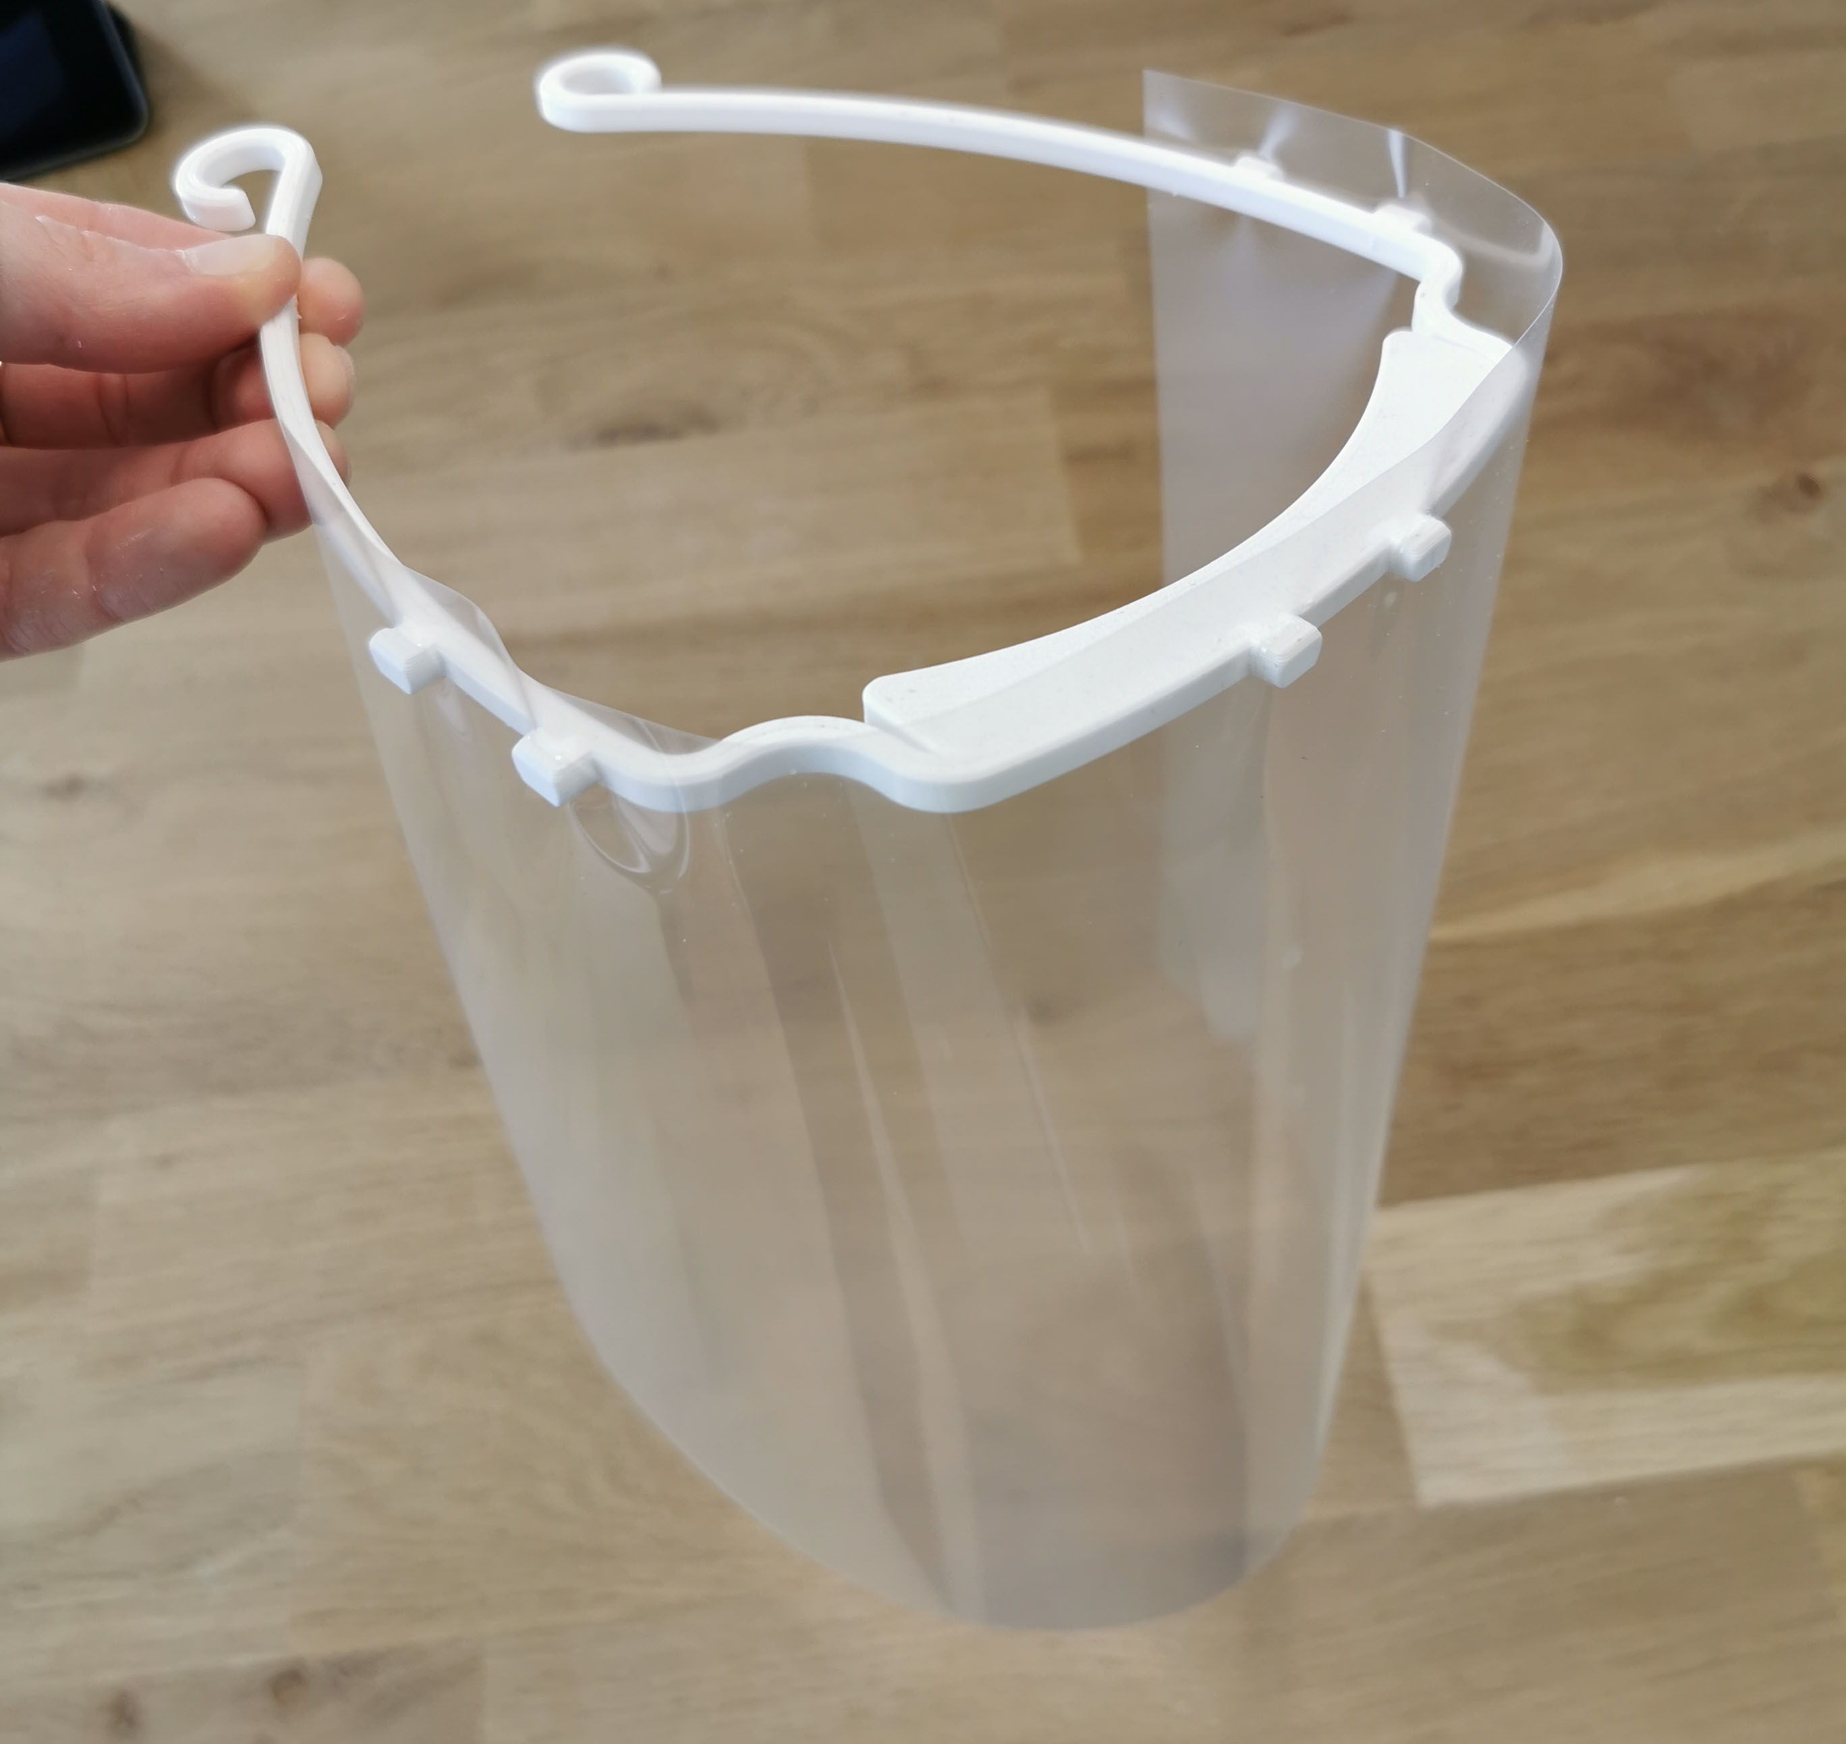
Problem: We have a shortage of the following, and problem
to coordinate the resources we have
Safety gear
Transport
Workers

Slide 2


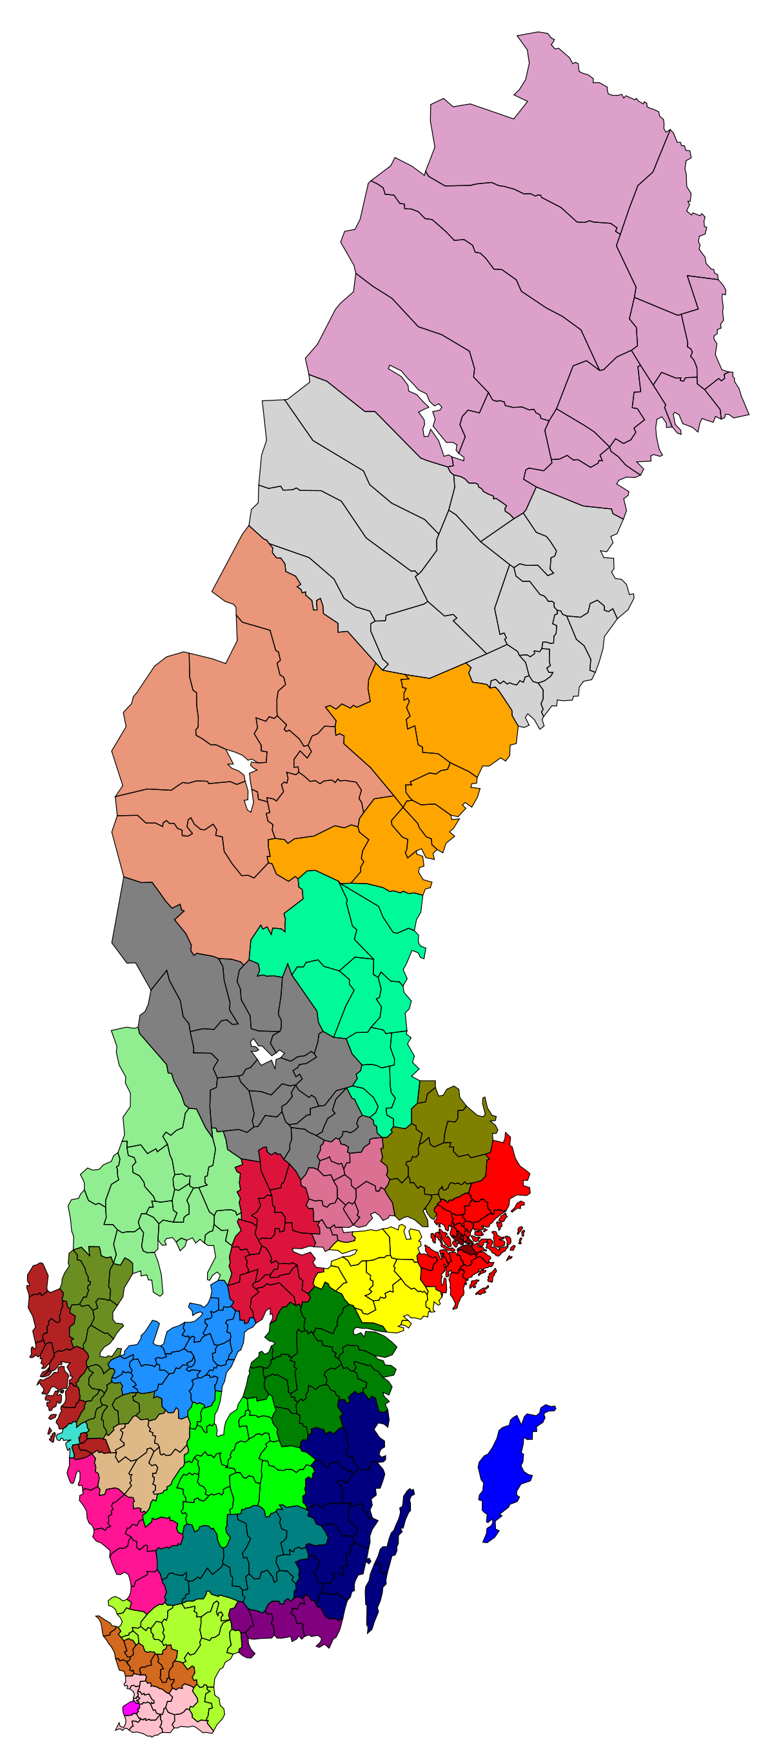
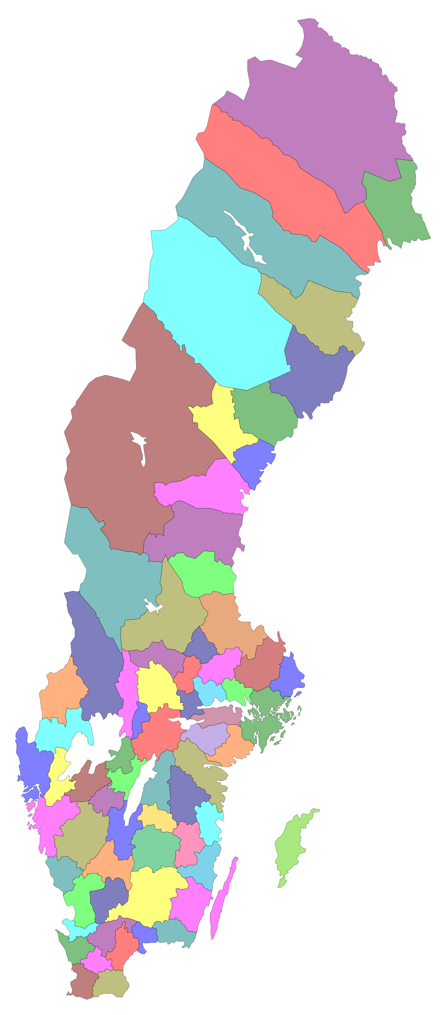


Vi behöver koordinera oss!
Företag/Föreningar
?
Privat personer
Kommuner
Regioner
Land

