Slide 1
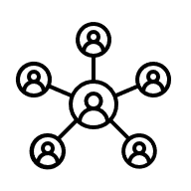



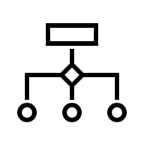

Evaluate
Brainstorm
Program test
Iterative workflow
Develop
Implement
Functionality test

