Slide 1
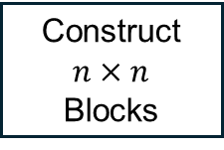
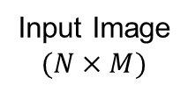

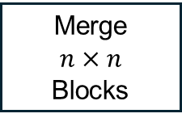
Compression Phase
Input Image
$$(N×M)$$
Construct $n×n$
Blocks
Forward Transform
Quantizer
Symbol Encoder
Compressed
Image
Decompressed Image
$$(N×M)$$
Merge
$$n×n$$
Blocks
Inverse Transform
Inverse Quantizer
Symbol Decoder
Compressed
Image
Reconstruction Phase

Slide 2
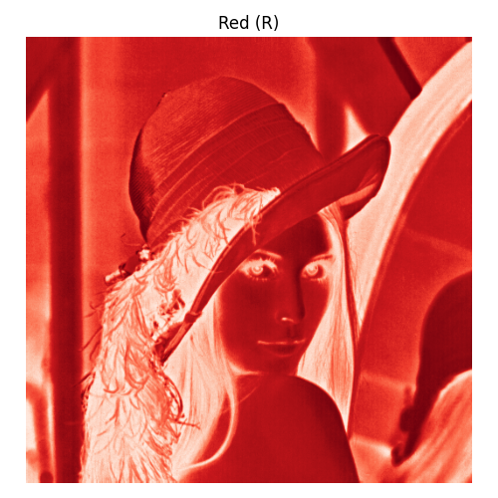
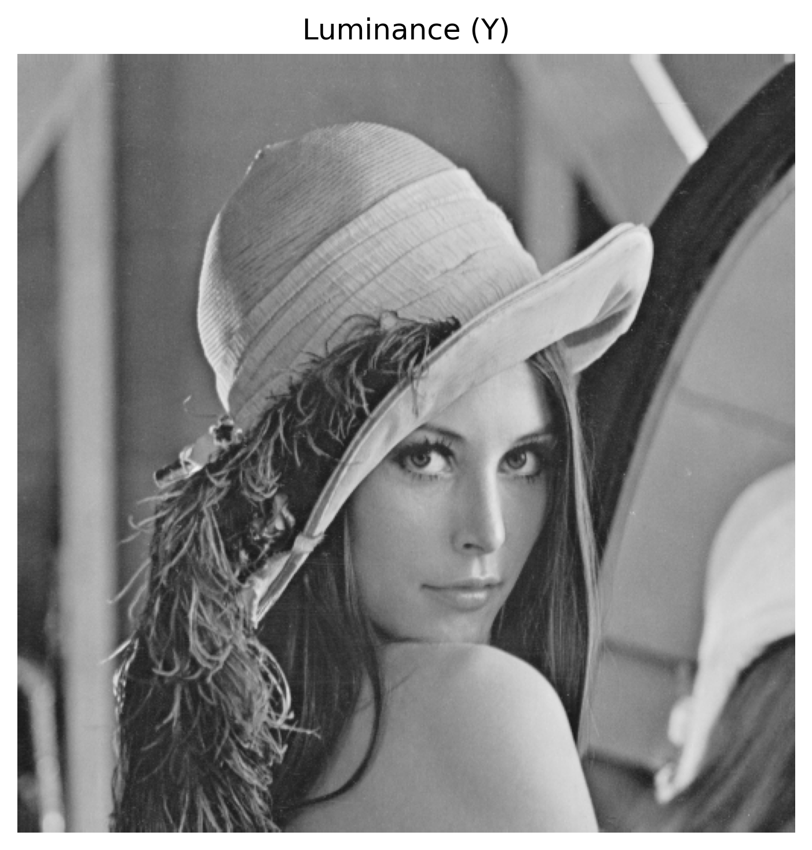
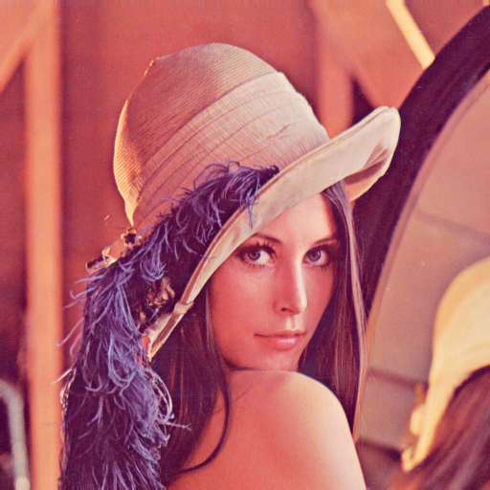
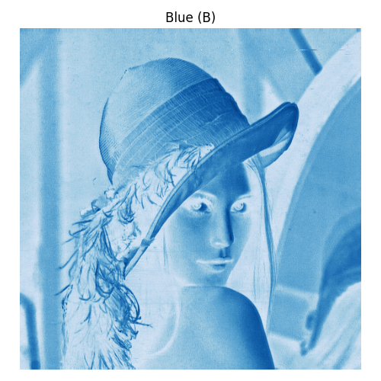
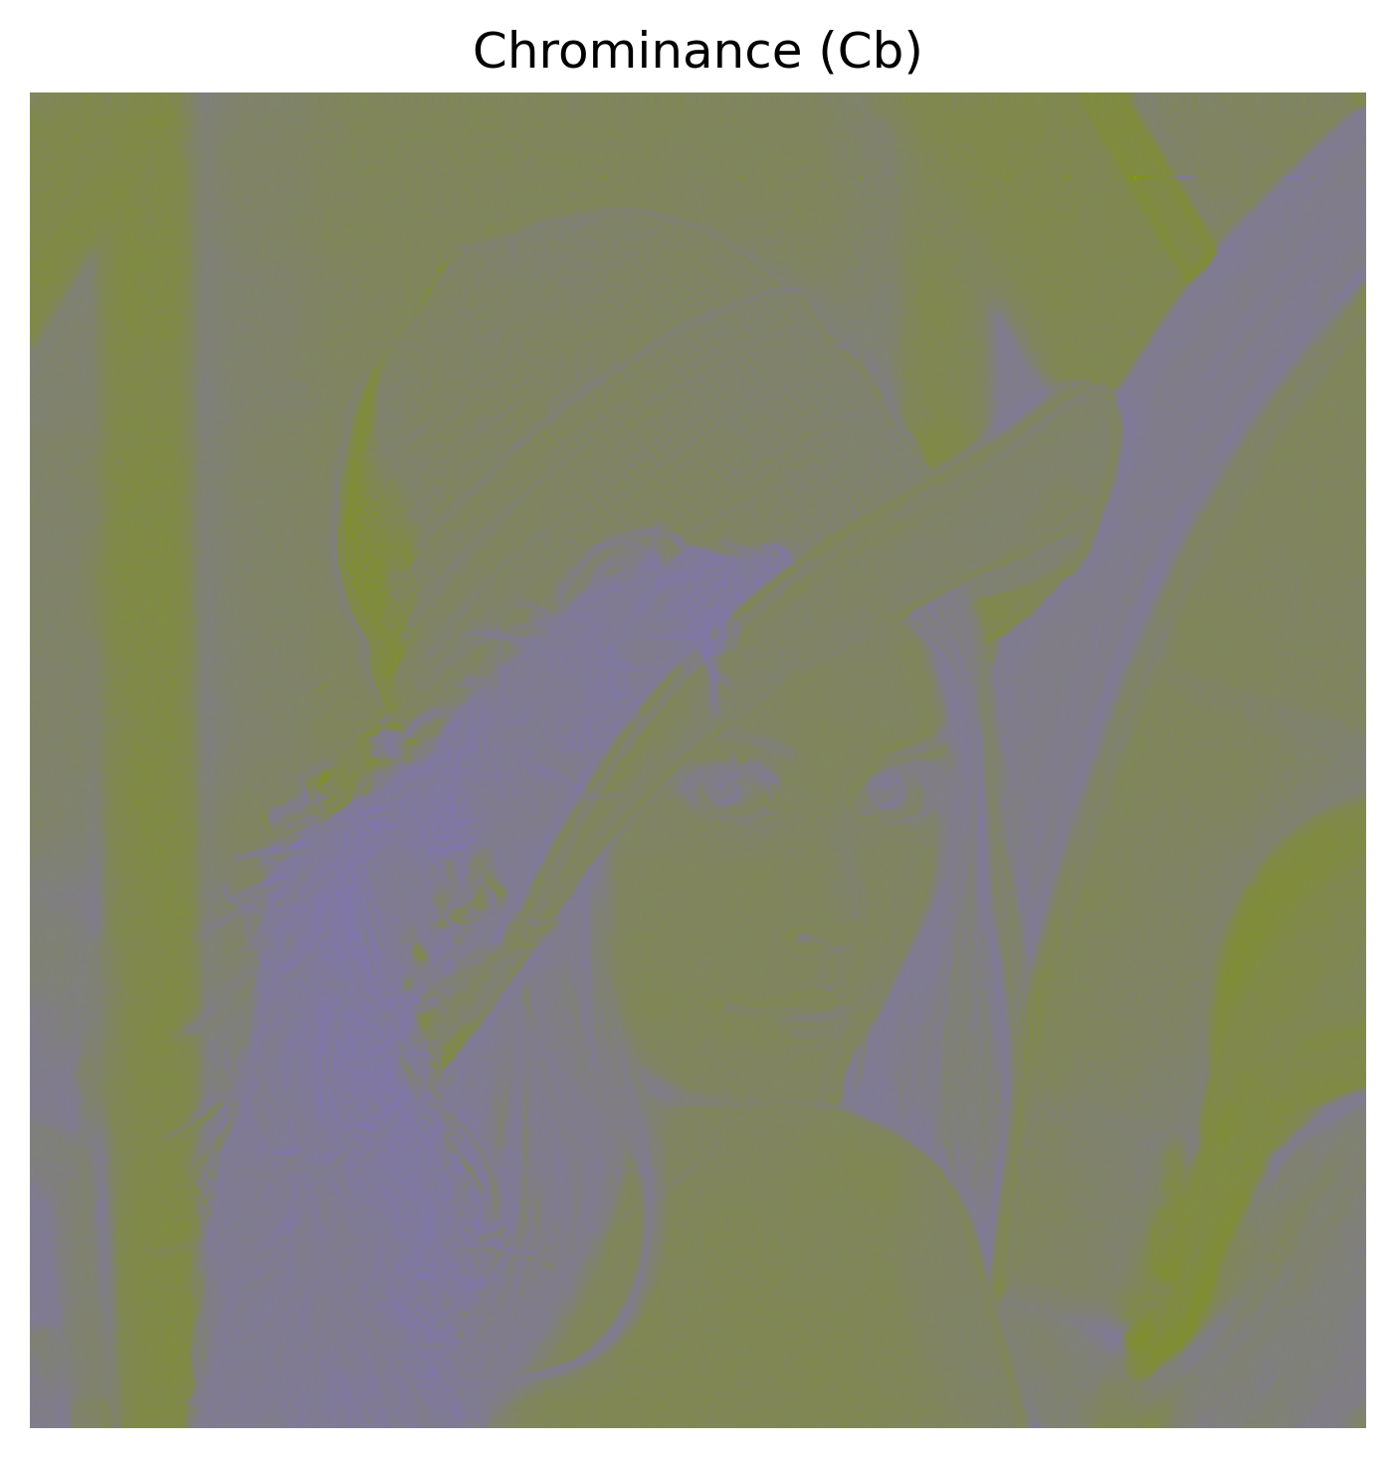
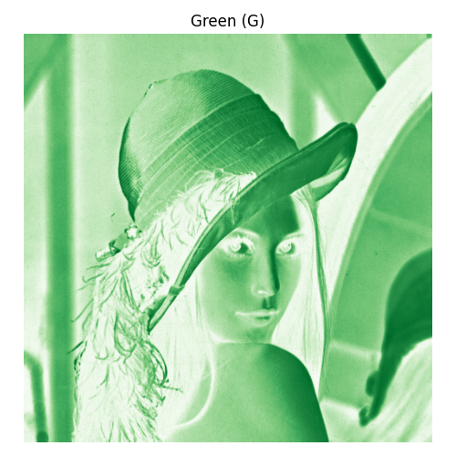
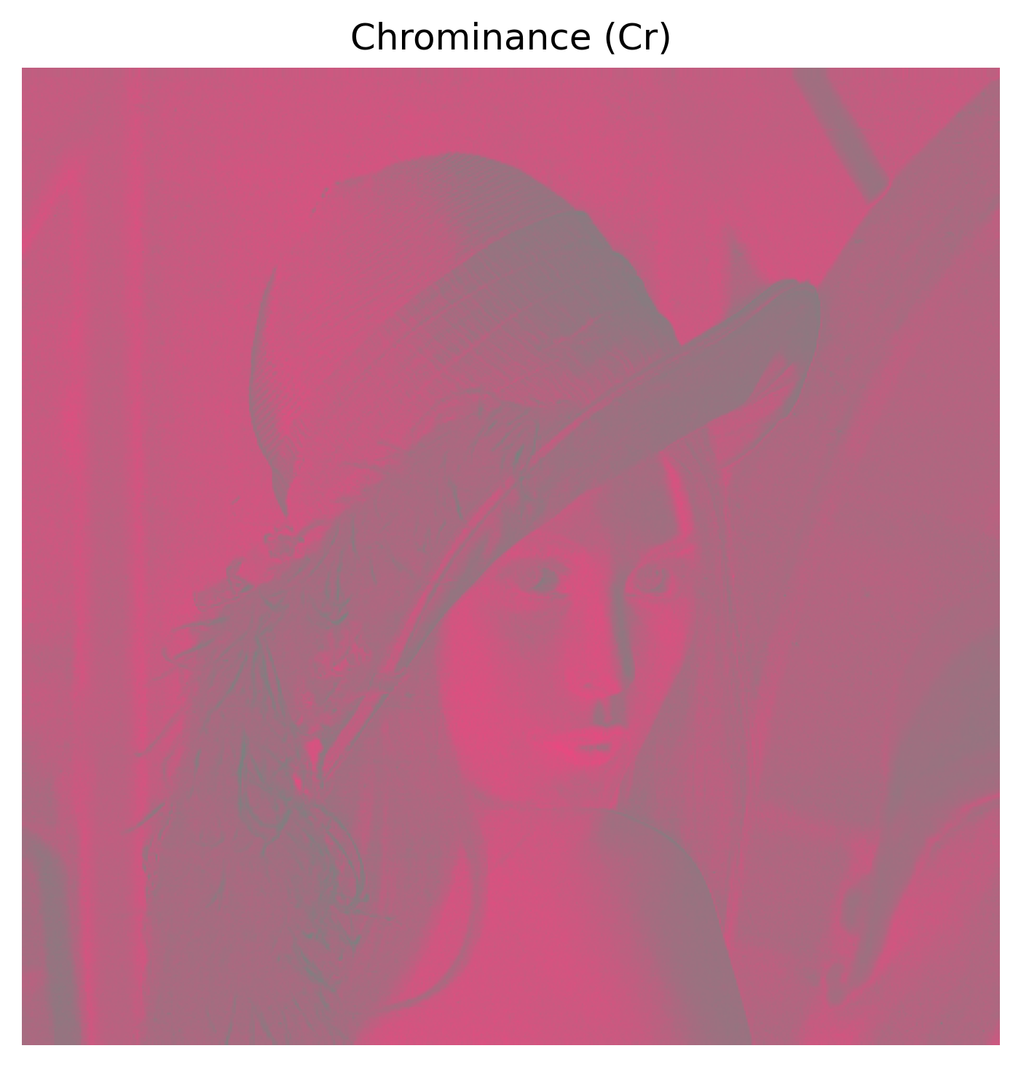
Red (R)
Luminance (Y)
RGB
Blue (B)
Chrominance (Cb)
Conversion
Green (G)
Chrominance (Cr)

Slide 3
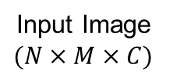


Compression Phase: Forward Transform
Input Image
$$(N×M×C)$$
Transform Image to YCbCr
Split Image into Channels
Construct $n×n$
Blocks
Subtract 128 on each pixel
Perform DCT on Blocks
Output Image
$$(N×M×C)$$
Transform Image to RGB
Merge Channels into Image
Merge $n×n$
Blocks
Add 128 to each pixel
Perform Inverse DCT on Blocks
Reconstruction Phase: Inverse Transform

Slide 4

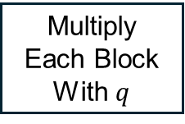
Compression Phase: Forward Transform & Quantization
Input Image
$$(N×M×C)$$
Transform Image to YCbCr
Split Image into Channels
Forward DCT Transform
Divide Each Block With $q$
Round Block Pixel Values
Output Image
$$(N×M×C)$$
Transform Image to RGB
Merge Channels into Image
Inverse DCT Transform
Multiply Each Block With $q$
Reconstruction Phase: Inverse Transform

Slide 5
9
3
5
2
1
1
0
0
0
5
4
1
1
0
0
0
4
2
1
1
0
0
0
0
1
0
0
0
0
0
0
0
0
0
0
0
0
0
0
0
0
0
0
0
0
0
0
0
0
0
0
0
0
0
0
0
0
0
0
0
0
0
0
0
End of Block
[9,3,0,4,5,6,2,4,2,1,0,0,1,1,1,1,1,1,EOB]
DC coefficient
AC coefficients

