Slide 1
Valve 2.0 (Team B4)
Civilization Wars: Advanced
Alex Bor
Dhruvil Tank
Mattie432
Robert Zlatarski
Luke Richardson

Slide 2
Game Mechanics
Turn-based
Train units
Build structures
Money
1v1, 2v2, Free For All
Predefined maps
Terrain (Flat, Mountain, Forest, River, Bridge)

Slide 3
Units & Buildings
3 Types of Building
Base
Barracks
Factory
2 Types of Units
Marines
Tanks

Slide 4
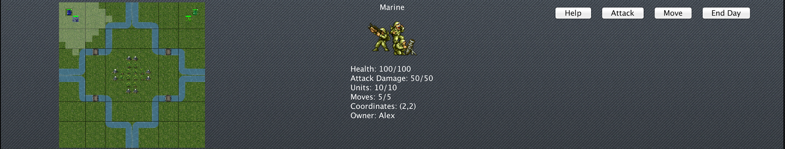
User Interface (UI)
Main Menu
Allowing picking the game type, adding name
In-Game UI
Showing icon of the selected object
Giving details of object
Minimap
Animations
Sprites
Sound

Slide 5
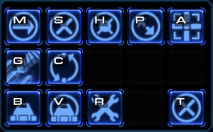
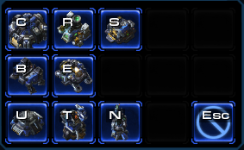
Interaction (HCI)
Mouse
Left-click
Right-click
Pan Map
Keyboard
Zoom In/Out
Pan Map
Buttons
Move/Attack
Train Units
Build Structures
End Turn

Slide 6
Artificial Intelligence (AI)
The AI will attempt to do three main actions.
Create buildings
Recruit units
Attack enemies

Slide 7
Artificial Intelligence (AI)
Buildings
Maintain a reasonable amount of buildings.
Units
Units are built with any remaining money.
Tanks are given priority & marines are build with remaining funds.
Notes:
Building buildings
Ai will attempt to maintain a reasonable amount of buildings.
If one is destroyed, ai will give priority to replacing it
Tries to do this so that it can still build units.
Building units
The ai will build units with any money that it has remaining.
Priority will be given to tanks, as they are stronger and cost more.
Marines will be built with any money remaining or if the tank limit is reached.

Slide 8
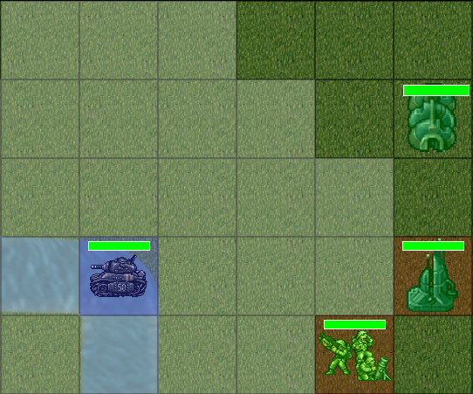
Artificial Intelligence (AI)
Attacking
Each unit will search in a radial pattern until it finds an enemy unit.
Once an enemy is found a route is traced back to the attacking unit from the enemy one. This route must avoid obstacles in the way (e.g units, water).
This creates a list of moves for the attacking unit to reach the enemy.
The unit then moves along this route for as far as its movement range will allow. If it comes into contact with the enemy unit then it attacks it.
Notes:
Attacking
Each unit will search in a radial pattern until it finds an enemy unit.
Once an enemy is found a route is traced back to the attacking unit from the enemy one. This route must avoid obstacles in the way (e.g units, water).
This creates a list of moves for the attacking unit to reach the enemy.
The unit then moves along this route for as far as its movement range will allow. If it comes into contact with the enemy unit then it attacks it.
Difficulty
Difficulty is implemented by increased starting money for the AI players.
This allows them to more quickly gather an army and puts them at an advantage from the player from the start.

Slide 9
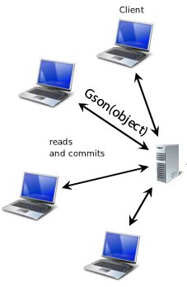
Multiplayer
Host
Has control over the game
Defines game settings
Client
Lobby chat
Notes:
One of the features of our game is that it can be played in a local network. When a player starts the game, besides single player option, he can choose whether to be a host of a game or join an already hosted game. Being a host, u get a screen with a chat area and a list of already connected users. The maximum of user connections is limited to 4. Some of the benefits of being a host is that you can choose which map to play on and you have control over who is going to play in your game. You can kick already connected clients and decide when to start the game. When you join as a user to an already created game, you get in the lobby and wait until the game is full and the host starts the game. Instead of feeling bored, each player can chat with the others in the lobby.

Slide 10
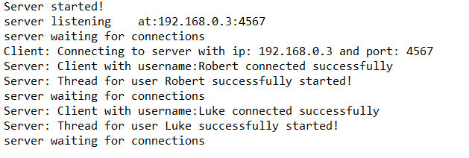
Multiplayer
Start game
Server
Recieve
Broadcast
Client
Recieve
Send
Server testing
Screenshot of console output
Notes:
Once the start game button is pressed, the game starts on all clients. Basically when a client makes a move, that move is sent to all other clients. We used Gson (the google version of json) for serialization of bigger objects. There are a lot of console outputs, about the server status and information that is being processed, that we have written in order to have server testing in real time.

Slide 11
...DEMO!

