Slide 1


Converting simulator specific formats to NeuroML2
Open Source Brain Meeting 2019
Boris Marin
boris.marin@ufabc.edu.br

Slide 2

Converting NMODL to NeuroML
The Simple™, OSB sponsored way of converting models to NeuroML2
mailto:p.gleeson@ucl.ac.uk

Slide 3
What is NeuroML, and why should I care?
Open Source Brain and NeuroML2
OSB accepts models in any format!
…. but with NML2 models, magic things can happen
http://opensourcebrain.org/projects/acnet2
http://opensourcebrain.org/projects/vogelsetal2011
http://opensourcebrain.org/projects/multicompgrc

Slide 4
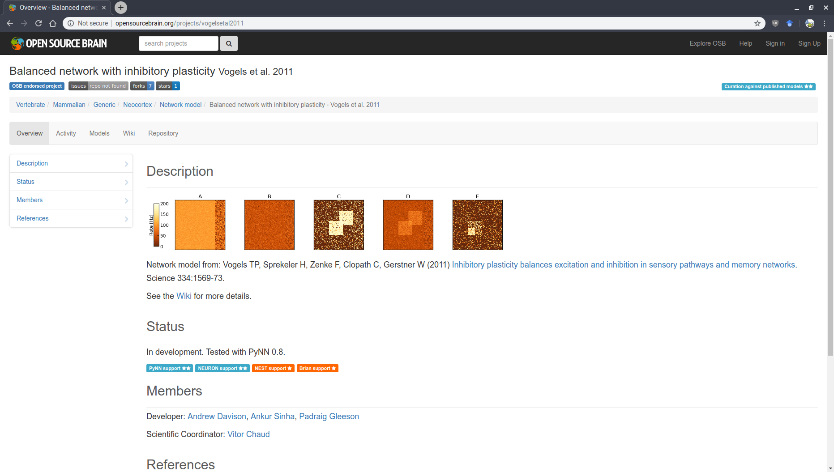

Slide 5
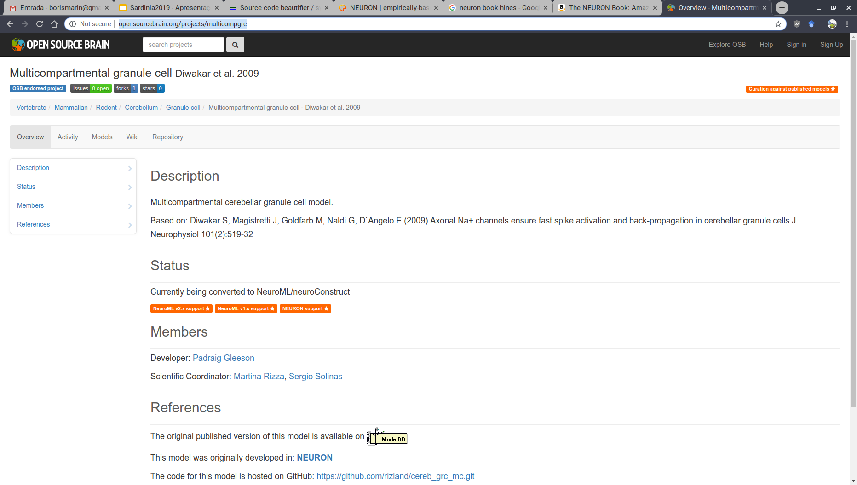

Slide 6
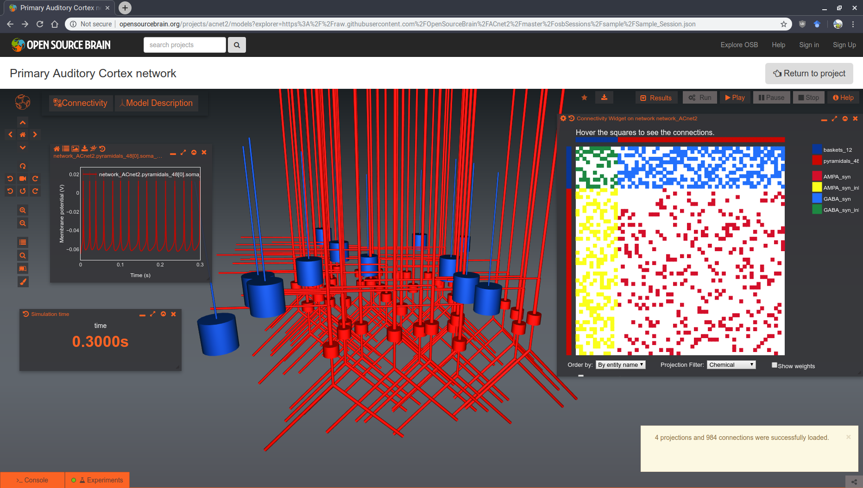

Slide 7
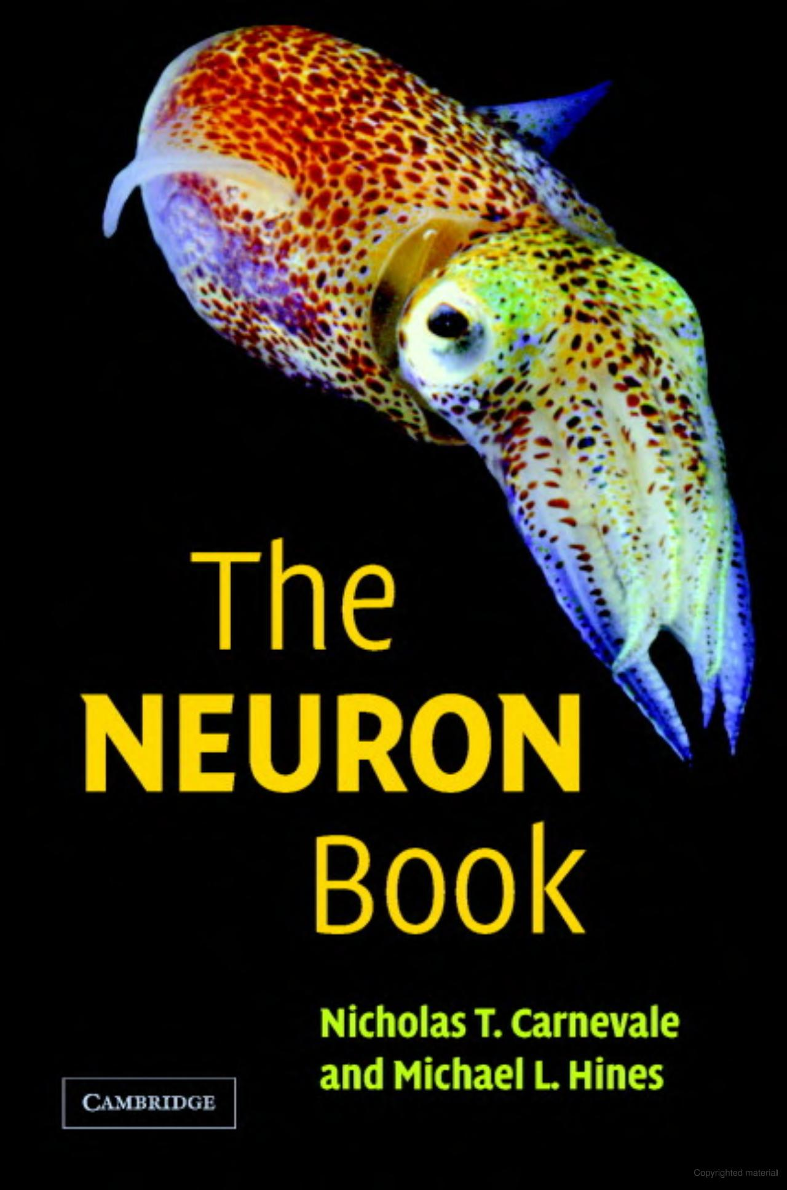
The NEURON simulator
Defining models in NEURON
https://www.neuron.yale.edu/neuron/
Cells, Networks: hoc language (accessible from Python)
morphologies
synaptic connections
.hoc files
Ion Channels (membrane mechanisms): NMODL
.mod files

Slide 8
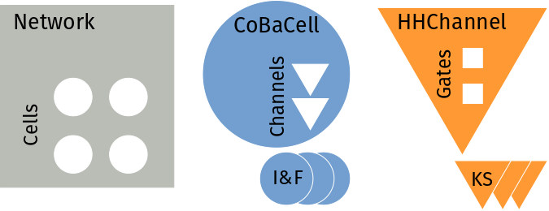
What is NeuroML, and why should I care?
Why can OSB process any NeuroML2 file?
NML is structured (not unlike a Type System)

Slide 9
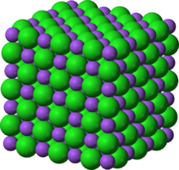
It is all about Structure
Structure in NeuroML / NMODL
A Type System (composability rules) is what grants NML its superpowers
nmodl is also powerful, but can be used as a general purpose language
VERBATIM blocks
many different ways of achieving same goal
prone to unstructuredness
OSB could in theory treat nmodl the same way it treats NML…
…. if only people stuck to "good practices"!

Slide 10
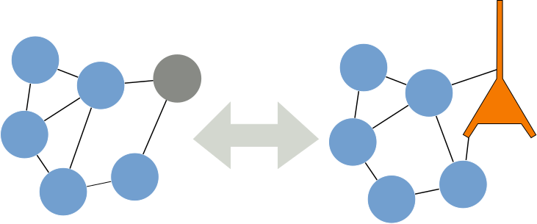
It is all about Structure
Benefits of structure
Such regularity is also very convenient from a model building/analysis perspective: it helps with modularity.
given a model that does something for a given biophysical network, can you achieve the same with simple models?
What is the crucial ingredient?

Slide 11
Levels of Abstraction
NeuroML2
<ionChannelHH id="kChan" conductance="10pS" species="k">
<gateHHrates id="n" instances="4">
<forwardRate type="HHExpLinearRate" rate="0.1per_ms" midpoint="-55mV" scale="10mV"/>
<reverseRate type="HHExpRate" rate="0.125per_ms" midpoint="-65mV" scale="-80mV"/>
</gateHHrates>
</ionChannelHH>
NMODL
BREAKPOINT {
SOLVE states METHOD cnexp
gk = gkbar * n ^ 4
ik = gk * (v-ek)
}
INITIAL{
n = alpha(v) / (alpha(v) + beta(v))
}
DERIVATIVE states{
n' = (1 - n) * alpha(v) - n * beta(v)
}
FUNCTION alpha(Vm(mV))(/ms){
LOCAL x
UNITSOFF
x = (Vm + 55) / 10
if(fabs(x) > 1e-6){
alpha=0.1*x/(1-exp(-x))
}else{
alpha=0.1/(1-0.5*x)
}
UNITSON
}

Slide 12
Levels of Abstraction
Declarative vs Imperative
NeuroML2 operates (at least syntactically) closer to the level of abstraction employed by electrophysiologists
The gory details exist, but elsewhere: LEMS
i.e. what to do with α, β; the definition of an ExpRate; how all of that is converted to conductances/currents…
But we seldom need (want!) to interact with that level (look under the hood)
<Network ...>
<Cell ...> <Channel ...>
<Gate ...>
<Rate ...>
SOLVE{...} METHOD euler
...
DERIVATIVE {...}
...
FUNCTION trap(v){...}

Slide 13
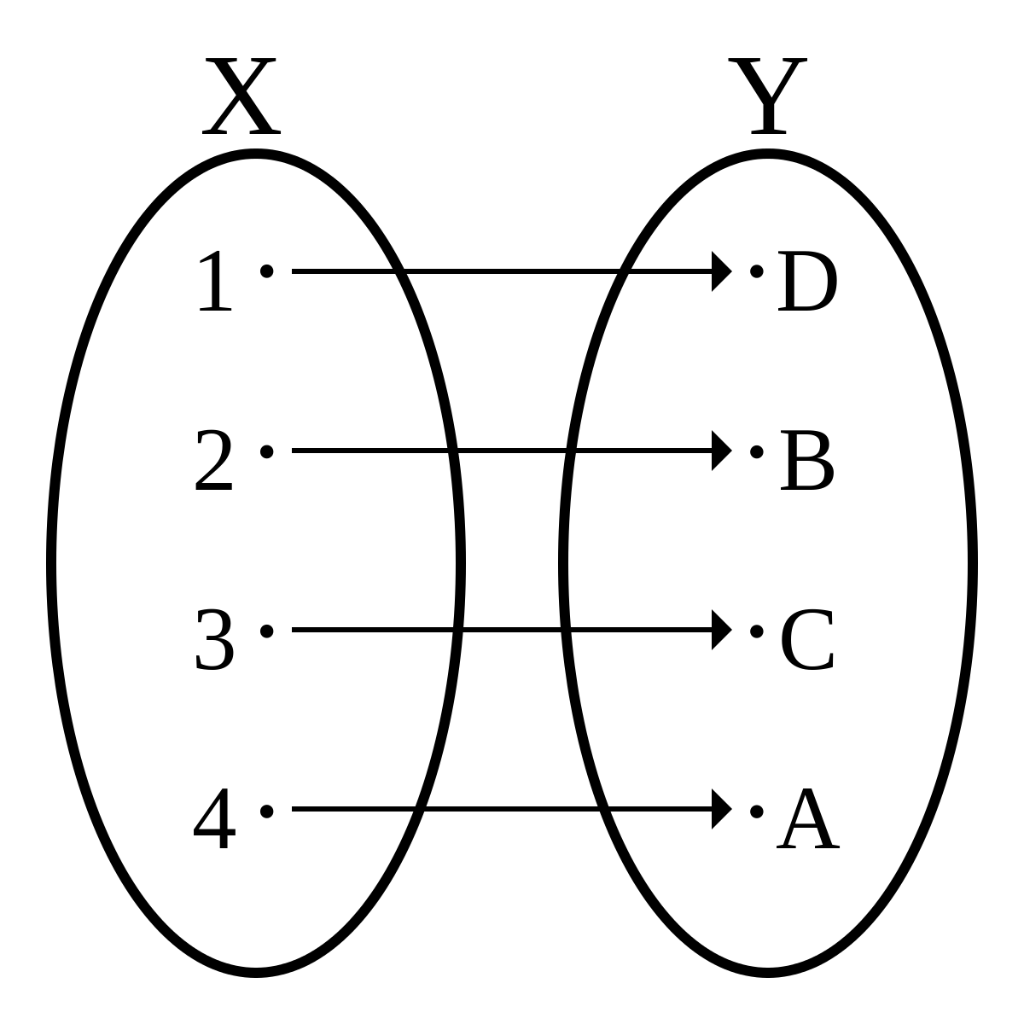
Levels of Abstraction
Direct translation
Nevertheless, an electrophysiologist can (usually) make sense out of carefully written NMODL files
there are functions called α, β
the kinetics look familiar
When languages operate at the same level of abstraction, we can directly "translate" one to another
Morphology / hoc — similar level of abstraction

Slide 14
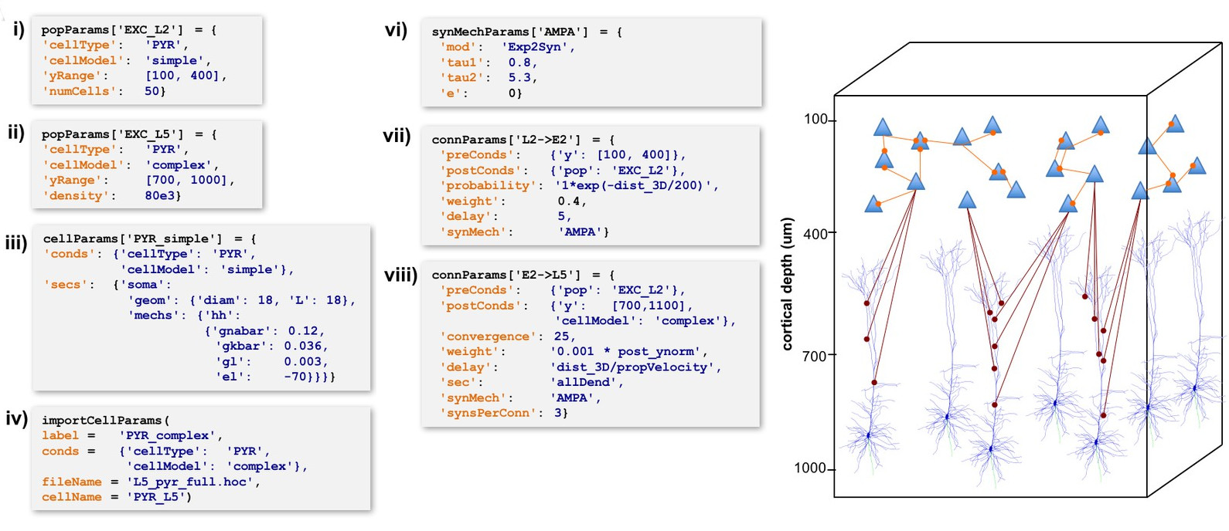
Levels of Abstraction
NetPyNE: structured network specification
Dura-Bernal, Salvador, et al. "NetPyNE, a tool for data-driven multiscale modeling of brain circuits." Elife 8 (2019): e44494.

Slide 15


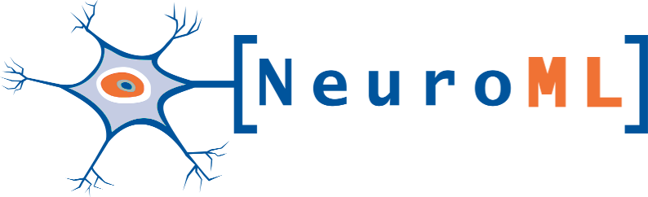
Example: NMODL to NeuroML2
How we can help
pyneuroml https://github.com/NeuroML/pyNeuroML
$pip install pyneuroml
everything you need to get started with NeuroML2, bundled in a single Python package

Slide 16
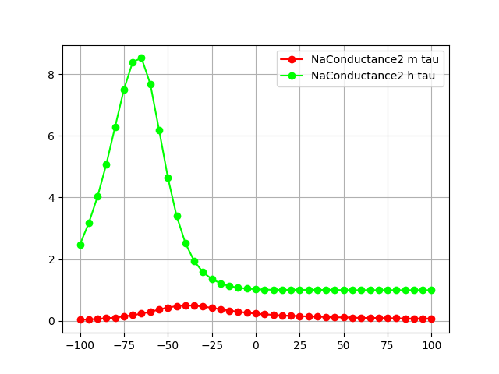
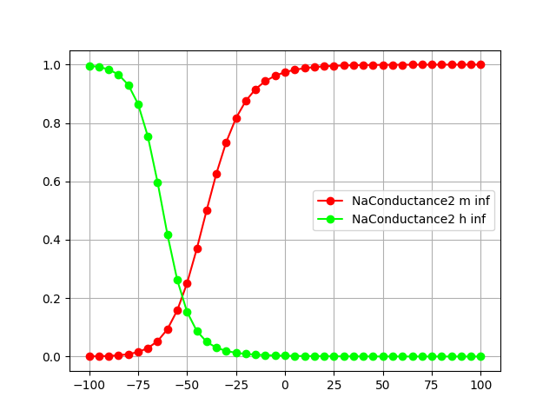
Example: NMODL to NeuroML2
Exploring channel dynamics with pyneuroml
> pynml-modchananalysis NaConductance2.mod

Slide 17
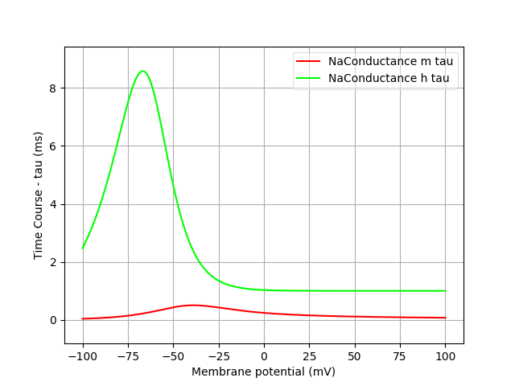
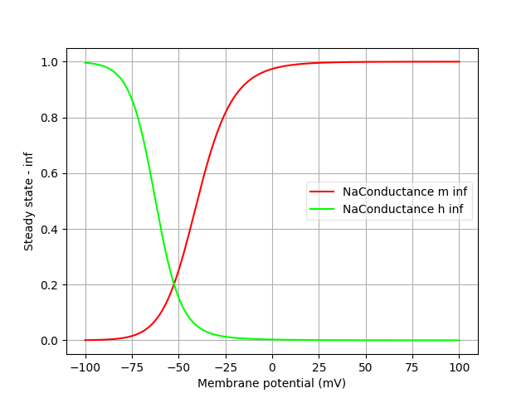
Example: NMODL to NeuroML2
Exploring channel dynamics with pyneuroml
> pynml-channelanalysis NaConductance.channel.nml

Slide 18
More reasons for NeuroML
What do we get besides visualization/simulation on OSB?
Once we have a model in NeuroML, we (usually) need to convert it back to a simulator-specific format in order to simulate it.
Does that mean we need to go back to NMODL after all that?
OSB visualization is not all you get. Given its regular structure, we were able to create a number of exporters:
We can also perform automated validation (structure, units)
 | NEURON | XPP
NeuroML2 | MOOSE | BRIAN
 | NEST | PyNN

Slide 19
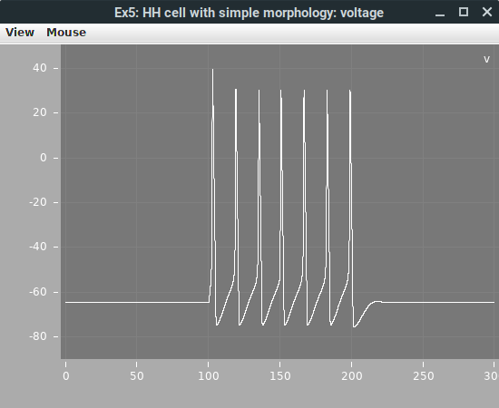
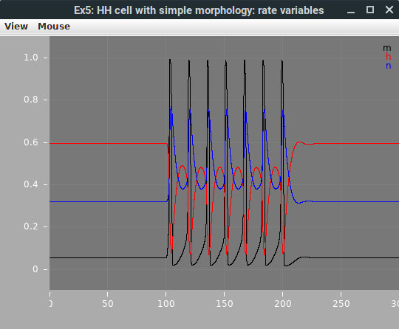
Example: PyNeuroML usage
Exporting NeuroML2 to different formats
Native interpreter (Java)
> pynml LEMS_NML2_Ex5_DetCell.xml

Slide 20
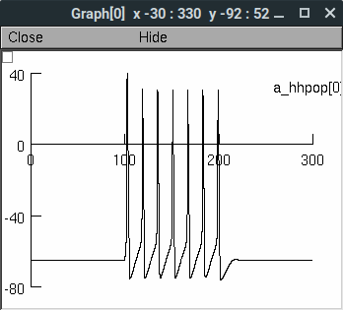
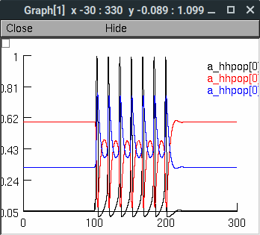
Example: PyNeuroML usage
Exporting NeuroML2 to different formats
NEURON
> pynml LEMS_NML2_Ex5_DetCell.xml -neuron

Slide 21
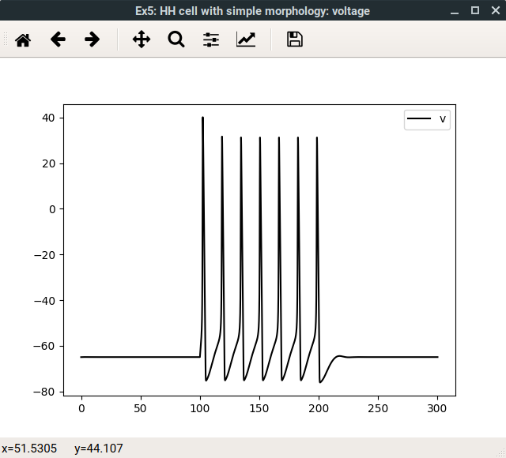
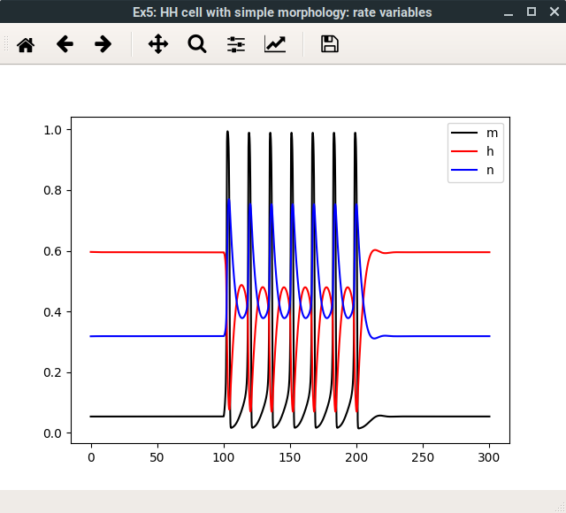
Example: PyNeuroML usage
Exporting NeuroML2 to different formats
Brian2 https://brian2.readthedocs.io/
> pynml LEMS_NML2_Ex5_DetCell.xml -brian2

Slide 22
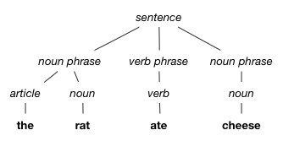
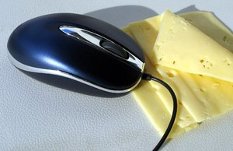
Future Plans
Automated conversion (whenever applicable)
The final frontier: automatic conversion from NMODL to NeuroML2
We first have to parse NMODL syntax: https://github.com/BlueBrain/nmodl
Hard part: semantic analysis
“Expert” humans can figure out that a mod file is employing HH formalism
How can we transfer that knowledge to the automated translator?
Interesting problem (compilers): pattern matching, symbolic computing

Slide 23

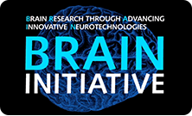

We want DATA!
How does all that apply to experimental data?
Structured information is central to OSB (and associated technologies)
A number of other initiatives have also recognised the need to standardize
Example: the Neurodata Without Borders Consortium has created a standard for neurophysiology data, NWB:N
More on that tomorrow!

Slide 24
Thank you!
Questions?

