Slide 1
Android as an Enterprise Platform
How To Fit Android into an Enterprise Organization

Slide 2
Who Am I?
I’m Matt Mehalso
My Resume
Senior Software Engineer & Mobile Consultant @ BlueFletch
8+ Years of experience in…
Custom Enterprise Java solutions
Custom mobile solutions in Logistics, Finance, and Retail
Back-end mobile infrastructure
Java, Web (HTML5/JS), and C/C++, in that order
Current Project
Over a year of architecture, design, and development using Android on a shared ruggedized device
Currently in the initial stages of deployment

Slide 3


BlueFletch? Blue What?
BlueFletch does cross platform mobile development for the enterprise.
What does that mean?
Mobile Business Solutions
Proof of Concepts
Technology Architecture
Not This…
… That

Slide 4

First – A little history…
Android’s Early Years
2008 to 2010
Consumer-Centric App Model
We’re so open, man!
Android 2.2 & the Half-Hearted Attempt at MDM
Introduction of Device Admin APIs
Security Still a Problem
Android 4.x Improvements
Security, Security, Security!
Real Enterprise Features

Slide 5
So What does ‘Android in the Enterprise’ Mean?
This is an EXTREMELY broad topic – no different than ‘mobile’ in the enterprise
Consider both hardware and software
I’ll try to touch on a few different variations:
Android as a Bring-Your-Own-Device Platform
Android as a Ruggedized Device or Embedded System
Android Software Development in the Enterprise

Slide 6

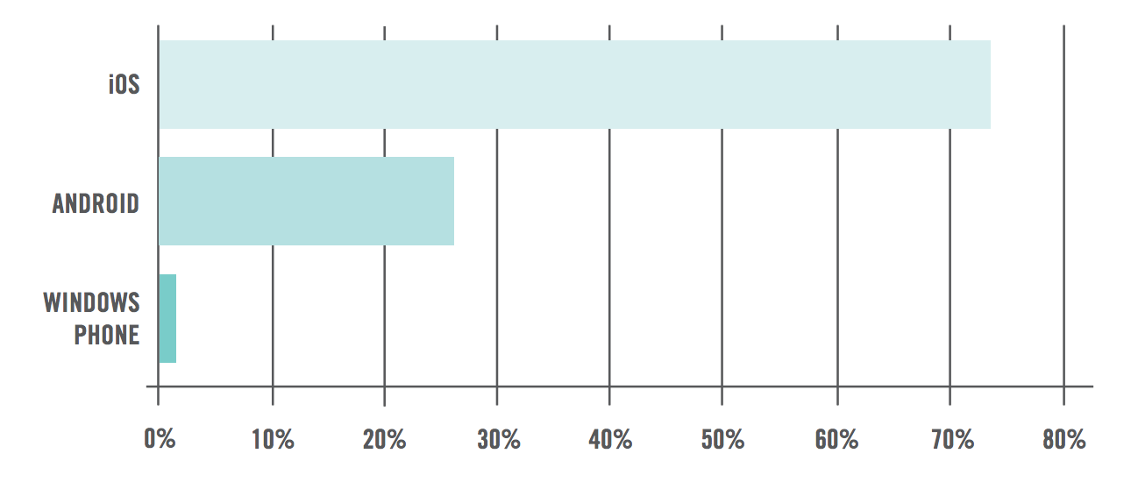
The Enterprise Mobile Landscape
iOS Dominates
Android saw rapid growth in 2012
War of the enterprise features – ios7 vs. Samsung KNOX

Slide 7
Mobile Activations by Industry

Slide 8

Enterprise Mobile = BYOD, Right?
Android & BYOD
Most Common
Support For…
Support a custom enterprise ‘Application Store’
Deployment of in-house, internally-facing applications
Support VPN connections to your corporate network
Support corporate e-mail
Deploy corporate WIFI configurations

Slide 9
Android as a Ruggedized or Embedded Platform
This is where Android has a chance to shine
OS is Flexible and Customizable
Hardware Vendors are Flexible and willing to Customize
Compared to other platforms:
Concern | Android | iOS | Win Phone Embedded
Custom Hardware Form Factor (example: ruggedized) | Y | Limited, 3rd party cases | Y
Hardware Extensions (example: barcode scanner) | Y | Limited, 3rd party extensions | Y
Custom OS Extensions | Y | N | N
OS Restricted API Access | Y | N | N

Slide 10
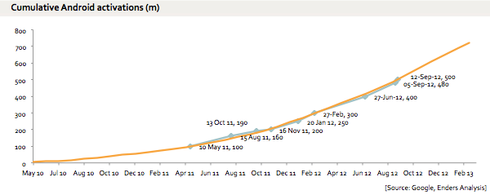
Android and Consumer App Development
Important for businesses to have exposure on Android (DUH!)
There are over 1 Billion Devices out there and 1 Billion Reasons to develop an app!

Slide 11

Android and Security
Security is the leading concern that most enterprises have with Android…
…and rightfully so.
Recent mishaps and other bad press…
Android Master Key Vulnerability
Android Malware increases 600 pct
WhatsApp privacy issues
Some legit (master key), some not.

Slide 12
OS Security
Lots of improvements starting with Android 4.x
Security and enterprise has actually be a major focus for Google over the last 3 years
Improvements in 4.x versions:
Keychain API for secure storage of app- and user-credentials
Address Space Layout Randomization (ASLR) for added memory security
Built-in VPN client and VPN Client API
App encryption to ensure secure transmission of apps from the Play Store
Application Verification to combat malware
Always-On VPN Configuration to prevent apps from using unsecure networks
Secure USB Debugging to prevent access from unauthorized computers
Restricted User Profiles for kiosk and multi-user devices
Introduction of SE Linux to augment Android’s existing UID-based application sandbox
Support for additional cryptographic algorithms – ECDSA and Scrypt Key Derivation
VPN profiles per user in multi-user environments

Slide 13
Android, Device Management, and Policy Enforcement
Lots MDM Providers
Airwatch, Good, Soti, MobileIron, etc.
Comparison blog post at BlueFletch.com
Unfortunately, security is a spectrum
Limited by your worst device in a BYOD environment
Fragmentation in Devices
Manufacturer’s build extensions into the OS for MDM
Samsung with KNOX is far and away the leader – 56% of Android Market
Moto, HTC, LG all have extensions as well
Fragmentation in OS
IBM Model for assigning trust levels
http://www.intel.com/content/dam/www/public/us/en/documents/white-papers/android-devices-in-byod-environment-paper.pdf

Slide 14
Application Signing
What is it? Why is it important in the enterprise?
It’s literally your signature in the Play Store and with the OS
Used as a trust mechanism during app updates
Allows multiple apps to share a common trust
Allows you to easily determine if an app in the wild belongs to you
What about self-signed keys?
Options
Worst – private key and password lives on your developer’s PC
Better – private key and password protected on build box, referenced during release builds
Best (but $$$) – Symantec or Thales Security solution, requires new infrastructure

Slide 15

Platform Teams and SCM
If you’re a Java-shop with a formal build process, this is an easy win.
The tooling…
Eclipse
Android Studio / IntelliJ IDEA
The Version Control…
Literally everything supported by Eclipse/IntelliJ
And the Continuous Integration…
Good support for Jenkins, Hudson, Travis CI, and others

Slide 16



Building Android
3 Major Options – Again, being a Java-shop helps…
The old fallback – Ant
The framework that everyone loves to hate – Maven
The hip and trendy - Gradle
Awesome Grunt Task Wrapper
Great way to abstract multi-platform builds
Successfully implemented on client engagement

Slide 17
Project Teams & App Development
Do you need new staff?
Mobile Architect and Designer are definitely valuable
Good Java developers can pick up native Android fairly easy
Even good C# developers can pick up native Android fairly easy
Mobile Frameworks make this easier
Xamarin, Phonegap, Titanium are good fallbacks
Out of scope for this conversation – check Google or the BlueFletch blog for a good breakdown

Slide 18
Testing
Unit Testing
Junit
Robolectric
http://robolectric.org/
Gradle Android Test Plugin
https://github.com/robolectric/gradle-android-test-plugin
Mockito
https://code.google.com/p/mockito/
Good Example / Reference Project
https://github.com/robolectric/deckard-gradle

Slide 19

Testing
Unit Testing is…
…still way too difficult in the Android Studio + Gradle software stack
Issues we’ve encountered:
Complex set-up, even with good Deckard references
Classpath conflicts
IDE integration… what IDE integration?
Really need some unit test support from the Android Tools Team

Slide 20
Testing
Functional Testing
Android Instrument Tests
Espresso - https://code.google.com/p/android-test-kit/wiki/Espresso
Automation
Robotium - https://code.google.com/p/robotium/
Appium – http://appium.io/
Lots of others…
Reporting
Spoon - http://square.github.io/spoon/

Slide 21
The Android Community
Stack Overflow – Mobile Framework Comparison
Android – 474,102
iOS – 343,424
Windows Phone – 28,195
Responses to enterprise questions can be… hostile
Open Source Libraries
Lots of Android-specific Options – see Square
Lots of Java Open Source work in Android

Slide 22
Enterprise Android - Applied
So, how is all this doublespeak applied?

Slide 23
Tough Requirements – How’d we do it?
Nexus-Style, with the platform key
Demo
Concern | How’d we do it?
Reboot | PowerManager.reboot() + system permission
Set Time | AlarmManager.setTime() + system permission
Set Defaults | Hidden PackageManager.setPreferredApplications + system permission
Install Certs | Hidden ICertificateChainService + system permission
Install / Uninstall Apps | PackageManager.install / delete + system permission

Slide 24
Tough Requirements – How’d we do it?
The Vendor’s preference
Concern | How’d we do it?
Reboot | Custom API
Set Time | Custom API
Set Defaults | Custom API
Install Certs | Custom API
Install / Uninstall Apps | Custom API

Slide 25
How’d we do builds?
Normal Builds
Android Gradle + Extensions
Build Version Dynamically
Increment Version Capability
Multiple Device Types
Gradle feature called Build ‘Flavors’
Define flavors = “vendor1”, “vendor2”
Define source trees for each
Call: gradle assembleVendor1 assembleVendor2

Slide 26
Flavored Builds
>
gradle assembleFlavor1
/src/main
+ java
+res
+AndroidManifest.xml
gradle assembleFlavor2
+
/src/flavor1
+ java
+res
+AndroidManifest.xml
app-flavor2.apk
app-flavor1.apk
+
/src/flavor2
+ java
+res
+AndroidManifest.xml

Slide 27
Builds + App Signing
Signing Keys Distributed by Risk Level
Platform apps share a key
Risky apps get their own key
Other apps share a key
Keys created by security organization, signed by a root CA
Staged with configuration on build box in protected location
Build scripts updated to inject an optional signing configuration

Slide 28
Pulling it all together!
DEMO : Different vendors, different flavors – the enterprise version of fragmentation!
DEMO : Protect your signing key in the CI environment
DEMO : Release Builds

Slide 29
Additional Reading, Tools, Etc.
Android in the Enterprise
Blog: http://bluefletch.com/2014/03/20/selling-android-as-an-enterprise-platform/
More Tools
Android SDK Gradle Plugin https://github.com/JakeWharton/sdk-manager-plugin
Jenkins Android Emulator Pluginhttps://wiki.jenkins-ci.org/display/JENKINS/Android+Emulator+Plugin
Jenkins Android Lint Plugin https://wiki.jenkins-ci.org/display/JENKINS/Android+Lint+Plugin
Travis CI and Android Builds http://rkistner.github.io/android/2013/02/05/android-builds-on-travis-ci/

Slide 30
Takeaways
Android is a viable enterprise platform
Latest versions are secure – aim for Android 4.x
More flexible and customizable than other platforms
Easy to integrate into an enterprise organization
Experience with MDM makes this easier
Having a staff learned in Java is a big bonus
We’ve learned a lot on our client engagement
Proof that Android is an option, and a good one
Android’s flexibility makes it a serious contender for specific enterprise solutions

Slide 31
That’s it, folks!
Questions?
Drinks?

