Slide 1
Project of Knowledge Discovery and Data Mining I

Slide 2



Overview of the Project
Pre-Processing
Model and Evaluation
Discussion
Notes:
As usual, collecting data is not enough, so processing them is necessary in order to extract useful information. In particular, given the nature of the study, real-time processing was necessary to show the participants the neurofeedback instantaneously. After that, offline data processing was computed, followed by the final analysis that allowed the researcher, in the end, to extract the results.

Slide 3
PREPROCESSING - 1
OUTLIER REMOVAL - Inter Quartile Range
FORMATTING
DateSinceForSale → delta days to the most recent one
fix typo (‘Location’ and ‘HeatingType’)
Retrieve material from ‘WindowModelNames’
HANDLING MISSING VALUES
No value = No feature
Numerical → Mean
Categorical → Mode
‘HeatingCosts’: Linear Regression with ‘SquareFootageHouse’
Notes:
As usual, collecting data is not enough, so processing them is necessary in order to extract useful information. In particular, given the nature of the study, real-time processing was necessary to show the participants the neurofeedback instantaneously. After that, offline data processing was computed, followed by the final analysis that allowed the researcher, in the end, to extract the results.

Slide 4
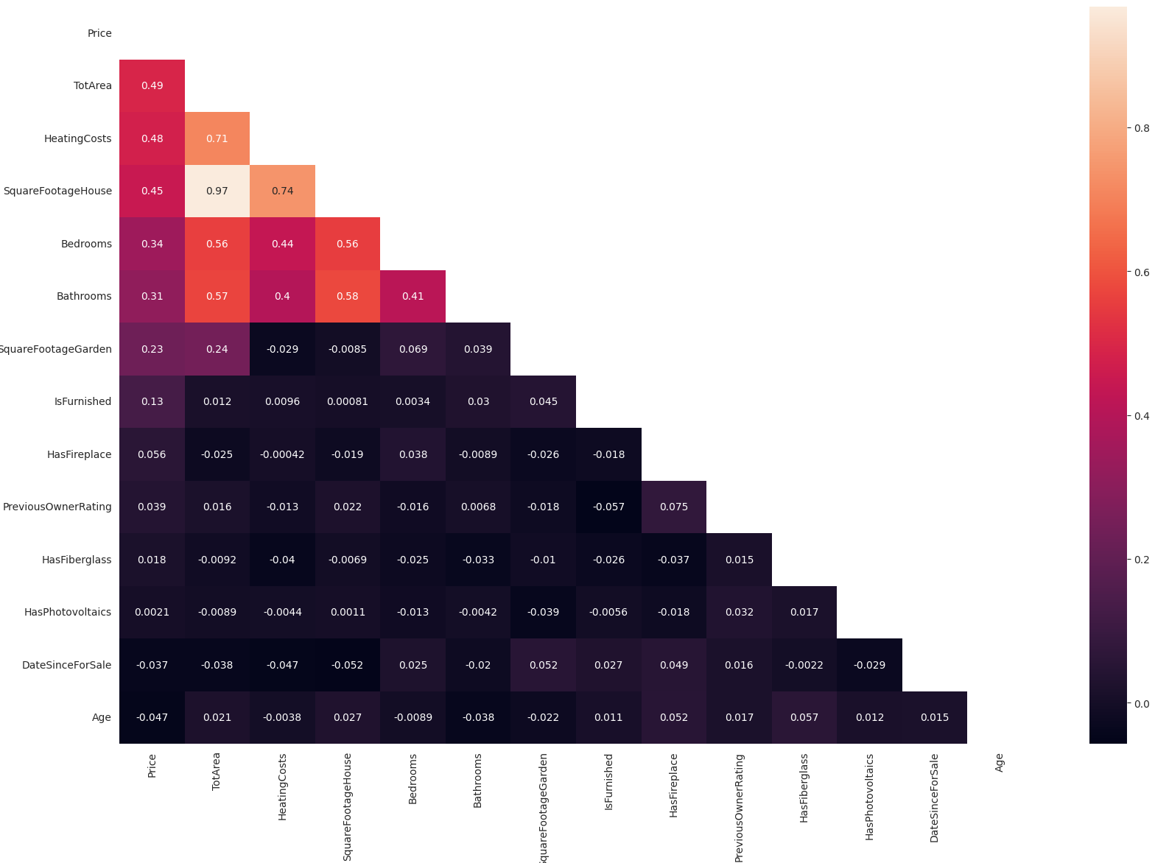
PREPROCESSING - 2
4. FEATURE ENGINEERING
a. ‘TotArea’=SquareFootageHouse’+’SquareFootageGarden’
5. SCALING 6. VISUAL INSPECTION
7. CORRLEATION
8. SPLITTING
Notes:
As usual, collecting data is not enough, so processing them is necessary in order to extract useful information. In particular, given the nature of the study, real-time processing was necessary to show the participants the neurofeedback instantaneously. After that, offline data processing was computed, followed by the final analysis that allowed the researcher, in the end, to extract the results.

Slide 5


METHODS
Model Training
Linear Regressor
Decision Tree regressor
Random Forest Regressor
OPTIMIZATION: Random Search
n_estimators: 500
min_samples_split: 2 min_samples_leaf: 1
max_depth: 50
bootstrap: True
Notes:
As usual, collecting data is not enough, so processing them is necessary in order to extract useful information. In particular, given the nature of the study, real-time processing was necessary to show the participants the neurofeedback instantaneously. After that, offline data processing was computed, followed by the final analysis that allowed the researcher, in the end, to extract the results.

Slide 6
DISCUSSION
If I have a budget of €100,000,
what kind of houses will I be able to buy?
The number of affordable houses is 123
Minimum square footage: 19.0
Maximum square footage: 116.0
Number of bedrooms:1
Number of bathrooms:1
Mainly affordable houses have suburban areas as their location
Notes:
As usual, collecting data is not enough, so processing them is necessary in order to extract useful information. In particular, given the nature of the study, real-time processing was necessary to show the participants the neurofeedback instantaneously. After that, offline data processing was computed, followed by the final analysis that allowed the researcher, in the end, to extract the results.

Slide 7
DISCUSSION
How much money can I save if I decide not to get a house with a pool?
Minimal house price without pool: 36.178€
Average house price without pool: 185.511€
Minimal house price with pool: 44.019€
Average house price with pool: 211.376€
Minimum savings by buying a house without a pool: 7.842€
Average savings by buying a house without a pool: 25.865€
Notes:
As usual, collecting data is not enough, so processing them is necessary in order to extract useful information. In particular, given the nature of the study, real-time processing was necessary to show the participants the neurofeedback instantaneously. After that, offline data processing was computed, followed by the final analysis that allowed the researcher, in the end, to extract the results.

Slide 8
THANK YOU FOR ATTENTION

