Slide 1
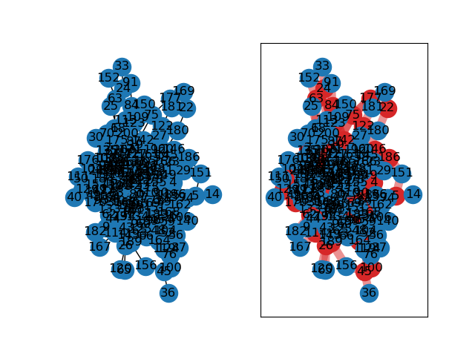
Min Vertex Cover Approximation
By Matthew Potter

Slide 2
Pseudocode
Adapted from steps laid out by Singh et al.
Input: An undirected graph G = (V, E), where |V| = N
v_list[N] ← all vertices in V
sort v_list by degree (ascending)
for each vertex u ε v_list:
if all of u’s neighbors are in v_list:
delete u from v_list
return v_list

Slide 3
Runtime Analysis
Input: An undirected graph G = (V, E), where |V| = N
v_list[N] ← all vertices in V O(n)
sort v_list by degree (ascending) O(nlog(n))
for each vertex u ε v_list: O(n)
if all of u’s neighbors are in v_list: O(n)
delete u from v_list
return v_list

Slide 4
Runtime Analysis
Input: An undirected graph G = (V, E), where |V| = N
v_list[N] ← all vertices in V O(n)
sort v_list by degree (ascending) O(nlog(n))
for each vertex u ε v_list: O(n)
if all of u’s neighbors are in v_list: O(n)
delete u from v_list
return v_list
As the loop iterates n times worst case, with the worst case being that u has n neighbors, the big-O runtime of this algorithm is O(n*n), or O(n²)

Slide 5
Lower Bounds
As I have not implemented any pruning algorithm, the optimal solution will still branch twice on every non-base case recurrence. Due to this, the best case runtime for the optimal solution remains exponential Ω(2^{n}), but the runtimes for each recurrence may be much shorter empirically.
The approximation algorithm’s best case occurs when u’s neighbors can be found in constant time. This means that the approximation algorithm’s lower bound depends on its sorting algorithm, which I assume to be Ω(nlog(n)).

Slide 6
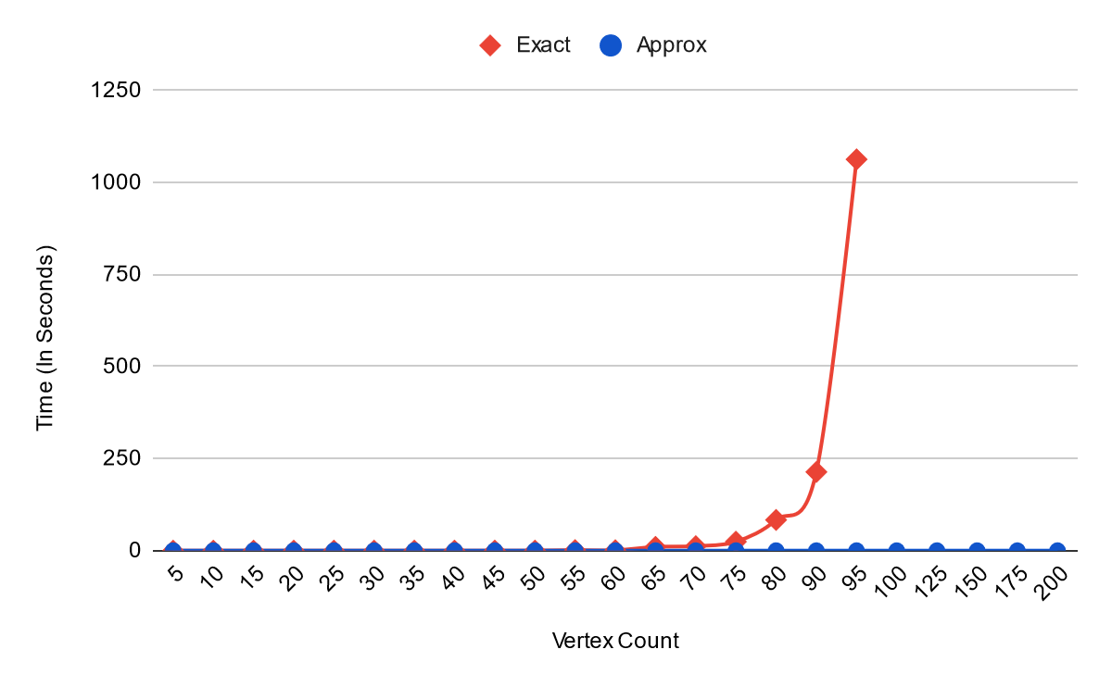
Empirical Runtime Vs Optimal (Stepped)

Slide 7
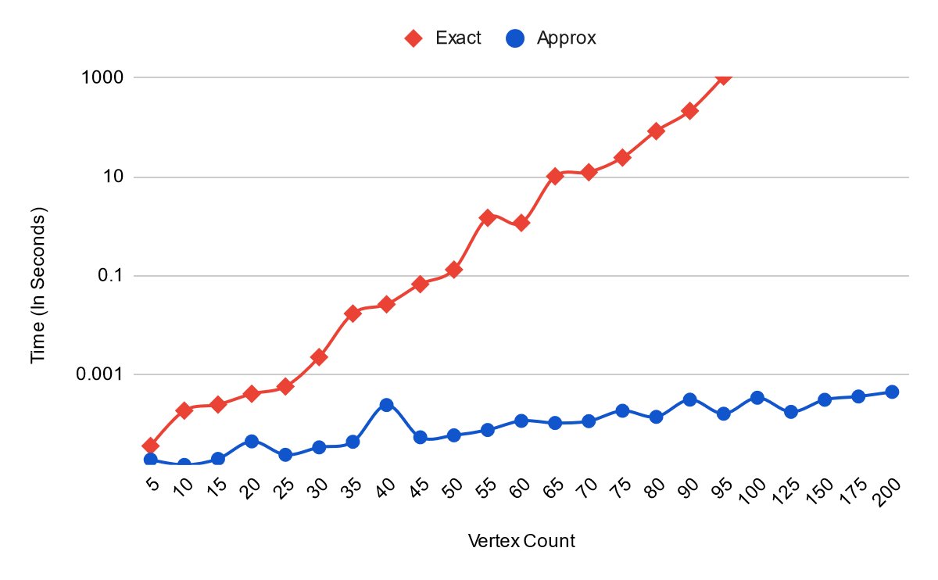
Empirical Runtime Vs Optimal (Logarithmic)

Slide 8
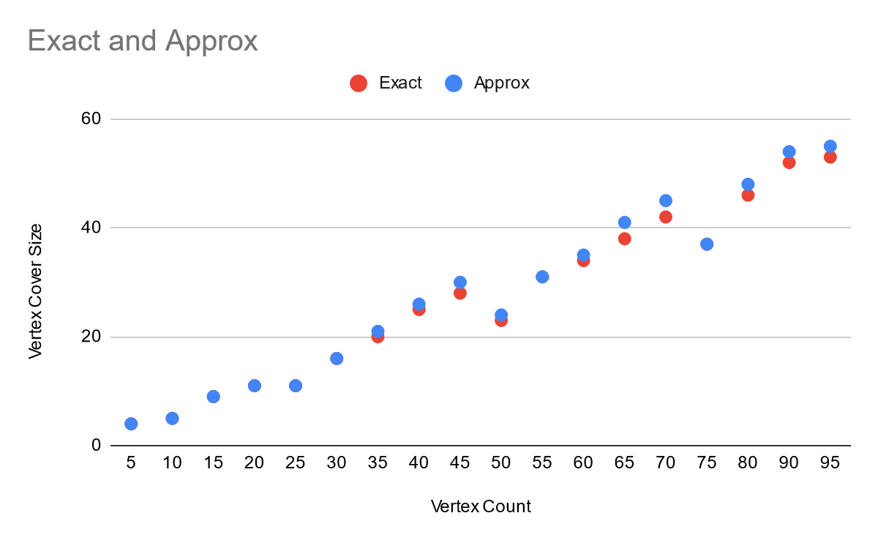
Exact Vs Approximation
Alongside the drastic runtime difference, the approximation used produces quite good results for the cases I ran, coming within 3 vertices of optimal for the tests that the optimal solution could complete.

Slide 9
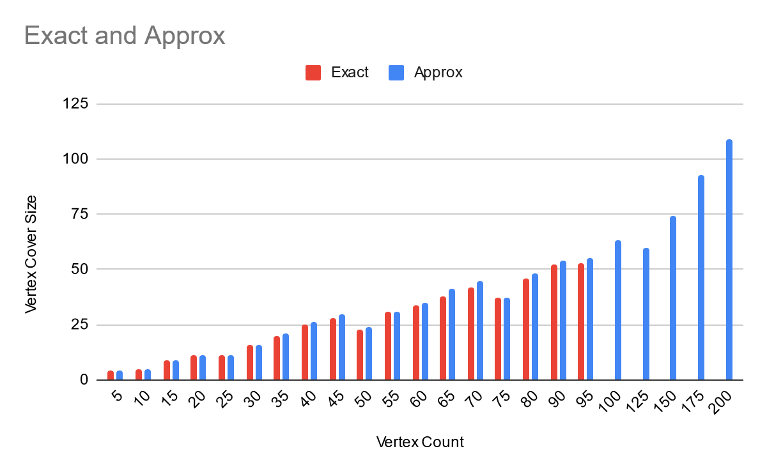
Exact Vs. Approximation

Slide 10
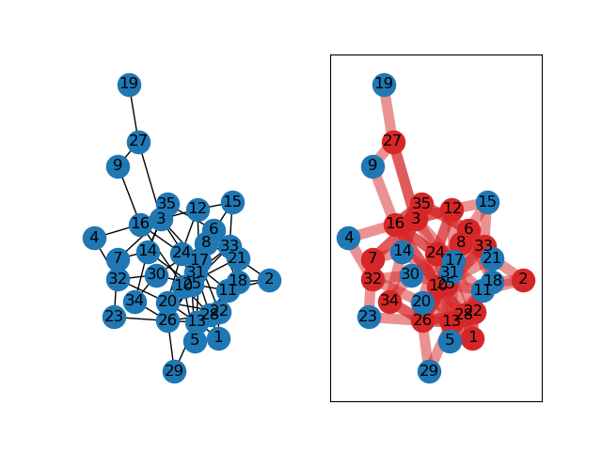
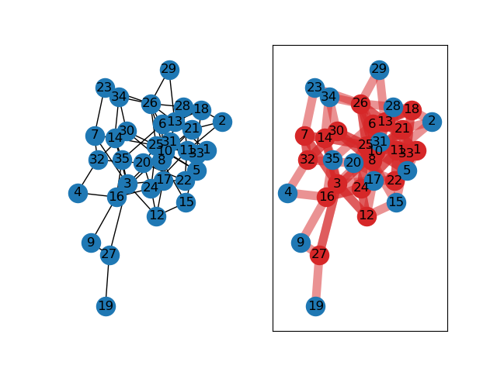
Example: 35 Vertices, 78 Edges
Ran for 0.0170097999999967 seconds Exact Vertex Cover Size: 20
Ran for 0.0000434000000026912 seconds Approx Vertex Cover Size: 21

Slide 11
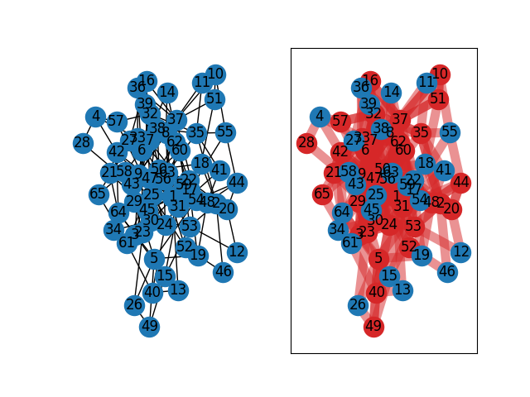
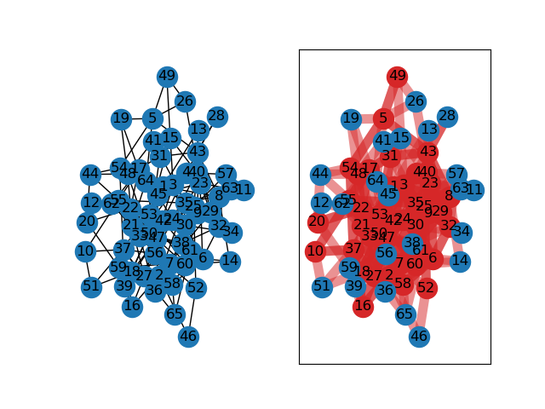
Example: 65 Vertices, 165 Edges
Ran for 10.1887124999993 seconds Exact Vertex Cover Size: 38
Ran for 0.000104200000002663 seconds Approx Vertex Cover Size: 41

Slide 12
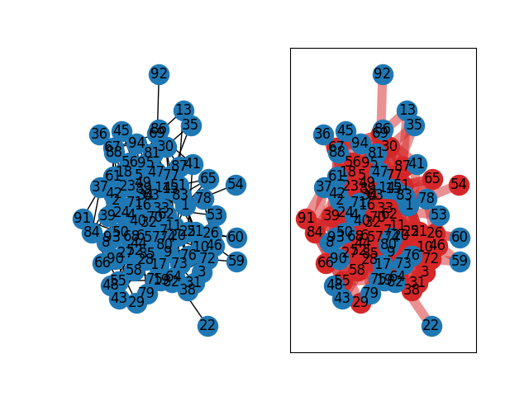
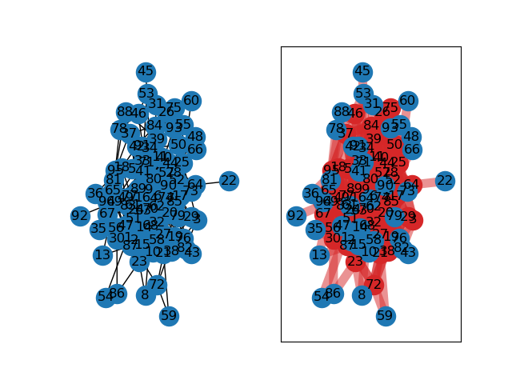
Example: 95 Vertices, 251 Edges
Ran for 213.850163799999 seconds (3.5 minutes) Exact Vertex Cover Size: 53
Ran for 0.000160399999998617 seconds Approx Vertex Cover Size: 55

Slide 13
Approximation Solution Sources
Thomas H. Cormen, Charles E. Leiserson, Ronald l. Rivest, and Clifford Stein, Introduction to algorithms, MIT Press, 3rd edition, 7 August 2009, ISBN 978-0-262-03384-8, https://dahlan.unimal.ac.id/files/ebooks/2009%20Introduction%20to%20Algorithms%20Third%20Ed.pdf.
Sharad Singh, Gaurav Singh, and Neeraj Kushwah, Optimal Algorithm for Solving Vertex Cover Problem in Polynomial Time, International Journal of Scientific & Engineering Research Volume 9, Issue 8, August 2018, ISSN 2229-5518.

