Slide 1
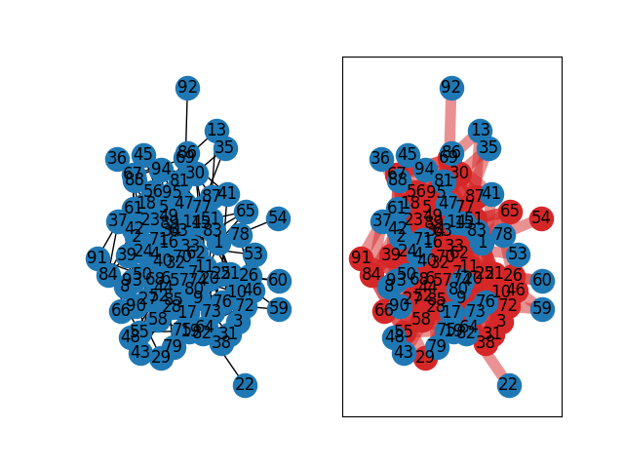
Min Vertex Cover
By Matthew Potter

Slide 2
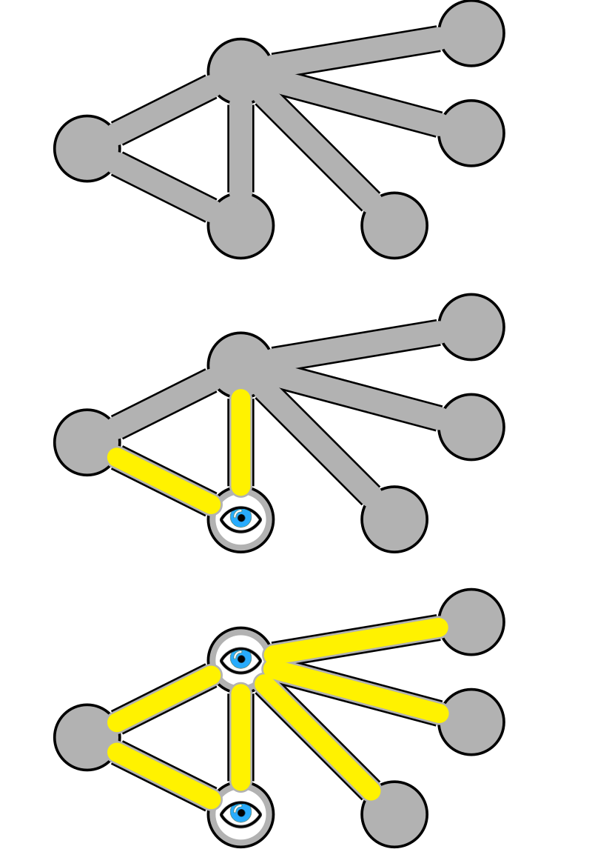
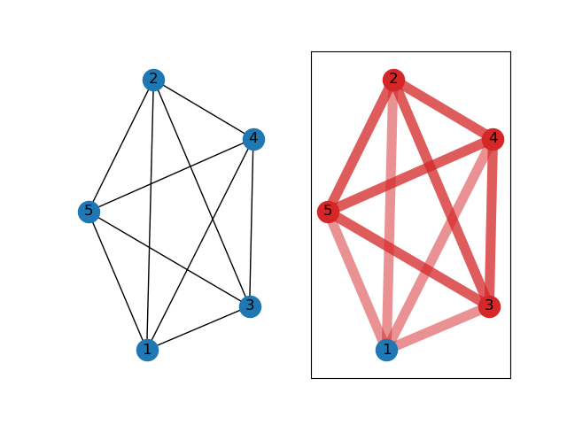
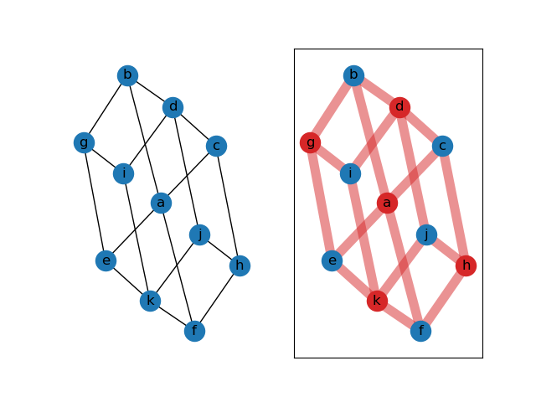
What is the Min Vertex Cover Problem?
A Vertex Cover is defined as a set of vertices whose edges cover all the edges in a graph.

Slide 3
Decision and Optimization Problems
Optimization Problem: Whether, for a given undirected graph G = (V, E), there exists a vertex cover of at most size k, where k is a positive integer.
Optimization Problem: For a given undirected graph G = (V, E), determine the smallest number k which is a vertex cover of G.
In both cases, k is clearly bounded by |V|.

Slide 4
Why is this Important?
Mainly the problems involve minimizing/eliminating repetition of some characteristic [such as repetitive DNA sequences in genetic systems (Hossain, A. et al.)].
The Minimum Vertex Cover problem could be useful for reducing cost on expensive networks
Say, for example, a network maintains many expensive routers (vertices) which branch out to supply their service to some local area (edges). Because the routers are much more expensive to sustain, it would be useful to have as few as possible while still maintaining service to all areas.

Slide 5
Certifier
Given an undirected graph G = (V, E), a positive integer k, and a set V’ which defines the supposed vertex cover, the problem can be certified as follows:
count ← 0
for e ε E:
count ← count + 1
if count >= k or neither of e’s endpoints is in V’:
return false
return true

Slide 6
Reduction
We can reduce the known NP Hard problem known as the Clique problem to the Minimum Vertex Cover problem.
The Clique problem is a decision problem which asks whether, for some undirected graph G = (V, E), there exists a subgraph which is complete (each vertex has an edge to each other vertex) and has k vertices, where k is some positive integer.
Reduction from Karthik Panyam on GeeksForGeeks.

Slide 7
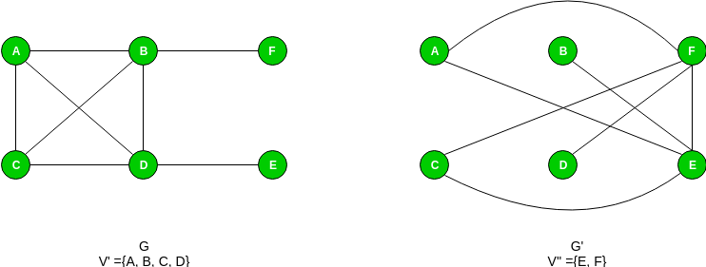
Reduction
Create a new undirected graph G’ = (V, E’), where E’ consists of the edges in the complete graph version of G which are not already present in E:

Slide 8
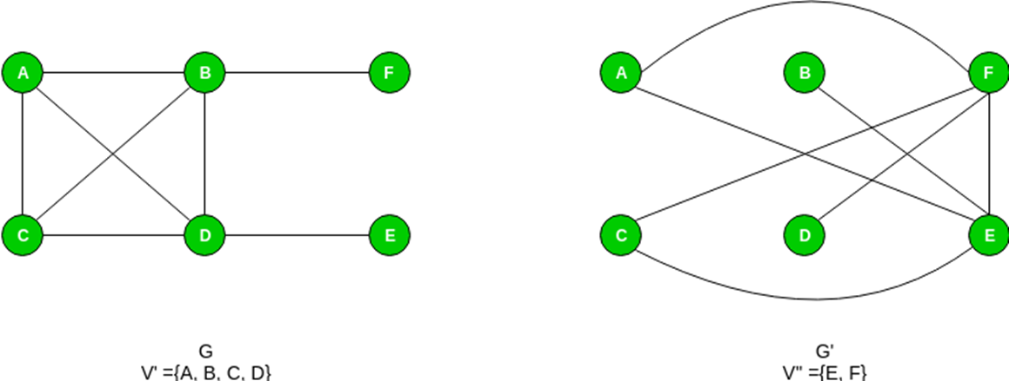

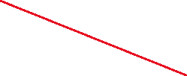
Reduction
Now that we have the graph G’, we can determine whether a Clique of size k exists by determining if there exists some Vertex Cover in G’ called V’’ with |V’’| = |V| - k. First, we assume there exists some clique V’ with |V’| = k. For any edge e ε E’, at most 1 of its endpoints will exist in V’ (the clique) as having both endpoints means the edge exists solely in G’, which is the complement graph of G.

Slide 9



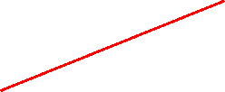


Reduction
3. Next, assume that the Vertex Cover V’’ does exist with |V’’| = |V| - k, with V’’ containing all vertices not present in the clique V’. If V’’ exists, all edges of G’ must have at least one endpoint in V’’.

Slide 10
Reduction
This shows the relationship that, for some undirected graph G = (V, E), a Vertex Cover V’’ in G’s complementary graph G’ will consist of all vertices which cannot be in the k-sized clique V’ in G. This means that if |V’’| != |V| - k there does not exist a clique of size k in the graph G.

Slide 11
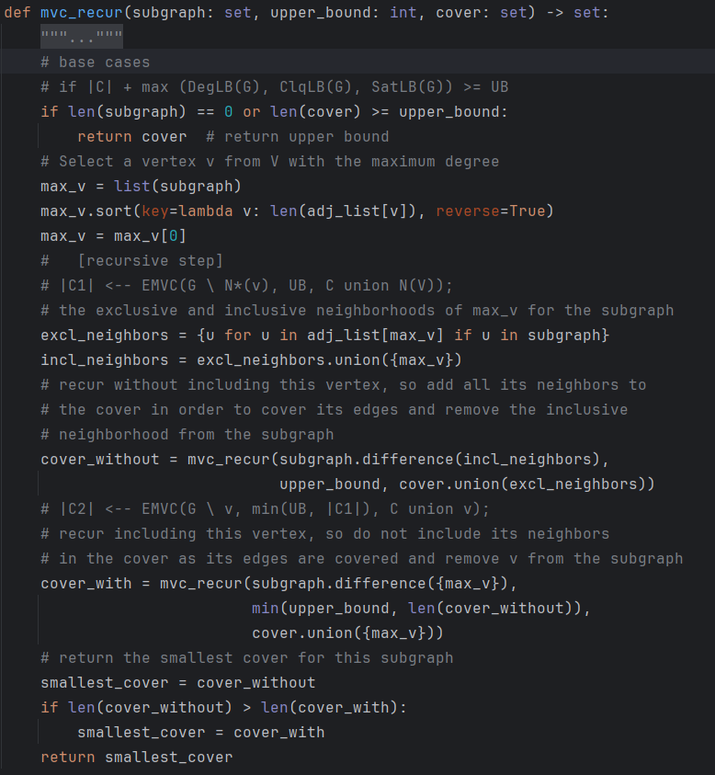
My Optimal Solution
For my code, I adapted pseudocode from Wang, L et al. and K. V. R Kumar, with some inspiration from the Knapsack problem.
I took a recursive branching approach where each possibility is brute forced, testing each combination of vertices which could be in the MVC. This is done by branching without the current vertex in the MVC, as well as with it in there.

Slide 12
My Optimal Solution
Subgraph is the set of vertices for that iteration which still could be possibly added to the working cover and must be tested.
As not adding a vertex to the MVC means that its edges will be uncovered, in that case we must add each of that vertex’s neighbors to the cover. Adding them to the cover means we can remove them from Subgraph.
Adding a vertex doesn’t mean its neighbors are guaranteed out of the cover, so they stay in Subgraph.

Slide 13
My Optimal Solution
The vertex with max degree is chosen at each step to more efficiently lead to the bounds which prune the tree. Those were defined by Wang, L et al., but I did not implement those myself and so my code is more inefficient than theirs on runtime.

Slide 14
Runtime Analysis
T(0) = 1
T(n) = nlog(n) + 2T(n – 1)
nlog(n) due to sort
= 2[2T(n-2) + (n-1)log(n-1)] = 2²T(n-2) + 2(n-1)log(n-1) = 2²[2T(n-3) + (n-2)log(n-2)]
= 2³T(n-3) + 2²(n-2)log(n-2)
=…
=2^{k}T(n-k) + 2^{k-1}(n-(k-1))log(n-(k-1))

Slide 15
Runtime Analysis
T(0) = 1
2^{k}T(n-k) + 2^{k-1}(n-(k-1))log(n-(k-1))
Assume k approaches n:
= 2^{n}T(0) + 2^{n-1}log(1)
= 2^{n} + 2^{n-1}(0)
= 2^{n}
Therefore, the runtime is O(2^{n}) for this function as the double branching recursion is dominant in runtime.

Slide 16
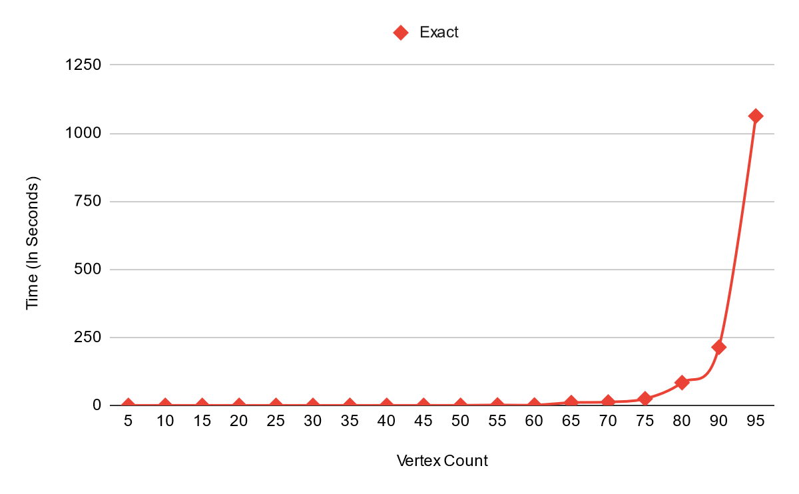
Empirical Runtime (Stepped)

Slide 17
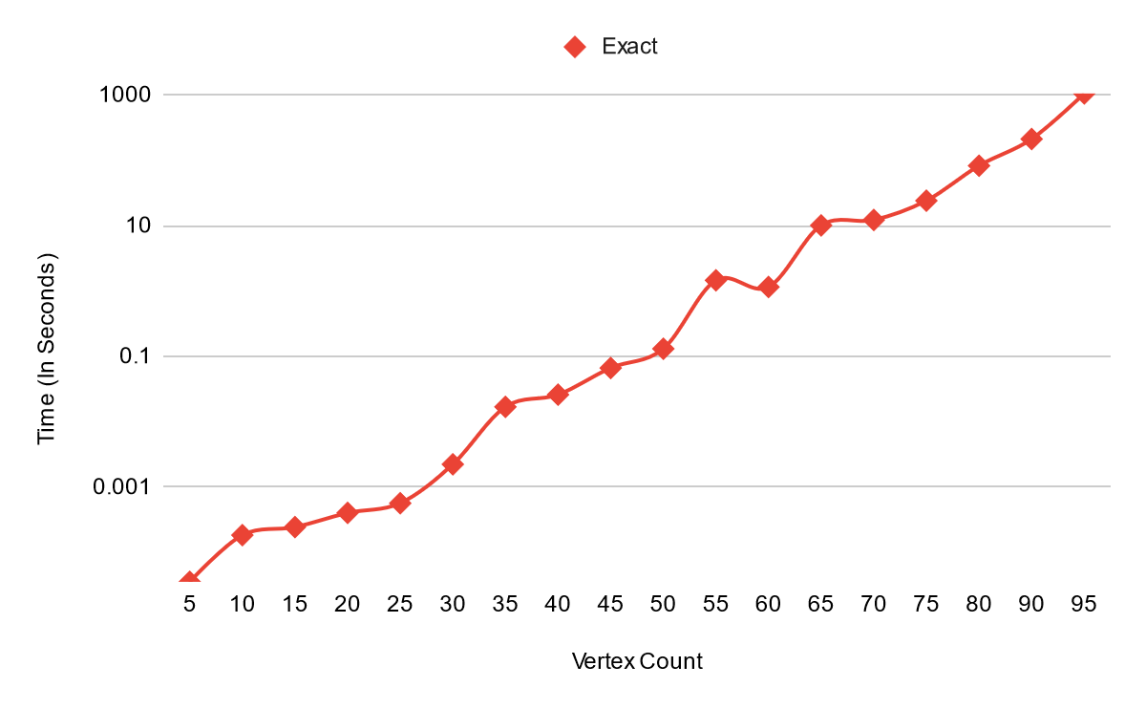
Empirical Runtime (Logarithmic)

Slide 18
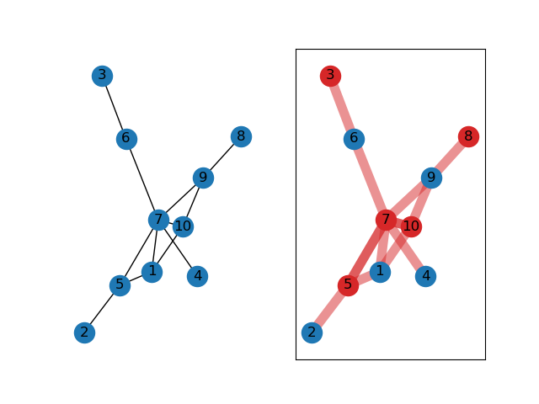
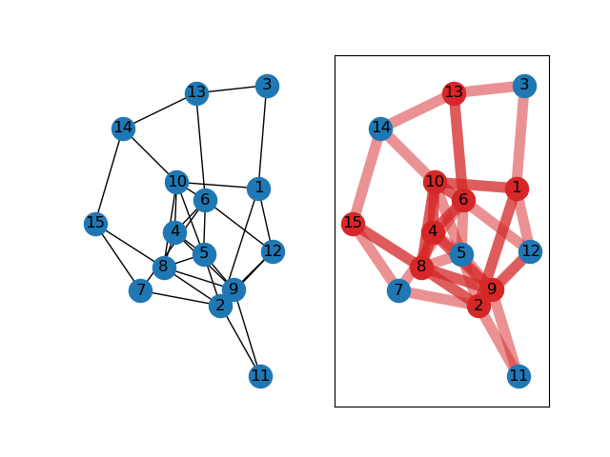
Examples
10 Vertices, 12 Edges Ran for 0.000185200000004215 seconds
15 Vertices, 35 Edges Ran for 0.000245700000000681 seconds

Slide 19
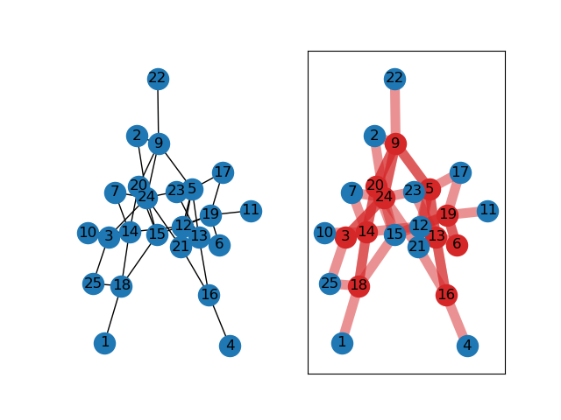
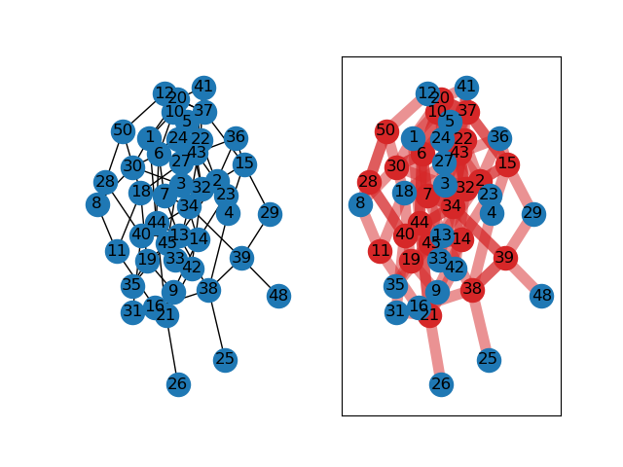
Examples
25 Vertices, 37 Edges Ran for 0.000571100000001934 seconds
50 Vertices, 85 Edges Ran for 0.131791000000006 seconds

Slide 20
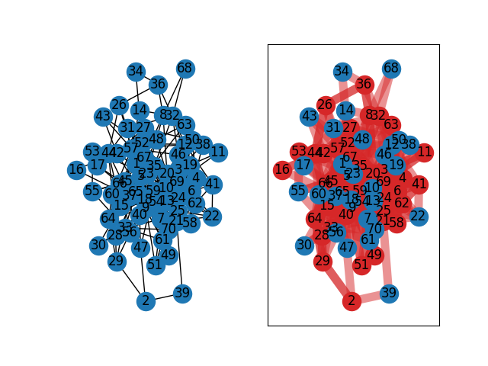
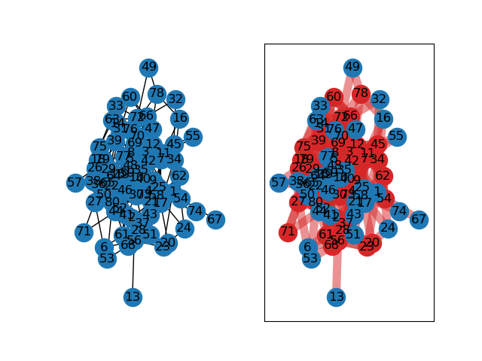
Examples
70 Vertices, 209 Edges Ran for 12.3239887000017 seconds
80 Vertices, 206 Edges Ran for 83.4970122 seconds

Slide 21
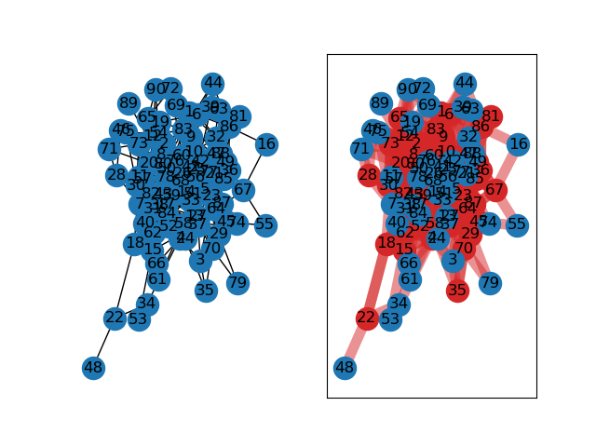
Examples
90 Vertices, 251 Edges Ran for 213.850163799999 seconds (3.5 minutes)
95 Vertices, 242 Edges Ran for 1063.0175228 seconds (17.7 minutes)

Slide 22
Optimal Solution Sources
Wang, L. et al. 2019. An Exact Algorithm for Minimum Vertex Cover Problem. Mathematics. 7, 7 (Jul. 2019), 603. DOI: https://doi.org/10.3390/math7070603.
K.V.R Kumar, Deepak Garg, 2009. Complete Algorithms on Minimum Vertex Cover. CIIT International Journal of Software Engineering and Technology, Issue May 2009 ISSN 0974 – 9748 & Online: ISSN 0974 – 9632. Accessed from https://gdeepak.com/thesisme/thesis-Choosing%20the%20Efficient%20Algorithm%20for%20Vertex%20Cover%20problem.pdf.

Slide 23
Works Cited
Hossain, A., Lopez, E., Halper, S.M. et al. Automated design of thousands of nonrepetitive parts for engineering stable genetic systems. Nat Biotechnol 38, 1466–1475 (2020). https://doi.org/10.1038/s41587-020-0584-2
Panyam, Karthik. Proof That Vertex Cover Is NP Complete. GeeksforGeeks, GeeksforGeeks, 3 Aug. 2018, www.geeksforgeeks.org/proof-that-vertex-cover-is-np-complete/.

