Slide 1

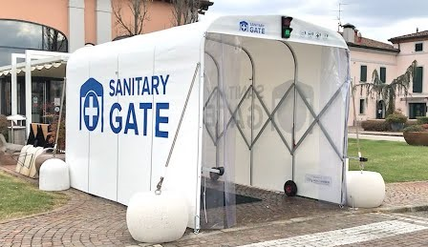
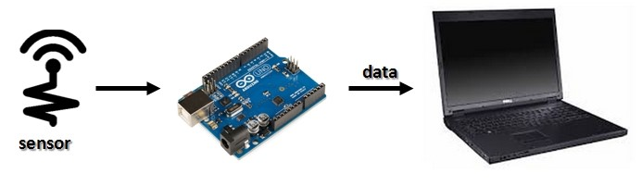
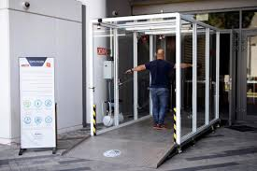
SOLVING SOCIAL ISSUES
BY APPLYING DIGITAL MANUFACTURING TECHNOLOGY,
AUTOMATION, SERIAL COMMUNICATION AND INTERNET OF THINGS.
HEALTHY GATEWAY PROJECT
/ NON-ZERO / MIN HTET MYET . NYI NYI THIT . BHONE TINT KYAW

Slide 2
Problem
The problem* is that we are in covid-19 pandemic and there are many crowded places in our cities .
Not enough volunteers for checking the health conditions in the entrances of some places and not enough health care.
Hand gel ,Masks and Thermometers are all the things we are relying on.
How people are reacting to this problem?
Most of the people are neglecting about pandemic and don’t care about health care.

Slide 3
Reason of problem
What caused the problem?
Lack of health care
Lack of volunteer
Lack of attention
Lack of technological support
Lack of awareness by the public.

Slide 4
Solution
The value our product can offer to improve people's life !
With the help of our Healthy Gateway project ,which apply the DIGITAL MANUFACTURING technology, there shall be a smart automated gateway at every required places.
Our project also supply the need of healthcare for every individuals passing through our gateway.
Our gateway includes temperature measuring, pulsemeter and oximeter, mini weather station, disinfecting, cleaning robot, monitoring, applying hand gel when entering, also saving information of individuals who don’t have proper health conditions.

Slide 5
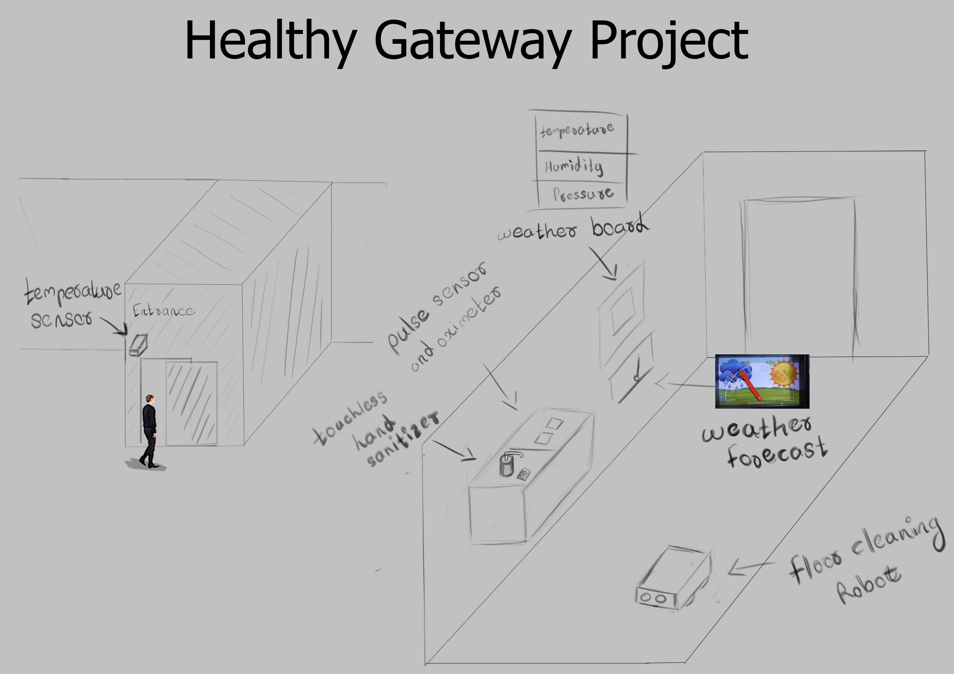
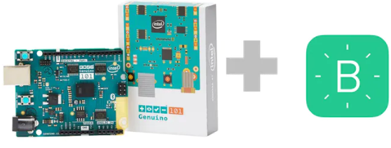

Prototypes
THIS IS THE OVERALL SKETCH OF OUR PROJECT

Slide 6
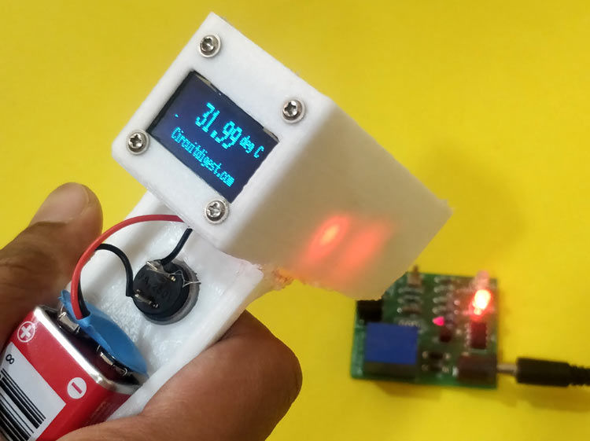
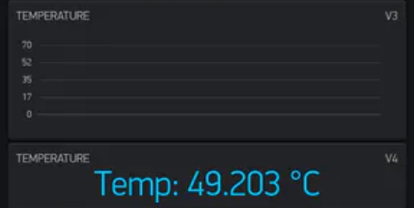
Prototypes
TEMPERATURE DETECTION AND OPENING THE GATE
*OPEN THE GATE DOOR ONLY IF THE PERSON IS WITHIN THE TEMPERATURE LIMIT.
*HOWEVER, THERE WILL BE AN EMERGENCY OPEN SWITCH.
USER INTERFACE SAMPLE (COMPUTER)
# PHOTO SAMPLES TAKEN FROM INTERNET

Slide 7
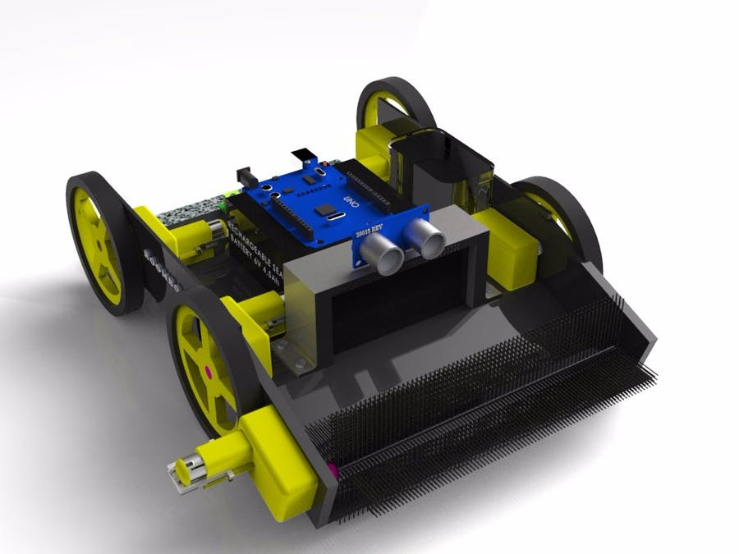
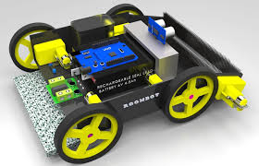
Prototypes
CLEANING ROBOT IDEA PROTOTYPE
*THERE WILL BE AN AUTONOMUS OBSTACLE AVOIDING
ROBOT WHICH STARTS CLEANING AROUND WHEN SOMEONE
ENTERS THE GATEWAY.
# PHOTO SAMPLES TAKEN FROM INTERNET

Slide 8
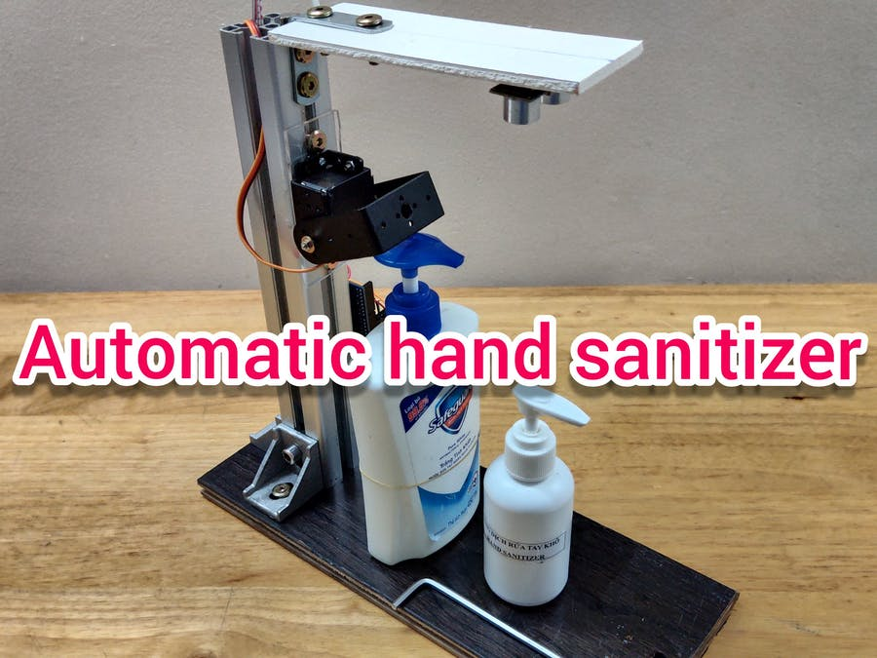
Prototypes
THERE WILL BE
AN AUTOMATIC HAND SANITIZER
FOR EVERYONE PASSING THROUGH.
ALERT
THE PROGRAM WILL ALLOW
THE USE OF OXIMETER AND
PULSE METER , ONLY AFTER
A PERSON HAS WASHED
THEIR HANDS HERE.
THE BUZZER ALARM WILL
MAKE NIOSE WHEN SOMEONE WALK THROUGH THE OTHER ULTRASONIC
SENSOR WITHOUT
WASHING THEIR HANDS HERE.
# PHOTO SAMPLES TAKEN FROM INTERNET

Slide 9
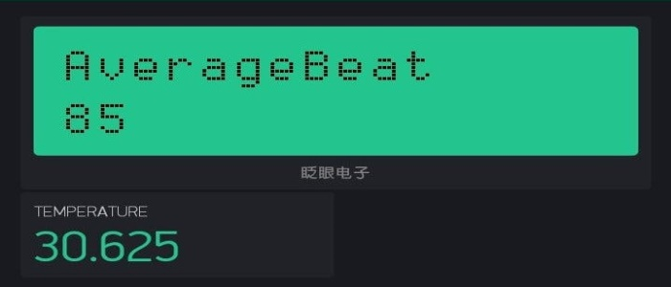
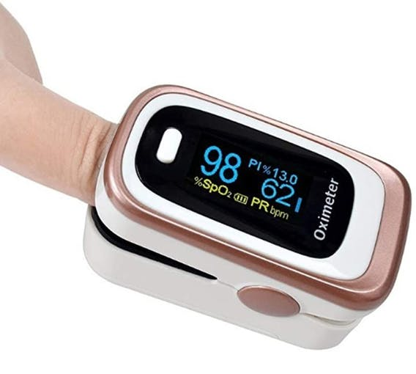
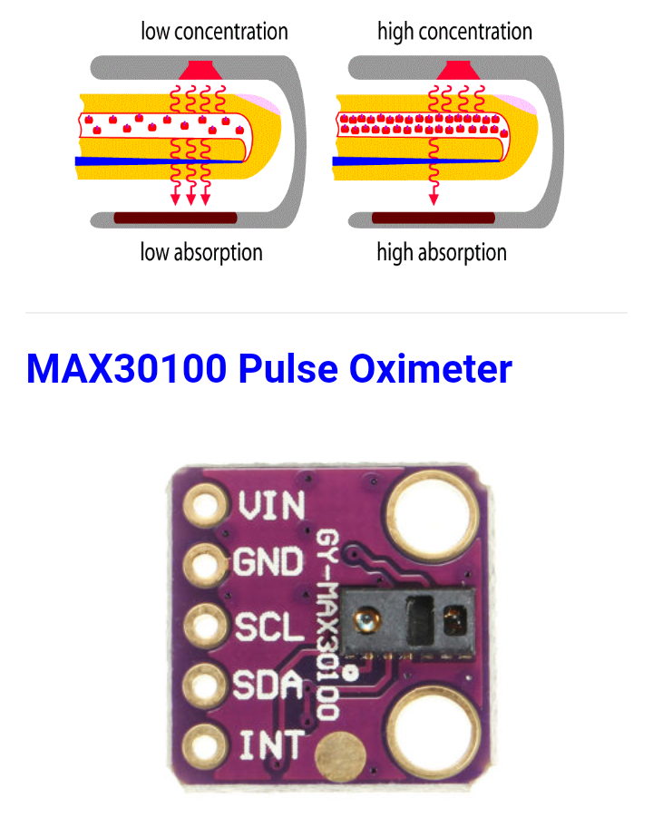
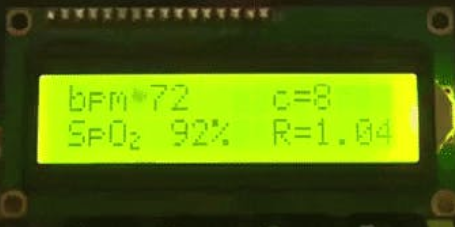
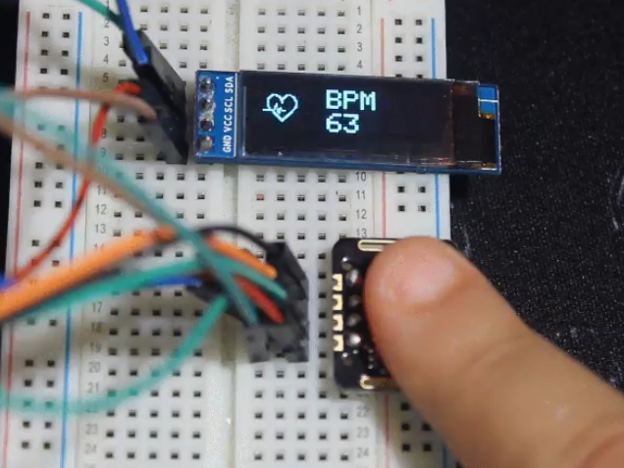
Prototypes
USER INTERFACE SAMPLE (COMPUTER)
OXIMETER AND
PULSE METER
SAMPLES
*ANYONE CAN CHECK THEIR
HEART RATE (BPM) AND
BLOOD-OXYGEN-LEVEL (SPO2)
# PHOTO SAMPLES TAKEN FROM INTERNET

Slide 10
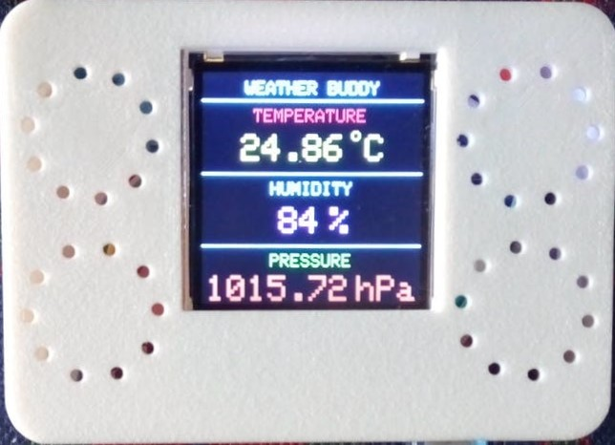
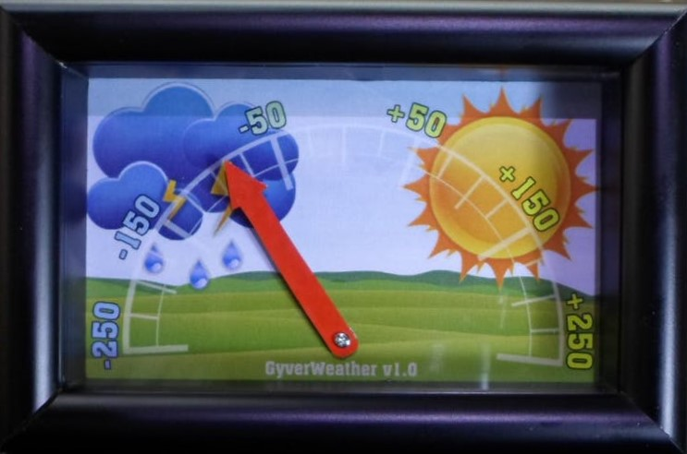
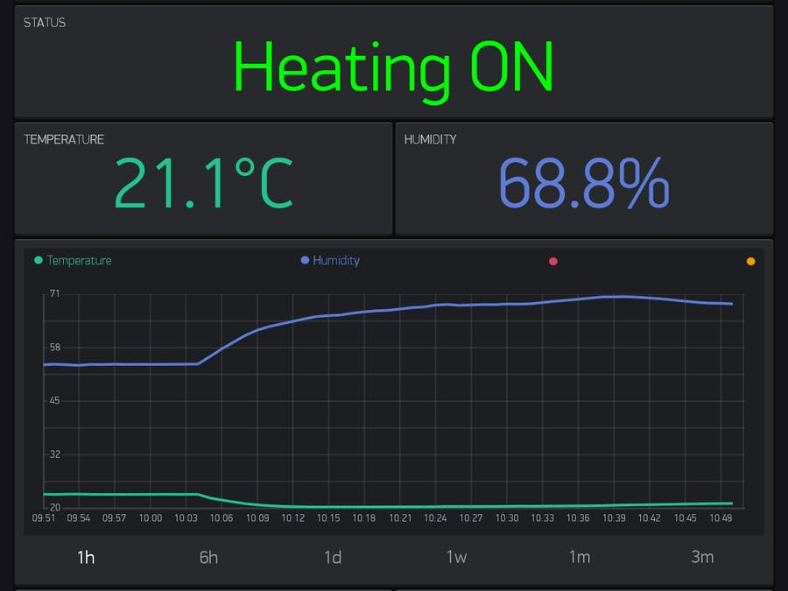
Prototypes
WEATHER STATION
*TEMPERATURE
*HUMIDITY
*AIR PRESSURE
*WEATHER FORECAST METER
# PHOTO SAMPLES TAKEN FROM INTERNET
NOTE: THE PROGRAM WILL CHANGE THE MAXIMUM
TEMPERATURE LIMIT FOR ENTRANCE WHEN THE
OUTSIDE TEMPERATURE IS TOO HIGH.
USER INTERFACE SAMPLE (COMPUTER)

Slide 11
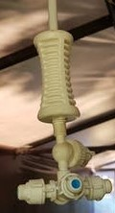
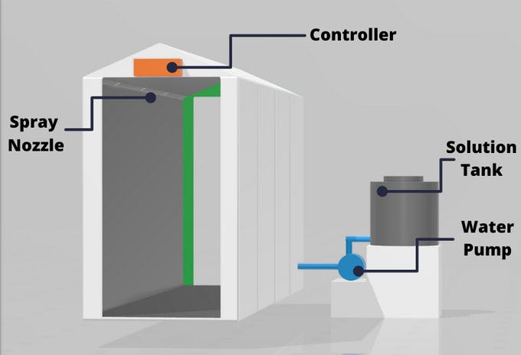
PROTOTYPES AND MORE IDEAS
THERE ARE SOME MORE IDEAS WE REALLY LOVE TO APPLY
IN OUR PROJECT,BUT WE ARE AFRAID OF THE FACT THAT OUR PROJECT
POSSIBLY MAY COST A BIG-BUDGET.
SMART DISINFECTION AND SANITATION TUNNEL
DESIGNED TO PROVIDE MAXIMUM PROTECTION OF
PEOPLE PASSING THROUGH THE TUNNEL IN LESS THAN 15 SECONDS
BY SPRAYING FOGS TO THE WHOLE BODY WITH (NAOCL + H2O) SOLUTION.
HOW IT WORKS
PIR MOTION SENSORS WILL BE MOUNTED
ON EACH SIDE OF THE SPRAYING AREA
WHICH WILL ACTIVATE THE WATER PUMPS
WHEN IT DETECTS MOTION.
TWO PIR SENSORS, MINI PUMP,FOGGER,ARDUINO
UNO WOULD BE REQUIED FOR THIS.
4 WAY FOGGER

Slide 12
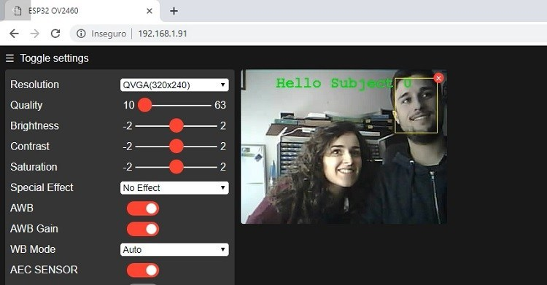
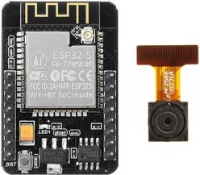
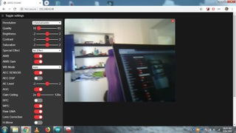
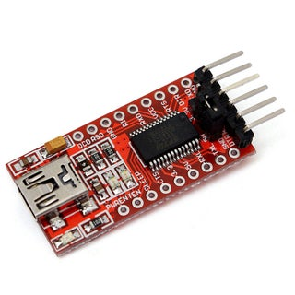
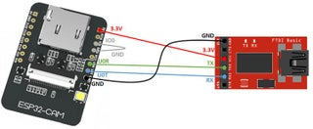
PROTOTYPES AND MORE IDEAS
2. (WIFI) CAMERA RECORDING
THIS WOULD PROVIDE THE REAL TIME MONITORING
AND CONTROLS FOR SECURITIES OF THE PLACE.
HOW IT WORKS
WITH IOT BOARD MOUNTED CAMERA AND URAT DEVICE BELOW;
ESP32 WIFI CAMERA - 13,000 MMK
FT232 USB UART BOARD MINI - 9,700 MMK
IOT REAL TIME MONITURING
CAN BE PROGRAMMED TO LIVE.
# PHOTO SAMPLES TAKEN FROM INTERNET

Slide 13
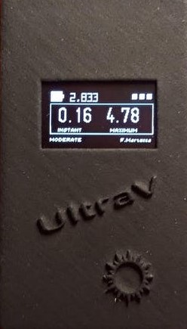
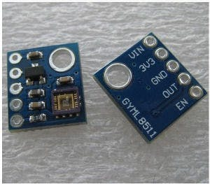
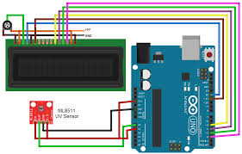
PROTOTYPES AND MORE IDEAS
# PHOTO SAMPLES TAKEN FROM INTERNET
3. UV INDEX METER.
THIS CAN BE MOUNTED BESIDES OUR WEATHER STATION
NEEDS ARDUINO UNO, ML-8511 AND LCD DISPLAY

Slide 14
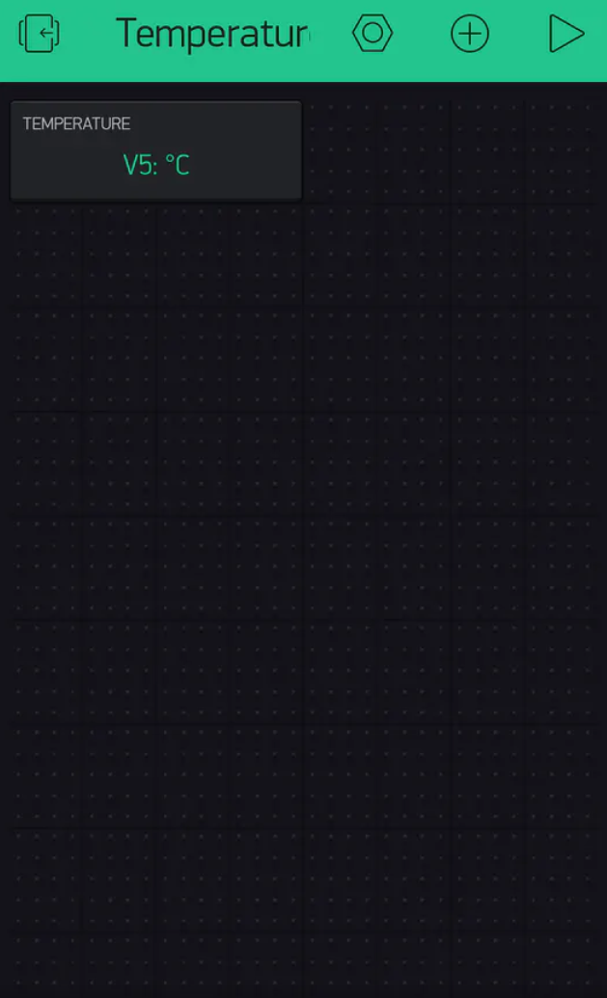
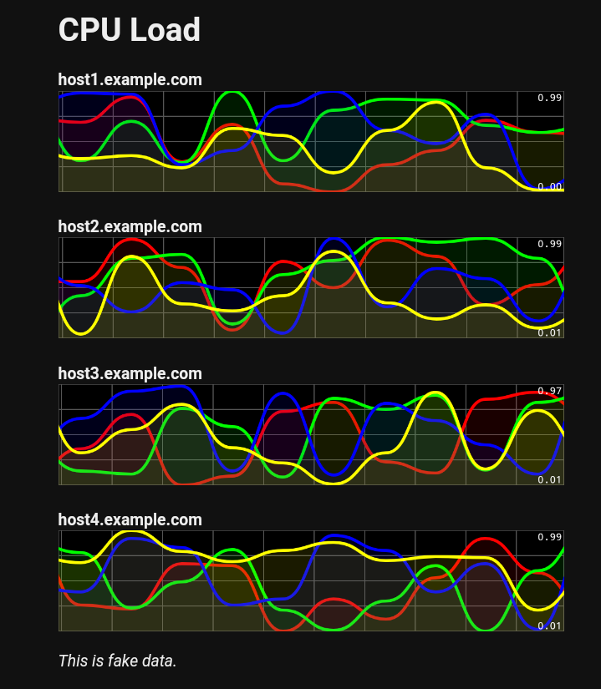
THE ROLE OF USER INTERFACE
WE WOULD LIKE OUR PROJECT TO BE APPLIED,
BY A UNIQUE FEATURE OF
DIGITAL MANUFACTURING TECHNOLOGY.
* ALSO, (NOT COPYING THE LOGICS FROM CNC ,
LASER CUTTING & 3D PRINTING MACHINES).
SO,ASIDE FROM AUTOMATION PROCESS,
WE WILL ALSO KEEP THE USER INTERFACE AND
CONTROL PROCESSES WHICH CAN ALSO BE
DONE FROM SMARTPHONE AND
LAPTOPS(APPLIED SERIAL COMMUNICATION
TO REDUCE COST).
SAMPLE UI IN
SMARTPHONES
SAMPLE UI IN LAPTOP

Slide 15
Budget
NO. | ITEM | PRICE | PCS. | COST
1 | GY-906 MLX 90614 Temp: | 22,000 | 1x | 22,000
2 | Laser Diode | 1,000 | 1x | 1,000
3 | OLED 0.96” (SSD 1306) | 12,500 | 1x | 12,500
4 | 180 degree Metal Gear Servo | 5,000 | 2x | 10,000
5 | HC-SR 04 Ultrasonic Sensor | 2,500 | 6x | 15,000
6 | XD-58C Pulse Sensor | 6,500 | 1x | 6,500
7 | Oximeter MAX30100 | 14,000 | 1x | 14,000
8 | PIR Motion Sensor | 2,000 | 2x | 4,000
9 | SC-90 Mini Servo Motor | 2,500 | 3x | 7,500
10 | 5000-RPM Blower Fan | 2,700 | 1x | 2,700

Slide 16
NO. | ITEM | PRICE | PCS. | COST
11 | L-298N Driver | 3,500 | 1x | 3,500
12 | Yellow Head Motor and Wheel | 2,500 | 4x | 10,000
13 | KDLIPO 2S 7.4V 1500maH Lithium Battery (25C) | 15,500 | 1x | 15,500
14 | DHT-11 (Temp & Humidity) | 6,700 | 1x | 6,700
15 | BMP-280 BARO-METER Sensor | 3,500 | 3x | 10,500
16 | ST-7735/ 1.8” LCD Display 128x160 | 13,300 | 1x | 13,300
17 | 1602 LCD Display (16x2) | 3,500 | 3x | 10,500
18 | I2C Serial LCD Text Module | 5,000 | 3x | 15,000
19 | ESP-32 WIFI Camera | 13,300 | 1x | 13,300
20 | FT-232 USB UART Board Mini | 9,700 | 1x | 9,700

Slide 17
NO. | ITEM | PRICE | PCS. | COST
21 | Breadboard Power Supply 5V/ 3.3V (1A) | 2,000 | 1x | 2,000
22 | Breadboard | 1,500 | 3x | 4,500
23 | 5V/ 2A AC to DC Adaptor | 4,000 | 3x | 12,000
24 | Arduino DC Jacks (Male) | 200 | 2x | 400
25 | Arduino DC Jacks (Female) | 200 | 2x | 400
26 | Jumper Wire (M-M/F-F/ F-M) | 2,200 | 3x | 6,600
27 | Micro Submersible Pump | 3,300 | 1x | 3,300
28 | ML8511 UV sensor | 9,000 | 1x | 9,000

Slide 18
NO. | ITEM | PRICE | PCS. | COST
29 | ARDUINO PRO MINI | 4,500 | 1x | 4,500
30 | ARDUINO NANO | 6,000 | 1x | 6,000
31 | ARDUINO UNO | 9,000 | 2x | 18,000
32 | ARDUINO MEGA | 15,500 | 2x | 31,000
T O T A L |  |  |  | 300,900

Slide 19
Making Roadmap
NAMES | AUGUST |  | SEPTEMBER |  |  | OCTOBER
 | 21 | 21-31 | 1-10 | 11-20 | 21-30 | 1-10 | 11-20 | 21-30
MHM | Presentation Day | Research & Micro-calculations | Programming |  | Changing respective programs for Assembling |  | Fix the errors
NNT |  |  | Designing And Function test |  | Installing |  | Perfecting the project
BTK |  |  | Checking components |  | Assembling & Safety of components |  | Maintenance
Printing models
Testing & Finishing
the project
Troubleshooting problems

Slide 20
Team
PROGRAMMER – MIN HTET MYET
DESIGNER- NYI NYI THIT
CIRCUIT AND ASSEMBLING – BHONE THINT KYAW.

Slide 21
temperature
Gate open
Hand wash
Oximeter and pulse meter
alarm
AUTOMATED CLEANING ROBOT
Weather board
CAMERA RECORDING and CONTROL PROCESS
Disinfecting tunnel
Monitor and Control from
SECURITY COMPUTER
EXIT

Slide 22
Thank you
Q&A

