Slide 1


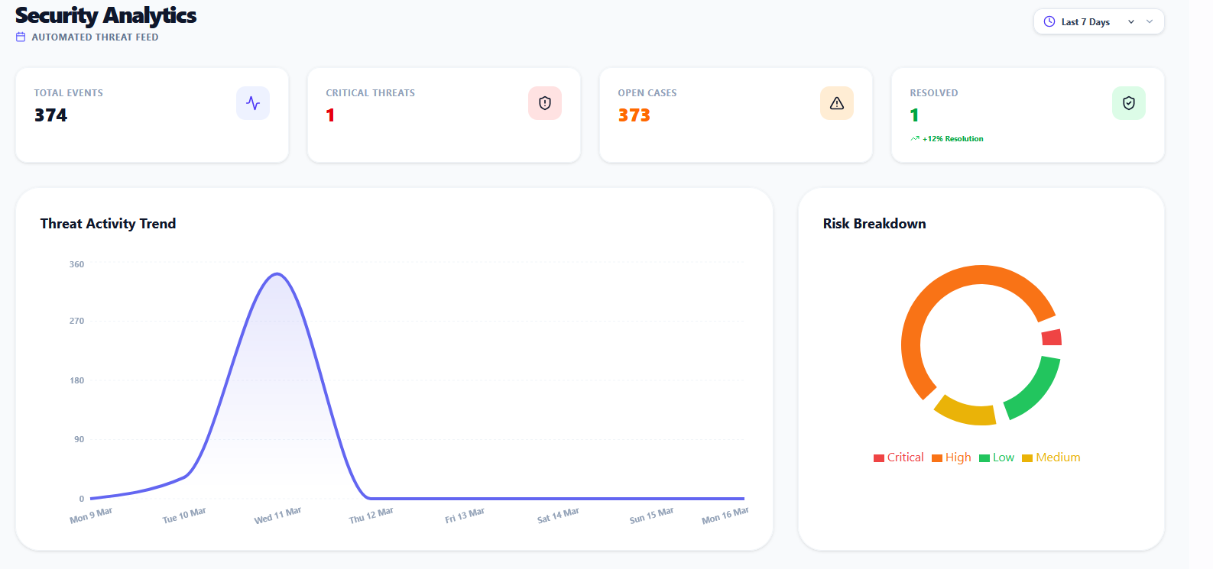
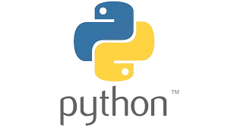





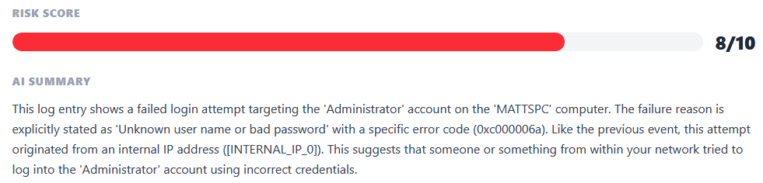




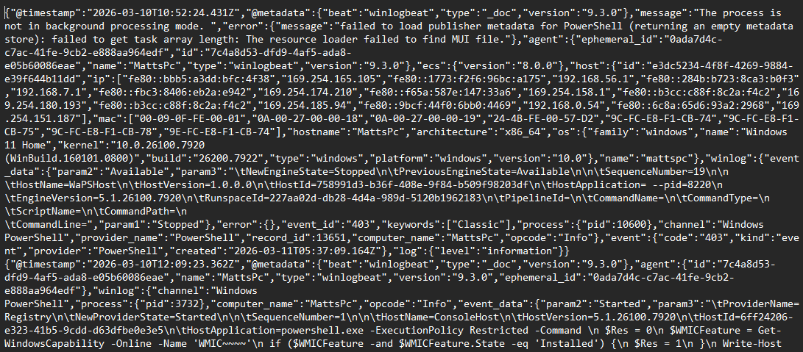
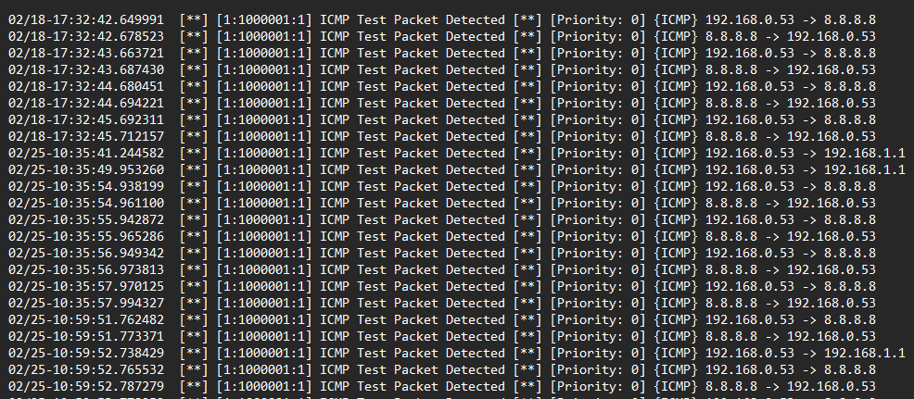
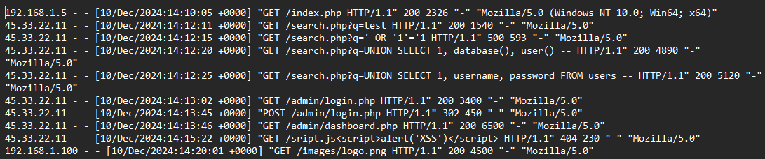

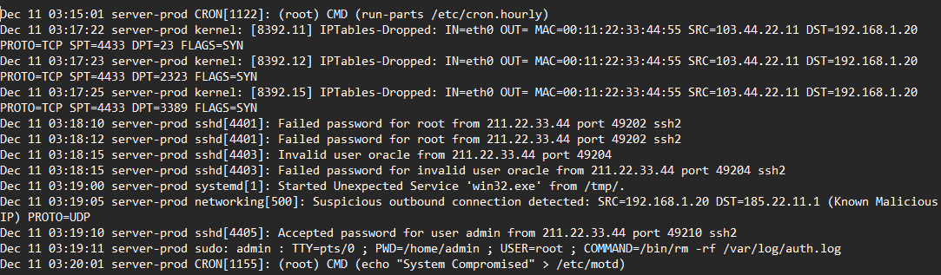




S.I.R.A: AN AI-POWERED DASHBOARD TRANSLATING COMPLEX CYBER THREATS INTO CLEAR ACTION PLANS FOR SMALL AND MEDIUM ENTERPRISES (SMEs)
BACKGROUND & PROBLEM
METHODOLOGY & SYSTEM ARCHITECTURE
IMPLEMENTATION & RESULTS
SME Challenge: Limited Resources & Expertise
DATA INGESTION
2. PROCESSOR
DASHBOARD VIEW
59% of SMEs experienced a cyber-attack in the last 12 months (HISCOX 2025).
Log Sanitiser & encryption
Lack of budget, awareness, and dedicated security staff.
4. DATA STORAGE
3. AI ENGINE
Summary and Mitigation Steps
INCIDENT INVESTIGATION
Technical alerts are complex & difficult to interpret, leading to delayed responses.
5. DASHBOARD
React UI
Raw Logs
Sanitise
RESULTS
Expertise Bridge: Translates complex security alerts into plain English.
Privacy: Local regex sanitisation.
Response Clarity: Provides clear, step-by-step instructions to contain active threats.
Security: Fernet AES Payload Encryption
Visualize
AI Analyse
Awareness Training: Transforms security incidents into real-world staff learning opportunities.
Small business owner
Adaptation: Dynamic persona prompting.
Matthew Fish
Matthew.fish@students.plymouth.ac.uk
BSc(hons) Computer Science (Cyber Security)

