Slide 1
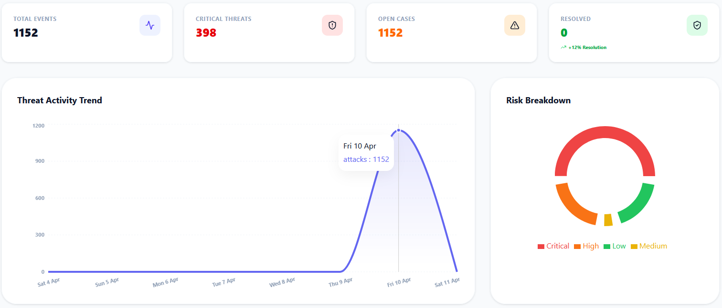
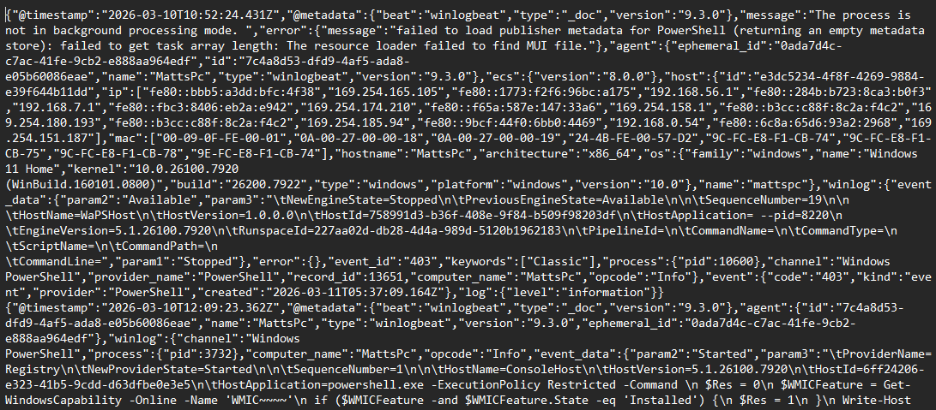
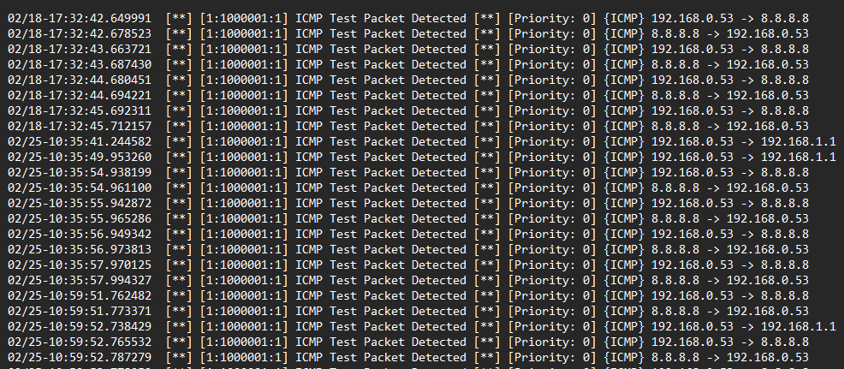
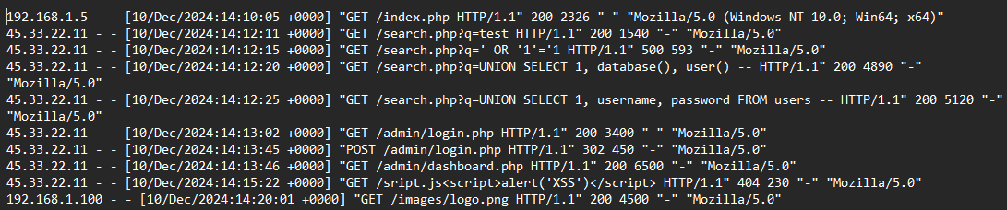
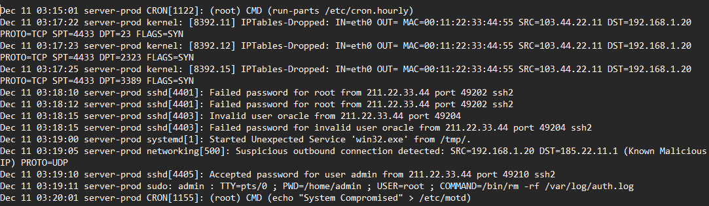





S.I.R.A
An AI-Driven Incident Response Dashboard for SMEs
BACKGROUND & PROBLEM
METHODOLOGY & SYSTEM ARCHITECTURE
IMPLEMENTATION & RESULTS
59% of SMEs experienced a cyber-attack in the last 12 months (HISCOX 2025).
Raw Logs
Sanitise
AI Analyse
Visualize
SME Challenge
Limited resources & expertise.
Lack of budget, awareness, and dedicated security staff.
Technical alerts are complex & difficult to interpret, leading to delayed responses.
Privacy: Local regex sanitisation prevents sensitive data leaks to external APIs.
Security: Fernet AES encryption guarantees secure database storage and payload transit.
Adaptation: Dynamic persona prompting tailors AI responses specifically for SME skill levels.
Expertise Bridge: Translates complex security alerts into plain English.
Response Clarity: Provides clear, step-by-step instructions to contain active threats.
Awareness Training: Transforms security incidents into real-world staff learning opportunities.
Small business owner
Matthew Fish
Matthew.fish@students.plymouth.ac.uk
BSc(hons) Computer Science (Cyber Security)

