Slide 1
Infix Support: Impact to date
March 2026

Slide 2
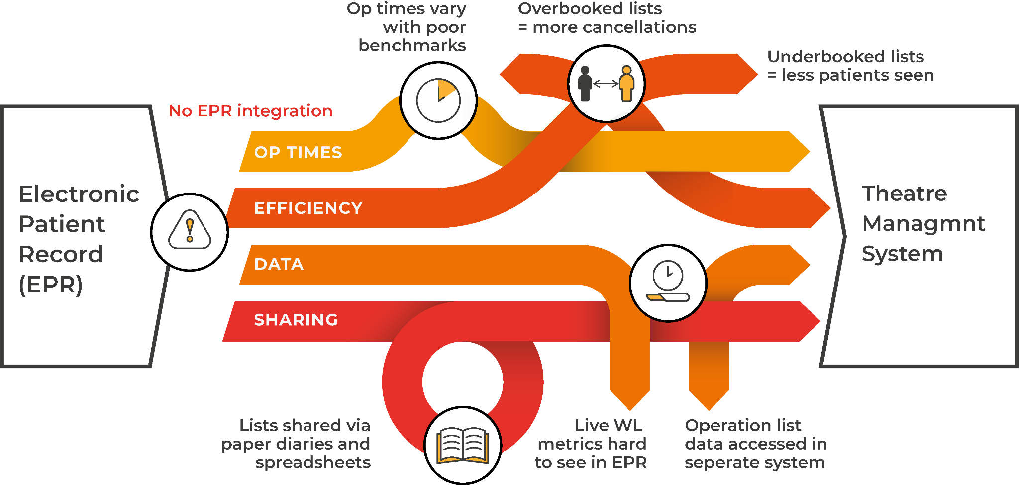
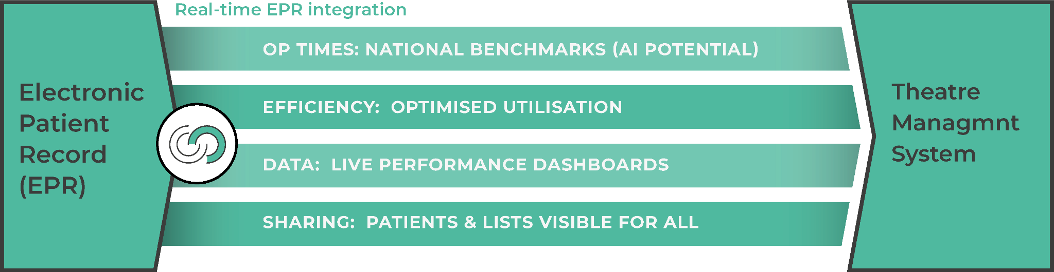
Current vs Infix
Current situation
No integration
Variable op times
65% theatre utilisation*
Poor data
Manual sharing
With Infix Schedule
Real-time integration
National benchmark op times
26.8% utilisation increase*
Live data dashboards
Easy sharing of patients/lists
*Utilisation percentages taken from Independent evaluation report by the University of Stirling

Slide 3


Benefits
The only system you need to use for ‘real-time’ visualisation of your patients and all populated surgical activity
All patients’ details from outpatient notes are shown for easy identification
A personalised calendar for all your activity
Allows easy communication between you and your admin team with a visual and user-friendly interface
Gives you more control and visibility during the entire scheduling process
Build operation lists in seconds, automatically or manually.
Live patient list data so that changes are updated in real-time.
Automation of the data transfer will reduce the manual workload
A visual and user-friendly interface to schedule lists with access to calendar views and a range of filters.
Allows easy communication between clinicians and administration
Surgeons
Administration teams

Slide 4

Benefits
Analytics
Real-time sessions worth for each department and surgeon will allow more accurate planning/resourcing
TTG and 52 week wait targets in a clean interface will again allow a proactive approach to planning and meeting these targets set out
Capacity management
Matching demand with resource availability is key to planning
Having the sessions will give the ability for capacity to be delivered to the most in need
Performance
Benchmarking operation times will allow an accurate booking utilisation to be determined. This together with the actual theatre utilisation will identify the areas of high and low performance
Knowledge sharing of how some areas perform higher can be adopted in other areas to improve the hospitals output
Areas of poor performance may indicate issues with upstream/downstream issues which will allow early identification and management
Service management

Slide 5


The difference Infix Schedule can make
26.8% increase in theatre efficiency
Equates to an
extra 845 joint replacements,
Independent review by the University of Stirling showed an increase of
therefore
reducing the waiting list by 6 months
16.1–36.5%
Pre-Covid theatre utilisation in our initial NHS health board was 65%, following the Infix: Schedule trial it
in theatre utilisation using Infix: Schedule
for these patients
increased to 82.4%

Slide 6
Quantitative results
NHS Lothian + Infix Schedule
Plastic surgery
Urology surgery
ENT surgery
Gynaecology Surgery
Increase in theatre utilisation by
18.3%
Increase in theatre utilisation by
12.8%
Increase of theatre utilisation by
24.4%
Increase of theatre utilisation by
11.8%
After 24 months of reporting
After 21 months of reporting
After 24 months of reporting
After 15 months of reporting
Notes:
Specialty
Months
% Increase
ENT
24
24.35
Gynae
15
11.82
Plastics
30
18.25
Urology
21
12.77

Slide 7
Secondary benefits
Improved Surgical coding
We have managed to support the improvements of the Trak code mapping in all NHS health boards' TrakCare system.
This has resulted in more accurate Trak to OPCS4 mapping to reduce variability.
We have gained domain expertise in this area and this continued work will have a national impact on the accuracy of surgical procedures on waiting lists.
Improvement of this data quality goes beyond Infix and will help with digital maturity across many programmes.
Prompts Clinicians to consider if the correct procedure has been added to the WL.
Initiated local discussions with Clinical teams regarding accuracy of on the day procedure coding which impacts National data being used to calculate median times.
Improved resource management
With the metric of ‘sessions worth’ Infix Schedule provides a significant benefit to service leads to understand the demand they have on services and therefore provide knowledge on what resource allocation should be given
Infix has digitised the format of surgeons waiting list and operations lists populated. It also highlights all changes made up to the day of surgery
Following user feedback, we have also upgraded the software to bring a more user-friendly calendar view
The ability to have warning signs on all lists that are under-booked, which is not possible with paper diaries, will give the service a much more proactive approach in handling these lists.
The dashboard Infix has provided has given the management/service leads overall visibility of what the demand is across the health board

Slide 8
Short and long-term effects
Why showing positive results:
‘Red triangle’ meetings
Short and predictable cases added
Engaged users
Long term effect:
Good initial impact
Plateau output gains due to lack of internal drivers
Return of ‘old behaviours’
Theatre Utilization %
Pre-Infix
Post Infix (6 month intervals)

Slide 9
Effects of poor use of software
ENT for July had available minutes of 3,780 and used 2,504
This gave a utilisation of 66%. A large portion of lists on Infix had "red triangles” for the month of July, which is built into the software to highlight underutilised operation lists
The highest utilisation for 1 consultant was 93% and the lowest was 69% Significant variation in clinical behaviour
The positive:
The infix schedule software is predicting underutilisation of theatres
Infix operation times are closely matched to actual times
The negative:
Services are not acting on the red triangles
The potential of infix to deliver significant service improvement and costs savings is being lost

Slide 10
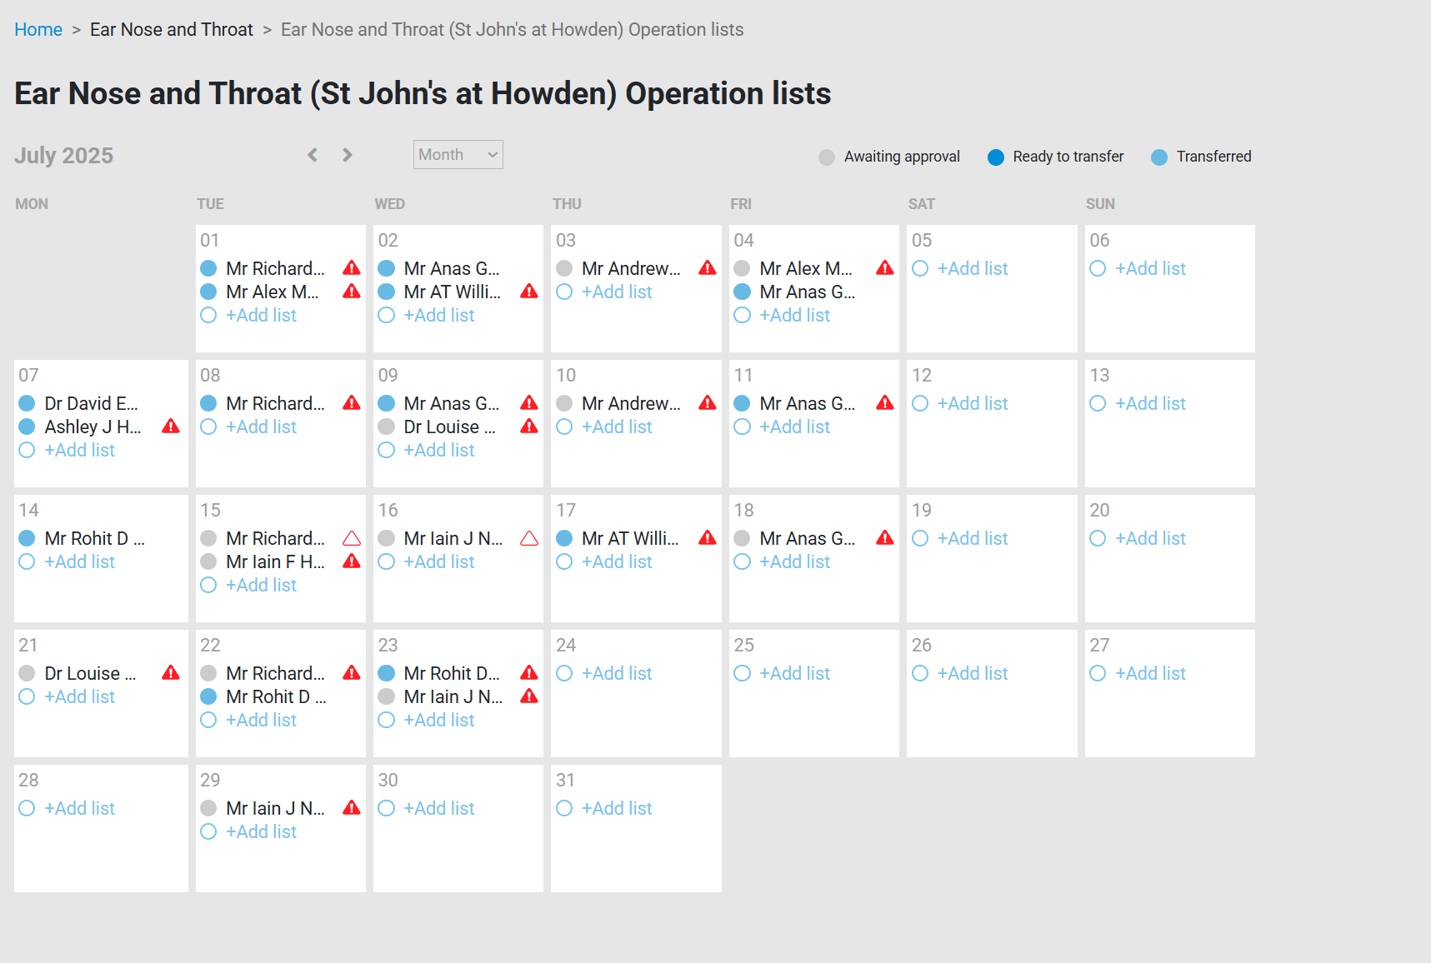

How can infix target improvements
Despite warning teams there are under booked lists, services continue to ignore and miss opportunities to increase productivity

Slide 11
Data Expertise – Predictive, data-driven solution
As quoted by world leading expert in theatre efficiency, Prof. Jaideep Pandit, Anaesthesia Consultant at the University of Oxford Hospital, this is the 1st time he has seen data that allows a prospectively comparison of the prediction of operation times by surgeons compared to digital theatre scheduling software.
Prof. Jaideep Pandit is currently writing an academic paper on the results Infix have collected over the last 3 years.
As shown by the example in ENT surgery, the surgeons’ prediction are overinflated to the time that OT actual run. This manual prediction process results in significant inefficiencies in OT utilisation.
With the use of Infix Schedule data driven predictive solution our accuracy consistently achieves over 91%, compared to that of the surgeons 81%.
Feb 2023
Aug 2023
Feb 2024
Aug 2024

Slide 12
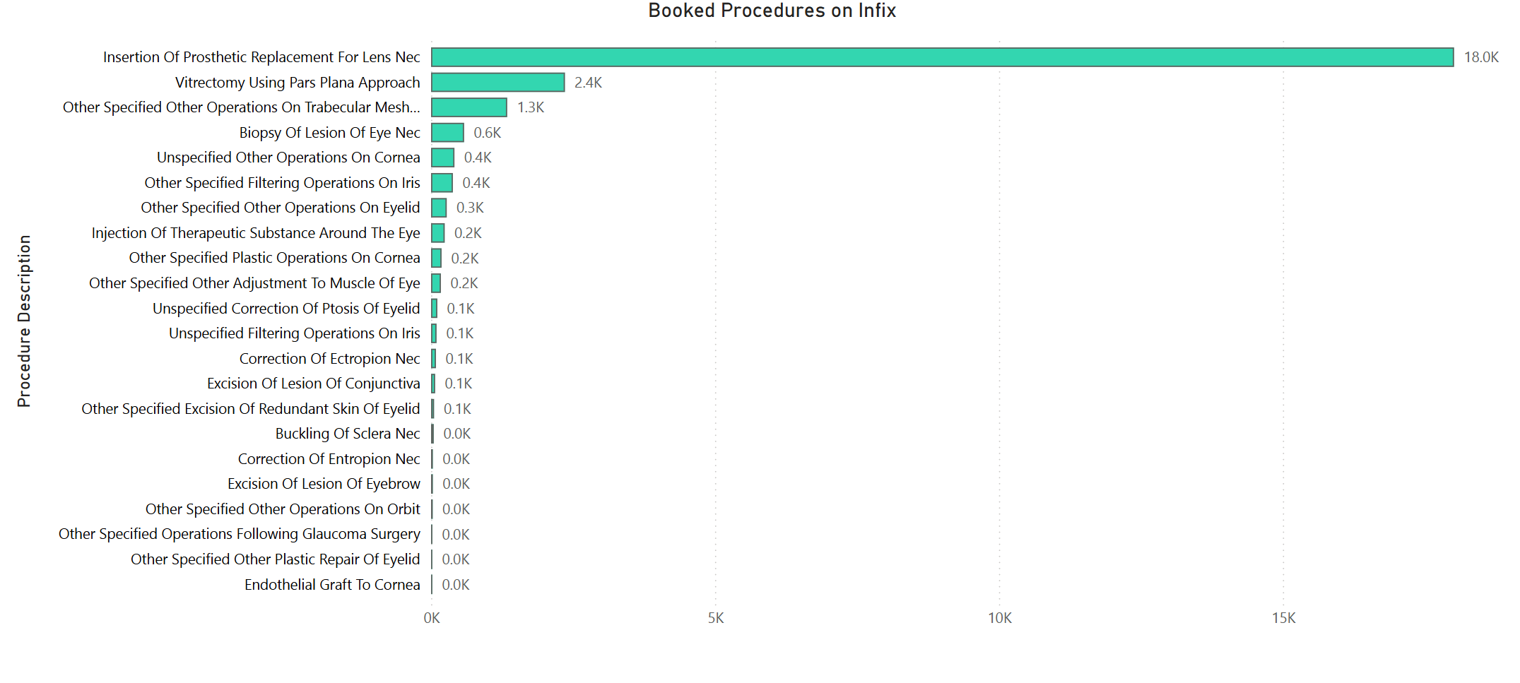
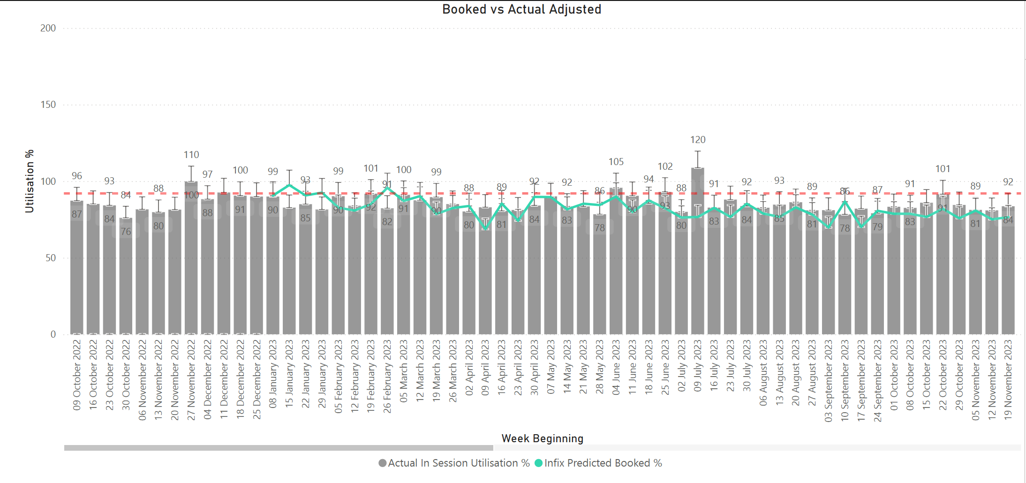
Surgical coding – the good
Ophthalmology is one of the specialities with the closest correlation of predicted operation times vs actual operation times.
After 12 months of data collection it is noted the spread and specificity of the OPCS-4 codes is reflective of what has been booked by surgeons
This proves if the data entry is good the output (accuracy) is good.
This improvement in booking code and proper use of infix scheduling will result in significant improvements in theatre utilisation

Slide 13
Impact of work on improving data quality by infix
4-month work on surgical coding showed a significant improvement with Infix predictive accuracy

Slide 14
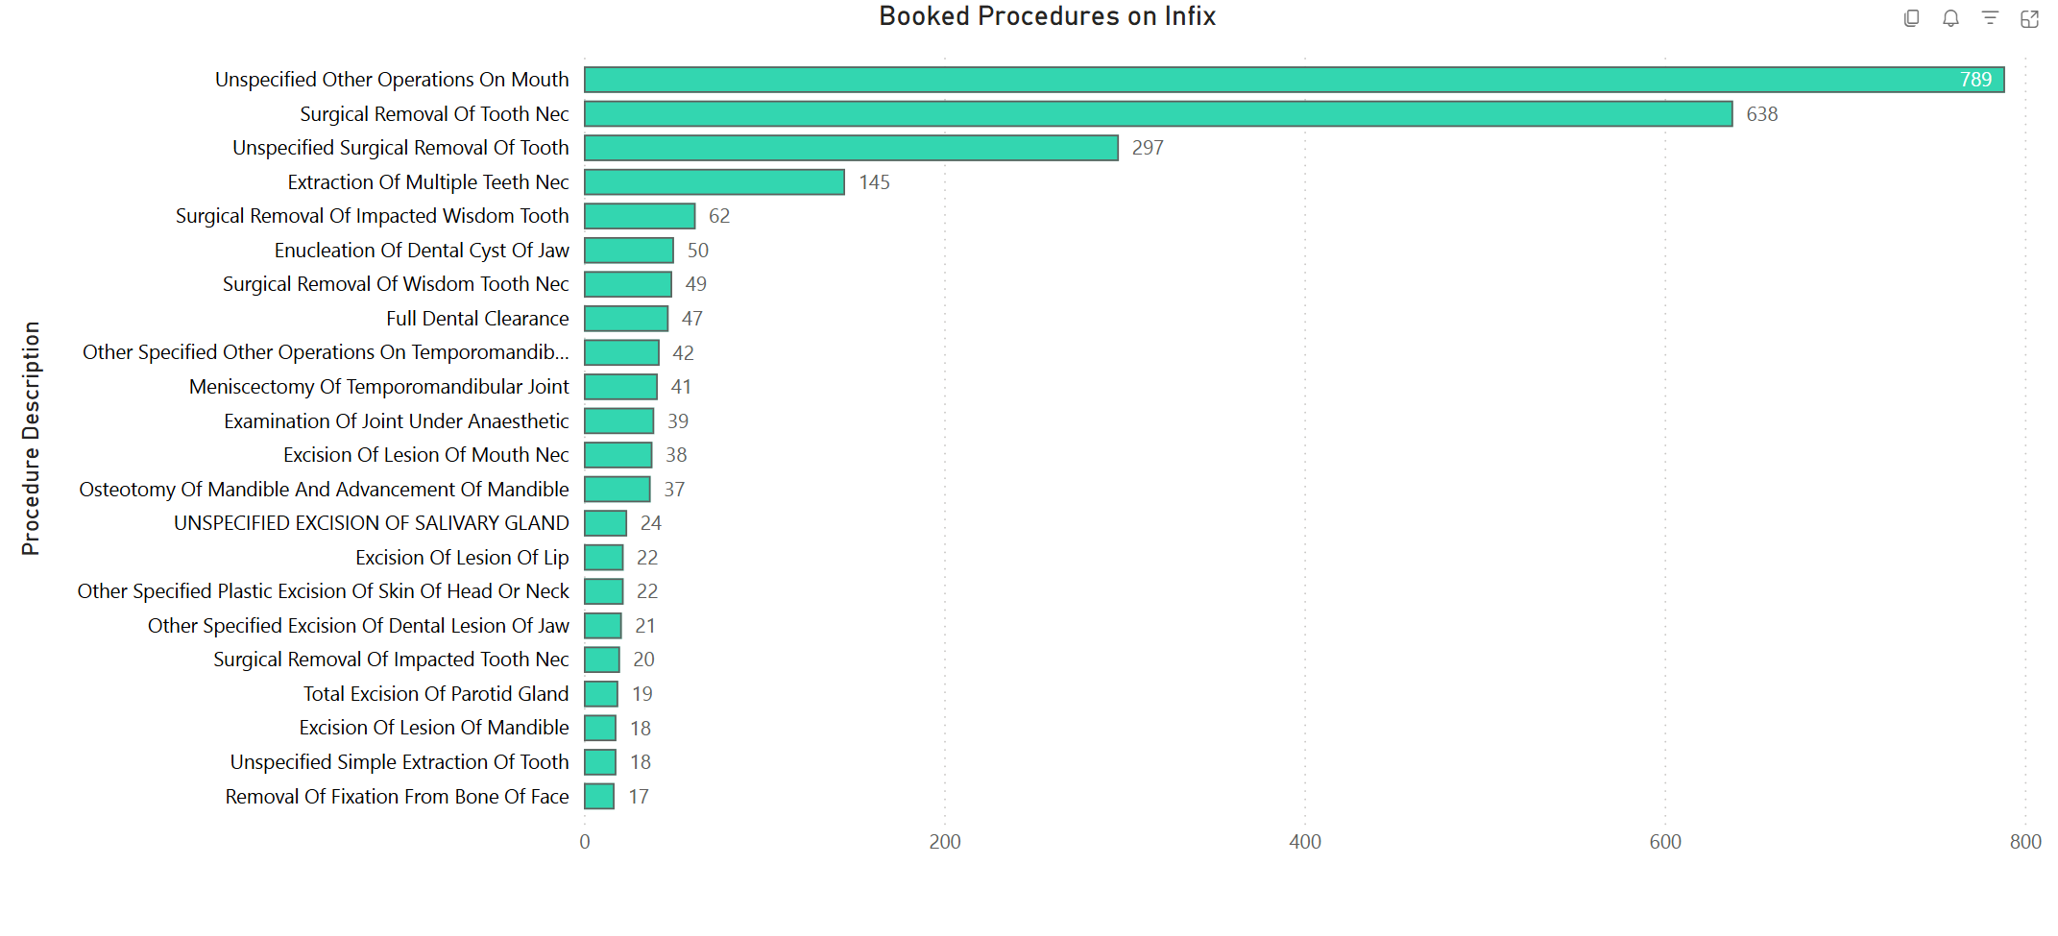
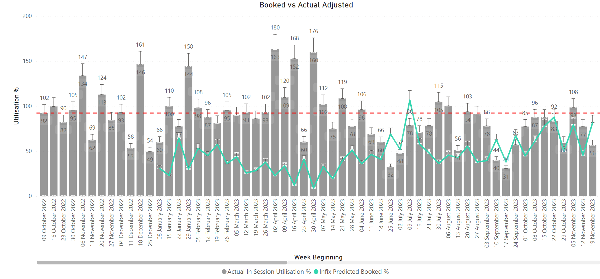
Surgical coding – the bad
Despite awareness, training and improvement of TrakCare coding, Maxillofacial surgery still has the worst OPCS-4 coding at the point of booking.
This is a mixture of old behaviours and lack of ownership from the clinical team. A variation in codes have been added but still not used.
As seen the most common procedure is generic and not specific to a surgical procedure
This data proves if data entry is poor then the output is inaccurate and unable to achieve the benefits the software can deliver

Slide 16
Data Expertise – Infix AI analysis tool
Infix use AI modelling to continue to evaluate and improve the software to ensure consistently high standards of prediction.
With our AI analysis tool, we can run multiple scenarios to check the predicted national times with local variants to the specific hospital. The results shown in the graph indicated the one of our hospitals should switch to our database of local times. This has resulted in average accuracy levels of 94% over a 4-month period.
Our software can switch to these new database of times overnight which will ensure Infix Schedule is always maximising the OT optimisation.
We have also run scenarios to check the health of surgical procedure codes and in 1 hospital in NHS Scotland we improved OT prediction in urology surgery by 9.6% by replacing a commonly used wrong code at point of booking.

Slide 17
Thank you
For more information please contact:
Matthew Freer, CEO matt@infixsupport.com
www.infixsupport.com

