Slide 1
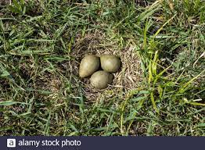
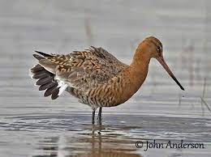
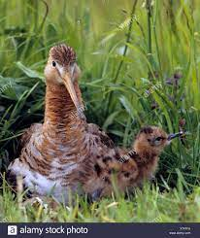
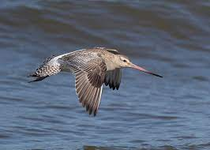
Inferring successful breeding of a precocial bird with tracking data
Matthew Duggan, Luke R. Wilde, Mo A. Verhoeven, Theunis Piersma, and Nathan R. Senner
Incubating
Foraging
Chick Tending
Migrating

