Slide 1
Path Tracking & Control
Turning a state estimate into a steering command
Notes:
Open here. Remind them where we are in the arc: 4.2 detected per frame, N1 fused the sensors, N2 estimated, N3 tracked. Every one of those is PERCEPTION — understanding the world. This lecture is the pivot to ACTION: turning that understanding into a steering command. Keep it to ~30 min; the depth is in the notebook.

Slide 2
From estimate to action
N2 said the filter is an observer, not a controller — the controller is the next module. N3 hands us tracked objects; now we act.
• Input: a reference path + the vehicle's state
• Output: a steering angle, every timestep
• Two classical geometric controllers, no learning
Notes:
Call back explicitly to N2's last slide ('an observer, not a controller'). That module IS this lecture. Frame the job narrowly: we are NOT planning the route (that was 4.2's A*); we are EXECUTING it — given a path and where we are, output a steering angle each tick. Stress 'no learning': these are 1980s-90s geometry, still shipping in real cars today, because they're simple and debuggable. Set up the two we'll cover: pure pursuit and Stanley.

Slide 3
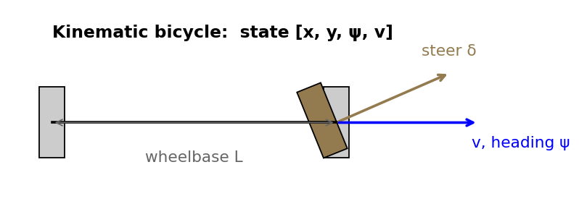
Kinematic bicycle model
A tractable stand-in for vehicle dynamics.
• State [x, y, heading, v]
• Controls: steering δ and acceleration
• One step forward = bicycle_step
Notes:
Motivate the abstraction: a real car has 4 wheels, suspension, tire slip — intractable. The bicycle model collapses each axle to one wheel and ignores slip (valid at workshop speeds). Point at the figure: rear axle is the reference point, the front wheel turns by delta, wheelbase L sets how sharply heading changes. Four numbers describe the car: position x,y, heading psi, speed v. Two inputs: steering and acceleration. Tell them the equations are next.

Slide 4
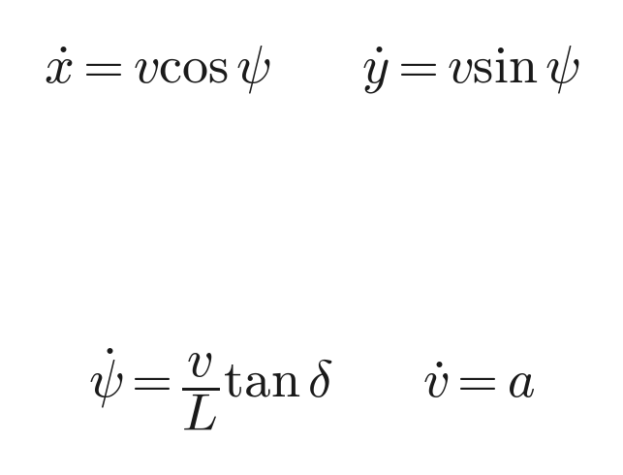
The bicycle model in equations
Four states, two controls — integrate forward each tick.
x, y position; ψ heading; v speed
• δ steering and a acceleration are the inputs
• Stepped by Δt in bicycle_step — plain forward-Euler
Notes:
Walk the equations left to right. x-dot and y-dot: the car moves in the direction it's pointing at speed v — pure trigonometry. psi-dot = (v/L) tan(delta) is the only subtle one: turn the wheel and heading changes FASTER the faster you go and the SHORTER the wheelbase — that's why a bus needs a bigger turning circle than a go-kart. v-dot = a is just throttle/brake. Emphasize there's no force or mass here — it's KINEMATIC, geometry of motion, not dynamics. In code it's one Euler step; mention RK4 if someone asks about accuracy.

Slide 5
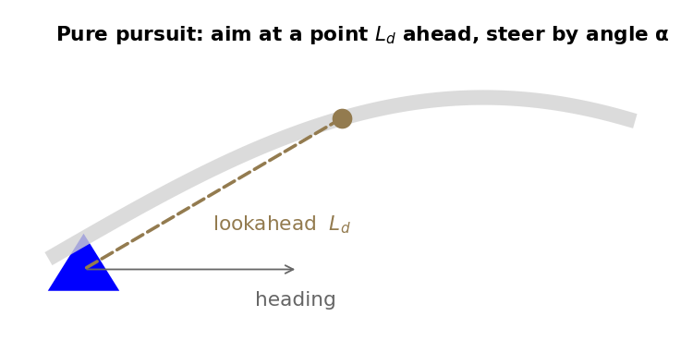
Pure pursuit
Aim at a point a fixed distance ahead and steer toward it.
• One knob: the lookahead L_d
• Short = twitchy; long = cuts corners
• δ = atan(2 L sin α / L_d)
Notes:
Best intuition: it's how a human drives — you don't stare at your bumper, you look down the road at a point and aim for it. Pick a point on the path a fixed distance L_d ahead (the figure), steer to follow a circular arc to it. The ONE knob is L_d. Make them feel the tradeoff before the math: short lookahead = you react to every wiggle = twitchy/oscillates; long lookahead = you smooth everything out but cut corners. This sets up the tuning-sweep slide.

Slide 6
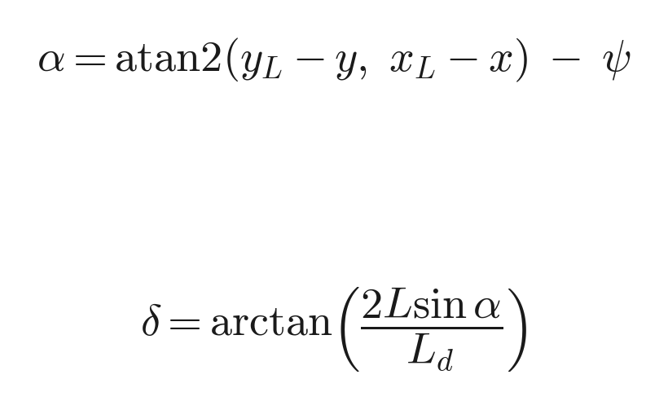
Pure pursuit, derived
Fit a circular arc through the rear axle and the lookahead point.
α = angle from the heading to the lookahead point
• Larger L_d ⇒ gentler steer (smaller curvature)
• Curvature κ = 2 sin α / L_d
Notes:
Two lines. First, alpha: the angle between where we're pointing and the lookahead point (atan2 of the relative position, minus our heading). Second, the steering law: delta = arctan(2L sin alpha / L_d). Where it comes from: there's a unique circle through the rear axle that passes through the lookahead point; its curvature is 2 sin(alpha)/L_d, and arctan(L * curvature) gives the wheel angle for the bicycle model. Don't belabor the geometry proof — the takeaway is delta falls out of pure geometry, and L_d in the denominator is exactly why bigger lookahead = gentler steering.

Slide 7
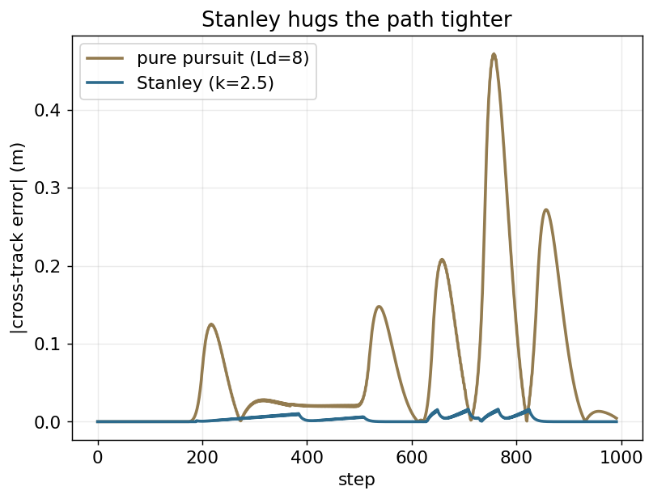
Stanley
Cancel heading error and cross-track error together.
• Steers from the FRONT axle
• Hugs the path harder than pure pursuit
• The DARPA Grand Challenge winner
Notes:
History hook: this is the controller on Stanley, the VW that won the 2005 DARPA Grand Challenge — students like that. Key difference from pure pursuit: it references the FRONT axle and it looks at TWO errors at once — how wrong the heading is AND how far off the path you are laterally. Point at the figure: Stanley's cross-track error curve sits lower than pure pursuit's — it hugs the path tighter. Trade-off: it can be more aggressive/sensitive to noise.

Slide 8
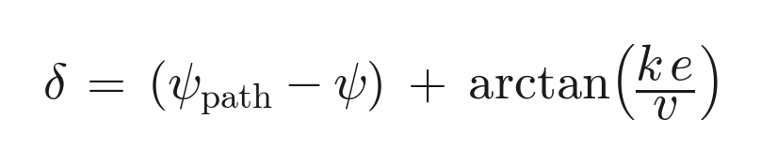
Stanley, the control law
Two terms: align the heading, then kill the lateral offset.
First term: path heading − vehicle heading (point the right way)
• Second term: cross-track error e, gain k, speed v (slide back onto the line)
• arctan bounds the correction; ÷v softens it at speed
Notes:
Read it as two jobs added together. Term one, (psi_path - psi): just align with the path's direction. Term two, arctan(k e / v): if you're off the line by e meters, steer back; gain k sets how hard. Two things to highlight: the arctan keeps the correction bounded (never commands an insane angle for a big error), and dividing by v means at high speed the SAME lateral error produces a GENTLER correction — which is what keeps it stable fast. Contrast with pure pursuit's single geometric law: Stanley is explicit error feedback.

Slide 9
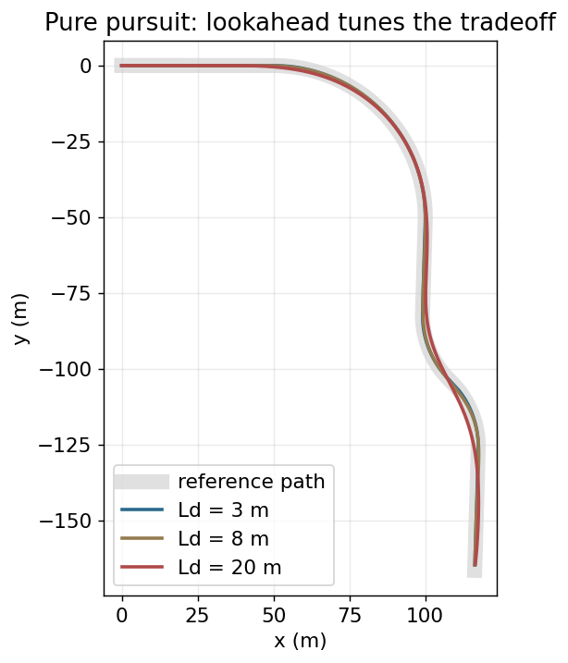
Tuning the tradeoff
Aggression vs stability vs accuracy.
• Sweep the lookahead, watch cross-track error
• Too short oscillates; too long drifts
• Real runs on the synthetic course
Notes:
This figure is REAL output from the notebook — three pure-pursuit runs at lookahead 3, 8, 20 m. Walk the curves: the short one tracks tightly but you can see it wiggling; the long one is smooth but bows out on the turns (cuts corners); 8 m is the sweet spot. The lesson generalizes to every controller: there's no free lunch, you trade responsiveness against smoothness, and the right value depends on speed. In the notebook they get to drag this knob themselves — encourage it.

Slide 10
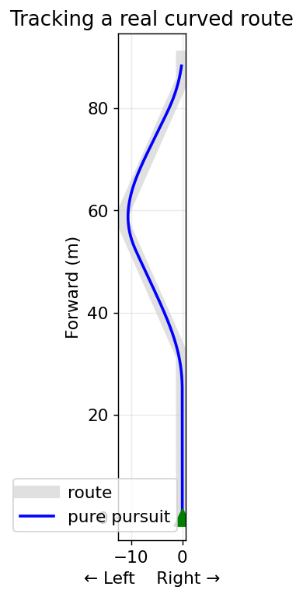
Tracking the real route
The synthetic course taught the controller; the capstone drives the real KITTI route (drive 0005).
• Same controller, real curved path
• Bird's-eye view in N3's convention (forward up)
• Hands directly to the capstone
Notes:
Close the lecture by grounding it. Everything so far was a clean synthetic course — good for LEARNING. But the same pure-pursuit code, unchanged, tracks the real trajectory the KITTI car drove (drive 0005). Point at the bird's-eye plot — note the convention flips to forward-UP to match N3, so the whole workshop shares one view. Then the hand-off: 'in the capstone we drive this exact route, but now there are cars in the way — that's where perception and control finally meet.' Transition to N5.

