Slide 1
Capstone: Navigate the Real Scene
Every subsystem, one closed loop, real obstacles
Notes:
Open the capstone by lowering the stakes on 'new material': there's almost none. This is INTEGRATION — every box is a notebook they already built. The novelty is the closed LOOP on real data, where small errors compound. Promise the payoff up front: a live demo where they tune knobs and watch the car thread real obstacles or clip one.

Slide 2
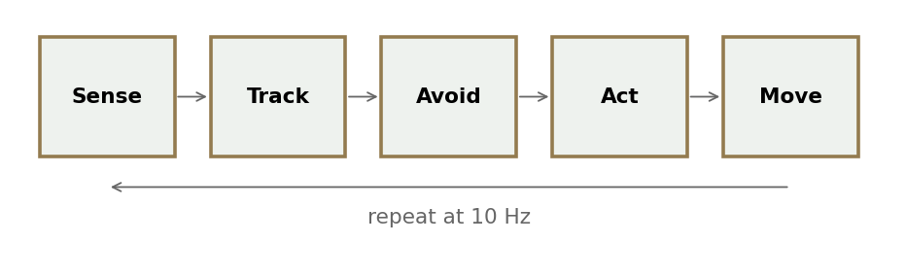
One loop, every piece
N1 fuse → N2 estimate → N3 track → N4 act, wired into one running loop on the real KITTI drive.
• No new theory — this is integration
• Real ego route, real-derived obstacles
• Emergent thread-or-clip outcomes
Notes:
Point at each box and name the notebook: Sense+Fuse = N1, Estimate = N2, Track = N3, Act = N4. The new word is 'loop' — control changes the next frame's perception, so unlike the isolated notebooks, errors COMPOUND here. That's the whole reason estimation and a safety layer matter. Stress 'emergent': we don't script a crash; outcomes fall out of the knobs you set. 10 Hz, deterministic given a seed.

Slide 3
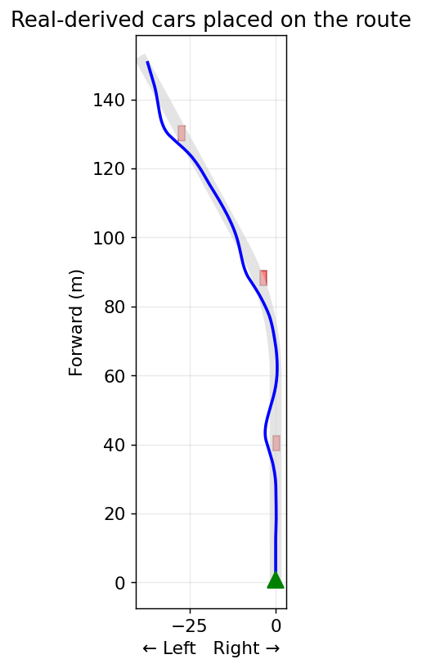
The obstacles are real (in spirit)
N3 detects cars at realistic sizes; we place them on the route so the ego must thread them.
• Car ≈ 4.2 × 1.8 × 1.5 m (from N3's clustering)
• Perceived with noise, then tracked
• Steer around the TRACKED positions
Notes:
Be honest about the modeling choice — students respect it. N3's REAL detections are mostly oncoming/parked traffic off to the sides; the recorded car drove a clear lane, so literally replaying them gives a boring demo. So we take the real SIZES (4.2x1.8x1.5 m straight from N3's clustering gates) and deliberately PLACE cars on the route. Crucial point: the ego doesn't get truth — it senses noisy detections and TRACKS them (reusing N3's tracker), then steers around the tracked estimate. That's why perception quality will matter in the blackout demo.

Slide 4
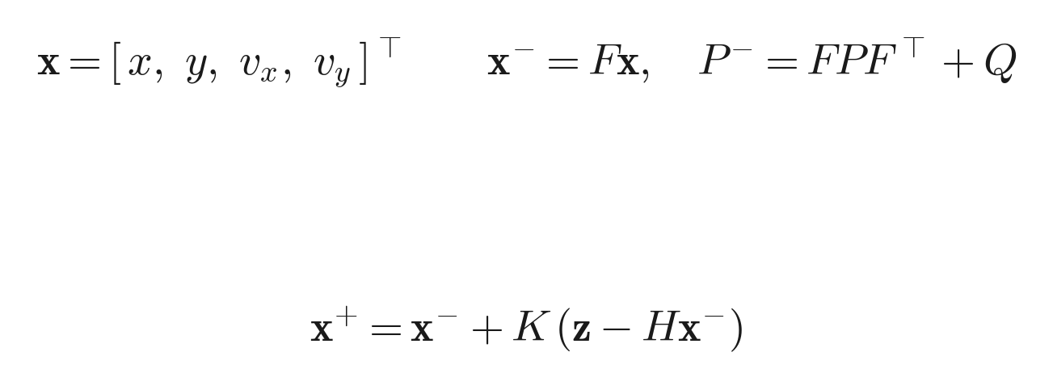
Tracking the obstacles: constant-velocity Kalman
The same N2 filter, one per obstacle, in the BEV plane.
State = position + velocity [x, y, vx, vy]
• Predict with F, correct with measurement z = [x, y]
• Hungarian assigns detections to tracks (gate 3 m)
Notes:
Reassure them: nothing new — this is N2's Kalman filter, verbatim, run once per obstacle in the bird's-eye plane. State is position AND velocity even though the cars are static, because the filter doesn't know that — it estimates velocity from the noisy detections (and it'll read near zero). Predict with the constant-velocity F, correct with the position measurement z. One extra piece from N3: when there are several cars you must decide which detection updates which track — that's the Hungarian assignment with a 3 m gate. Coasting under dropout is the same predict-without-update trick — foreshadow the blackout demo.

Slide 5
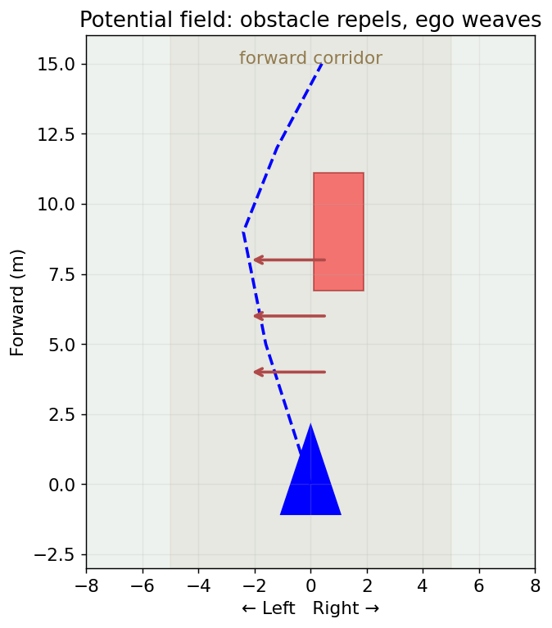
Steering around: potential field
Each obstacle in the corridor pushes the ego sideways; it weaves and re-centers.
• One gain to tune
• Pure-pursuit steer + repulsion bias
• Emergency brake if dead-ahead
Notes:
Analogy: imagine each obstacle gives off a 'wind' that pushes you sideways — stronger the closer and more head-on it is. Point at the figure: the obstacle in the forward corridor, the repulsion arrows, the resulting swerve. The ego steers with pure pursuit toward the path AND gets this sideways push; the sum makes it weave around and settle back. One knob: the gain. Keep the emergency brake as the backstop for the case it can't swerve in time (dead ahead). Note this is a REACTIVE method — no replanning — which is why it's cheap and runs every tick.

Slide 6
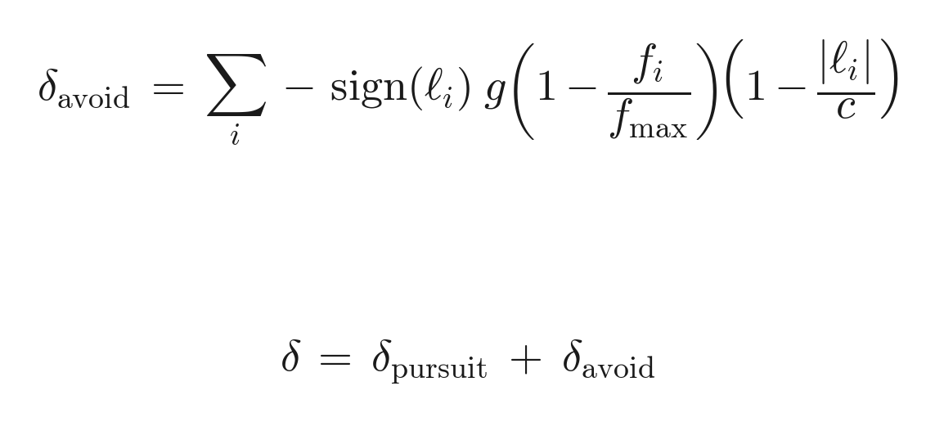
The repulsion field, in math
Each obstacle in the corridor adds a signed steering bias.
sign(ℓ) pushes AWAY from the obstacle's side
• Weighted by closeness (f) and centering (ℓ)
• Total steer δ = pursuit + avoidance
Notes:
Decode the formula piece by piece. The sum is over obstacles in the corridor. sign(l_i): l is the lateral offset — if the car is on your left (l>0) the minus-sign makes the bias negative = steer right, away from it. The two parenthesised factors are the weighting: (1 - f/f_max) means closer = stronger; (1 - |l|/c) means more head-on (small lateral) = stronger, edge-of-corridor = near zero so it fades smoothly. Then the punchline second line: the actual steer is just pursuit PLUS avoidance, clipped to the wheel limit. That superposition is the whole trick.

Slide 7
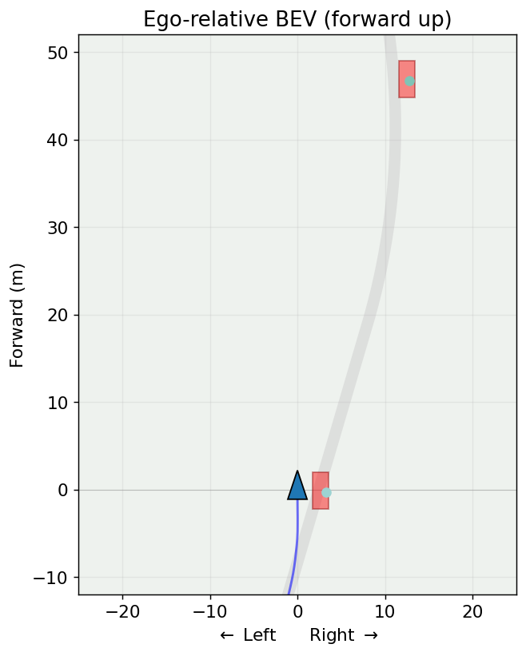
The bird's-eye view
Ego-relative — forward up, you near the bottom — exactly N3's BEV.
• Green = road, red = obstacle
• Tracked detections + a trajectory trail
• The real, curved KITTI route
Notes:
Orient them to the view since it's the one they'll stare at in the demo: forward is UP, you (blue triangle) sit near the bottom so you can see a little behind, the gray ribbon is the route, red boxes are obstacles, the blue trail is where you've been. It deliberately matches N3's bird's-eye convention so the whole workshop shares one mental picture. Mention the trail toggle — it's great for seeing WHAT the controller did after the fact.

Slide 8
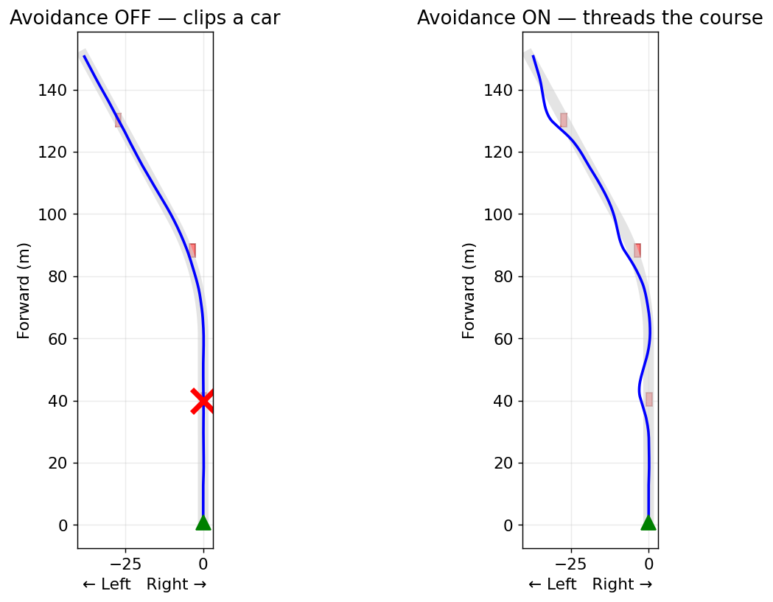
Live demo: tune the knobs
Set the controls, render, watch it thread or clip.
• Avoidance gain, lookahead, speed
• Number of cars / layout seed
• Sensor noise / blackout
Notes:
This is the heart of the session — spend real time here, live. The figure is the money shot: avoidance OFF the ego drives straight into a car (red X); ON it weaves through. Demo script: (1) start with avoidance ON, clean thread; (2) turn avoidance OFF -> clip, to motivate why we built it; (3) back ON, then crank sensor noise or open a BLACKOUT window and watch it clip a car it can't see — that's the 'estimation quality gates safety' lesson made visceral; (4) push the avoidance gain too high and show oscillation. Then hand it to them: 'now you break it.'

Slide 9
What you built
A perception-to-control stack on real data — sense, fuse, estimate, track, act.
• Modular and auditable
• Each piece swappable behind a clean interface
• The frontier learns these pieces end-to-end
Notes:
Land the plane. Restate the arc one last time — they personally built every stage, on real KITTI data, and wired it into a loop that drives. The meta-lesson is MODULARITY: each piece sat behind a clean interface, so you can swap the detector or the controller without touching the rest — exactly why production autonomy stacks are built this way and stay auditable. One forward-looking sentence: the frontier (end-to-end learned driving) replaces these hand-built boxes with one network — higher ceiling, but you lose the ability to inspect WHY it did something. Thank them; send them to the notebook to go break the simulator.

