Slide 1
Camera–LiDAR Projection & Back-Projection
Mapping 3D point clouds into the image plane — and back

Slide 2
Camera–LiDAR Projection & Back-Projection
A camera sees everything but knows no distances. A LiDAR measures distances but sees almost nothing.
Projection is the bridge: a chain of matrices that maps any 3D LiDAR point onto its camera pixel, and, with one extra constraint, back again.
Three building blocks, then the applications:
Geometry — coordinate frames, homogeneous transforms, the pinhole camera · slides 3–6
The projection chain — KITTI’s calibration matrices and forward projection · slides 7–12
Back-projection — the ground-plane constraint, calibration sensitivity · slides 13–18
No vision background needed — we keep it basic and focus on exactly what notebook N1 implements on a real KITTI drive.
2

Slide 3
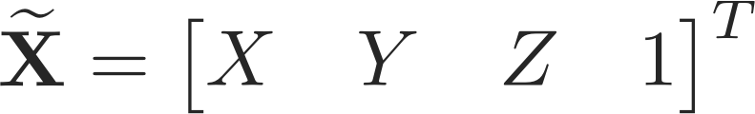
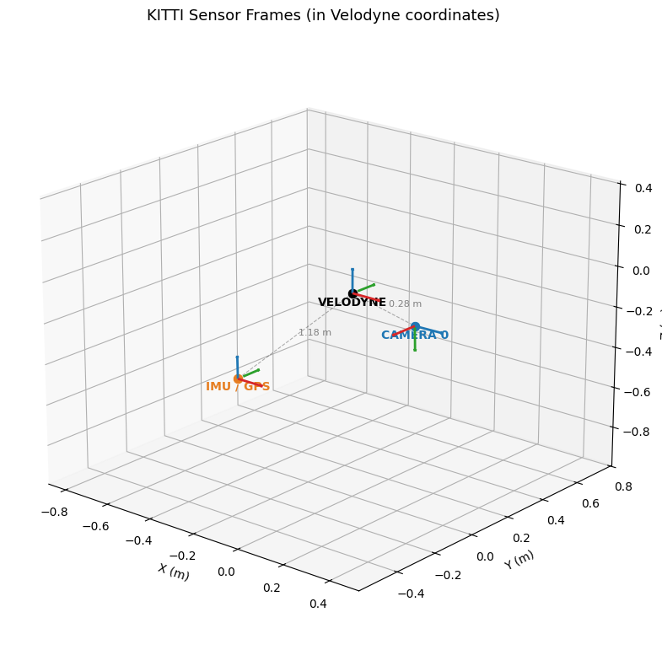

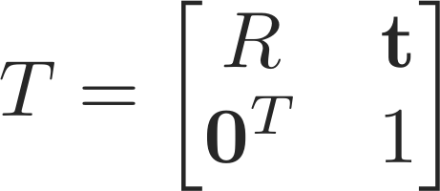
Geometry: Homogeneous Coordinates
A 3D point is written in homogeneous form by appending a 1:
A rigid-body transform moves a point between sensor frames — a rotation followed by a translation:
Stacking R and t into a single 4×4 matrix lets entire transform chains collapse into one multiplication:
3

Slide 4
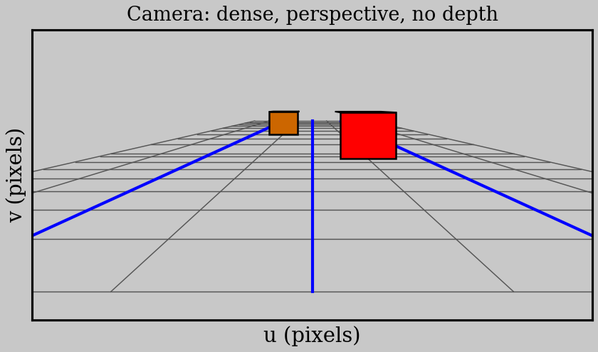
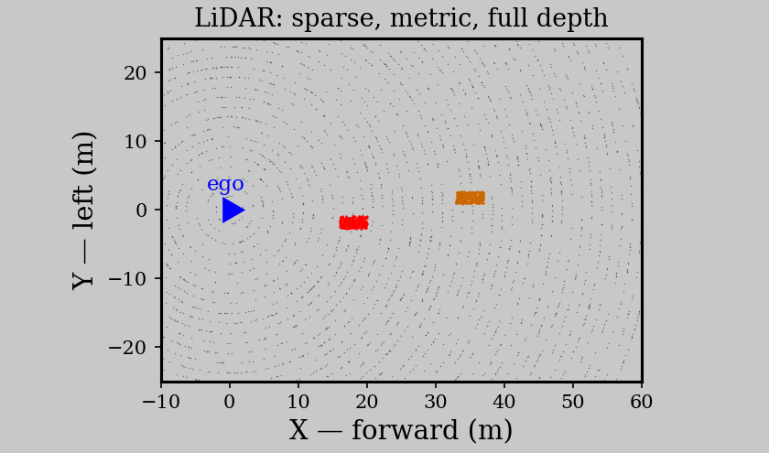
Two Sensors, Two Geometries
The camera flattens the world — both cars look adjacent; their depths are gone.
The LiDAR keeps the metric layout — 18 m and 35 m ahead — but samples sparsely.
Fusion needs a precise map between the two frames — that map is the projection chain.
4

Slide 5
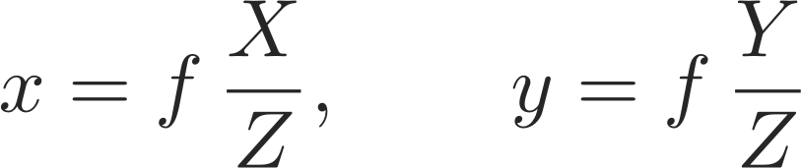
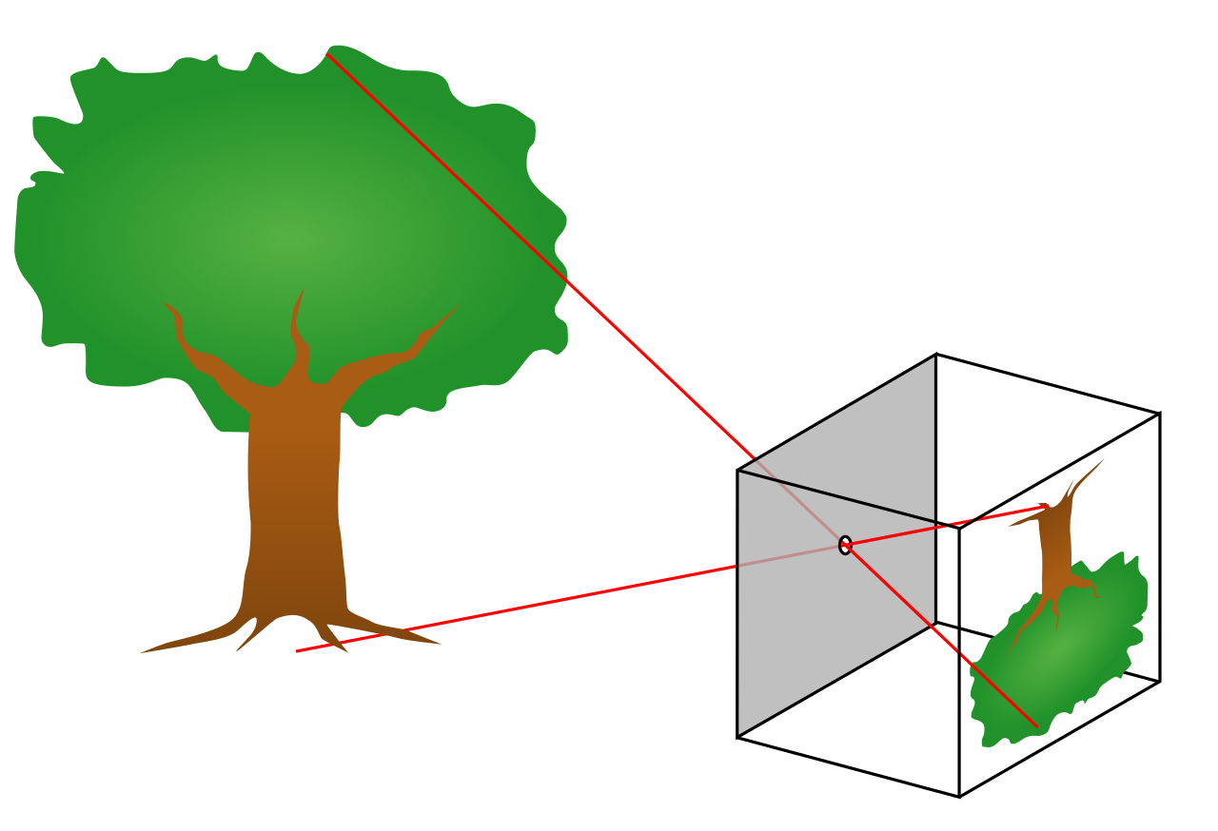
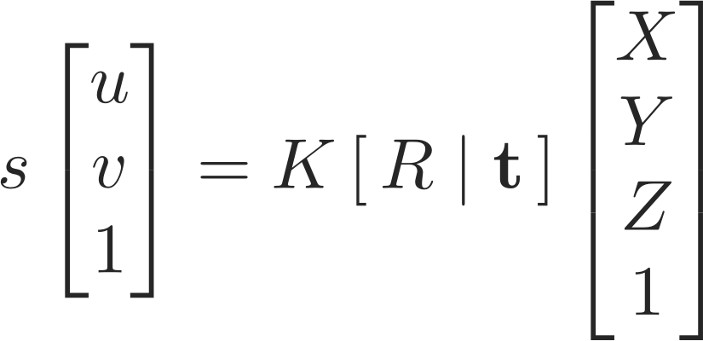
The Pinhole Camera Model
Light passes through one point — the optical center. Similar triangles divide every coordinate by depth:
In matrix form — intrinsics K times extrinsics [R | t], in homogeneous coordinates:
Read s as the depth — dividing by it is exactly what erases distance from the image.
5

Slide 6
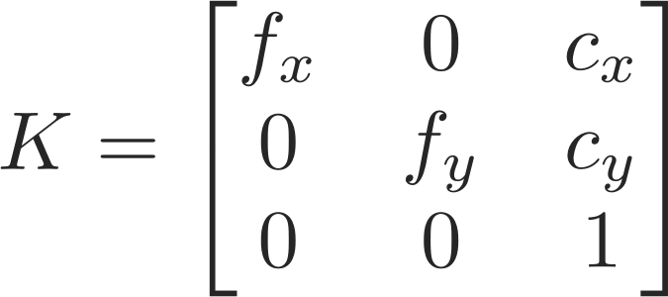
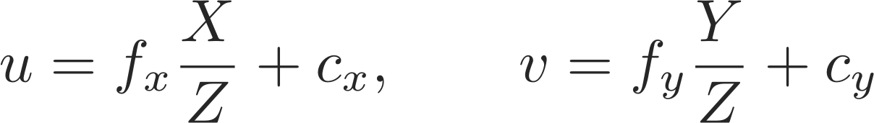
The Intrinsic Matrix K
K gathers the camera’s internal geometry — focal lengths and principal point — into one matrix:
Applying K after the perspective divide gives the pixel coordinates explicitly:
fx and fy are focal lengths in pixels — they scale lateral offset per unit depth into pixels.
(cx, cy) is the principal point — roughly the image center, where the optical axis pierces the sensor. For KITTI’s camera 2: fx ≈ fy ≈ 720 px.
6

Slide 7

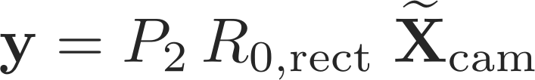
The KITTI Transform Chain
To reach the image, a LiDAR point passes through two stages — each one a matrix from the calibration files:
Extrinsics — frame to frame
Rectification + projection — frame to pixels
Only valid for points in front of the camera — points behind it project to phantom pixels.
Frame conventions: Velodyne is X-forward, Y-left, Z-up; the camera is X-right, Y-down, Z-forward — the rotation in T handles the axis swap.
7

Slide 8
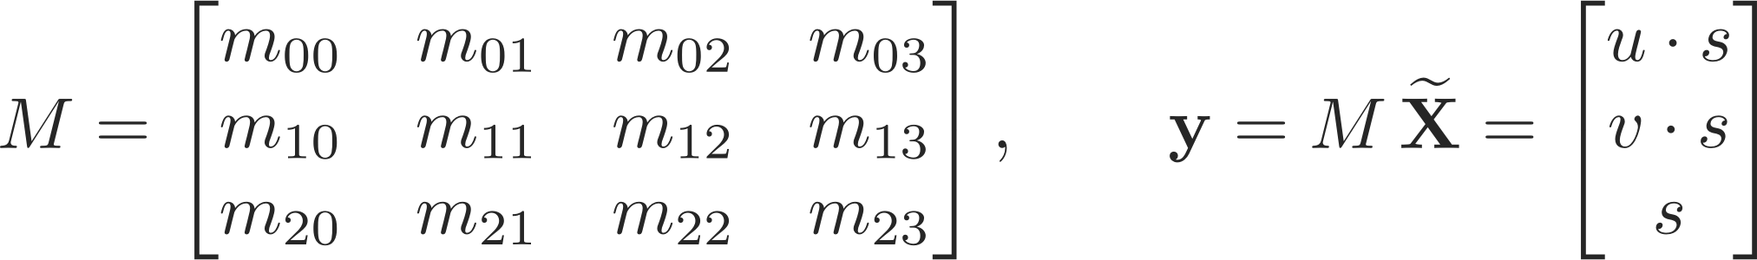
The Combined Projection Matrix M
Multiplying the chain once gives a single 3×4 matrix that is applied to every point in the scan:
Writing out its twelve elements — these mᵢⱼ are everything back-projection will need later:
8

Slide 9
What Projection Gives You — and Loses
Forward projection hands every LiDAR point two things: a pixel (u, v) and its depth s.
The image alone keeps only (u, v). The depth was divided out — infinitely many 3D points along one ray land on the same pixel.
How to recover 3D from a pixel:
A second sensor — LiDAR or stereo supplies the missing depth directly
A geometric constraint — pin the point to a known plane, like the road surface
No constraint, no 3D — a lone pixel is a direction, never a position
This asymmetry shapes the whole notebook: 3D → 2D is mechanical matrix multiplication; 2D → 3D is only possible because we add knowledge the image lost.
9

Slide 10
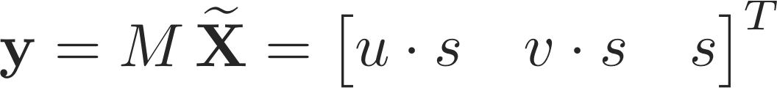
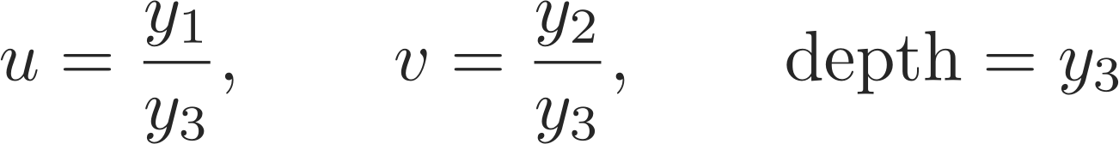
Forward Projection in Practice
Lift each point to homogeneous form and apply M — one matrix multiply for the whole scan:
Divide by the third component to land on the image — and keep the depth as a bonus output:
Then keep only the points that are actually visible — positive depth, inside the image bounds:
Filter first: drop points with X ≤ 0 in the Velodyne frame — half the 360° scan is behind the camera and would otherwise project to phantom pixels.
10

Slide 11
Before You Can Project
Every projection in the notebook is built from three calibration inputs:
1. The extrinsic transform Tr_velo_to_cam (4×4) — LiDAR frame to camera frame
2. The rectifying rotation R0_rect — aligns the stereo camera axes
3. The projection matrix P2 (3×4) — camera 2 intrinsics plus its stereo baseline offset
Never skip the depth check — a point behind the camera still divides to a valid-looking pixel, silently corrupting the overlay.
pykitti parses all of this for you — data.calib.T_cam0_velo, data.calib.R_rect_00, and data.calib.P_rect_20 — but check the shapes: R0 may arrive 3×3 or 4×4 depending on the version.
12

Slide 12

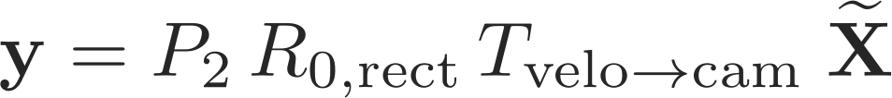
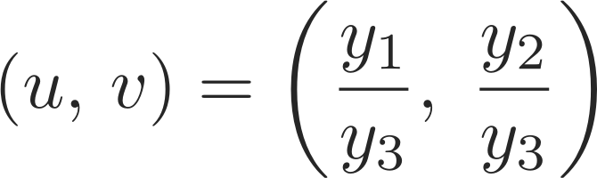
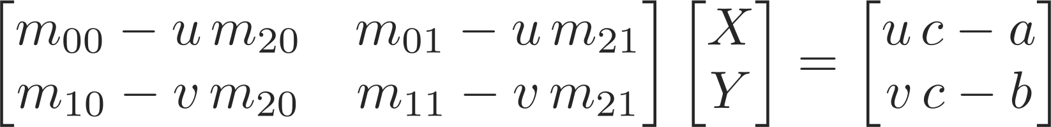
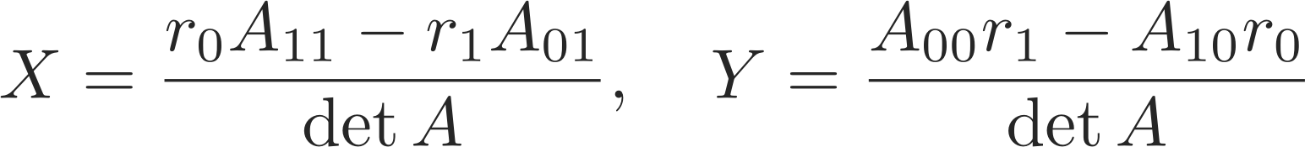

The Two Directions
One matrix M, two directions: project 3D into the image, or pin a pixel to the ground plane and solve back out.
Forward — every point, every frame
Backward — only with a constraint (Z = z_g)
13

Slide 13
Which Pixels Are Road?
Back-projection needs pixels to project — and only ground pixels obey the ground-plane constraint.
In KITTI scenes the road blends into the sidewalk — edge detectors see gradients, not meaning. We need a model that knows what things are.
SegFormer, trained on Cityscapes, labels every pixel:
19 classes — road, sidewalk, car, person, vegetation, sky, …
Lightweight — the B0 variant is ~15 MB and runs per frame in the notebook
Class 0 = road — mask the road pixels, back-project them, get a metric bird’s-eye view
Division of labor: segmentation decides which pixels matter; geometry decides where they are. Neither can do the other’s job.
15

Slide 14
Geometry First, Fusion Second
Tracking, depth completion, point painting — every fusion technique stands on the same projection chain you now know.
Notebook N1 runs all of it on a real KITTI drive: a hundred thousand points per scan, a real camera, the actual calibration files.
What you will build in the notebook:
Forward — project the scan onto the image, color points by depth, render fusion video
Backward — segment the road with SegFormer, back-project to a metric bird’s-eye view
Beyond — dense depth maps and a 3D point-painting viewer, all from the same M
Don’t worry if it hasn’t all clicked — notebook N1 ties the theory to working code, one cell at a time.
18

