Slide 1
Kalman Filters & Extended Kalman Filters
From noisy measurements to confident estimates

Slide 2
The Plan
A detection is a noisy guess about one frame. It has no memory and no confidence.
The Kalman filter turns a stream of noisy measurements into a state estimate that lives in time, with a confidence attached.
Three building blocks, then the algorithm:
Statistics — variance and the covariance matrix · slides 3–6
State-space models — and linearizing them with Jacobians · slides 7–8
The EKF algorithm — predict, update, tuning · slides 9–18
2

Slide 3
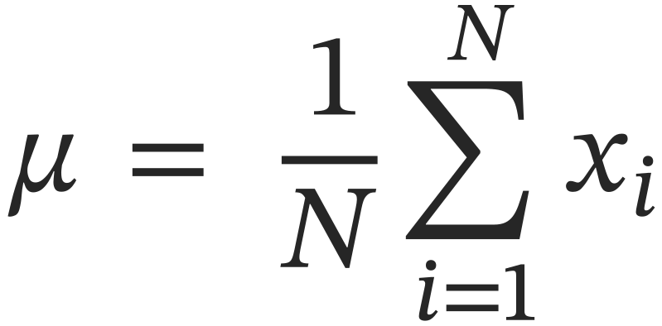
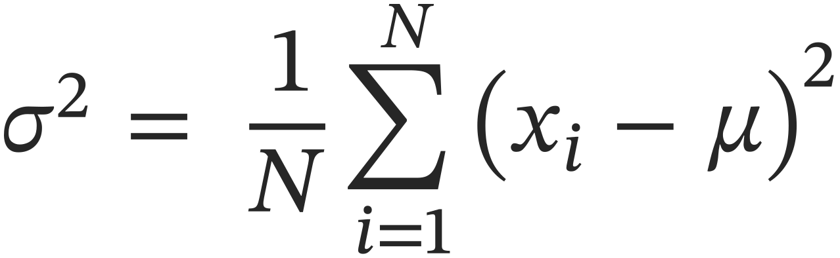
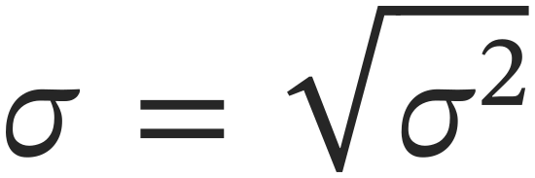
Statistics: Mean and Variance
The mean of a signal x is the average value over a number of samples N:
The variance is the average squared deviation from the mean:
The standard deviation is the square root of variance:
3
Notes:
Section 1: Statistics Refresher (0:00 – 6:00)
[SLIDE: Title]
Alright, so lets jump into the statistics If
[SLIDE: Mean and variance definitions]
So let's start with the mean of a random signal. The mean is just the average value over some number of samples. We take random samples of a variable x, add them all up, divide by the number of samples, and that gives us the mean, which we denote with the symbol mu.
The variance is the average squared deviation from that mean. We take the same samples we used to compute the mean, subtract the mean from each one, square those deviations, and average them. Variance is denoted sigma squared, and the standard deviation, sigma, is just the square root of the variance.
So what does standard deviation actually mean intuitively?
[SLIDE: Red and blue signal plot]
Here's an example. We've got two random signals, one red and one blue. Just by eye, you can guess which one has higher variance — the blue signal jumps around a lot more, so it has higher variance. But notice the means are different too: the blue signal is centered around zero, while the red one is centered around one.
[SLIDE: Probability densities]
If we plot the probability density of each signal, this is what we get. The red signal's bell curve is centered at one — that's its mean — and the blue one is centered at zero. Where the variance shows up is in how spread out each curve is. The blue signal varied a lot more, so its distribution is much wider, and that width is exactly what the standard deviation measures.
The one number worth memorizing here: the area under the curve from minus one sigma to plus one sigma is about 68 percent of the total probability. So when you grab a random sample, there's a 68 percent chance it lands within one standard deviation of the mean. Go out to three sigma and you've captured 99.7 percent. So sigma is, in a very concrete sense, a measurement of how random a signal is. And in Kalman filtering, this concept of variance is going to be everywhere.
[SLIDE: Expected value notation]
Now, one piece of notation. Rather than writing out the full summation every time, we're going to use the expected value, written as capital E of x. Mathematically, the expected value is what the mean converges to as the number of samples goes to infinity. So we define the mean as mu equals E of x, and the variance as sigma squared equals the expected value of x minus mu, quantity squared. Same concepts, more compact notation.
[SLIDE: Multivariate case — covariance matrix]
Everything so far is for a single variable: one scalar mean, one scalar variance. But in Kalman filtering, we're going to be tracking multiple random variables at once, and those variables might be correlated with each other. So we need to extend these ideas to the multivariate case.
The mean is easy: with three variables, the mean is just a three-element vector — the expected value of each variable individually.
The variance is where it gets interesting. With multiple variables, instead of a scalar sigma squared, we get a covariance matrix, capital sigma. It's defined as the expected value of the sample vector minus the mean vector, times that same thing transposed. A column vector times a row vector — that expands into a square matrix, n by n for n variables, and it's always symmetric.
Here's the part I want you to remember, because it's the key to everything we do later:
The diagonal elements of the covariance matrix are the individual variances of each variable. The off-diagonal elements are the cross-covariances — how much one variable moves with another.
If your variables are completely independent — one changes and the other doesn't care — the off-diagonals come out close to zero. And in Kalman filtering, that's exactly the simplification we're going to make: we'll set the diagonal elements and leave everything off-diagonal at zero, unless we have a really good reason not to.
So that's the statistics. Means, variances, and the covariance matrix with its all-important diagonal.

Slide 4
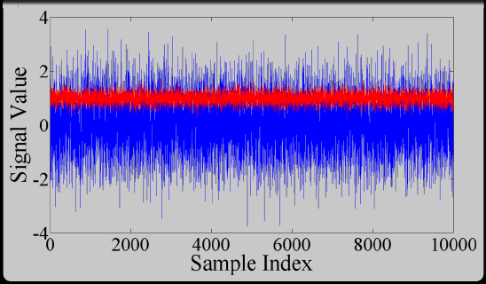
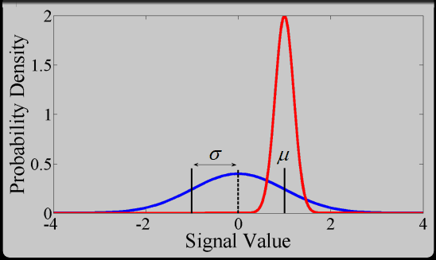
Two Random Signals
The blue signal varies more — higher variance, wider density.
μ centers the bell curve; σ sets its width.
±1σ covers about 68% of samples; ±3σ covers 99.7%.
4
Notes:
Here's an example. We've got two random signals, one red and one blue. Just by eye, you can guess which one has higher variance — the blue signal jumps around a lot more, so it has higher variance. But notice the means are different too: the blue signal is centered around zero, while the red one is centered around one. If we plot the probability density of each signal, this is what we get. The red signal's bell curve is centered at one — that's its mean — and the blue one is centered at zero. Where the variance shows up is in how spread out each curve is. The blue signal varied a lot more, so its distribution is much wider, and that width is exactly what the standard deviation measures.
The one number worth memorizing here: the area under the curve from minus one sigma to plus one sigma is about 68 percent of the total probability. So when you grab a random sample, there's a 68 percent chance it lands within one standard deviation of the mean. Go out to three sigma and you've captured 99.7 percent. So sigma is, in a very concrete sense, a measurement of how random a signal is. And in Kalman filtering, this concept of variance is going to be everywhere.

Slide 5
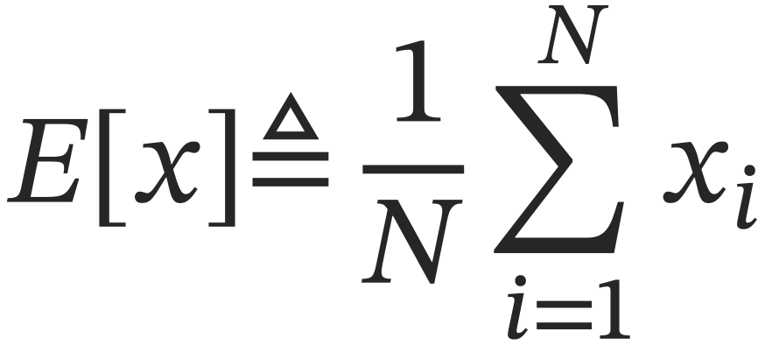
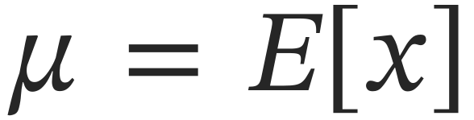
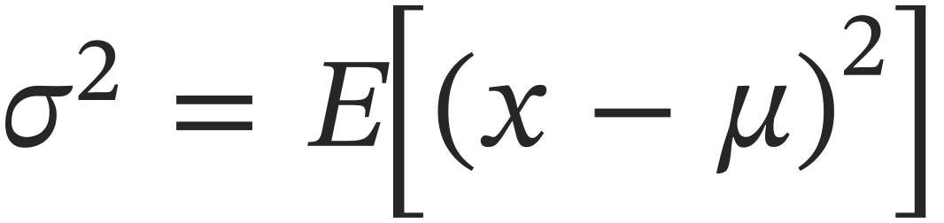
Statistics: Expected Value
The summation notation can be replaced by defining the expected value of a signal x:
Using expected value notation, the mean and variance become:
Read E[x] as the mean over infinitely many samples.
5
Notes:
Now, one piece of notation. Rather than writing out the full summation every time, we're going to use the expected value, written as capital E of x. Mathematically, the expected value is what the mean converges to as the number of samples goes to infinity. So we define the mean as mu equals E of x, and the variance as sigma squared equals the expected value of x minus mu, quantity squared. Same concepts, more compact notation.

Slide 6
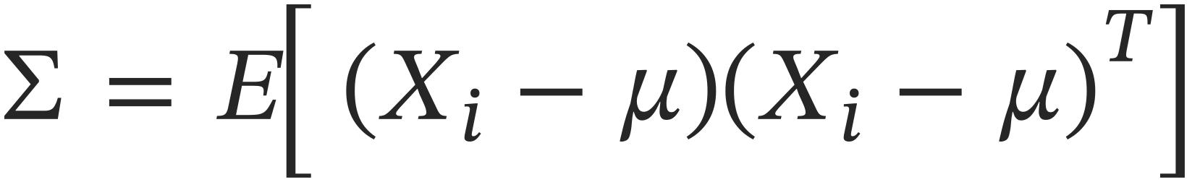
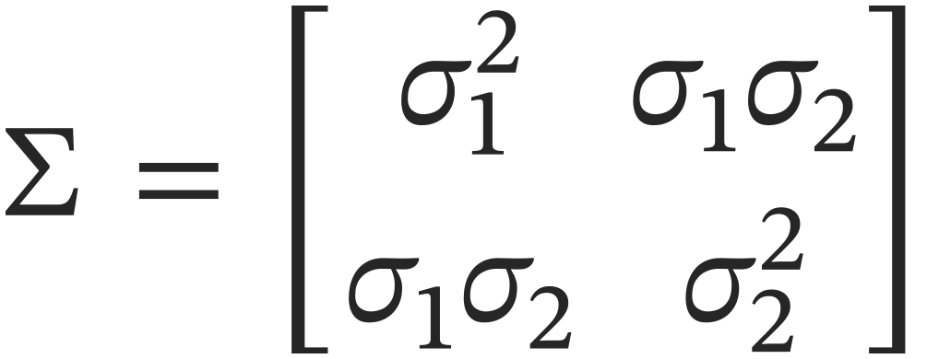
Statistics: The Covariance Matrix
In the multivariate case, the mean is a vector containing each variable’s average; the covariance matrix adapts variance to multiple variables:
To see how covariance is a matrix, expand the two-variable case:
Diagonal elements are the variances of the individual variables.
Off-diagonal elements are the cross-covariance between variables, zero when the variables are independent.
6
Notes:
Everything so far is for a single variable: one scalar mean, one scalar variance. But in Kalman filtering, we're going to be tracking multiple random variables at once, and those variables might be correlated with each other. So we need to extend these ideas to the multivariate case.
The mean is easy: with three variables, the mean is just a three-element vector — the expected value of each variable individually.
The variance is where it gets interesting. With multiple variables, instead of a scalar sigma squared, we get a covariance matrix, capital sigma. It's defined as the expected value of the sample vector minus the mean vector, times that same thing transposed. A column vector times a row vector — that expands into a square matrix, n by n for n variables, and it's always symmetric.
Here's the part I want you to remember, because it's the key to everything we do later:
The diagonal elements of the covariance matrix are the individual variances of each variable. The off-diagonal elements are the cross-covariances — how much one variable moves with another.
If your variables are completely independent — one changes and the other doesn't care — the off-diagonals come out close to zero. And in Kalman filtering, that's exactly the simplification we're going to make: we'll set the diagonal elements and leave everything off-diagonal at zero, unless we have a really good reason not to.
So that's the statistics. Means, variances, and the covariance matrix with its all-important diagonal.

Slide 7
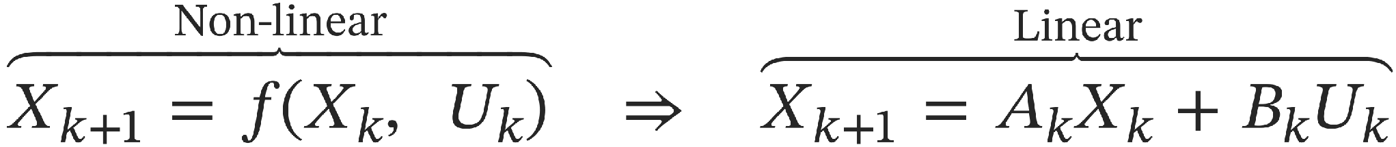
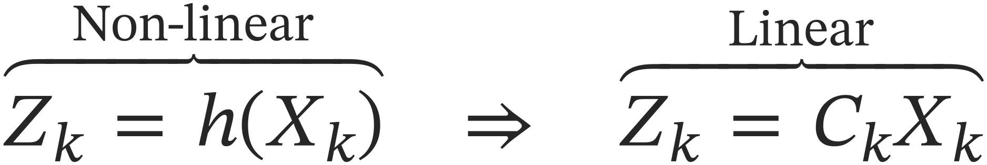
State Space Linearization
For use in the EKF algorithm, the state space equations need to be linearized:
State equation
Observation equation
Only possible if f and h are differentiable.
For our tracker: X holds x, y position and velocity (4×1); Z is the lidar x, y position (2×1); U = 0 — no control inputs.
7
Notes:
how do we go from f(x) to the linear form? is F the state transition matrix? The second ingredient we need is a state-space model of the system, and we need to know how to linearize it.
Here's the idea. The way a Kalman filter works is that you describe a model of how your system updates through time. We write that in this very generic form: x at step k plus one equals some function f of x at step k and the inputs u at step k.
That x is the state vector — it's a vector of every aspect of the system we want to keep track of. For our lidar object tracking application, the state is going to be four values: x position, y position, x velocity, and y velocity. So a four-element vector — two elements for position, two for velocity.
The function f describes how those values progress through time. In our case, we're not going to have any control inputs — we're just passively observing how an object moves — so the u term drops out. But the whole point of f is: plug in the current state, and it tells you what the next state looks like.
Now, f could be literally anything. It could have cosines and sines in it, any kind of nonlinear function. But here's the catch: you can't use a nonlinear f directly in the Kalman filter algorithm. You have to linearize it first, into this form: x at k plus one equals a matrix A times the current state, plus a matrix B times the current inputs. And notice the A has a k subscript — the A matrix is allowed to change over time, and that's going to matter in a few minutes.
The other piece of the state-space model is the observation equation. This describes how our sensor measurements relate to the state we're trying to estimate. We write z at step k equals some function h of the state.
For our application, z is a two-element vector: the x and y position of the cluster bounding box coming out of our lidar segmentation pipeline from notebook3. So we're tracking four states — position and velocity — but we only measure two of them: position.
Just like f, this h function could in general be nonlinear, and just like before, we have to linearize it into the form z equals a matrix C times the state. In our case, since the measurements literally are two of the states, that C matrix is just going to pick the position elements out of the state vector. Very simple. But we're setting up the general machinery first.

Slide 8
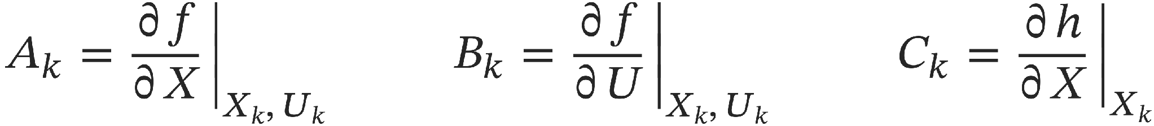
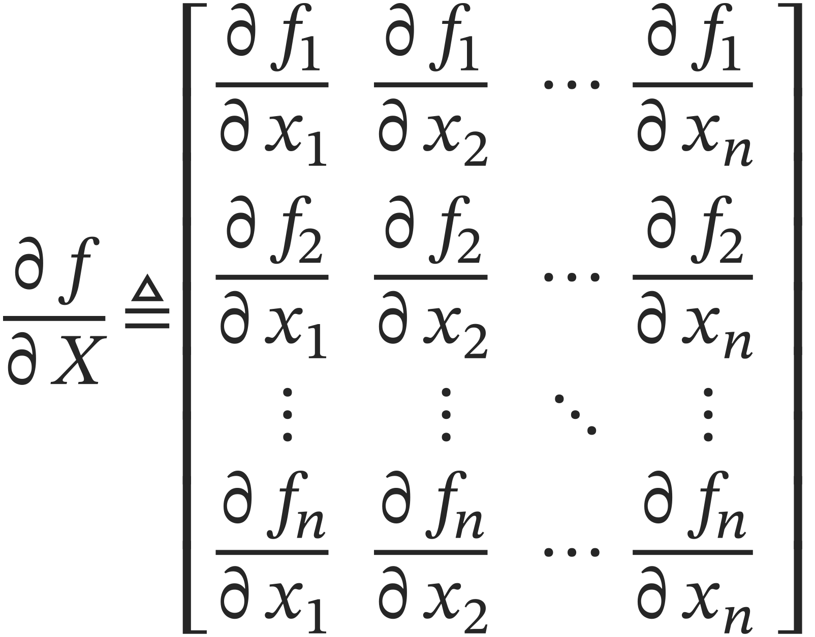
Linearization: The Jacobian
Each linearized matrix is a partial derivative of the model, evaluated at the current state:
Differentiating every function with respect to every state variable gives the Jacobian matrix:
8
Notes:
We know that we have to linearize the model but the question that still remains is: how to linearize it.
Here's the idea. A Kalman filter works on a model of how your system updates through time. We write that generically: X at step k plus one equals some function f of X at step k and the inputs U at step k.
That X is the state vector — everything we want to keep track of. For our lidar tracking application, four values: x position, y position, x velocity, y velocity. The function f describes how those values progress through time. We have no control inputs — we're passively watching an object move — so the U term drops out for us.
Now, f could be literally anything: cosines, sines, any nonlinear function. But you can't feed a nonlinear f directly into the Kalman filter algorithm. You have to linearize it first, into the form on the slide: next state equals a matrix A times the current state, plus B times the inputs. Notice the k subscript — A is allowed to change over time, and hold that thought, because it's going to matter in a few minutes.
Same story for the observation equation: Z equals h of X describes how sensor measurements relate to the state. For us, Z is two elements — the x-y position of the cluster bounding box from the homework-three lidar pipeline. We track four things, we measure two of them. And just like f, h gets linearized: Z equals a matrix C times the state.
[SLIDE 8: The Jacobian]
So how do you actually do this linearization? You take partial derivatives. But before I show you the recipe, I want to spend one minute on why partial derivatives linearize anything — because if you've never seen it, the recipe looks like magic, and it isn't.
Think back to one-dimensional calculus. Near a point, any smooth function is well-approximated by its tangent line: f of x is approximately f at x-naught, plus the derivative at x-naught times how far you've moved. That's the first-order Taylor expansion. And here's the framing I want you to carry: the derivative isn't just "the slope" — it is, by definition, the slope of the best straight-line stand-in for the function at that point. Zoom in far enough on any smooth curve and it looks straight. Taking the derivative IS finding the local linear approximation. Differentiation and linearization are not two related operations — they're the same operation.
Now lift that to vectors. With n state variables, the question "how does f change if I nudge the state a little?" no longer has a single slope as its answer. Nudging x-two changes f-one by some amount, changes f-two by a different amount, and so on — there are n-times-n slopes, one for every pairing of function and variable. Arrange them in a grid and you get exactly the matrix on the slide. Row i, column j answers one question: how sensitive is function i to a nudge in variable j?
If you've seen the term Jacobian matrix — this is exactly that. It's the slope of the tangent, in n dimensions, where the slope has to be a matrix. So the A matrix is the partial derivative of f with respect to the state vector, evaluated at the current state; C is the same procedure on the measurement function h; and if we had inputs, B would be the partials with respect to U — ours is zero.
Two consequences fall out of the tangent picture, and both matter.
First: a tangent is only good locally. It matches the curve at the point of tangency and drifts away as you move off. Remember that — it's about to explain the name "extended Kalman filter."
Second: the functions have to be differentiable. At a cusp — a point where the function jumps non-smoothly — there is no well-defined tangent, so there's nothing to linearize. You'd need something like piecewise linearization. We're not going down that road; for our application the functions are very kind to us.
Last note on this section: you'll see models written two ways — dots on top for time derivatives, and k indexes. Dots are the continuous-time model; indexes are discretized. My recommended workflow: design in continuous time first, because that's where the physics lives, then discretize for the computer — that's where the delta-t time step gets baked into your A matrix. You'll see exactly how in the example.

Slide 9
What the Filter Gives You
Every iteration produces two outputs, always together: an estimate and a confidence.
X̂ is the state estimate. P is its covariance: each diagonal element is the variance, the uncertainty, of one state’s estimate.
How to read P:
Big diagonal value — high variance: low confidence in that state
Consistent measurements — P shrinks: confidence grows over time
Never one without the other — estimate and covariance travel as a pair
The “extended” in EKF: the Jacobians A and C contain the state itself, so they are recomputed every step. That is how the filter rides along a nonlinear system.
9
Notes:
Okay. We've got our statistics, we've got our linearized state-space model. Now let's talk about what the Kalman filter actually does.
The filter operates on that linearized model and generates an estimate of the state vector, which we write as x with a little hat on it. But it never gives you just the estimate. Along with x-hat, it always produces a covariance matrix P that represents the uncertainty of that estimate.
P is square, n by n, and just like we discussed in the stats review, each diagonal element corresponds to the variance of one state in the estimate. Big number on the diagonal means high variance, which we interpret as the filter having low confidence in that particular state. As the filter runs and we keep feeding it sensor data, if the measurements are consistent with its internal model, that covariance shrinks — the filter is telling you it's getting more confident.
So the bottom line: a Kalman filter always gives you two things, an estimate and a confidence in that estimate. You never get one without the other.
[SLIDE: Why "extended"?]
Quick word on naming. Why is it called an extended Kalman filter? The "extended" part refers to handling the time-varying nature of the linearized A and C matrices. Remember, those matrices came from partial derivatives, and the resulting expressions generally contain the state variables themselves. So as the system evolves, A and C change with it, and the EKF recomputes them every step.
In the real world, almost nothing is strictly linear, which is why you'll see extended Kalman filters far more often than plain ones. Same core algorithm — the extension is just this accommodation of nonlinearity through time-varying A and C.

Slide 10
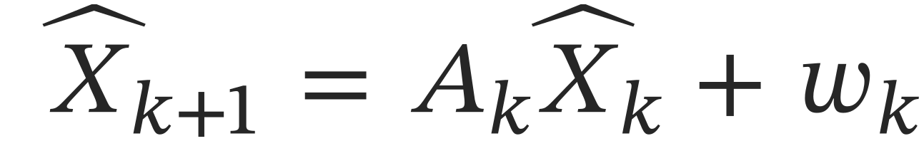
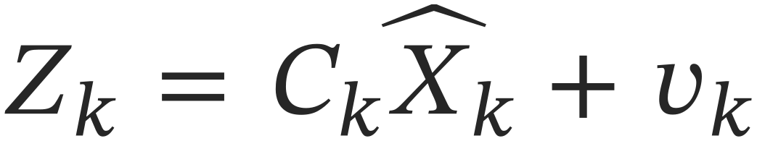
Modeling the Noise
State uncertainty is modeled by a process noise vector w:
Measurement uncertainty is modeled by a measurement noise vector v:
You specify their covariances — Q for the process noise, R for the measurement noise:
All noise is assumed zero-mean and Gaussian. Q and R are your design knobs, not specs read off your devices. (How we much we trust the model and how much we trust the measurement)
10

Slide 11
Reading the Notation
X̂(a | b) — the estimate at time a, using information available through time b.
The filter works in two phases: predict where the state is going, then use measurements to correct it. The bar tells you which phase you are looking at.
Two estimates per step:
X̂(k | k−1) — prediction: no step-k measurements yet
X̂(k | k) — corrected: step-k measurements applied
Same for P — P(k | k−1) predicted, P(k | k) corrected
Next iteration, this step’s (k | k) becomes (k−1 | k−1) — the loop feeds itself.
11

Slide 12
Initializing the Filter
At start-up, the Kalman filter must be initialized with three things:
1. An initial state estimate X̂(0)
2. An initial covariance estimate P(0) — typically the identity matrix
3. The process and measurement noise covariances, Q and R
Never initialize P(0) to all zeros — the algorithm inverts matrices, and a zero covariance causes numerical trouble.
For simplicity, the process and measurement noise variables are assumed independent of each other — so Q and R are diagonal matrices.
12

Slide 13
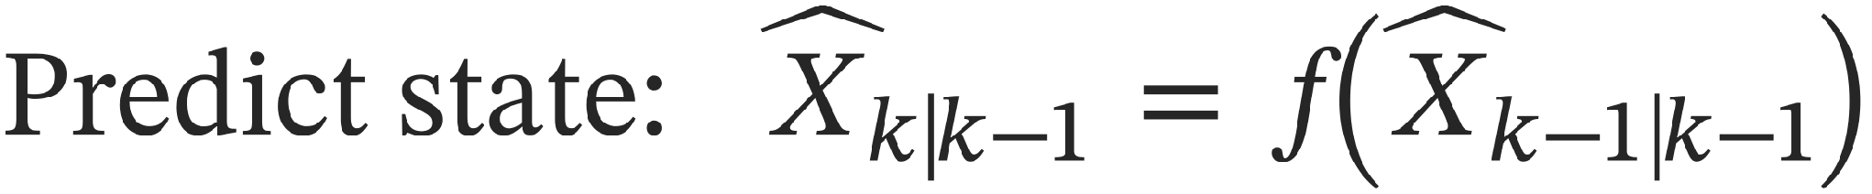
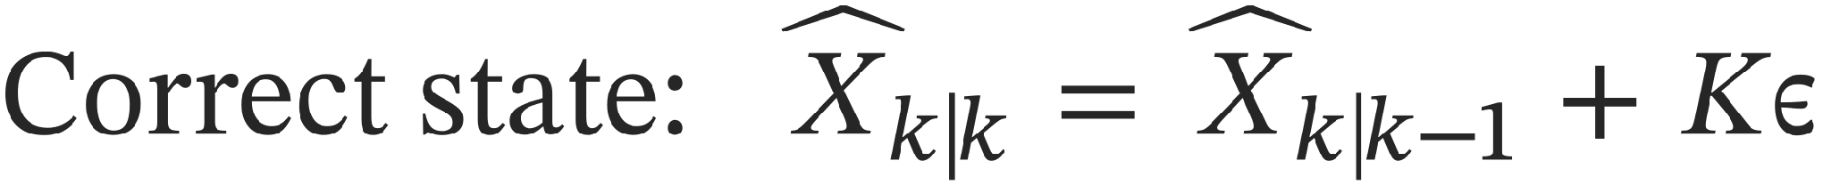
The EKF Algorithm
Every iteration: a model-only prediction, then a measurement-driven correction. Loop forever.
Prediction — no measurement data
Update — correct with measurements
13
Notes:
Here it is — the whole algorithm. Every symbol on this slide is something you've already met, and I'm going to walk it by what each piece means, not by its letter. Quick recap of the cast so the slide reads as a story: A is the motion model — physics, one tick forward. C is the sensor lens — what the lidar can actually see of the state. P is our uncertainty cloud. Q is our distrust of the model; R is the noise of the sensor. Left column first.
Prediction. Step one: refresh the motion model — re-take the tangent to the physics at wherever we currently believe the state is. That's the re-tangenting from earlier, and it happens at the top of every single iteration.
Step two: predict the next state — push our best guess forward through the actual physics, the full nonlinear f, not the tangent. Worth pausing on: a single point passes through a nonlinear function just fine; nothing stops you from evaluating f. So where did the linearization go?
Step three answers that: predict the uncertainty. Take the uncertainty cloud and push it forward through the motion model — and notice the cloud is the thing that needs the tangent, because a point survives a nonlinearity but a cloud doesn't. That's the sandwich on the slide, motion model on the left, its transpose on the right — the matrix version of a fact you already know: scale a random variable by a, and its variance scales by a-squared. Variance is built from squared deviations, so the motion has to touch it twice, once per copy of the deviation. Then we add our model distrust, Q, on top. The whole line in one sentence: my uncertainty rode along with the physics, and grew a little, because my physics isn't perfect.
Notice what this column never touched: measurement data. Pure model. That's why everything still says k given k minus one.
Update — right column. Now the sensor weighs in, and the goal is to correct the prediction.
First line, the residual covariance S — in words, how much disagreement should I expect when I compare my prediction against the sensor? Two ingredients, added together: my own uncertainty, viewed through the sensor lens — given how unsure I am about position and velocity, how unsure am I about what the lidar will report? — plus the sensor's own noise, R. Prediction scatter plus sensor scatter: total expected disagreement.
Second, the Kalman gain — the trust dial. Read it as a fraction: the uncertainty that's my fault, divided by the total expected disagreement. That inverse on the slide is the "divided by." Hold onto it — I'll cash it in two slides from now.
Third, the measurement error epsilon — the surprise. What the lidar actually said, minus what my model expected it to say. In real life, never zero; this is the filter's measure of how wrong its prediction was.
Fourth and fifth: apply the correction, to both outputs. New estimate equals the prediction plus the trust dial times the surprise — move toward the measurement, by an amount proportional to how much of the disagreement was your own fault. And the uncertainty shrinks by the matching amount — the more of the surprise you accepted, the more confident you've just become. The notation flips to k given k: this step's measurements are now baked in.
And that's it. It loops forever: this step's k-given-k becomes the next step's k-minus-one-given-k-minus-one, new measurements arrive, around we go. The rhythm to leave them with: predict, get surprised, correct by trust — repeat. Working properly, the estimate converges toward the true state and the uncertainty shrinks.
[SLIDE 14: Signal Flow]
Here's the same thing as a picture. Measurements come in on the left; the previous estimate feeds back to refresh the motion model and the sensor lens — there's the re-tangenting, drawn as a feedback loop — and the output is always the pair: best guess plus uncertainty. Nothing new here; it's the slide you just walked through, drawn as a block diagram.

Slide 14
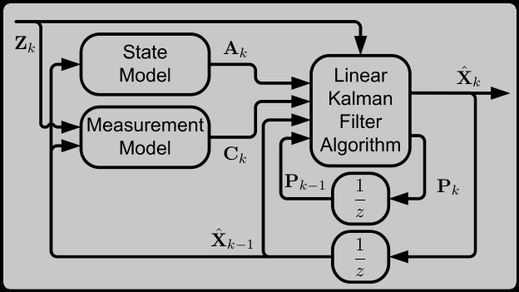
Signal Flow Through the Filter
The previous estimate updates A and C; measurements Z drive the correction; the output is always the pair (X̂, P).
14

Slide 15
The Gain Is the Trust Dial
Look inside K = P·Cᵀ·S⁻¹ — the residual covariance S enters inverted.
Big S means small K. And R sits right inside S — so declaring a sensor noisy directly shrinks the gain.
Follow it through to the correction x̂ + K·ε:
Big R — small gain: lean on the model, nudge toward the data
Small R — big gain: chase the measurements aggressively
Where Δt lives — inside A; ideally the filter runs on a fixed timer
The gain continuously balances trusting the model against trusting the data — and Q and R are how you set that balance.
15

Slide 16
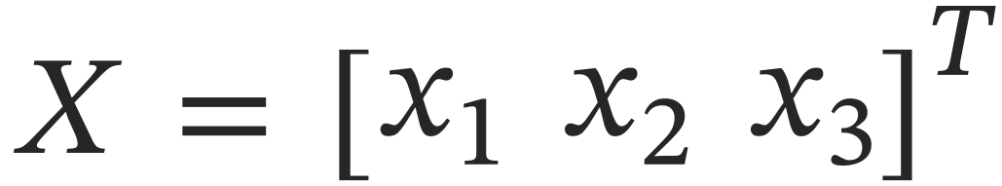
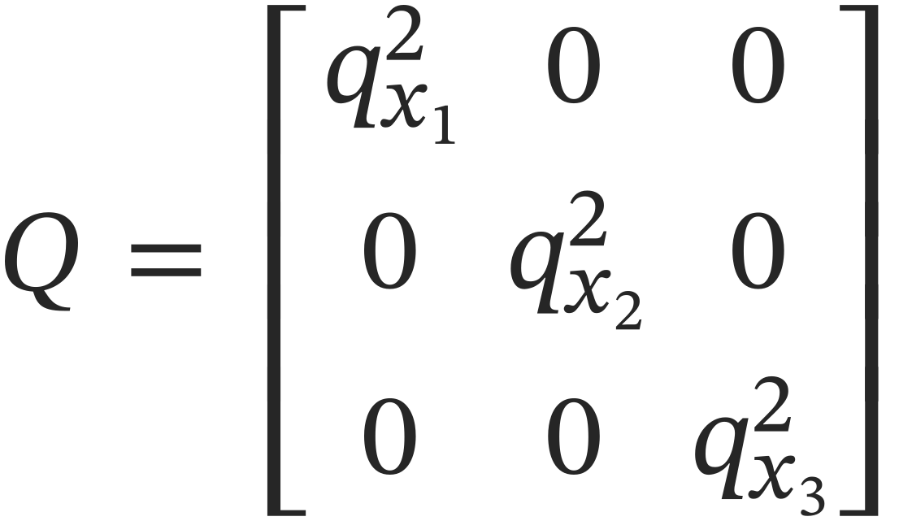
Tuning Q
Consider a three-state system:
Q is the covariance of the process noise — one diagonal entry per state:
Higher covariance in a state → generally faster filter response in that variable.
Analogous to changing the time constant of a low-pass filter — one knob per state.
16

Slide 17
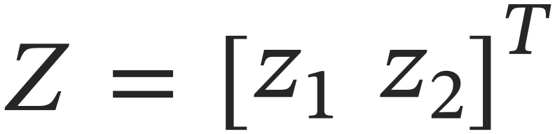
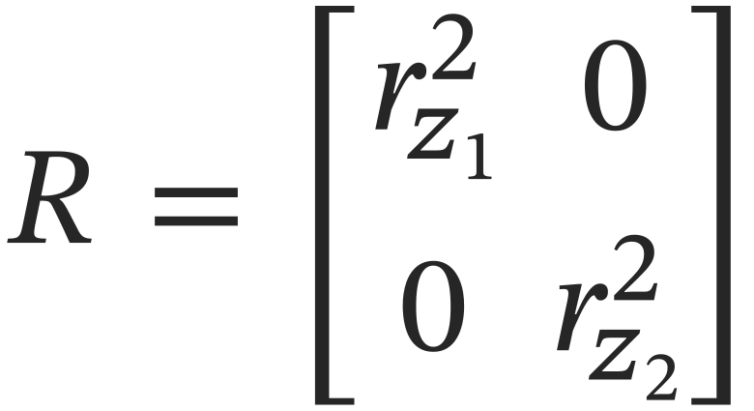
Tuning R
If there are two measurements:
R is the covariance of the measurement noise — one diagonal entry per measurement:
Higher r → noisier signal → the filter reacts slower to that measurement, preventing the noise from reaching the output.
Lower r → less noise → the filter is more responsive to that measurement.
17

Slide 18
An Observer, Not a Controller
Adaptive cruise control needs the position and velocity of the car ahead. Our lidar pipeline measures only position.
Feed positions into the EKF; out come estimated position and velocity, with a confidence attached. The controller is a separate module that consumes that estimate.
Keep the modules separate:
EKF — independent observer: measurements in, estimate out
Don’t worry if it hasn’t all clicked — the homework ties the theory to a working implementation.
18

