Slide 1
LiDAR Object Detection
From 120,000 raw points to a handful of tracked objects

Slide 2
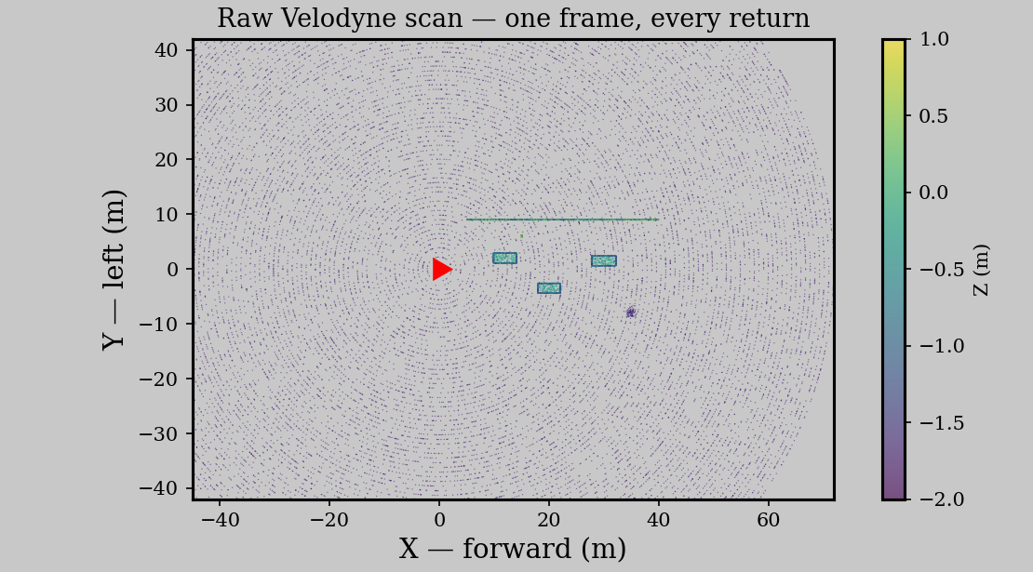
The Problem
One Velodyne frame: ~120,000 unlabeled 3D points, ten times a second. Nothing in this scan says “car.” How do we go from this to tracked objects?
2

Slide 3
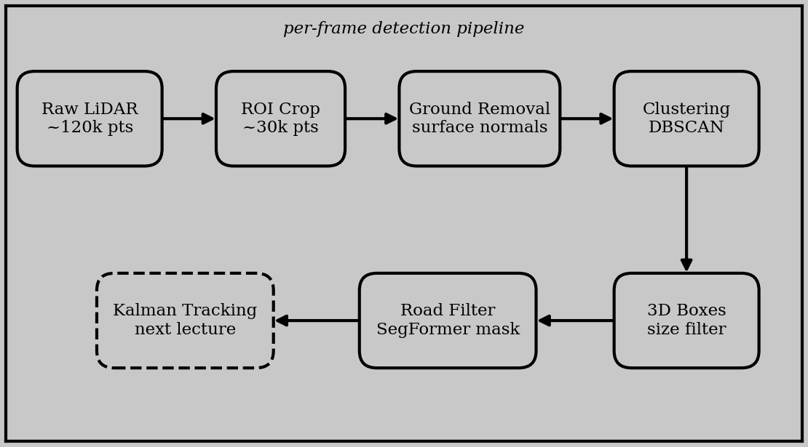
The Pipeline at a Glance
Six stages, each one simple: crop, remove ground, cluster, box, filter by size, filter by road. The tracker (dashed) is next lecture’s job.
3

Slide 4
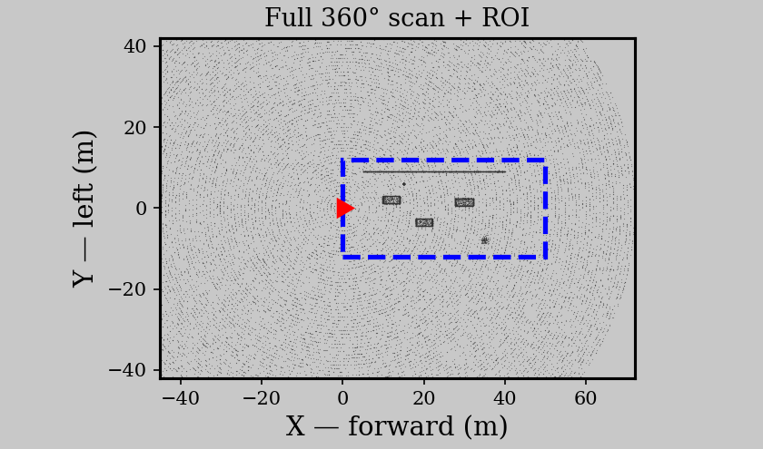
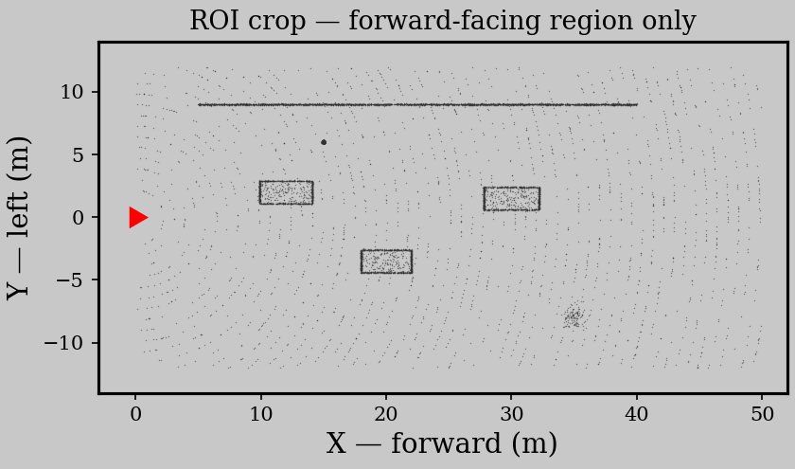
Step 1: Region of Interest
Most of a 360° scan is irrelevant for forward driving — crop to the region ahead.
A simple box — 0 < X < 50 m, |Y| < 12 m, plus a height cut — keeps everything that matters.
~120k points in, ~30k out: every later stage runs 4× faster for free.
4

Slide 5
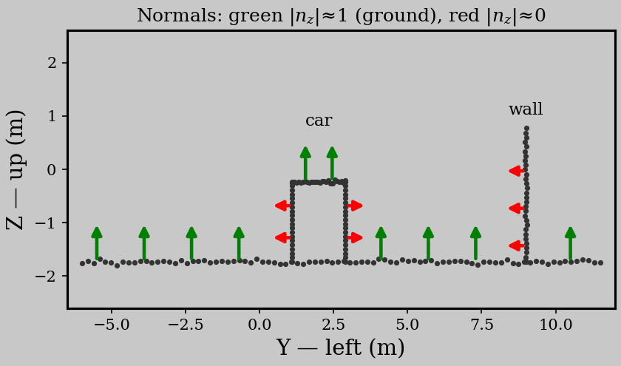
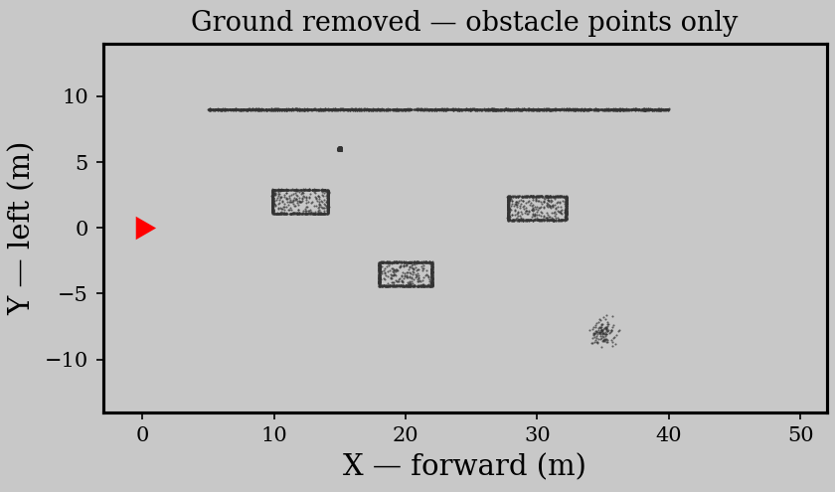
Step 2: Ground Removal via Surface Normals
A point’s normal is the direction of least variance in its local neighborhood — the normal of a plane fit to the nearest points
Road normals point up (|n_z| ≈ 1, green); obstacle surfaces point sideways (|n_z| ≈ 0, red) — threshold |n_z| and the ground falls away.
Speed tricks: pre-filter by height and voxel-downsample before computing normals.
5

Slide 6
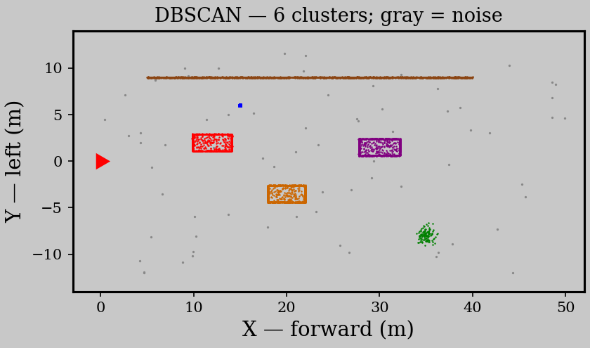
Step 3: Euclidean Clustering (DBSCAN)
Grow clusters from neighbors within ε of each other; a cluster forms only if it gathers min_samples points.
Points that never join a cluster are labeled noise and discarded — DBSCAN needs no fixed number of objects.
Each color is one connected blob of obstacle points — a candidate object, not yet a detection.
6

Slide 7
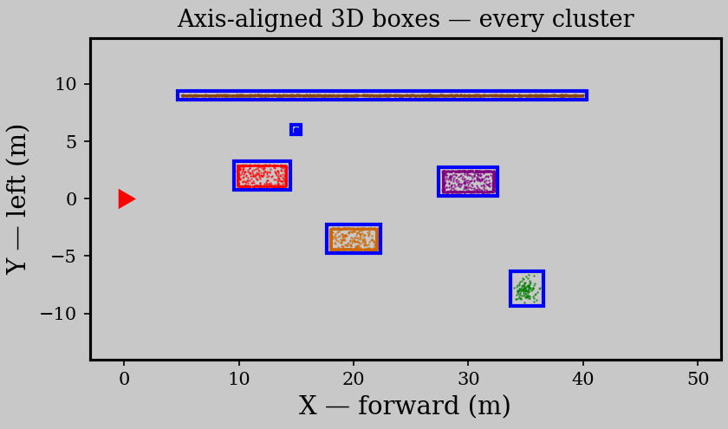
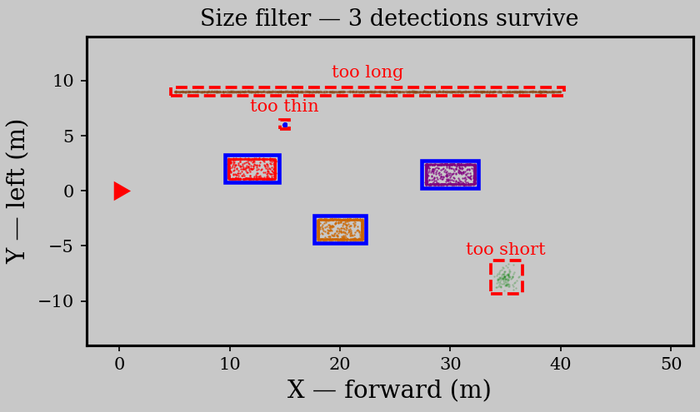
Step 4: From Clusters to Detections
Fit an axis-aligned 3D box to each cluster — min/max in X, Y, Z. Cheap, and good enough for tracking.
Then gate by physical size: height 0.3–3.5 m, length 0.5–15 m — poles are too thin, walls too long, fragments too short.
This is the moment blobs of points become objects — each surviving box is a per-frame detection.
7

Slide 8
Step 5: Road Filtering — N1 Meets N3
Geometry found the objects — but a parked car behind a fence is not traffic.
Project each box’s bottom-center into the camera with the N1 projection chain, and keep the detection only if that pixel lands on the SegFormer road mask.
Why this works so well:
Geometry detects — LiDAR clustering finds every physical object, on road or off
Semantics gates — the camera’s road mask decides which detections are traffic
One matrix, reused — the same projection matrix from N1 does the projection
8

Slide 9
Detections, Meet the Kalman Filter
We now have per-frame 3D detections: a position and a box for every object on the road, ten times a second.
But frames don’t know about each other yet — detection 3 in this frame and detection 5 in the next might be the same car. That association is what tracking adds.
What happens next:
Associate — match detections across frames, nearest-neighbor in position
Track — feed each object’s positions to the Kalman filter from N2
Out — smoothed position and estimated velocity per object, with confidence
Detection answers “what is out there right now?” — tracking answers “where is it going?” That handoff is the next lecture.
9

