Slide 1



Useful Information About The Guild For Your Written Statement & Campaign
Officer Elections 2024

Slide 2

What is the Guild?
The Guild is an independent charity that is here to support the social and academic experience of UoB students, and ensure that you get the very best experience!
We offer a variety of services and opportunities to students, including:
• Decision-making (democracy)
• Student Rep System
• Campaigns
• Guild Advice
• Societies, Student Groups & Associations
• Joe’s Bar
• Nightclubbing events (e.g. Fab)
• Student Mentors
• Community Wardens Scheme
• Student-Staff Jobs
• Employability Support
…and lots more volunteering opportunities!

Slide 3

Guild Strategy 2022-2027
The Guild has a strategy for the work that we'll be doing over the next few years.
The Trustee Board sets the strategy with different Guild departments responsible for different areas.
We’d suggest that you read the strategic plan to understand where the Guild is heading over the next five years.
It has three key aims for the Guild:
Engagement and Participation
Representation
Community and Support
The Guild of Students Strategic Plan

Slide 4

What is the NUS?
NUS (National Union of Students) is the largest democratic student organization in Europe.
• NUS was founded in 1922, with UoB Guild being a founding member!
• NUS works to represent students on a national level – lobbying the government and universities on a variety of issues including tuition fees, teaching standards and liberation issues.
• It’s achieved lots of successes over it’s history e.g. securing an exemption from paying Council Tax for students
• It has two key conferences every year in the Spring – National Conference & Liberation Conference
• You can find out more about NUS here , and more about NUS national campaigns here

Slide 5
What Do We Know About UoB Students?
Over 43,000 students registered at the University of Birmingham. Any registered students who hasn't opted out is a member of the Guild.
There are:
Undergraduate Students
Postgraduate Taught Students
Postgraduate Researchers
Online Students
Full-Time Students
Part-Time Students
Commuter Students
International Students
UoB students are from all over the world.
Students study at either the Birmingham campus, abroad, at joint institutions, the Dubai campus, or are distance learners

Slide 6
Guild Democracy
The Guild is a “democratic” organization
Democracy -> NOUN Democratic -> ADJECTIVE
• Democracy is all about people being able to have their say in what they want to see change & being able to choose who they want representing them
• As the Guild is a democratic organization, all of its members (UoB students) are able to have their say in things they want to change in the University, Guild and local community, and elect who they want representing them.
• Decisions are made by UoB students – UoB students have decision-making power in the Guild!
The Guild should be representative and inclusive of ALL UoB students!

Slide 7
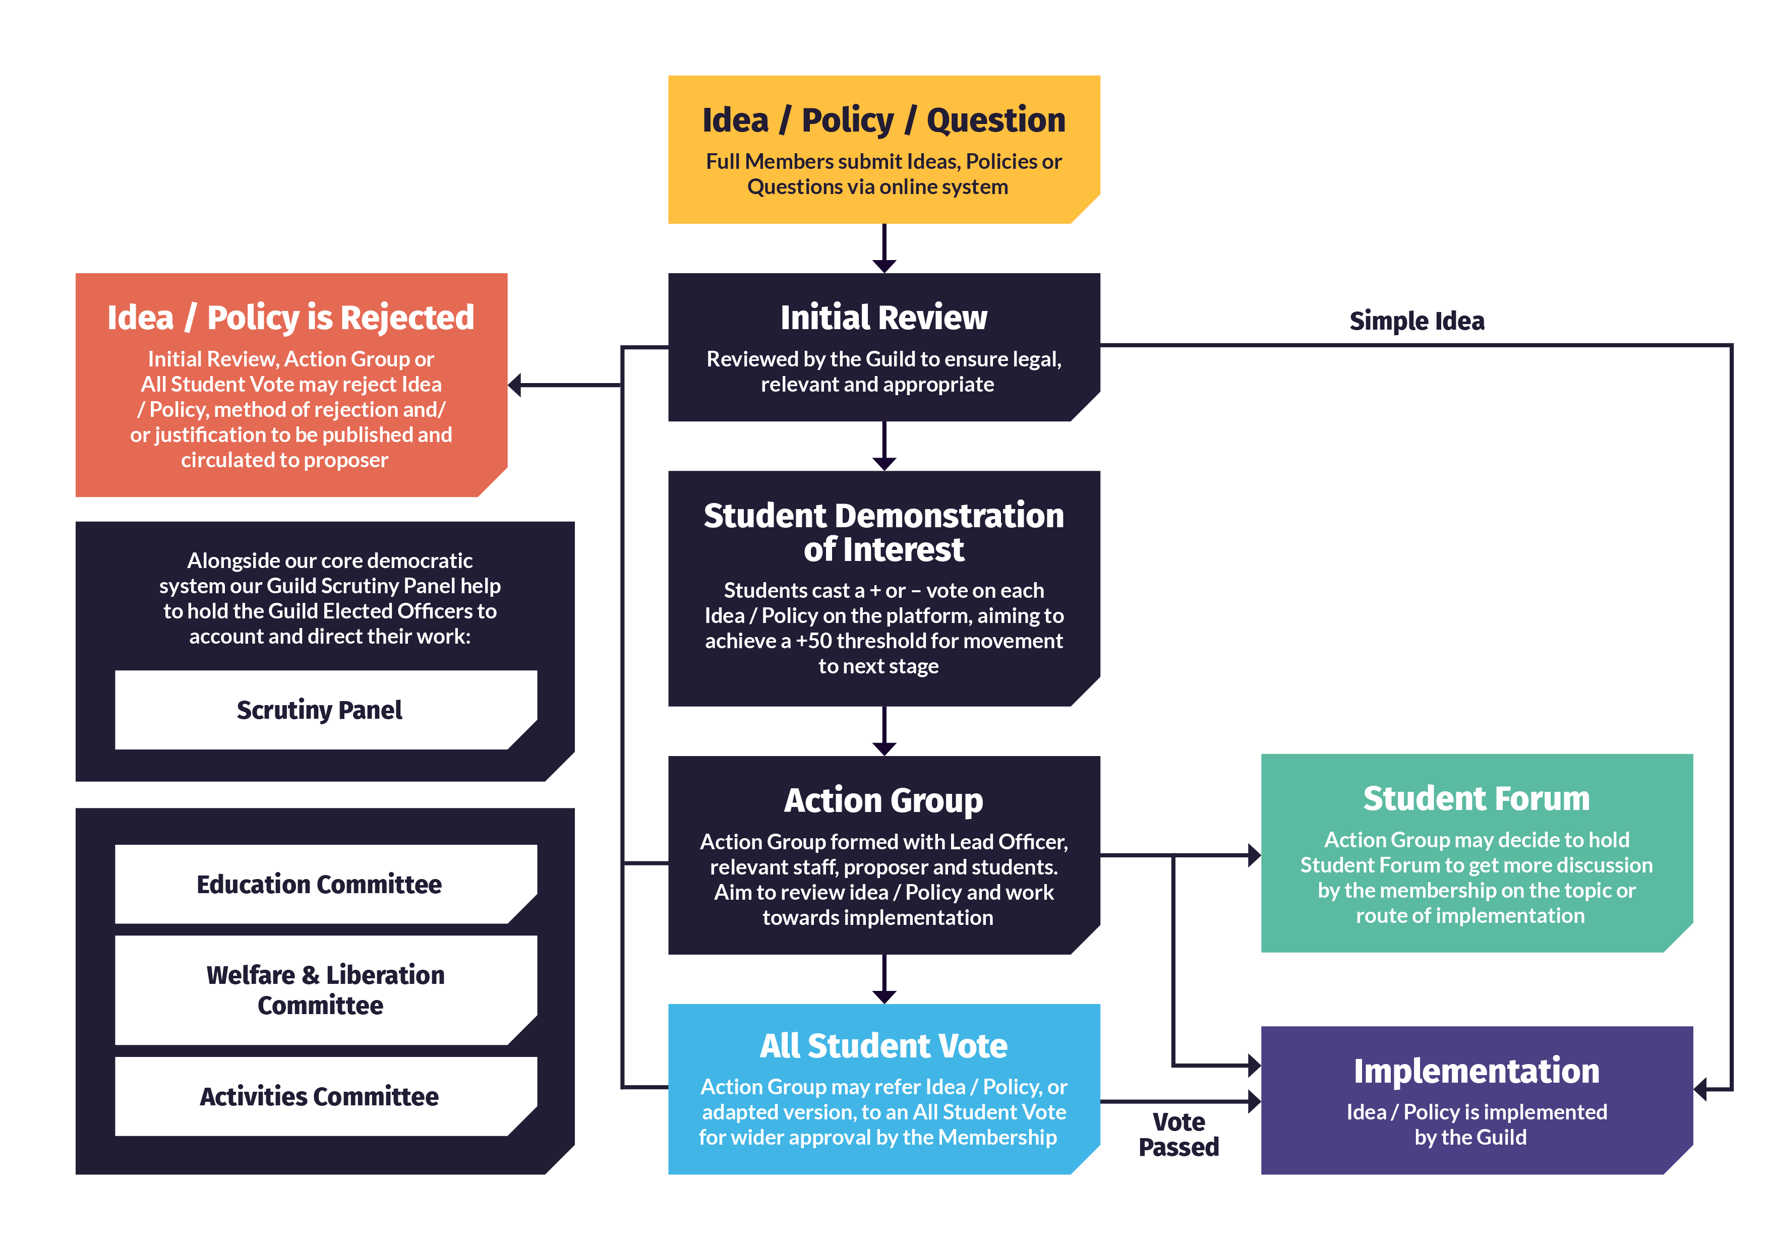
The Guild’s Democratic System
You can find more info & details about how Guild decision-making works here.
The Guild's Democratic System is designed to give students a voice and a way to make change at the University and the Guild.

Slide 8
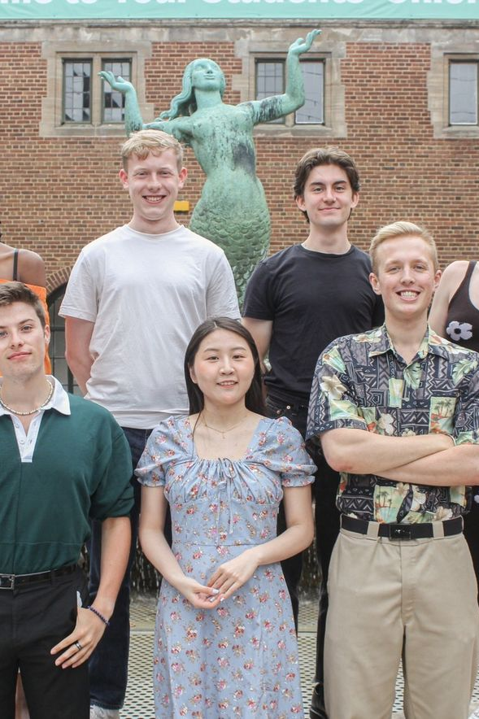
Your Elected Officer Team
The Guild is run by students for students.
Students can have their say in which students they want representing them
7 Elected Full-Time Officers and 6 Elected Part-Time who are elected every year to represent UoB students.
As an Officer, although the President is the lead Officer for Guild democracy and elections, ALL Officers still play a HUGE role in Guild democracy.
Find out more about your current Officer Team here

Slide 9
How Can You Find Out More About What UoB Students Care About?
Student Ideas, Policy & Campaign Submissions
Decision-Making Committee & All Student Meeting Minutes
Scrutiny Panel minutes & Officer reports
NSS, PTES & PRES Data
Issues raised by Reps/Previous Rep Impacts
Officer Priority Campaigns & Black Voices Campaign
We recommend that you include information in your written statement & campaign that is relevant to the role that you are applying for!

Slide 10
Student Idea & Policy Submissions
At the Guild, students are able to submit ideas and policy proposals for things they would like to see change in the Guild, University and local community, on the Guild of Students website.
These ideas and policy proposals may be allocated to the Officers/Staff or to the Student Demonstration of Interest.
Ideas and policy proposals that have been submitted in the past year have included:
Introducing reusable containers in Joe's Bar.
The Guild should introduce more accessible gender-neutral toilets.
Updated Islamaphobia Definition.
The Guild Should Offer Low-Budget Cooking Classes.
The Guild Should Support the University and College Union Postgraduate Research Manifesto to Recognise Postgraduate Researchers as Staff.
For a full list of submitted ideas and policy, in addition to progress that has been made on them, please email elections@guild.bham.ac.uk

Slide 11
Student Campaign Submissions
The Guild provides advice and support to those who want to run campaigns, as well as funding support for campaign activity!
Funding for campaign ideas related to welfare, liberation, equality and diversity and wellbeing are approved by the Guild’s Welfare & Liberation Committee.
Previous campaign ideas that have been submitted have included:
• Evening of Elegance 2021 Campaign
• Raising awareness of sustainable fashion
• Guild to Endorse the UoB Amnesty International Society’s Campaign to Stop “Killer Robots”
• University-Wide Campaign for the Climate & Ecological Emergency Bill (CEE Bill)
For information about campaigns, please email campaigns@guild.bham.ac.uk

Slide 12
Scrutiny Panel Minutes & Officer Reports
The Scrutiny Panel consists of 5 recruited UoB students.
The Panel scrutinizes the work of your Officer Team. They ask them questions based on reports that the Officer Team write, to ensure that they are making progress on their written statements (manifestos), ideas and policy, and any other work that is in their remit.
The Panel also provide positive feedback and suggestions for improvement to the Officer Team, as well as writing a report summarising their feedback to the Officers.
Minutes from previous Scrutiny Panel meetings can be found here (you must be logged into the Guild website first to view them).

Slide 13
National Student Survey
The NSS is a survey that all final year Undergraduate students at UK Universities complete.
The survey asks these students for feedback on different areas of University life (e.g. teaching, University services etc)
You can find out more general information about the NSS here
Data from this survey shows that students are mainly happy with “Teaching on my course”, “Learning Resources” and “Learning Community” and the overall experience at Birmingham.
Areas where students show they are not as satisfied include:
Assessment and feedback
Learning opportunities
Organisation and Management
Student voice (listening to student feedback)
Provision of welfare services
University’s responsibility for student safety
Workload
For more information, please contact elections@guild.bham.ac.uk

Slide 14
PTES & PRES Surveys
The Postgraduate Taught Experience Survey (PTES) and Postgraduate Research Experience Survey (PRES) are surveys which aim to find out more about the PG student experience.
Key points from these surveys:
In 2022 the PTES showed that 82% were satisfied with their course.
In 2023 the PRES showed that 82% were satisfied with their course.
Postgraduates showed higher rates of loneliness and isolation that in the wider student population.
In the 2023 PRES Community scored the lowest (58%) for Postgraduate Researchers at Birmingham.
In 2022 Birmingham participated in the OfS’s new Postgraduate Experience Survey.
This showed that 89% of students rated their course as either “Very good” or “Good”.
For more information about these, please contact elections@guild.bham.ac.uk

Slide 15
Issues Raised by Reps
Rep Impacts are when Reps raise an issue, the issue is resolved, and a positive impact has been made on the student experience. When asked what changes were made to their school/college/course this year, Reps provided answers such as:
“Timetable and Room changes during both semesters. Improvement of teaching quality and revision notes given by lecturers in the second semester”
“Assignment deadlines changed, simulated exams put in place, current second year course content introduced in first year”
“Shaping year 3 project dissertations discussion – making them inclusive by removing the need for first year grades and including keywords to help students rank all of the projects”
“Changes to PGR study space policy and procedure, access to HEFi modules for distance learning PGRs, clarification and (hopefully) improved access to PGTA opportunities for distance learning PGRs, updated guidance regarding international PGTAs, access to scanning services for shielding and isolating students during the pandemic”
“One module has been reviewed so it is more accessible to disabled students”
You can also find out more about representation of academic interests on the Guild website
…or by emailing studentreps@guild.bham.ac.uk

Slide 16
Officer Priority Campaigns
In previous years, your Officer Teams hosted 1-3 Priority Campaigns.
These have included:
Change in Mind Campaign
Black Voices Campaign
Care Leavers Representation
Last year the Officers’ priority campaign is the Cost of Living Campaign (see the next slide).
Black Voices Campaign
The Black Voices Campaign is still ongoing, and is run by a group of student volunteers.
You can find out more about the Black Voices Campaign here

Slide 17

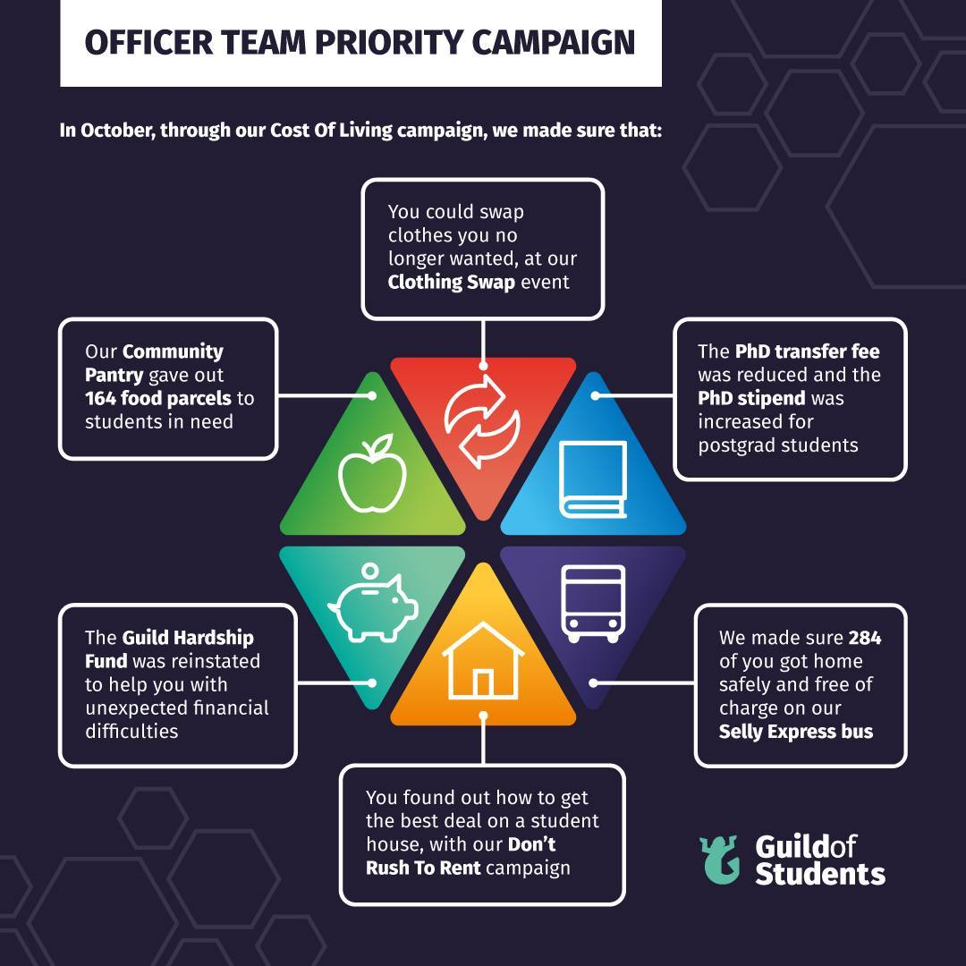

Cost of Living Campaign
Last year your Officer Team have decided that the Cost of Living is their focus for campaigning this academic year.
This activity is focus on a number of different areas:
Community Pantry
Guild Hardship Fund
Housing and Renters Rights
Supporting students and researchers throughout their time here.
If you’d like more information on this work you can contact the Full-Time Officers fto@guild.bham.ac.uk

Slide 18
Thank-You For Reading!
Please email any questions, queries or concerns to elections@guild.bham.ac.uk

