Slide 1



Democracy Review Update
May 2023

Slide 2

What we will cover
Current Structure & The Need for a Democracy Review
Democracy Review Phase 1 Overview
How the new system was designed through consultation
What does the new Democratic System look like
The Democracy Review, as we move into Phase 2 next year
Timeline of Implementation

Slide 3
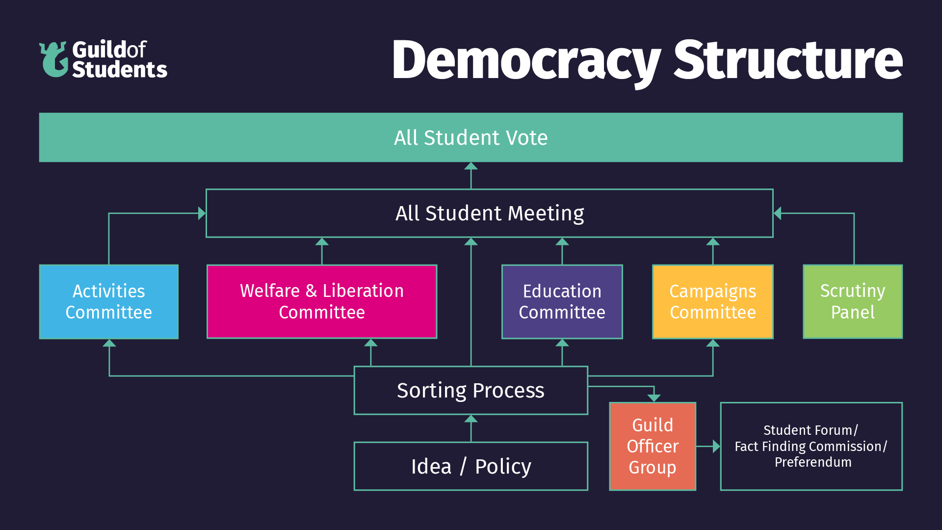
Current Structure

Slide 4
The Need for a Democracy Review
The current democratic system is overcomplicated and often hard for students to understand.
Democratic mandates are often slow to be reached, with only three All Student Votes a year. Students submitting ideas and proposals are often unclear on outcomes
Extremely Low Turnout in Autumn Elections for Guild Committees, with tiny mandates (sometimes as few as under 15 votes) and roles often left unfilled.
Many Guild Committees are rarely quorate, creating a barrier to change and slowing down sometimes clear decisions. Activities and Education Committees being exceptions.
Similarly, the All Student Meeting has never been quorate, with on one occasion as few as 8 students attending – today being an anomaly. The time and length of the all student meeting often excludes students from the democratic process.
Low Engagement from Part Time Officers, over a number of years, as they understandably struggle to balance study, work, & their officer roles.

Slide 5
The Democracy Review – Phase 1
A review of the Guild Democratic System was undertaken by Alkhemy (an external SU consultation group) across January – March 2023. The review looked at:
The Democratic Process – does it work?
How do we put students at the heart of our democracy?
Part-Time Officers – how do we facilitate under-represented voices within the process?
Role and Function of Liberation and Representation Associations – what barriers do they and students face?

Slide 6
Consultation
Alkhemy, the external consultant, undertook the following consultation across January – March 2023:
5 Co-creation sessions with 15 students demographically reflective of the University of Birmingham student population. Anyone could apply to be involved, and we had over 150 applications. Those not chosen were still given the opportunity to contribute.
Interviews with Guild Officers (Full-Time & Part-Time), Liberation Associations and Guild Staff who support the process.
Surveys sent to Committee Members and Committee Chairs across Associations and Student Groups.
Desk Research of 4 other Student Union Democratic processes and systems.
Alkhemy also reviewed models of community organising, a key campaigning model used at the Guild.

Slide 7
Overall Feedback
Feedback 1 = Very Positive, 5 = Very Negative:
All Student Vote (2.4) – Accessible and useful, needs more support
Scrutiny Panel (3.4) – Good, but lack of awareness
Campaigns Submission Form (3.4) – Lacking support
All Student Meeting (3.4) – Lack of accessibility/incentivisation
Decision Making Committees (3.5) – Lack of quoracy
Sorting Process (3.8) – Overly complicated, lack of updates
Here we can see that the All Student Vote received the most positive feedback, and was the only structure to be seen more positively than negatively.

Slide 8
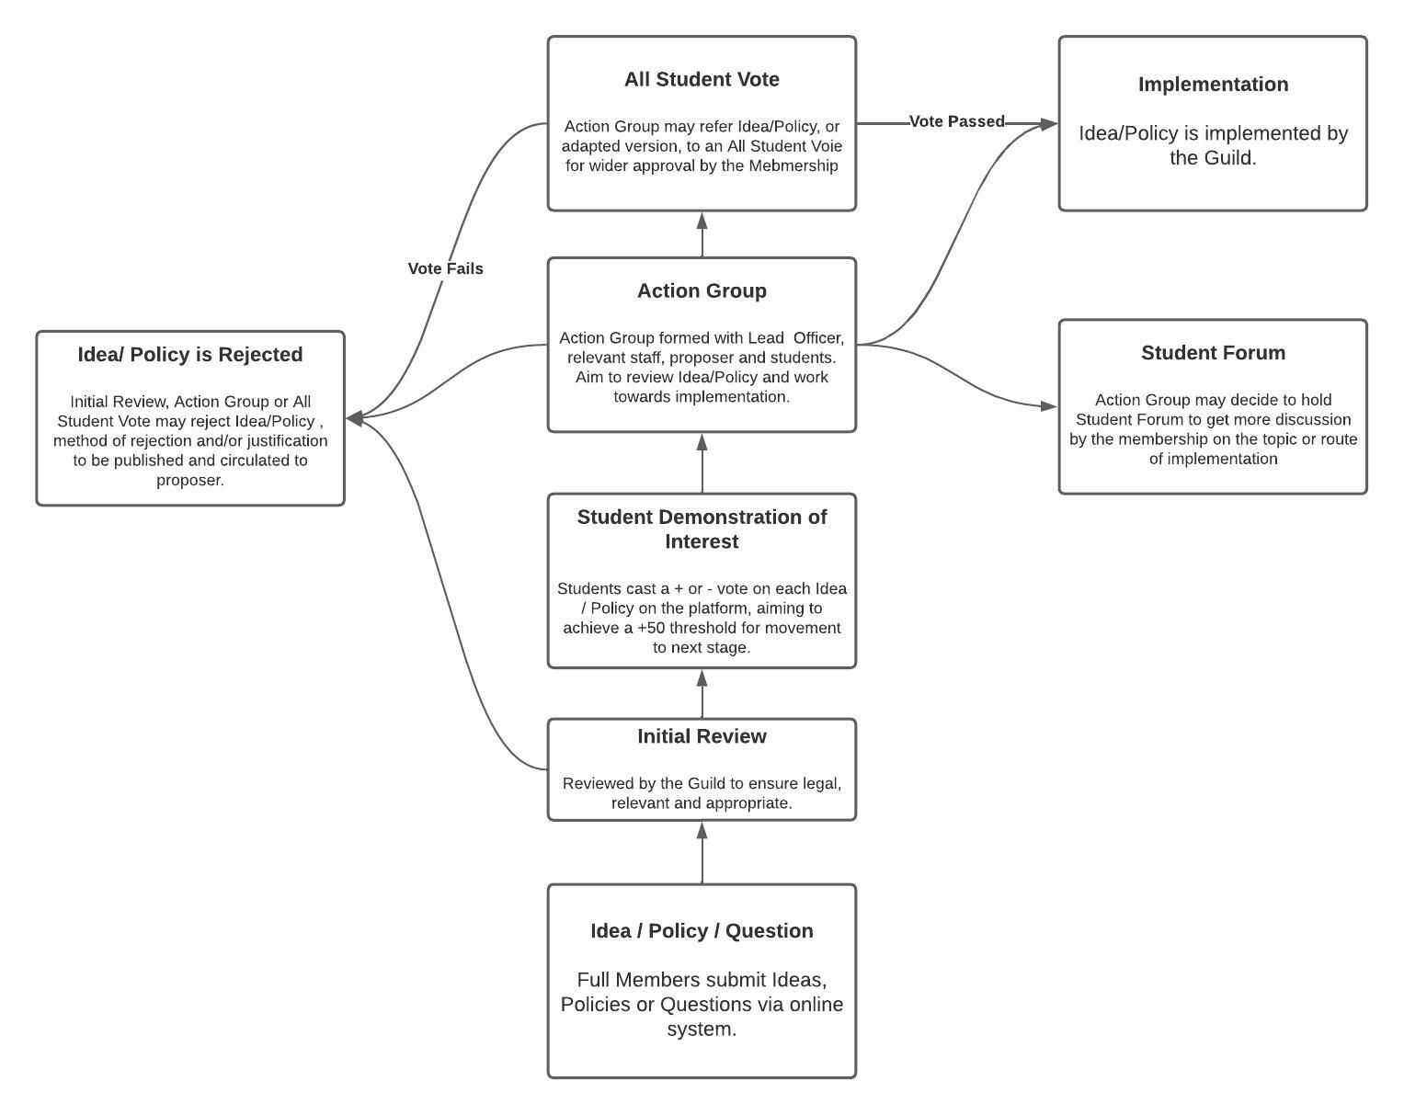
The New System
New Democratic Structure, from September 2023
To be implemented for September 2023:
We will now look at an example…
ChangeIt | Kent Union
Note: Scrutiny Panel will also continue within the new structure, but will be operationally reviewed to allow more effective and transparent scrutiny of Officers.
Start Here

Slide 9
Phase 2
Part Time Officers may be upgraded to paid Community Organisers
Move 7 current volunteer PTO roles in to 5/6 Organiser Roles
Focus on equity and inclusion for marginalised groups
Feed into Full-Time Officer Team
Liberation and Representation Associations
To be consulted again regarding scope and remit
Could continue as is, be partially changed, or be linked with paid community organiser roles
Consultation on these changes:
September – early November 2023, extensive consultation with Part Time Officers and Liberation associations

Slide 10
Recap on Timeline
September 2023:
New Democratic Structure is fully implemented
September 2023 – November 2023:
Consultation on Community Organiser and Liberation Association Changes
December 2023:
Community Organiser and Liberation Association changes approved, bar feedback in favour of the status quo
February/March 2024:
New system implemented in time for Officer Elections 2024

Slide 11
Any Questions?

