Slide 1



Guild Central Training 2019:
College of Arts & Law (CAL)

Slide 2


Guild Central Training: CAL
Objectives
To understand the responsibilities of being a representative and the responsibilities we have as a Guild
To broaden knowledge on college-level issues (from data obtained 2018-19 or strategy work)

Slide 3
Guild Central Training: CAL
Talk to the person next to you…
Why did you become a Rep?
What is expected of Reps?

Slide 4
Guild Central Training: CAL
Benefits of Being a Rep
Training and Support
Development of new and existing transferable skills including communication and problem-solving
Personal development such as confidence and leadership
Opportunity to make a difference to the academic experience of current and future students at Birmingham
Gaining a better understanding of the academic environment of Higher Education
Notes:
Socials, thank you, PSA, Enhanced Transcript
Masterclass sessions:
Quality Assurance, Not On, Equality and Diversity
Leadership, Higher Education Policy, Rep Employability

Slide 5
Guild Central Training: CAL
Your Responsibilities as a Representative
To continuously improve the student learning experience in partnership with the University and The Guild by helping create solutions to problems
To represent all your cohort’s views and opinions on all matters relating to learning and teaching
To provide both positive and negative feedback to staff
To act as a communication channel between staff and students
Notes:
Though note, it is useful to help comes up with solutions to student problems, but it is not your sole responsibility. It might help to attend Student Staff Forums with a solution in mind that is reasonable, but it is always useful to draw attention to a problem even if you don’t have a solution
Remember that your cohort will include more than just your friendship group on your course. You should consider the needs of other students – i.e. some of you may prefer 5pm lectures to 10am lectures as you may function better in the afternoon, but there may also be commuters or parents/carers on your course who would prefer a 10am lecture so they can get home an hour away while it’s still light or pick up their kids from school etc.
Without positive feedback, staff won’t know what works well and can be extended to other modules and departments

Slide 6
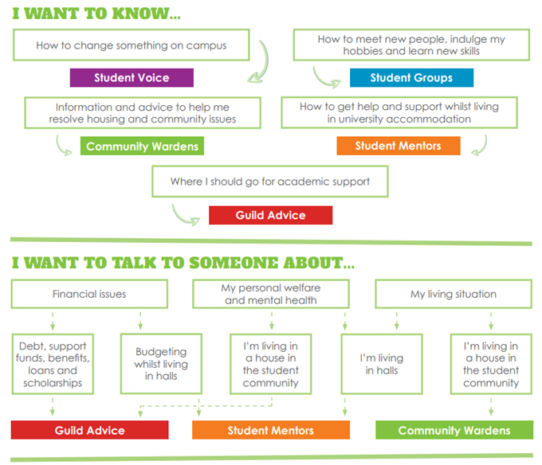
Not to rep
Notes:
Your job is to represent your cohort’s academic interests, not any of the other stuff, but feel free to signpost students to the following services especially as they may come to you as a friendly and familiar face
Note that there are also services at the University that you can signpost students to, i.e. the Student Hub in Aston Webb, College Wellbeing Officers etc.

Slide 7
Guild Central Training: CAL
Our Responsibilities as a Guild
To identify trends and issues that we need to raise at University and College level committees
To support you in your role by providing training and enhancing your skills and expertise through our masterclass sessions
To celebrate and recognise your individual successes
To create a community of reps
To keep you updated with events you can get
involved with via our Student Rep Newsletter

Slide 8


Make sure students on your programme know who you are
Identify student issues and needs
Attend meetings and communicate student issues and positive experiences with staff
Identify issues for your School/College Reps, or the Education Officer to take to meetings and committees
Notes:
If you can’t attend a meeting, please send your apologies so that staff know you are unable to attend. If possible, email in any feedback you have gathered so it can still be discussed at the meeting (another Rep can raise it on your behalf, or a staff member can read it out)

Slide 9

Guild Central Training: CAL
Your College Reps
Role | Name | Email address
UG College Rep | Owen Shann | ols856@student.bham.ac.uk
PGT College Rep | Lily Gibbs | lag673@student.bham.ac.uk
PGR College Rep | Rik Sowden | rms685@student.bham.ac.uk
Notes:
Electing PGT and PGR College Reps during Autumn cycle – check website for updates throughout the year

Slide 10
Guild Central Training: CAL
The Guild
Student feedback
Rep communicates with staff
University action
Students experience change
Rep communicates with students
Feedback Loop
Notes:
The Guild sits in the middle because if everything works well, we can leave SSFs to it, but if there are issues at any point during this loop or something isn’t happening, please let us know and we can support

Slide 11
Guild Central Training: CAL
Feeding back to the Guild
Helps us identify college-wide and university-wide trends and themes that your Guild Officers can raise with the University
Enables us to share your successes and impacts with the student body
Rep Journals
Key way to feed back to the Guild
Each month a Guild Officer and the Rep Coordinators will select a ‘Rep Win of the Month’. If you’re the Rep who gets picked for this, we will give you a £10 Amazon Voucher in recognition of your work!
Find it on the Guild website

Slide 12
Guild Central Training: CAL
Rep Fund
Any Student/PGR Rep can apply for up to £150 per term to gather feedback from their cohort
The event/idea must be used to gather feedback from your cohort about academic issues
The application is reviewed by a panel who will approve or suggest amendments for the event
You can find an application form for this fund on the Guild website, or email studentreps@guild.bham.ac.uk

Slide 13
Guild Central Training: CAL
Student Experience Team – key priorities in 2019/20
Inclusivity
Staff - student community
Communications & Student Voice
Improving the research culture and monitoring use of desk spaces for PGRs
Extend your knowledge of the College and get involved
Get to know your School Student Experience Officer and the PGT/PGR Student Experience Officer and what they do.
Get to know our Student Experience Ambassadors and our College Equality & Diversity Ambassador and what they do.
What we can do to help you
Put out calls for student feedback (via Canvas announcements) on your behalf
Help with feeding back updates to students from SSFs
Minuting of meetings – new PGR role
CAL Rep socials
How you can help us
Share what you learn with the SSF
Be part of the comms channel to other students

Slide 14
Guild Central Training: CAL
Student Experience Team
Name | Location | Phone number | Email address | Days of work
Antonia Parker Smith (Administrative Officer) | Arts 107 | 0121 4148714 | A.E.ParkerSmith@bham.ac.uk | Mon-Fri
Bal Loyal (PTR SEO) | ERI 257 | 0121 41 45994 | b.k.loyal@bham.ac.uk | Monday, Tuesday: 10am – 2.30pm Wednesday: 10am-2pm Thursday: 9.30am – 5.30pm Friday: 10am – 2pm
Dorothy Lamb (LCAHM SEO) | Ashley G05 | 0121 4144734 | d.j.lamb@bham.ac.uk | Tues - Thurs
Edward Mushett Cole (PGR/PGT SEO) | Arts G7 | 0121 414 9582 | e.j.mushettcole@bham.ac.uk | Various
Helen Murray (SE Manager) | Arts 252 | 0121 4146432 | h.murray@bham.ac.uk | Mon-Fri (term time) Mon, Tues, Thurs, Fri (vacation)
Jodie Neville (SHaC SEO) | Arts 347 | 0121 41 44075 | j.neville@bham.ac.uk | Mon-Fri
Liana Turner (Law SEO) | Law G19 | 0121 414 6720 | L.M.Turner@bham.ac.uk | Mon-Fri
Rachel Canty (Head of Ops) | Arts 252 | 0121 414 5678 | r.canty@bham.ac.uk | Mon-Fri
Sophia Robertshaw (EDACS SEO) | Arts 107 | 0121 4147517 | s.f.robertshaw@bham.ac.uk | Mon pm, Tues-Thurs, Fri pm

Slide 15
Guild Central Training: CAL
Student Experience Ambassadors 2019-20
Name | School | Email
Christopher Morrall | EDACS | CJM711@student.bham.ac.uk
Bethany O’Brien | EDACS | BXO657@student.bham.ac.uk
Amy Townsend-Kennedy | EDACS | AXT679@student.bham.ac.uk
Rosie Butler | SHaC | REB770@student.bham.ac.uk
Nathan Jopling | SHaC | NTJ795@student.bham.ac.uk
Janat Kanwal | PTR | JXK691@student.bham.ac.uk
Caitlin Evans | PTR | CJE745@student.bham.ac.uk
William Taylor | LCAHM | WXT854@student.bham.ac.uk
Luca Campopiano | LCAHM | LXC876@student.bham.ac.uk
Lucy Painter | LCAHM | LXP630@student.bham.ac.uk
Dilraj Ahmed | Law | DXA766@student.bham.ac.uk
Hannah Cottam | Law | HFC602@student.bham.ac.uk
Yasmin Vetter | PG | YXV830@student.bham.ac.uk
Alice Williams | PG | AKW429@student.bham.ac.uk

Slide 16
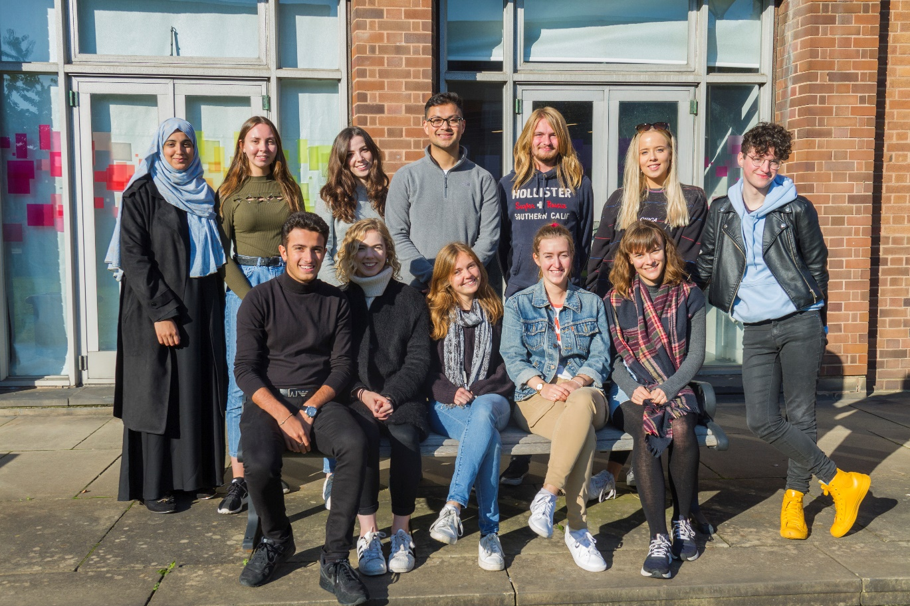
Guild Central Training: CAL
Student Experience Ambassadors 2019-20

Slide 17
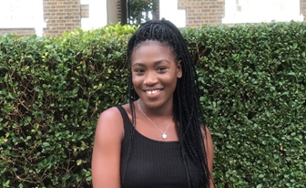
Guild Central Training: CAL
CAL Equality & Diversity Ambassador 2019-20
Oluwaronke (Ronke) Oladele - OXO589@student.bham.ac.uk

Slide 18
Guild Central Training: CAL
Discussion:
What issues have you already come across on your course/programme?
How could you collect feedback on these issues?

Slide 19
Guild Central Training: CAL
Student Voice Report 2019
Black student satisfaction, attainment and experience
Assessment and feedback
Academic integrity and examinations
Supporting the student voice & building a community of staff and students
The Postgraduate Researcher experience
Access and participation plan
Support for students on study abroad and placement years

Slide 20
Guild Central Training: CAL
Events coming up….
“Not On” Masterclass
Monday 18th November 2019 13:00-14:00 Amos Room, The Guild
Equality and Diversity Masterclass
Tuesday 10th December 2019 13:00-14:00 Mandela Room, The Guild
SPEAK WEEK
Monday 2nd to Friday 6th December 2019
We will be asking all students/researchers to “spill the tea” on their student experience
You can get involved as a Rep!
Email studentreps@guild.bham.ac.uk

Slide 21



Guild Central Training: CAL
Next Steps…
Communicate on a regular basis with students - try to make sure you are vocal in lectures
Join our Facebook Group !
Attend Staff Student Forums and read the papers
Close the feedback loop
Don’t forget you can always talk to us
at the Guild for support and advice

Slide 22
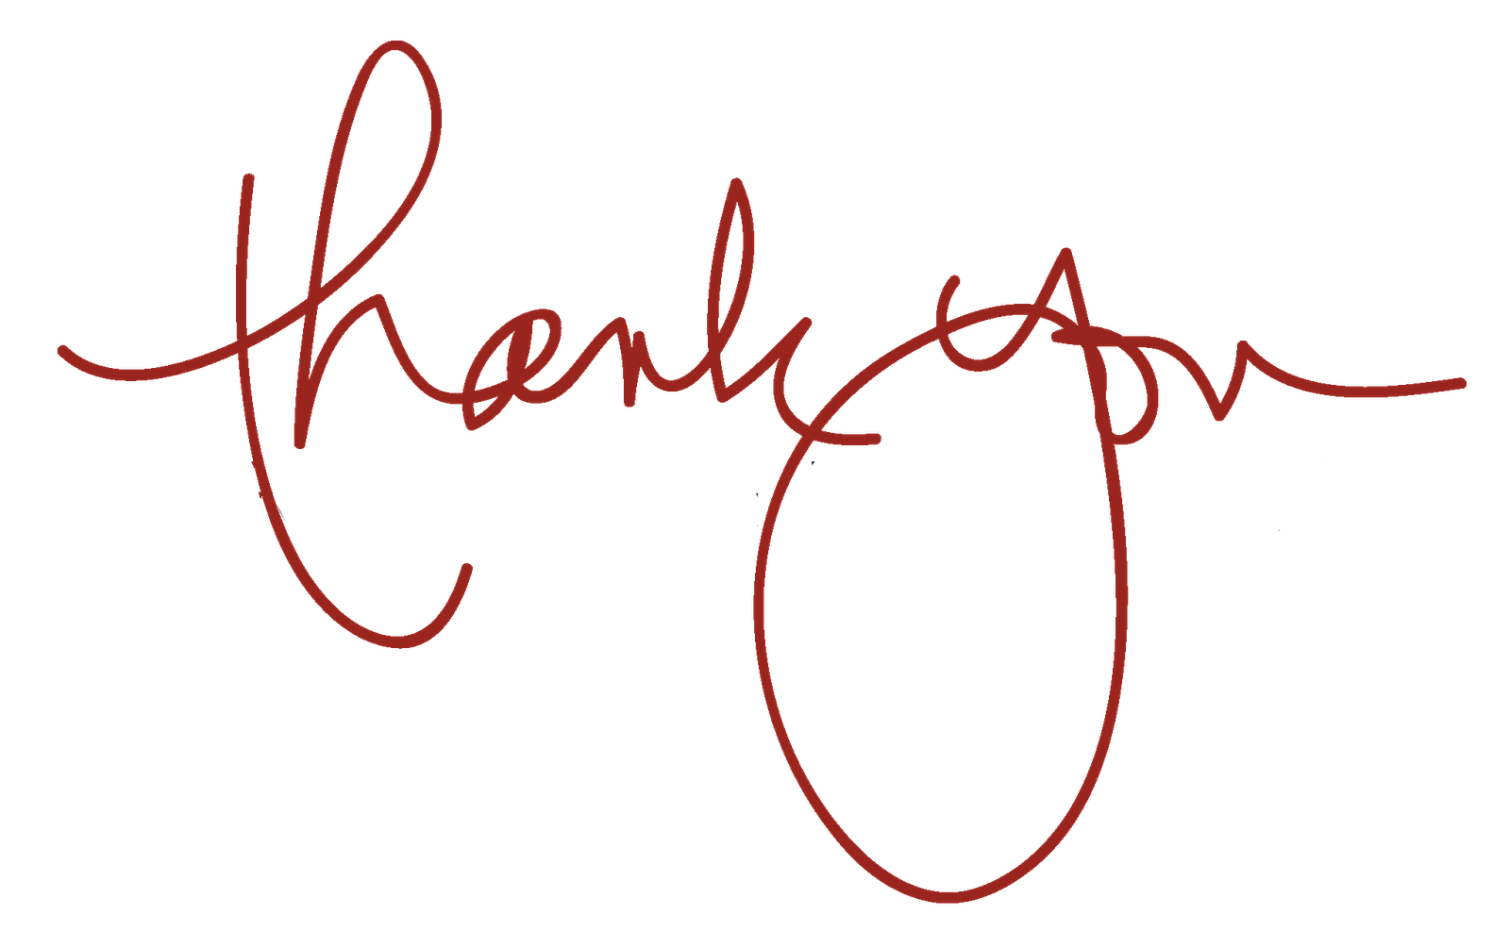

Guild Central Training: CAL
Key contacts:
Your Staff Liaison Contact
Your Student Experience Officer
Education Officer: education@guild.bham.ac.uk
Rep Coordinators: studentreps@guild.bham.ac.uk

