Slide 1



Guild Central Training 2019:
Medical and Dental Sciences (MDS)

Slide 2


Guild Central Training: MDS
Objectives
To understand the responsibilities of being a representative and the responsibilities we have as a Guild
To look at key focus areas of your College and understand how you can get involved

Slide 3
Guild Central Training: MDS
Talk to the person next to you…
Why did you become a Rep?
What is expected of Reps?

Slide 4
Guild Central Training: MDS
Benefits of Being a Rep
Training and Support
Development of new and existing transferable skills including communication and problem-solving
Personal development such as confidence and leadership
Opportunity to make a difference to the academic experience of current and future students at Birmingham
Gaining a better understanding of the academic environment of Higher Education
Notes:
Socials, thank you, PSA (personal skills award), Enhanced Transcript
Masterclass sessions:
Quality Assurance, Not On, Equality and Diversity
Leadership, Higher Education Policy, Rep Employability

Slide 5
Guild Central Training: MDS
Your Responsibilities as a Representative
To continuously improve the student learning experience in partnership with the University and The Guild by helping create solutions to problems
To represent all your cohort’s views and opinions on all matters relating to learning and teaching
To provide both positive and negative feedback to staff
To act as a communication channel between staff and students
Notes:
Though note, it is useful to help comes up with solutions to student problems, but it is not your sole responsibility. It might help to attend Student Staff Forums with a solution in mind that is reasonable, but it is always useful to draw attention to a problem even if you don’t have a solution
Remember that your cohort will include more than just your friendship group on your course. You should consider the needs of other students – i.e. some of you may prefer 5pm lectures to 10am lectures as you may function better in the afternoon, but there may also be commuters or parents/carers on your course who would prefer a 10am lecture so they can get home an hour away while it’s still light or pick up their kids from school etc.
Without positive feedback, staff won’t know what works well and can be extended to other modules and departments

Slide 6
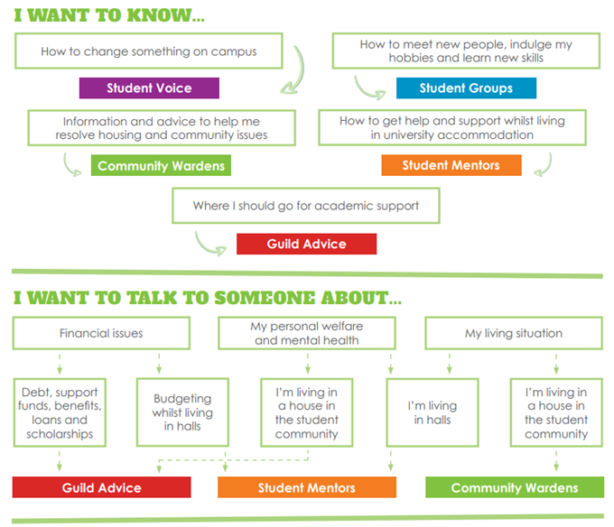
Not to rep
Notes:
Your job is to represent your cohort’s academic interests, not any of the other stuff, but feel free to signpost students to the following services especially as they may come to you as a friendly and familiar face
Note that there are also services at the University that you can signpost students to, i.e. the Student Hub in Aston Webb, College Wellbeing Officers etc.

Slide 7
Guild Central Training: MDS
Our Responsibilities as a Guild
To identify trends and issues that we need to raise at University and College level committees
To support you in your role by providing training and enhancing your skills and expertise through our masterclass sessions
To celebrate and recognise your individual successes
To create a community of reps
To keep you updated with events you can get
involved with via our Student Rep Newsletter

Slide 8
Guild Central Training: MDS
Jargon Buster
Agenda – list of items to be discussed at a meeting
Minutes – a written record of what was discussed at a meeting
Apologies – formally notifying that you are unable to attend a meeting
Terms of Reference – a document that states both the purpose of a committee and the membership of a committee

Slide 9


Make sure students on your programme know who you are
Identify student issues and needs
Attend meetings and communicate student issues and positive experiences with staff
Identify issues for your School/College Reps, or the Education Officer to take to meetings and committees
Notes:
If you can’t attend a meeting, please send your apologies so that staff know you are unable to attend. If possible, email in any feedback you have gathered so it can still be discussed at the meeting (another Rep can raise it on your behalf, or a staff member can read it out)

Slide 10

Guild Central Training: MDS
Your College Reps
Role | Name | Email address
UG College Rep | Joseph Devereux Louise Pilkington | jxd804@student.bham.ac.uk lcp891@student.bham.ac.uk
PGT College Rep | Damilare Faniran | def958@student.bham.ac.uk
PGR College Rep | Position vacant | Position vacant
Notes:
PGR College Rep position currently vacant – check website for updates throughout the year

Slide 11
Guild Central Training: LES
The Guild
Student feedback
Rep communicates with staff
University action
Students experience change
Rep communicates with students
Feedback Loop
Notes:
The Guild sits in the middle because if everything works well, we can leave SSFs to it, but if there are issues at any point during this loop or something isn’t happening, please let us know and we can support

Slide 12
Guild Central Training: MDS
Feeding back to the Guild
Helps us identify college-wide and university-wide trends and themes that your Guild Officers can raise with the University
Enables us to share your successes and impacts with the student body
Rep Journals
Key way to feed back to the Guild
Each month a Guild Officer and the Rep Coordinators will select a ‘Rep Win of the Month’. If you’re the Rep who gets picked for this, we will give you a £10 Amazon Voucher in recognition of your work!
Find it on the Guild website

Slide 13
Guild Central Training: MDS
Rep Fund
Any Student/PGR Rep can apply for up to £150 per term to gather feedback from their cohort
The event/idea must be used to gather feedback from your cohort about academic issues
The application is reviewed by a panel who will approve or suggest amendments for the event
You can find an application form for this fund on the Guild website, or email studentreps@guild.bham.ac.uk

Slide 14
Guild Central Training: MDS
MDS – how can work together?
Community - what does that mean to you?
Tell us what we do well so we can do more of it
Challenges of NATY

Slide 15
Guild Central Training: MDS
To note:
Med Soc – a student-run society open to all courses in MDS
CAWC (Curriculum and Wellbeing Committee) - operates as a School level committee for Medicine Reps
Year Reps in Medicine - the same as School Reps
Think about how to collect feedback from students who are on placements
Notes:
Med Soc: student-run society open to all courses in MDS – sports teams, societies, charities

Slide 16
Guild Central Training: MDS
Discussion:
What issues have you already come across on your course?
How could you collect feedback on these issues? (think about students on placements and/or commuters/distance learners)

Slide 17
Guild Central Training: MDS
Student Voice Report 2019
Black student satisfaction, attainment and experience
Assessment and feedback
Academic integrity and examinations
Supporting the student voice & building a community of staff and students
The Postgraduate Researcher experience
Access and participation plan
Support for students on study abroad and placement years
Notes:
How - Using student surveys, all Guild survey data, and SSF reports, the Guild creates a Student Voice Report.
Purpose – to identify key issues to work on and prioritise based on what students have said
Black student satisfaction – working to reduce the gap between the percentage of black and minority ethnic students getting a first or a 2.1 and their white counterparts
Assessment and feedback – improving consistency of feedback and reduce number of times students don’t receive feedback on time
Academic Integrity – ensuring that assessment practices and extenuating circumstances are consistent across the Uni and easy for everyone to understand
Student Voice/Community – working together, representing student needs and academic interests, better student experience
PGR experience – improving experience of progression, assessment and research Access and participation plan – reducing barriers and increasing the number of opportunities to student engagement
Support for students on study abroad or placement years – support before and after and during a year abroad or placement year.
Guild will work with the Uni over the next year to ensure that these changes are on track

Slide 18
Guild Central Training: MDS
Events coming up…
“Not On” Masterclass
Monday 18th November 13:00-14:00 Amos Rom, The Guild
Equality and Diversity Masterclass
Tuesday 10th December 2019 13:00-14:00 Mandela Room, The Guild
SPEAK WEEK
Monday 2nd to Friday 6th December 2019
We will be asking all students/researchers to “spill the tea” on their student experience
You can get involved as a Rep!
Email studentreps@guild.bham.ac.uk

Slide 19



Guild Central Training: MDS
Next Steps…
Communicate on a regular basis with students - try to make sure you are vocal in lectures
Join our Facebook Group !
Attend Staff Student Forums and read the papers
Close the feedback loop
Don’t forget you can always talk to us
at the Guild for support and advice

Slide 20
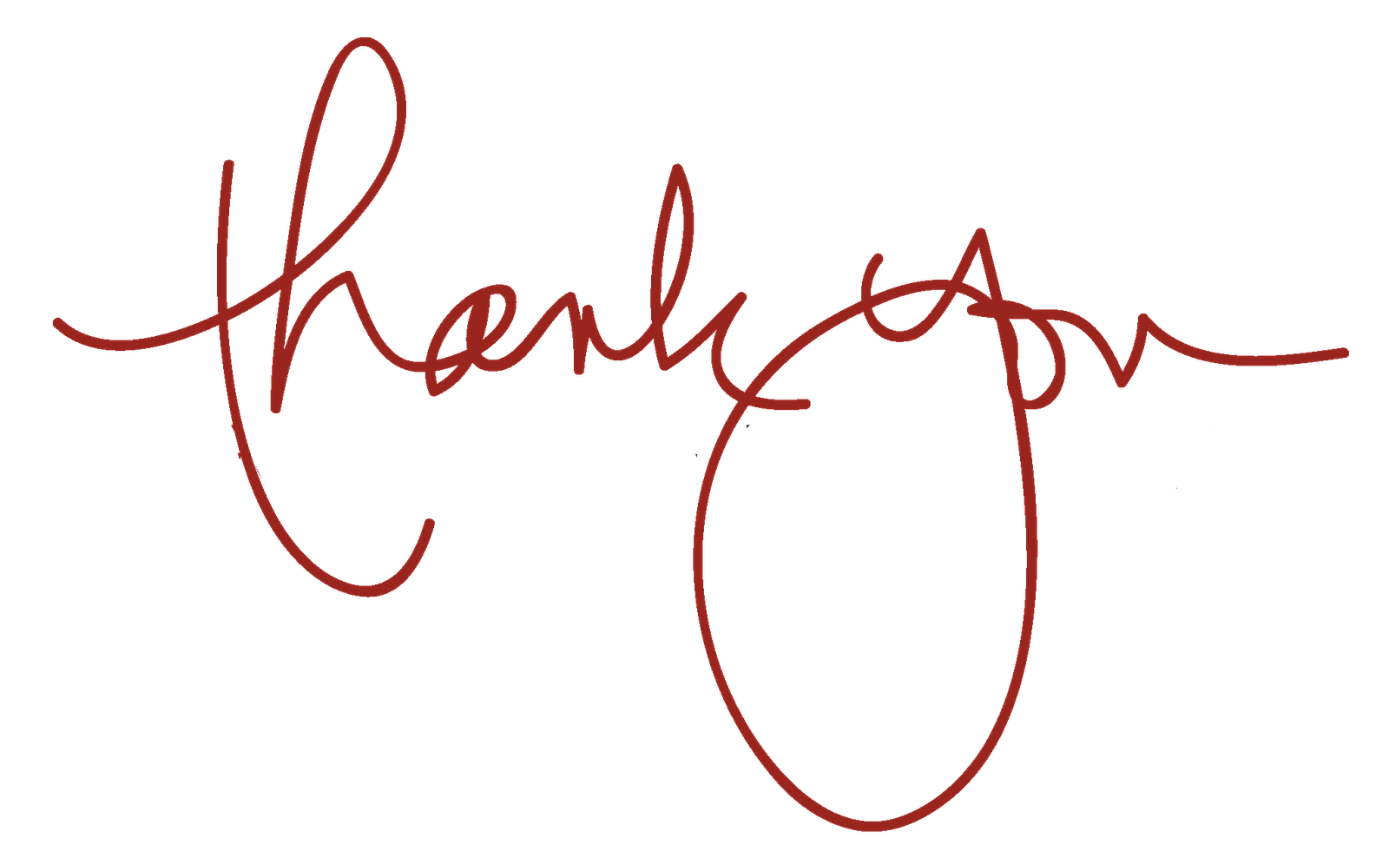

Guild Central Training: MDS
Key contacts:
Your Staff Liaison Contact
Education Officer: education@guild.bham.ac.uk
Rep Coordinators: studentreps@guild.bham.ac.uk

