Slide 1



Senior Rep training
Notes:
Hello and introductions…

Slide 2

Senior Rep Training
Role of the Senior Rep
To chair or co-chair the Staff Student Forum meetings
To pass on any relevant information to students and Guild of Students
To have an understanding of the issues being raised by other Reps in your SSF
Refer any Reps who are having difficulties in their role to the Staff Liaison Contact (SLC) or Guild
This role can be shared
kkk

Slide 3

Senior Rep Training
Chairing a meeting

Slide 4
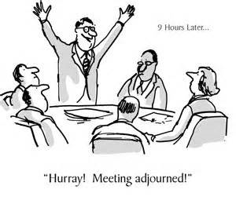

Senior Rep Training
#studentreps17
Activity!
Mix and match exercise!
Match up the agenda points with their definitions
!
kkk

Slide 5
Senior Rep Training
#studentreps17
AGENDA ITEM | PURPOSE
1. Welcome | For all members to introduce themselves and their role. Particularly relevant if your SSF meets infrequently.
2. Apologies | To record members of the forum who are unable to attend the meeting. All apologies should be recorded in the minutes.
3. Minutes of previous meeting | Forum members need to approve each set of minutes as an accurate record of the last meeting. Any amendments that need to be made should be recorded in the minutes. If there are no amendments to be made, the minutes are ‘approved’.
4. Matters Arising | An opportunity to receive updates on agenda items discussed at the last meeting. It may be that a forum member was asked to do some work or that there have been subsequent developments on an issue which now needs discussion.
5. The SSF Annual Report | Each year in the summer term, SSFs are required to complete an Annual Report. The report is divided into two sections: How the SSF operates Issues discussed and resolved Both staff and Student/PGR Reps should complete this report together. The report may be best completed during a meeting.

Slide 6
Senior Rep Training
#studentreps17
#studentreps17
6. Section A of the External Examiner Report (for UG and PGTs) | These agenda items relate to surveys and reports that the University uses to assess its performance. They must be discussed by SSFs each year. By discussing these papers, Student/PGR Reps are given the opportunity to understand how the University is doing, and the areas they want to improve. Student/PGR Reps may be able to offer ideas on how to achieve these improvements.
7. National Student Survey (NSS) Results / Postgraduate Taught Experience Survey (PTES) / Postgraduate Researcher Experience Survey (PRES)
8. Annual programme review (for UG and PGTs) or Postgraduate Research annual review (for PGRs)
9. 1st Year reports | For Student/PGR Reps to raise any issues on behalf of the students they’re representing.
10. 2nd Year reports
11. 3rd Year reports
12. Any Other Business | This is an opportunity for members to bring up any additional items for discussion, or any information to pass onto other forum members.
13. Date of next meeting | Reminder of next meeting.

Slide 7


What is chairing?
Senior Rep Training
#studentreps17
A Few Tips
Within the meeting, the student co-chair is responsible for...
Welcoming all and introductions within the meeting
Ensuring everyone has the chance to contribute
Keeping the discussion on-topic and relevant, challenging any inappropriate behaviour
Helping debates and discussions reach a conclusion in a timely manner
Specifying actions to take forward to future meetings
Making sure actions from the last meeting are read out and updated on
NB: The Chair is not necessarily neutral and is likely to contribute to the discussion

Slide 8
What is chairing?
Senior Rep Training
#studentreps17
A Few Tips
Before and after the meeting, the co-chair is responsible for…
Helping create the agenda for the next meeting
Taking the lead on closing the feedback loop by communicating or encouraging Student/PGR Reps to communicate the discussions and actions from the meeting back to the wider student body
Checking the minutes are an accurate reflection of the meeting and discussions had
Signing off the SSF annual report

Slide 9
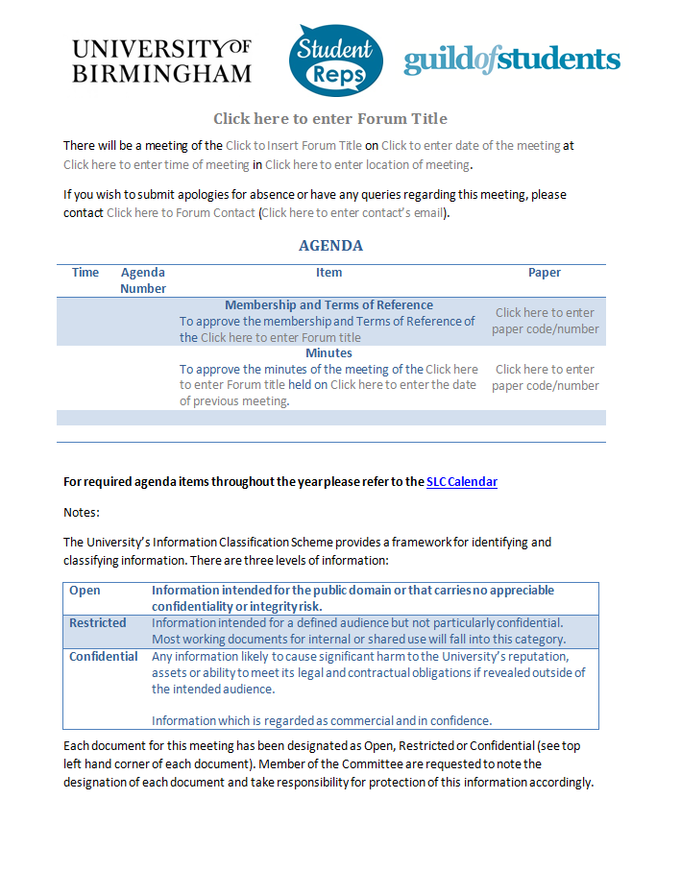
What papers will you see?
Senior Rep Training
#studentreps17
A Few Tips
SSF Agenda Template (some SSFs may not use the template, so be aware this may be laid out differently)
Terms of Reference (membership of the forum) approval
Confirmation that minutes of the last meeting have been approved

Slide 10
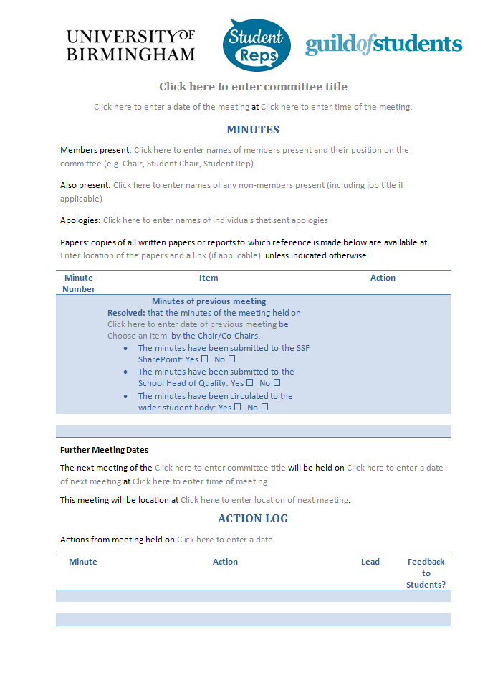
What papers will you see?
Senior Rep Training
#studentreps17
A Few Tips
SSF Minutes Template (some SSFs may not use the template, so be aware this may be laid out differently)
List of forum members that are present, have sent apologies and any others in attendance
Checklist for previous meeting minutes including key information such as whether minutes have been submitted to SharePoint, to the School Head of Quality and circulated to the student body
Space to write minutes from current meeting – these should outline the actions and key points and should not be too long
Summary of actions from the meeting

Slide 11
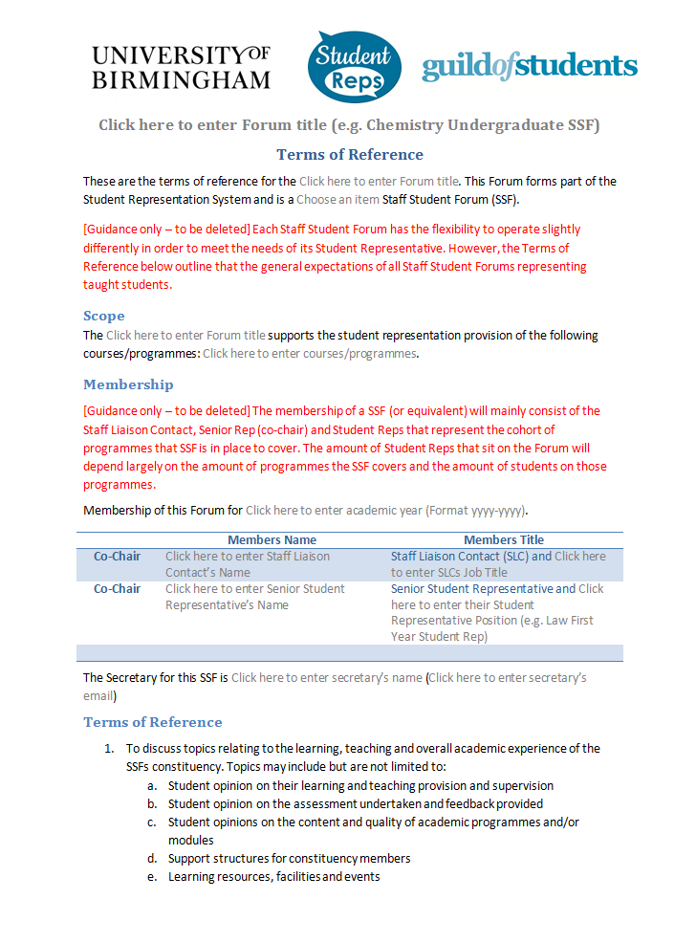
What papers will you see?
Senior Rep Training
#studentreps17
A Few Tips
SSF Terms of Reference Template (some SSFs may not use the template, so be aware this may be laid out differently)
List of courses/programmes represented by the SSF
Listed student and staff co-chairs
Listed forum secretary
Summary of topics that may be discussed at an SSF and the purpose of the forum, including reporting later on

Slide 12
How do we make decisions?
Senior Rep Training
#studentreps17
A Few Tips
In a meeting, there are some occasions where a vote might be used to come to a final conclusion, but these are rare.
Most of our decisions are made through consensus decision making. It is often the job of the chair to guide the discussion towards a consensus outcome that everyone is agreed on (even if it is not their ideal outcome).

Slide 13
Chair Role-Playing
Senior Rep Training
#studentreps17
#studentreps17
A Few Tips
Get into groups of 5, and choose a chair.
Each person take a paper slip with your role in the meeting
In this meeting, you are debating which animal your College should have as a pet – a dog or a micro-pig.
The Chair will aim to make sure everyone has a say in the meeting, while steering it to a consensus decision.
The Chair will also aim to keep everyone to time to ensure a conclusion is reached within the allocated time.

Slide 14
Senior Rep Training
#studentreps17
#studentreps17
Our Strategic Plan 2011-14
#studentreps17
Top tips
Stay calm
Prepare, prepare, prepare (and arrive early)
Read all the papers and meet with individuals in advance if needed
Allow everyone to contribute and ask for thoughts from others
Make sure everyone gets a chance to speak- think about asking quiet people if they would like to contribute
If you have issues, let someone else present them for you or step down from your role
Introduce the meeting. If the people there don’t know each other, make sure introductions are made
Introduce the topic, and if appropriate give some context. You may ask someone in the room to introduce it on your behalf if it is their idea/proposal
Make sure the initial proposal is heard (e.g. we would like the water fountains in the Guild to be full of lemonade, and here’s why)
Guide the group to a conclusion
kkk

Slide 15

Senior Rep Training
#studentreps17
Any Questions?
studentreps@guild.bham.ac.uk

