Slide 1



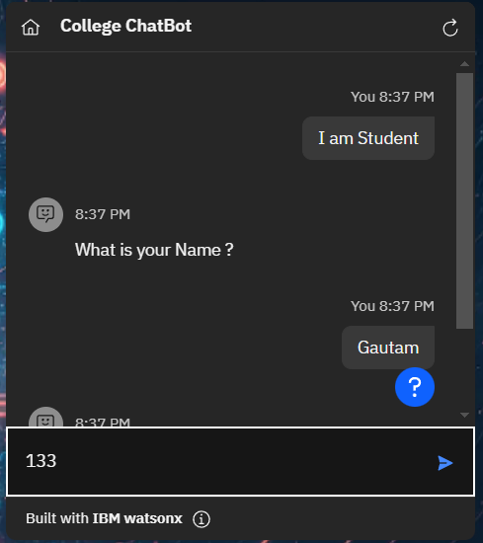
College ChatBot
Program Feedback
Project Short Summary
Edunet’s IBM Skills Build Program is very interactive for me developing my skills.
In conclusion, the development of a college admission chatbot offers a practical solution to enhance the application experience for prospective students
Gautam Mehar
Gautammehar792@gmail.com
Final Project Outcome Screenshot
Medi-Caps University, Indore
#skillsbuild

