Slide 1
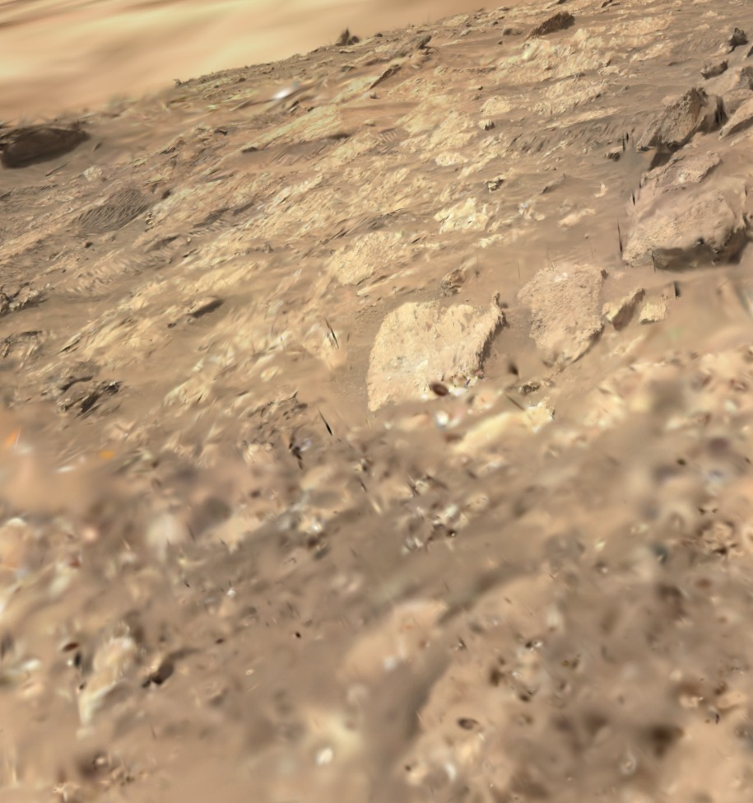
GAUSSIAN SPLATTING
From rover photos
to a walkable
piece of Mars
241 Perseverance photos of Cheyava Falls became 972,047 Gaussians, in real metres, without ever guessing where a camera was.
Right: our splat in the viewer, from rover height.
Planetary Scene Studio · MHacks

Slide 2
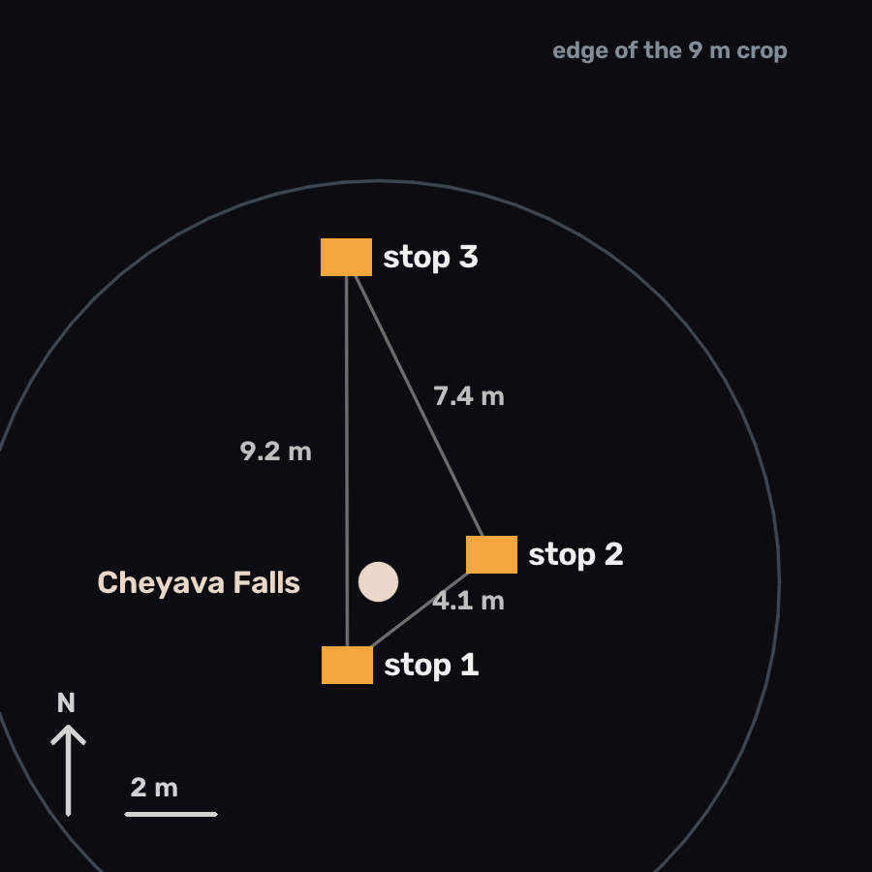
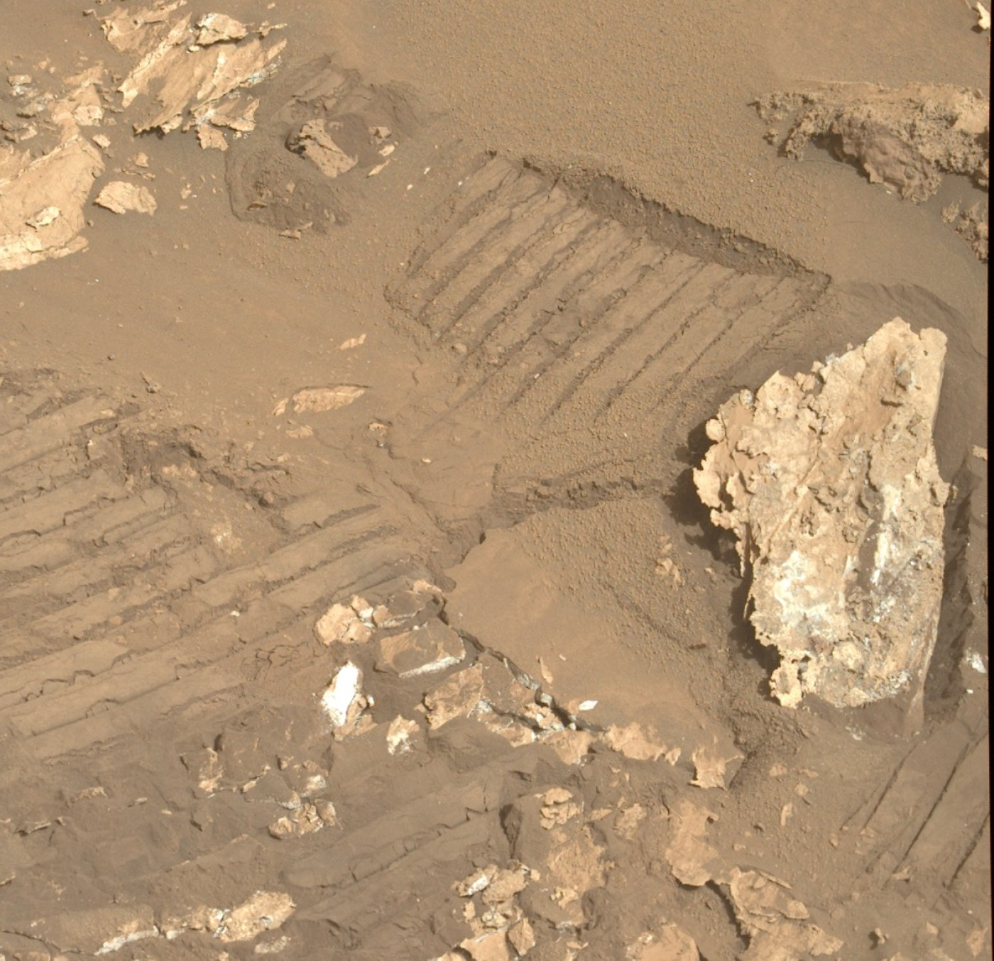
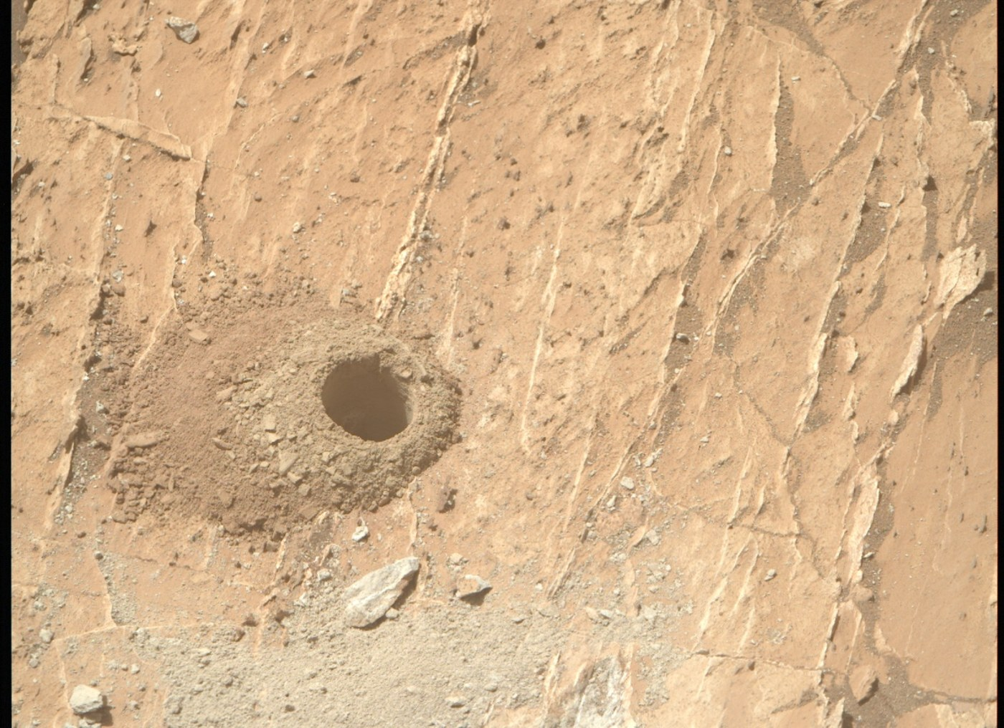
STEP 1
Start from real photos, from three parking spots
A splat needs the same ground seen from different places. One stop only gives rotation; three give depth.
Mastcam-Z: where the sample was drilled
Mastcam-Z: a rock and the rover's wheel tracks
241 photos from NASA's public Mars 2020 feed, sols 1195 to 1210
2 cameras Navcam (wide stereo pair) and Mastcam-Z (zoom, colour)
Where the rover stood, to scale
Planetary Scene Studio · how the Mars splat was made

Slide 3
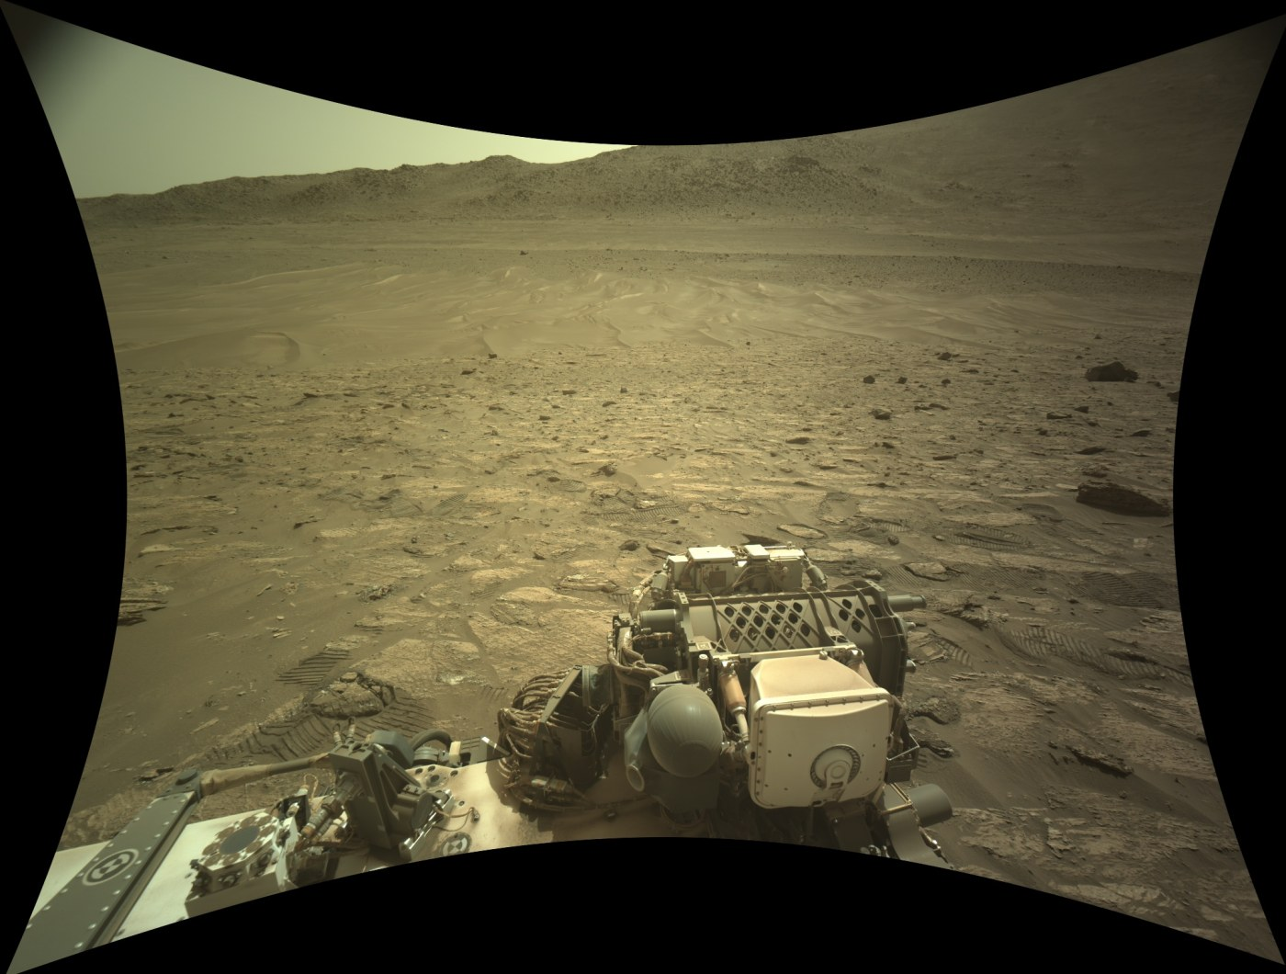
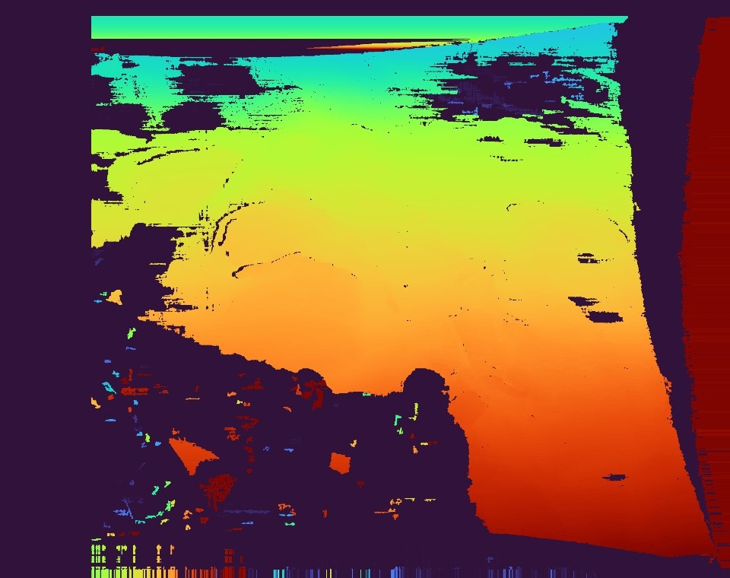
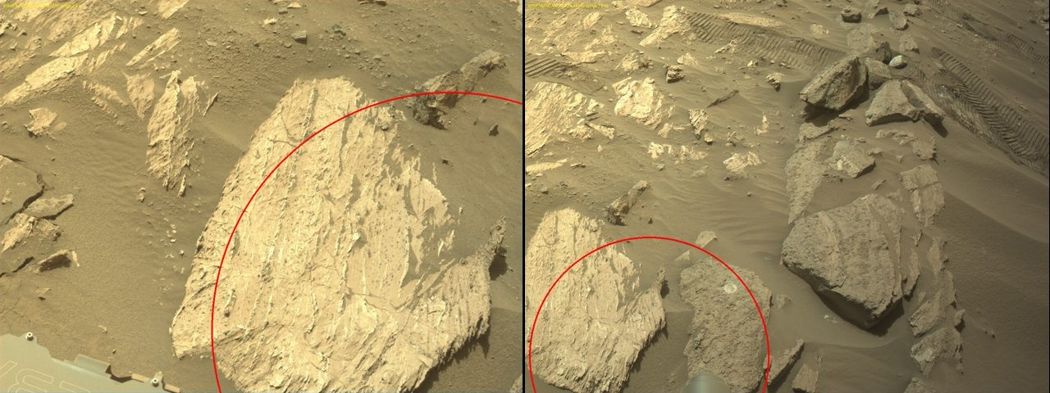
STEP 2
Get the geometry from NASA, not from guesswork
Every image ships with its camera model and the rover's position, so the scene is in metres from the first step. No structure-from-motion.
One spot (red circle) located in photos from other stops, from rover telemetry alone
Fisheye Navcam frame, straightened with its JPL camera model
Depth from the two Navcam eyes, 42 cm apart (red is near)
0.1 px stereo matching error after undistorting, down from about 1 px
312,136 3D points from stereo, used as the starting positions
2 px worst misalignment between the three stops after registration (our limit: 3)
Planetary Scene Studio · how the Mars splat was made

Slide 4
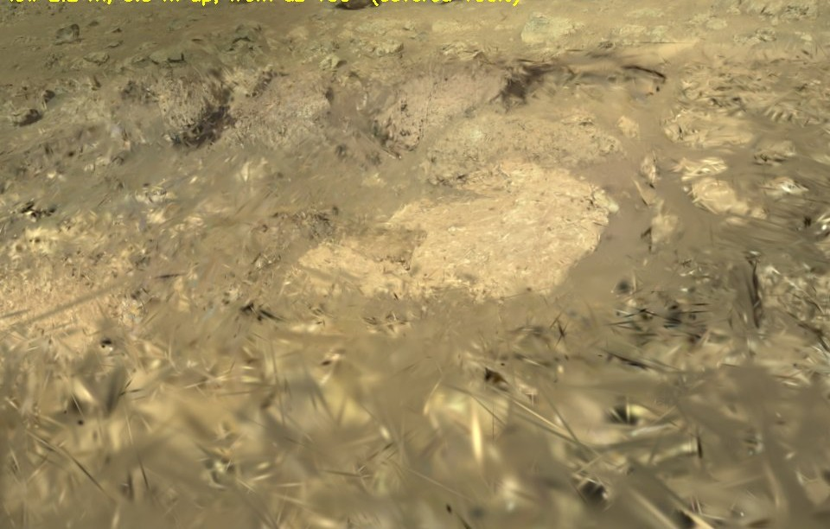
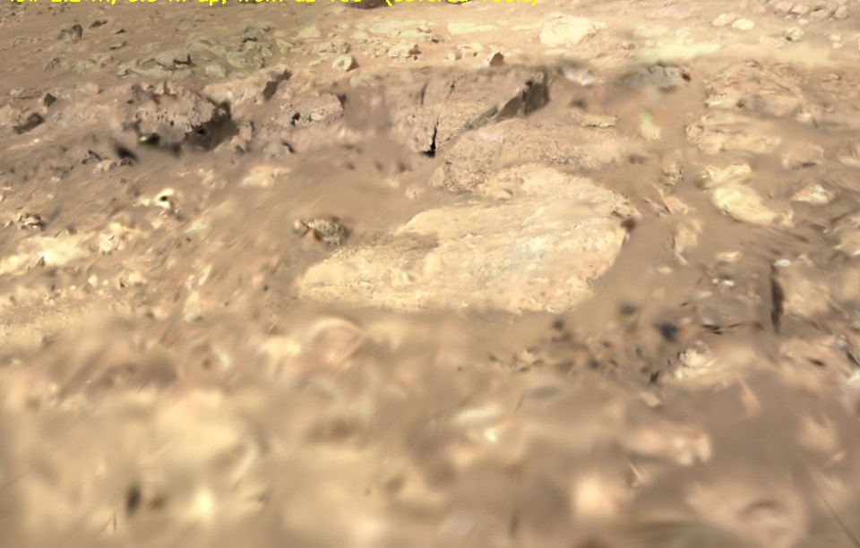
STEP 3
Train, then judge by looking
gsplat with the MCMC strategy on a Colab A100. The usual score barely moved between good and bad runs, so every run was rendered from new viewpoints.
30,000
steps
25 min
on one A100
2.5 M
Gaussians
First run: fine from the training cameras, spikes from anywhere else
Final run, same viewpoint
Fix 1 a depth-loss bug that produced NaNs
Fix 2 two regularisers that removed Gaussians seen by only a few photos
Fix 3 a penalty on needle-shaped Gaussians, which were the spikes
Planetary Scene Studio · how the Mars splat was made

Slide 5
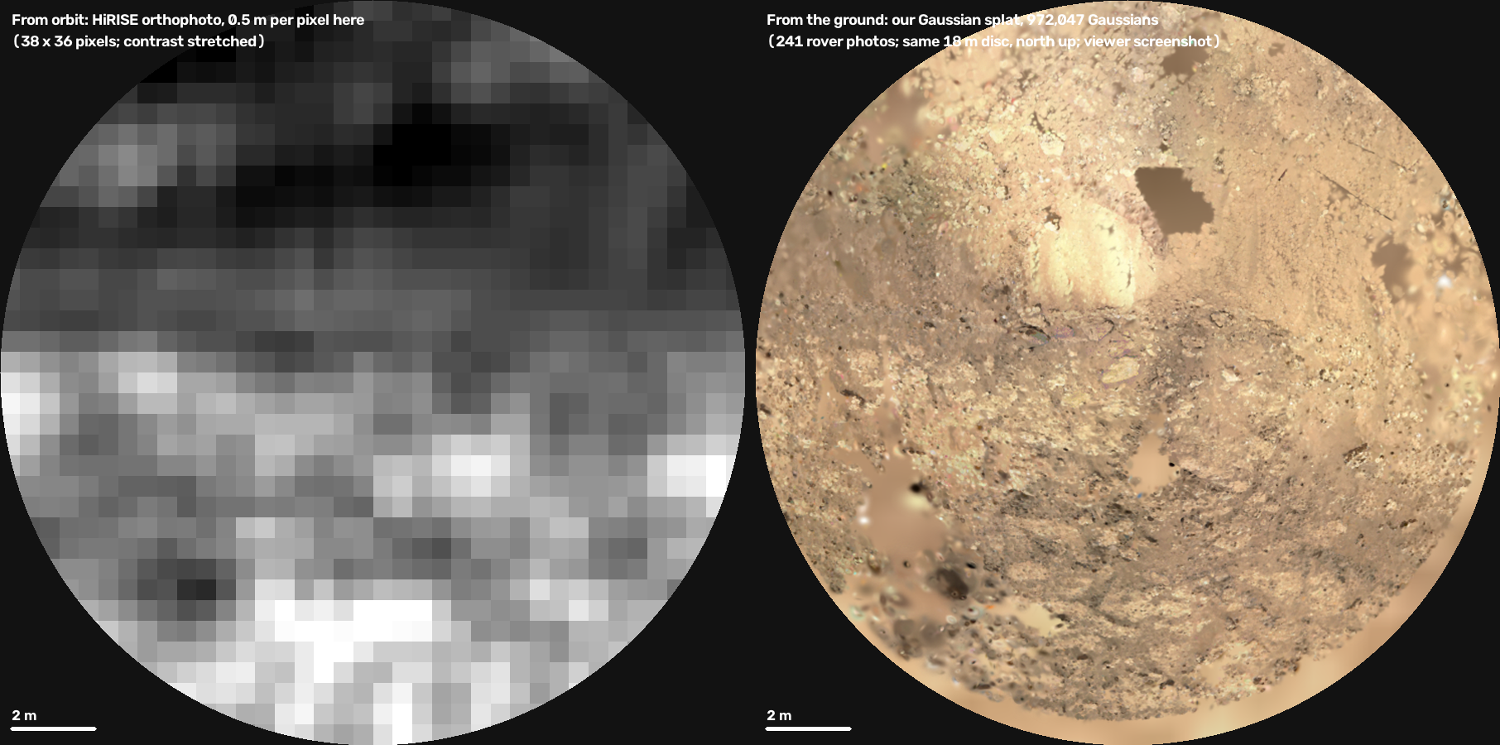
STEP 4
Put it on the map, and make it data
Cropped to the 9 m that the photos cover well, placed on NASA's orbital terrain in the same metric frame, with a layer value on every Gaussian.
972,047
Gaussians in a 16 MB file
270
orbital height samples in the same disc
Layers
terrain class, roughness, search cluster on every Gaussian
10 cm
surface map the rover drives on
Limits: soft from closer than about 2 m, and holes where no photo covers the ground.
The same 18 m disc: 38 x 36 orbital pixels on the left, our splat on the right
Planetary Scene Studio · how the Mars splat was made

