Slide 1
Early Computer Vision Development Timeline
Computer vision tasks include methods for acquiring, processing, analyzing and understanding digital images, and extraction of high-dimensional data from the real world in order to produce numerical or symbolic information, e.g. in the forms of decisions.
1957
1959
1960
1966
Oliver Selfridge
Frank Rosenblatt
Lawrence Roberts
Marvin Minsky and Seymour Papert
Began to explore ideas related to pattern recognition and early forms of what would later be known as computer vision.
Is credited with creating the perceptron, which later influenced various approaches in computer vision.
Later become known as one of the founders of the Internet, conducted early work on image scanning, which contributed to the evolution of computer vision.
Founded the MIT AI Lab. The lab became a hub for AI research, including early work in computer vision.

Slide 2
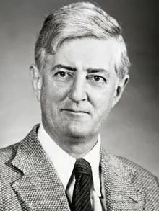
Oliver Selfridge
1957
1959
1966
Oliver Selfridge
Began to explore ideas related to pattern recognition and early forms of what would later be known as computer vision.

Slide 3
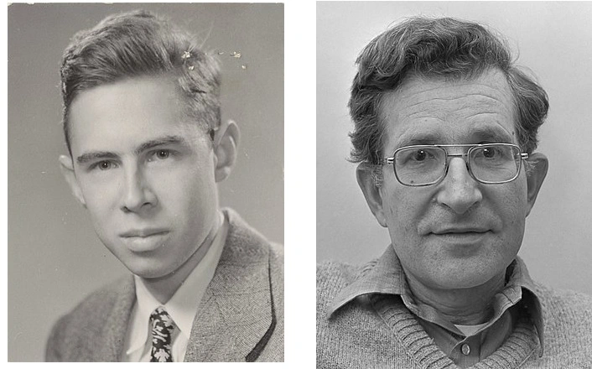
Frank Rosenblatt
1959
1957
1959
1966
Frank Rosenblatt
Is credited with creating the perceptron, which later influenced various approaches in computer vision.

Slide 4
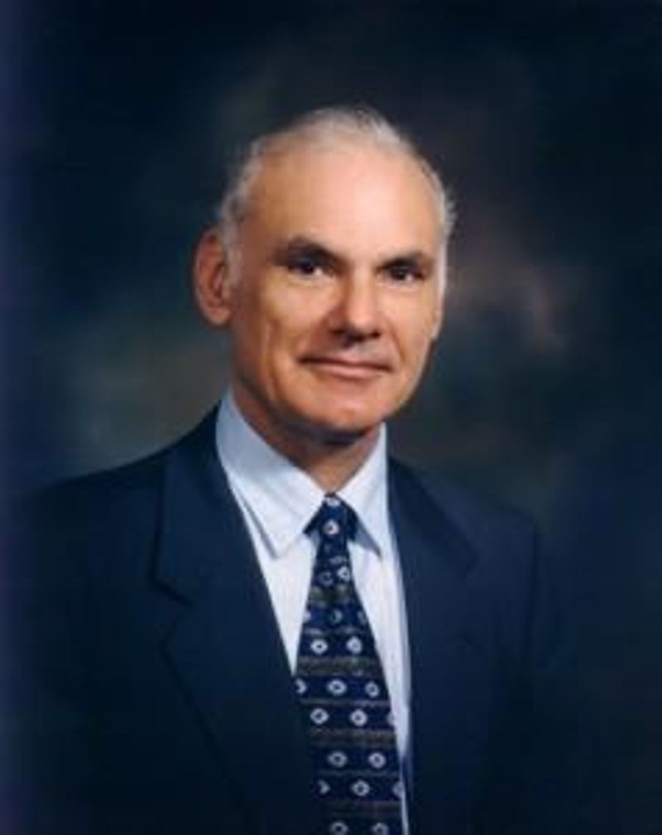
Lawrence Roberts
1960
1959
1966
Lawrence Roberts
Later become known as one of the founders of the Internet, conducted early work on image scanning, which contributed to the evolution of computer vision.

Slide 5
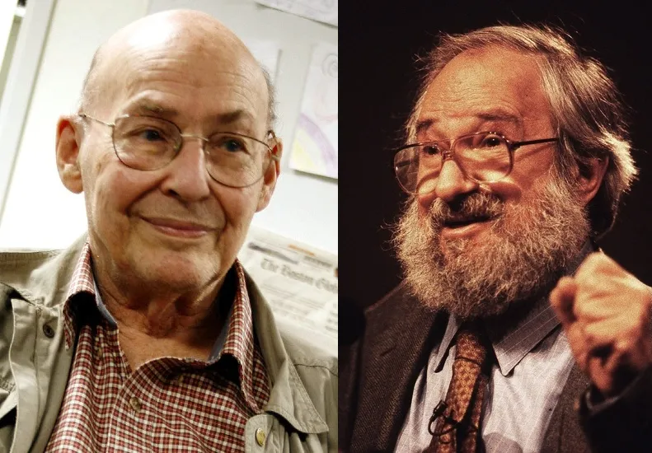
Marvin Minsky and Seymour Papert
1966
1966
1959
1966
Marvin Minsky and Seymour Papert
Founded the MIT AI Lab. The lab became a hub for AI research, including early work in computer vision.

