Slide 1

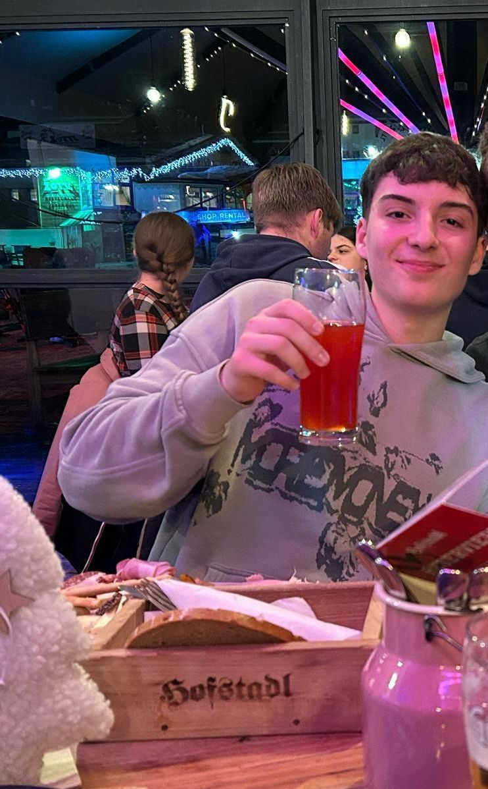

Introductuon
By: Harald Zach, Florian Thienel, Matthias Hrbek

Slide 2
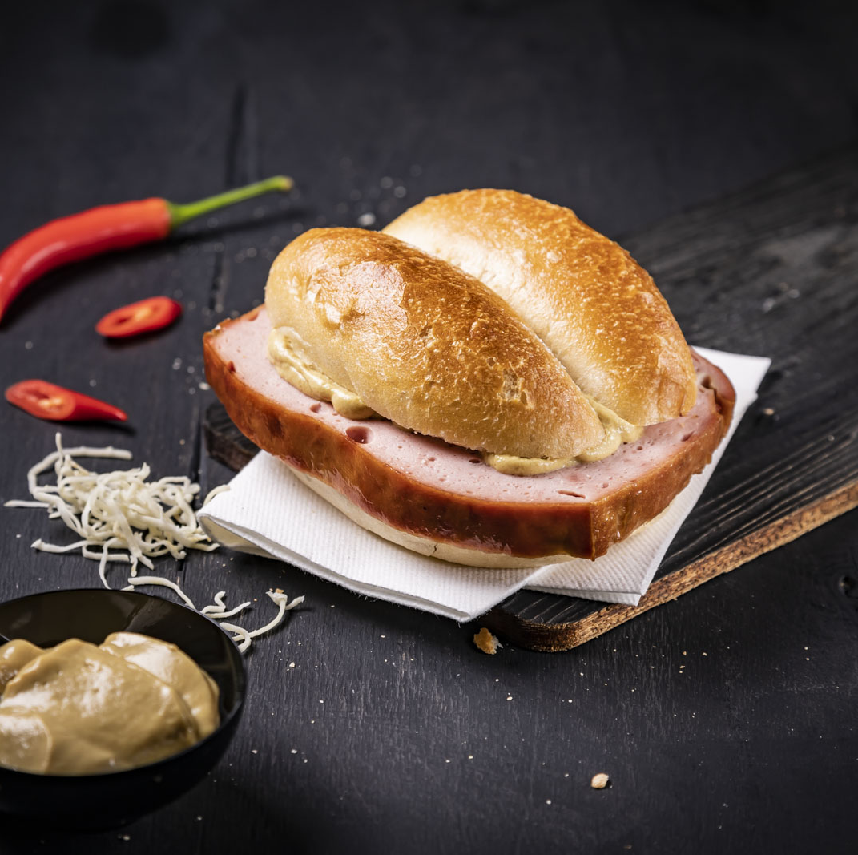
Austria
Population: ~ 9 Mio.
National dish: Wiener Schnitzel
Size: 83.871 km² (1/6 of Spain)
There are over 300 types of bread in Austria 🍞😋😮

Slide 3
Harald Zach
Nickname: Hari, Bauernbua
Age: 17
Hobbys:
Drinking alcohol
Walking da dawg

Slide 4
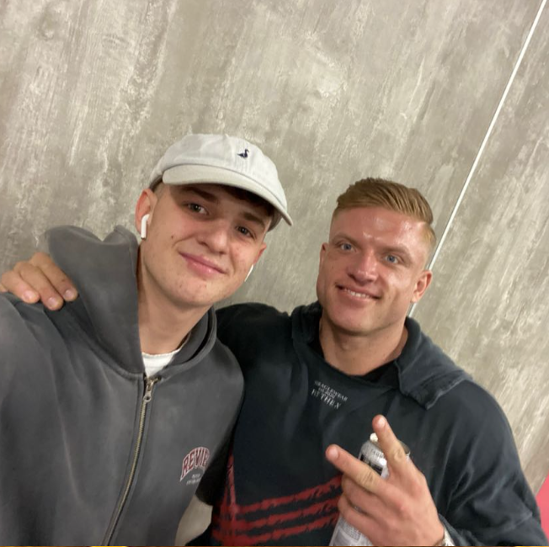
Florian Thienel
Nickname: Tindl
Age: 17
Hobbys:
Motorcycling
Playing trumpet

Slide 5
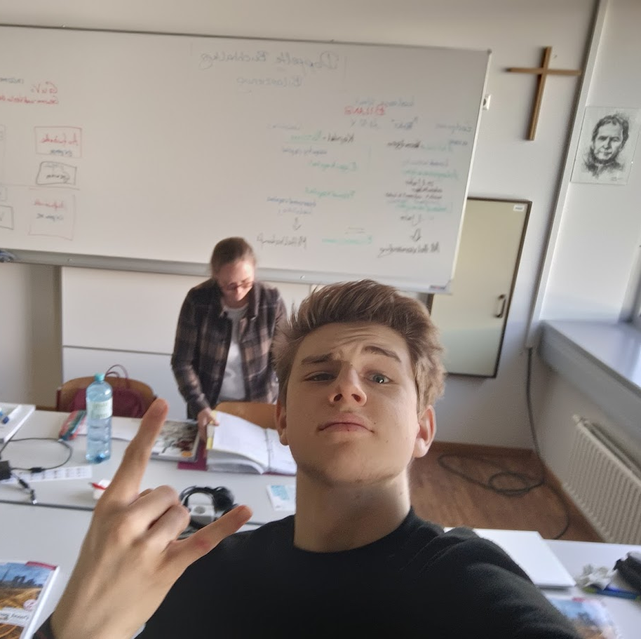
Matthias Hrbek
Nickname: Maze
Age: 18
Hobbys:
Motorcycling
Gambling (i never lose)

Slide 6
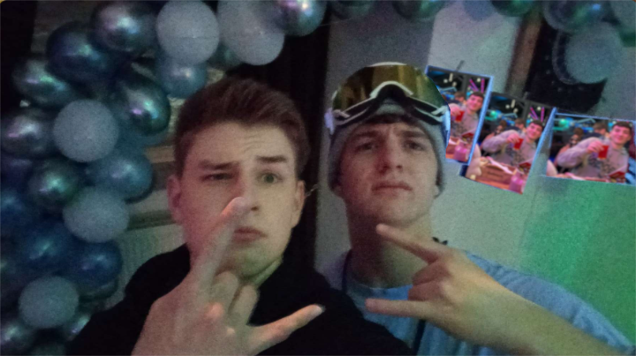
SEAS!

