Slide 1
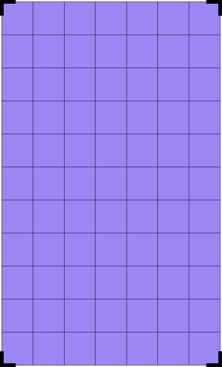
Final Gaming Project
TRESURE HUNT
20/07/2025

Slide 2
THE TEAM
1
Maya
Wissotzky
Alen
Aizmaylov
Ortal
Semo

Slide 3
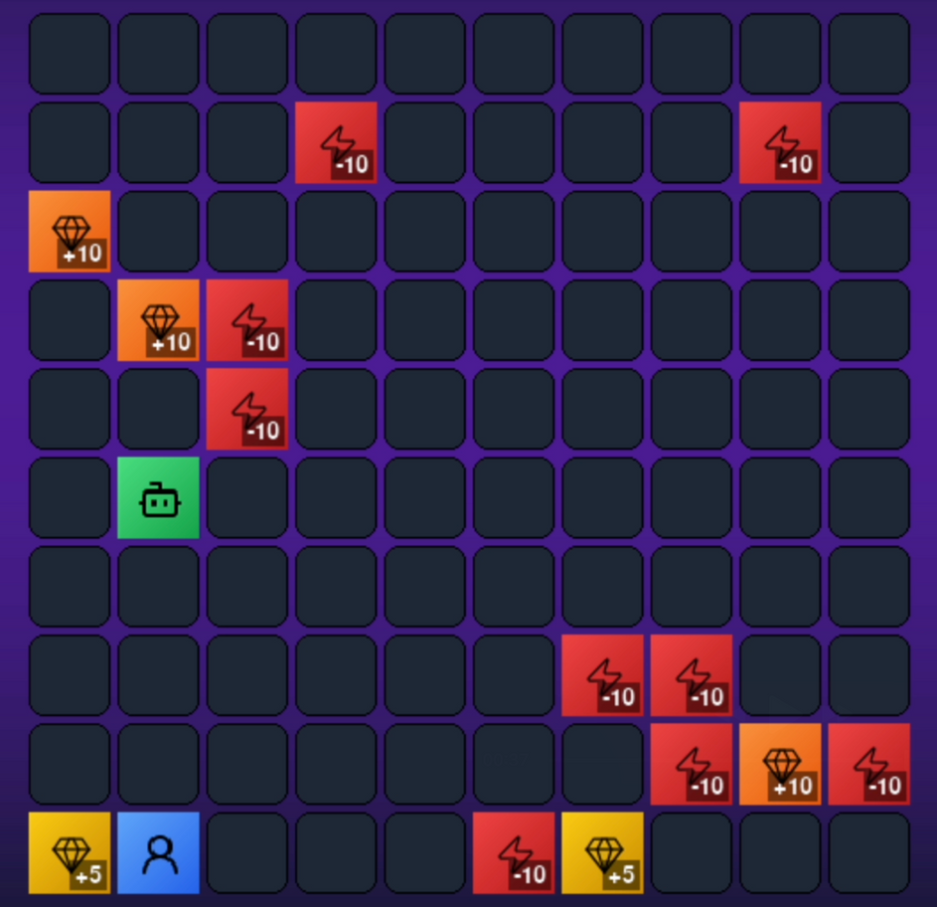

Overview
2
Project Goal
Design and implement an interactive path‑finding game.
Demonstrate AI search techniques in a fun, visual context.
Technologies & Tools
Language: Python.
Libraries: pygame for graphics, custom A* implementation.

Slide 4
Overview
3
Core Algorithm: A*
Heuristic‑driven shortest‑path search
Ensures optimal and efficient route finding
Key Features
Randomly generated mazes/grid maps
Real‑time visualization of open/closed sets

Slide 5
Game Rules
4
1
2
3
Collect treasures: +5, +10, +15 points
Avoid traps: -10 points
First to reach 100 points wins
4
5
6
Use F key to freeze opponent
Movement with Arrow keys
Pause: Space bar
Collision: Bounce off opponent if paths cross

Slide 6


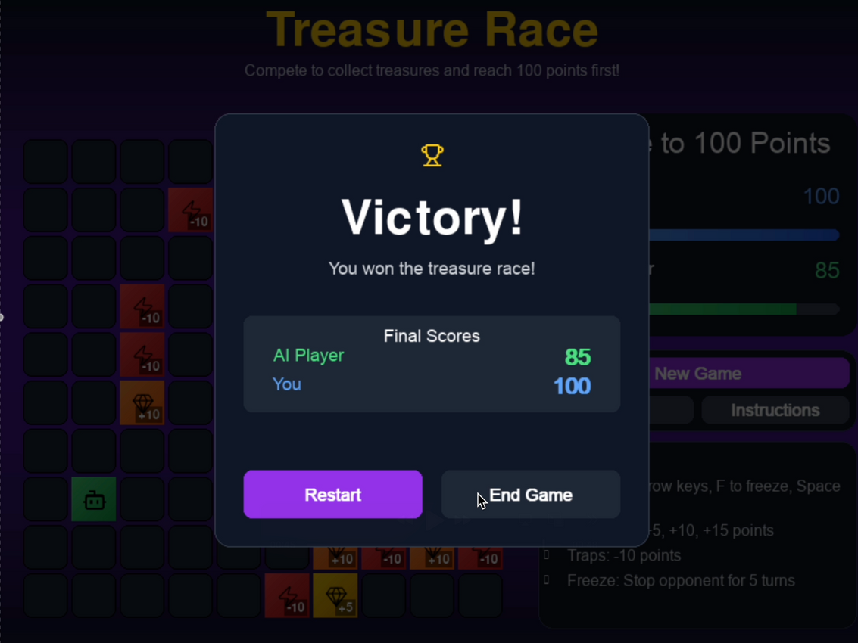
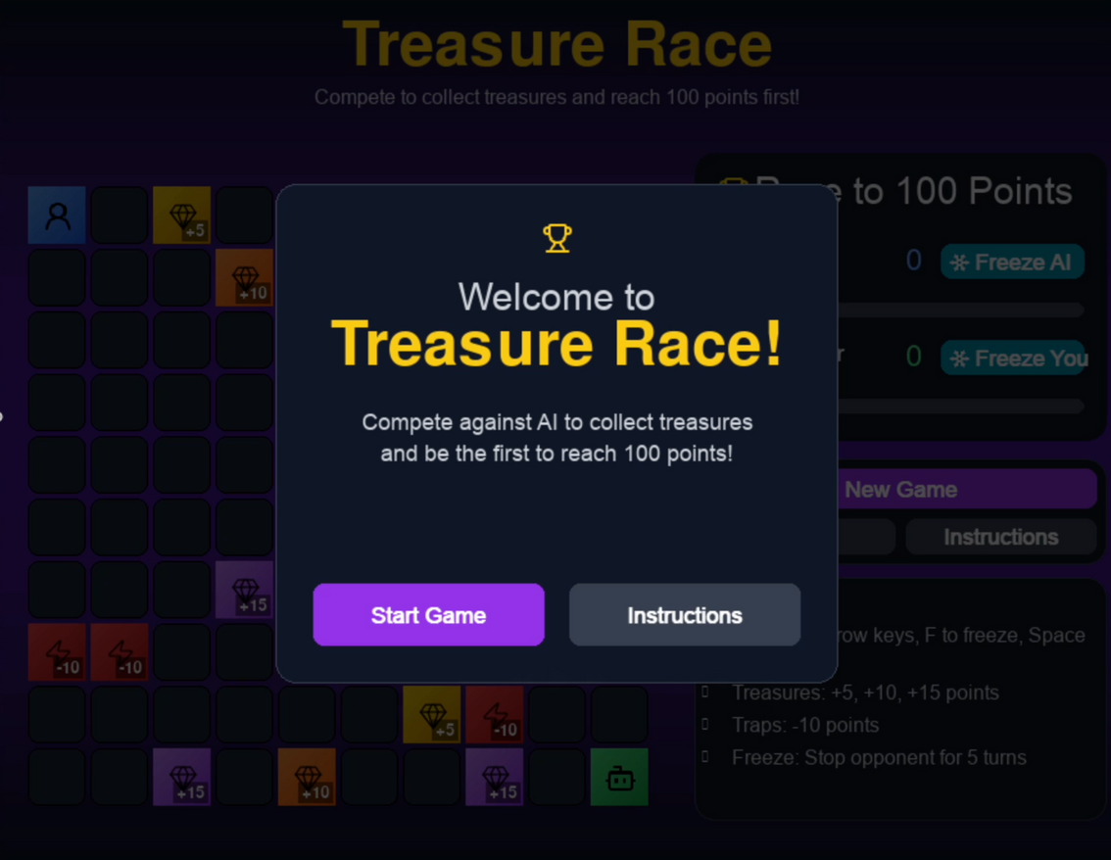

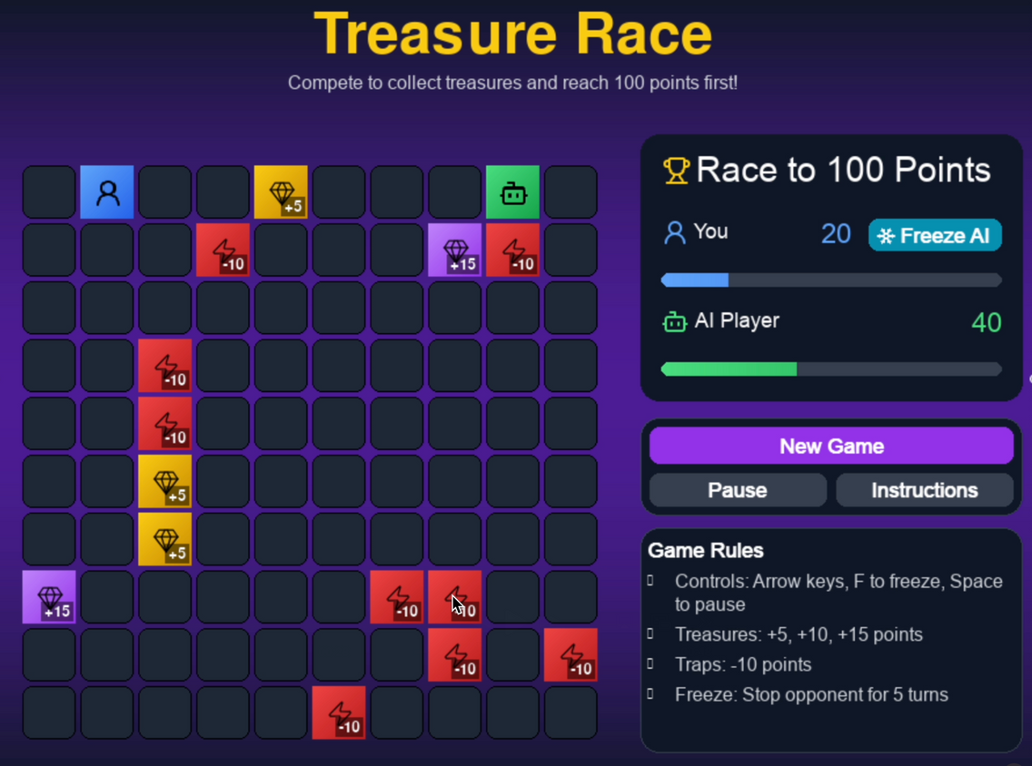
FIRST SCREEN
VICTORY SCREEN
6
MID GAME SCREEN

Slide 7
The Algorithms - ASTAR
7
Core Principle
Data Structures
Open Set (min‑heap) for frontier nodes sorted by lowest f‑score
Closed Set for nodes already evaluated
Maintains two scores per node:
g(n) = exact cost from start to n
h(n) = heuristic estimate from n to goal
f(n) = g(n) + h(n) guides the search
Heuristic Function
Manhattan distance: ∣x1−x2∣+∣y1−y2∣

Slide 8
The Algorithms - ASTAR
8
Search Process
Path Reconstruction
Pop the node with lowest f from the open set
If it’s the goal → reconstruct path
Otherwise, move it to the closed set
For each neighbor:
Calculate tentative g = g(current) + cost(step)
If this path is better, update g, f and parent, then add to open set
Backtrack from goal using parent links to build the full route
Performance & Guarantees
Optimal: finds shortest path when heuristic is admissible
Efficient: prunes paths that cannot improve on current best

Slide 9
Challenges in Implementation
5
NUM.1
NUM.2
NUM.3
Balancing AI difficulty vs fairness
Optimizing real-time rendering performance
Managing dynamic spawn probabilities

