Slide 1



Aloe Vera
Maud Gesbert

Slide 2

Table of contents
01
02
03
The datasets
Cleaning
Analysis

Slide 3

01
The datasets
Sales
Customers
Salespeople

Slide 4
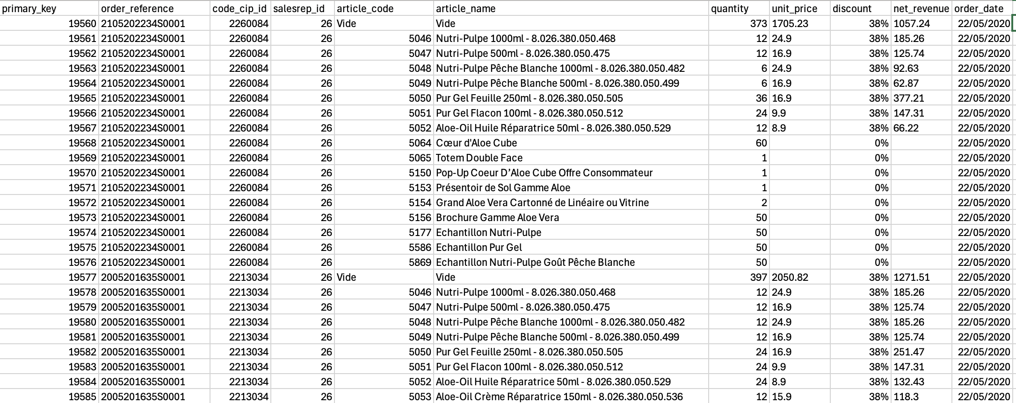
The datasets
Sales
Information about sales including:
Product names
Date and total amount of the sale
Code of the salesperson who made
the sale
CIP code of the customer who
made the purchase (personal code)
1. The datasets

Slide 5
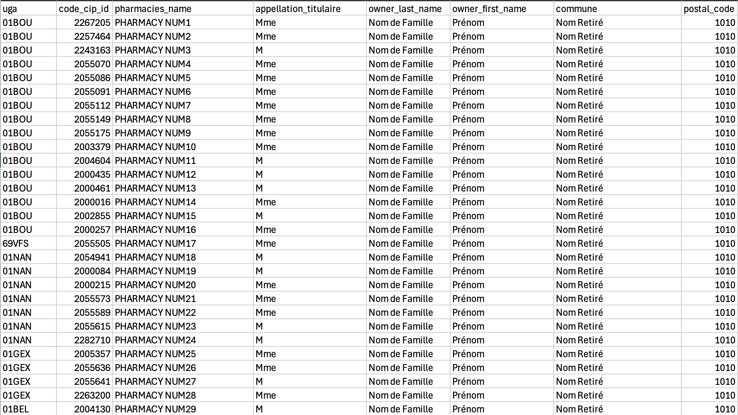
The datasets
Customers
Information about customers including:
Name of the pharmacy
First and last name of the manager
Location of the pharmacy
CIP code (personal code)
1. The datasets

Slide 6
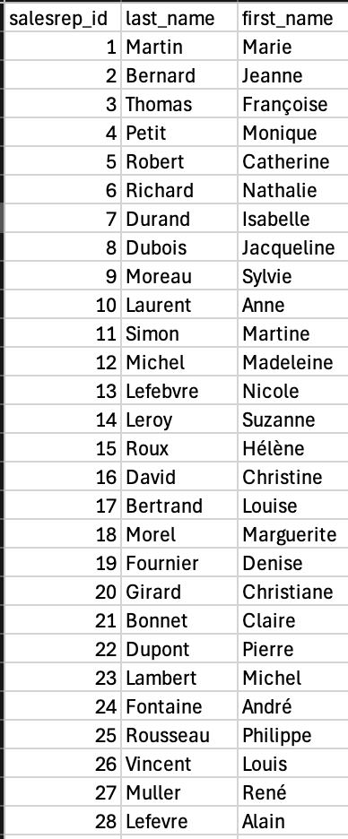
The datasets
Salespeople
Information about salespeople including:
Their first and last name
Their salesperson ID number
1. The datasets

Slide 7

Cleaning
02
Cleaning the data

Slide 8
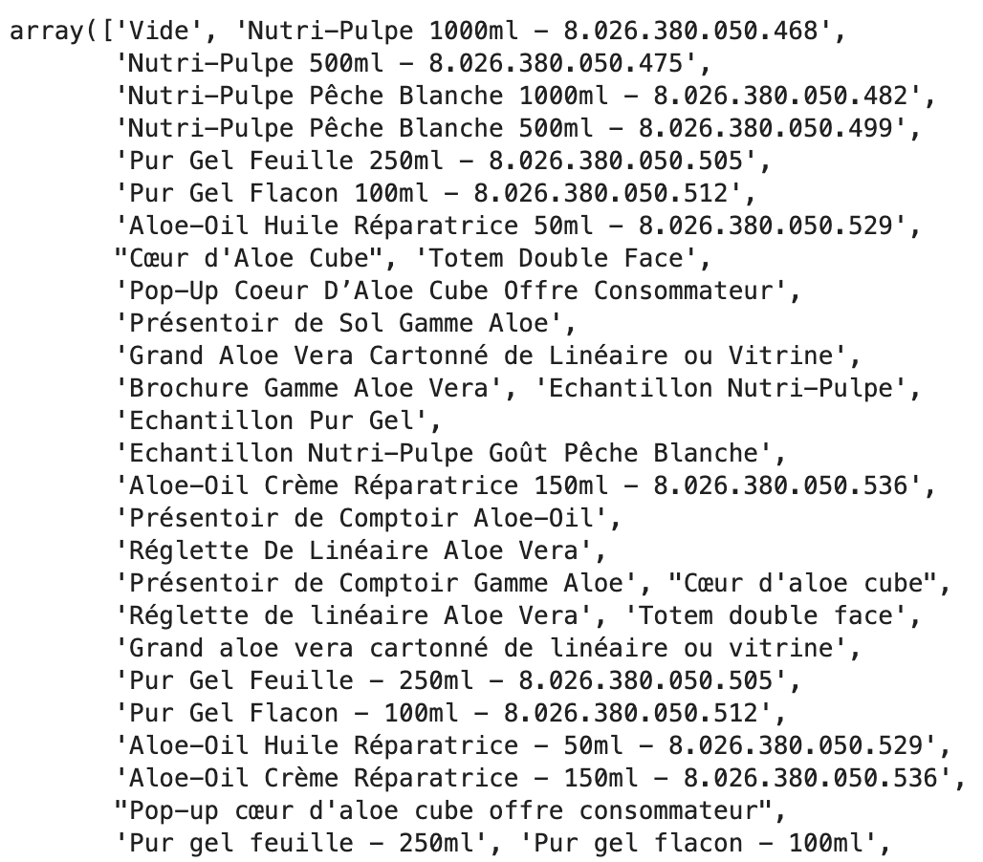
Sales dataset
Some product names contain numbers.
Some special characters interfere with the analysis because
products containing them are not recognized properly: it’s
impossible to group them to perform a general analysis of
the product in question.
2. Cleaning

Slide 9
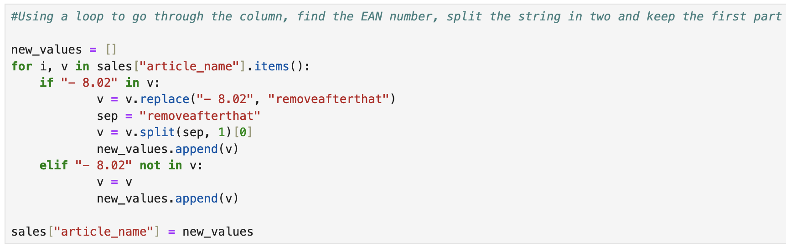
Sales dataset
Cleaning of special characters
Removal of numbers from product names
2. Cleaning

Slide 10
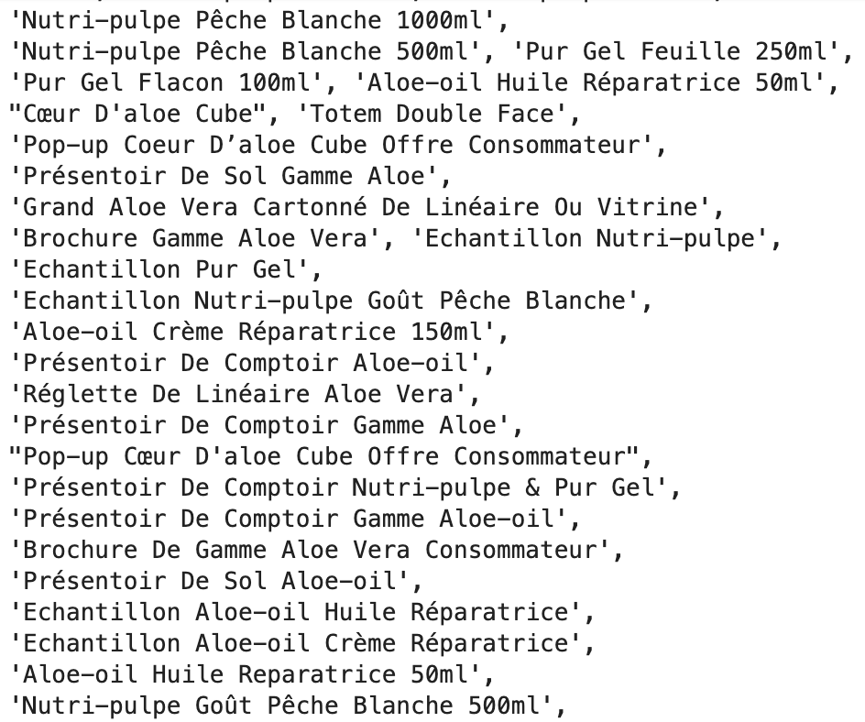
Sales dataset
Result of the cleaning
2. Cleaning

Slide 11
03
Analysis
Excerpt from the requested sales analysis

Slide 12
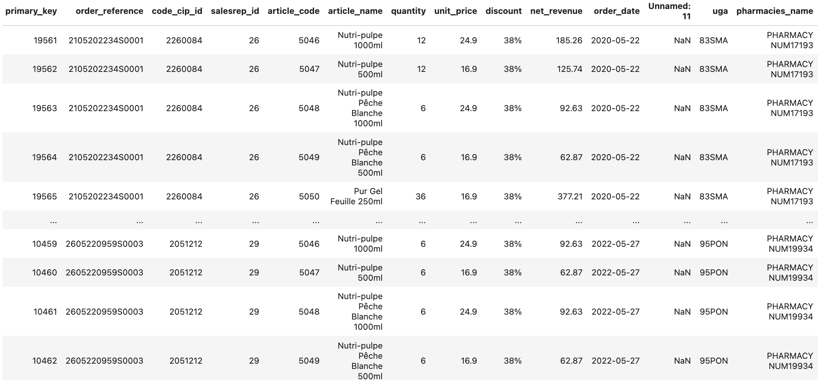
Merging the tables to perform the analysis
The CIP code allows to merge the ”customers" and "sales" tables
The merge results in an extra column named "unnamed" which needs to be removed
This merge enables a deeper analysis of customer purchasing habits, the seasonality of these purchases, and an examination of which clients order the most/least and which products they prefer
3. Analysis

Slide 13
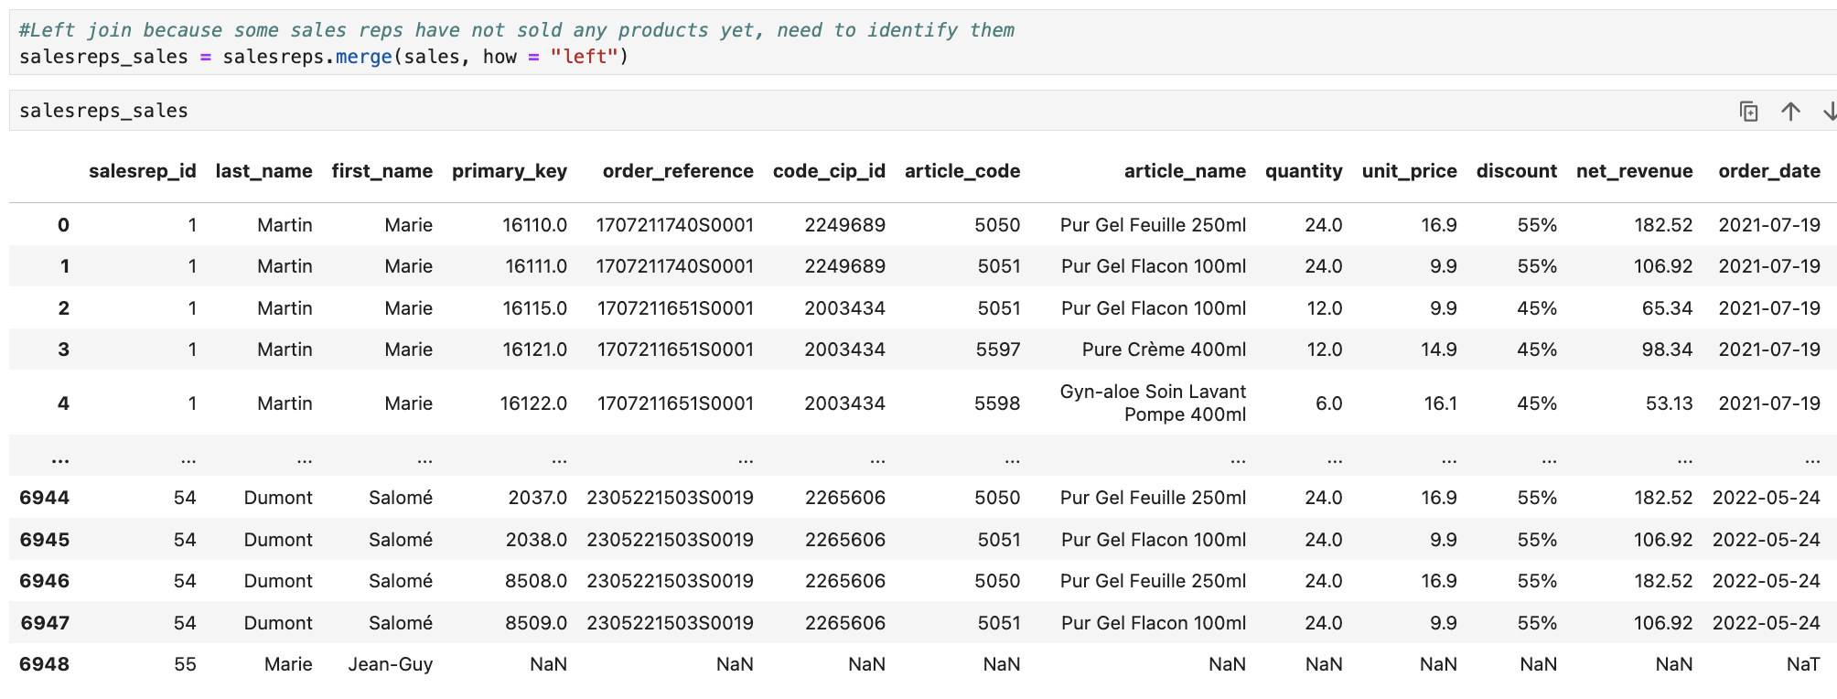
Merging the tables to perform the analysis
The salesperson ID allows merging the "sales" and "salespeople" tables
This merge enables a detailed analysis of the top-performing salespeople, as well as the products they sell the most
3. Analysis

Slide 14
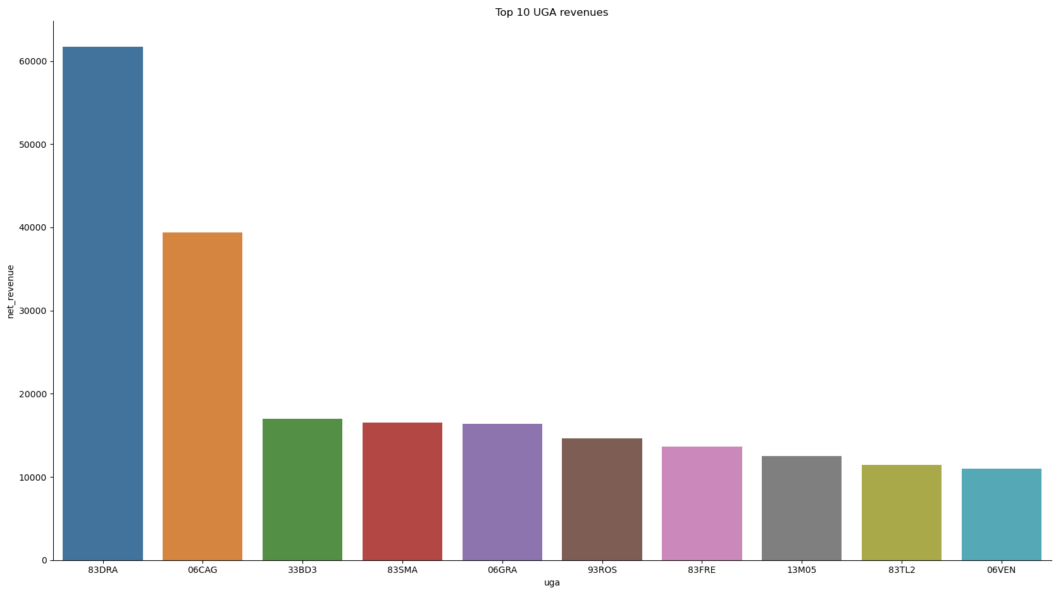
Excerpt of the results
Sales by UGA (Geographical Areas)
3. Analysis

Slide 15
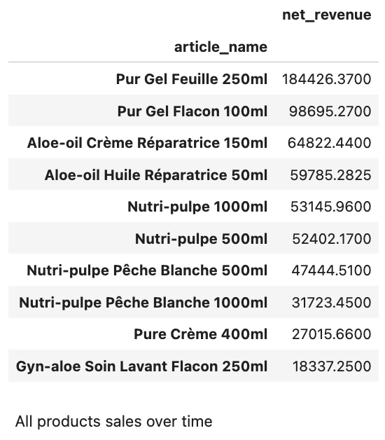
Excerpt of the results
Net revenues by products
3. Analysis

Slide 16
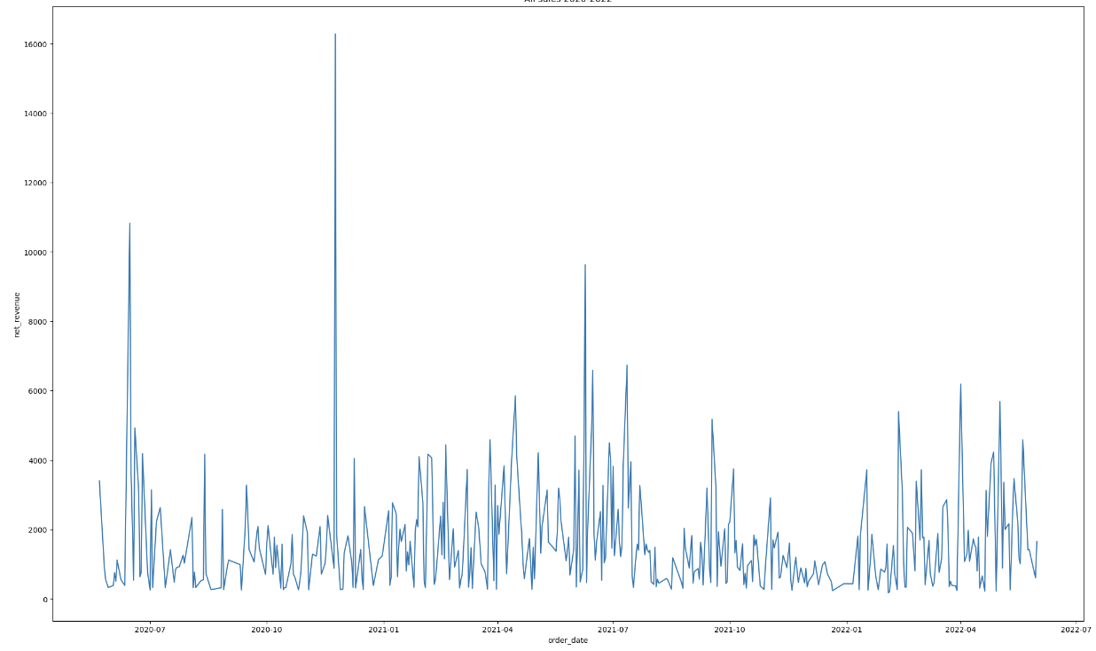
Excerpt of the results
Sales from May 2020 to July 2022
3. Analysis

Slide 17
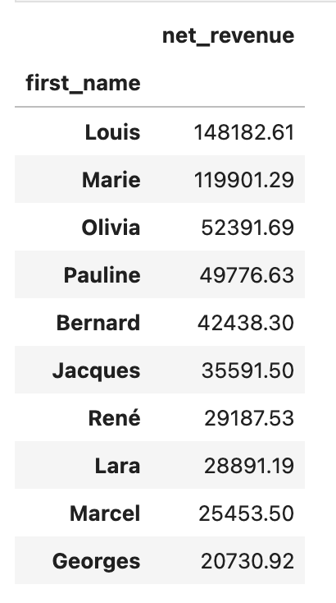
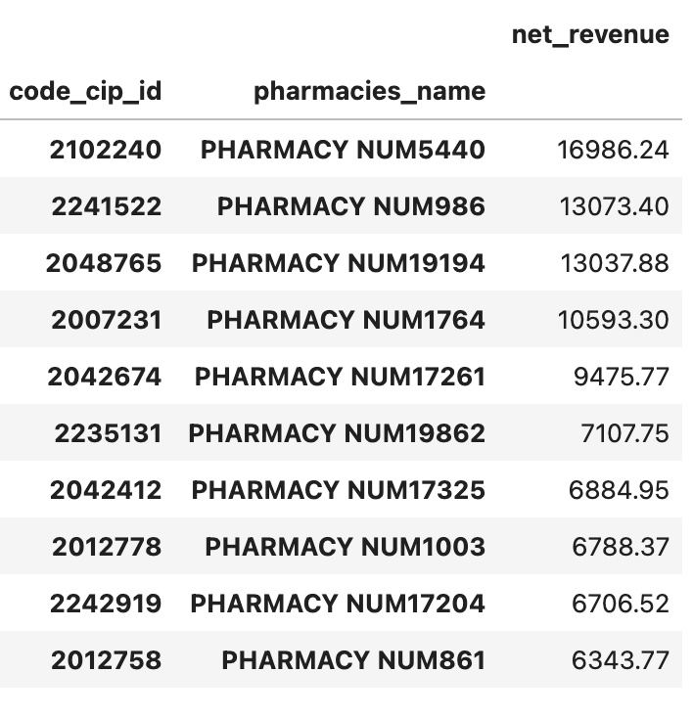
Excerpt of the results
Best salespeople
Best customers
3. Analysis

Slide 18


