Slide 1
Prediction of Heart Disease Development
Project based on a dataset from the CDC
US Centers for Disease Control and Prevention
Maud Gesbert

Slide 2
TABLE OF CONTENT
01
02
03
04
05
The dataset
Preliminary analyses
Model testing and final selection
Selection of fields to fill
Conclusion

Slide 3
01
The dataset

Slide 4

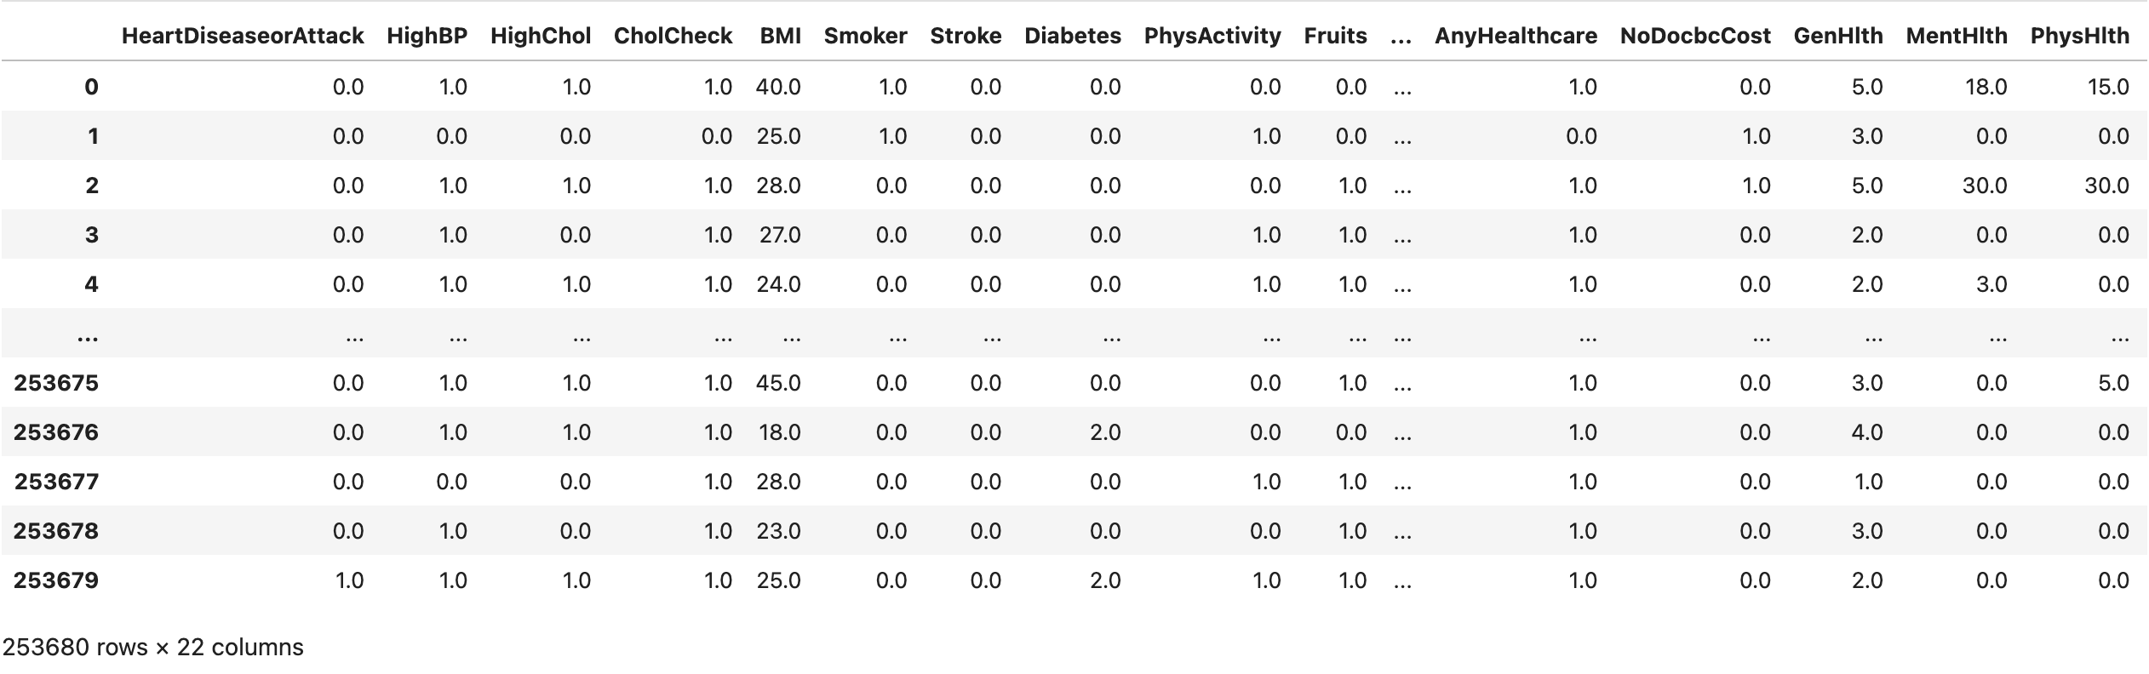
Dataset overview
Dataset available on Kaggle, found on the CDC website:
Contains anonymized information on 253,680 patients
Includes a target column: indicates whether the person developed heart disease or had a heart attack, this is the information the algorithm will need to predict after being trained
Includes 21 additional columns: represent the responses given by the patients and will allow the algorithm to identify which types of patients developed a condition
253,680 surveyed individuals
22 columns in total
1. The dataset

Slide 5
02
Preliminary Analyses
* See Heart_Disease_EDA file

Slide 6

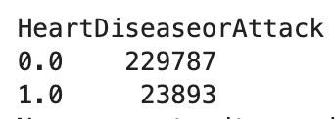
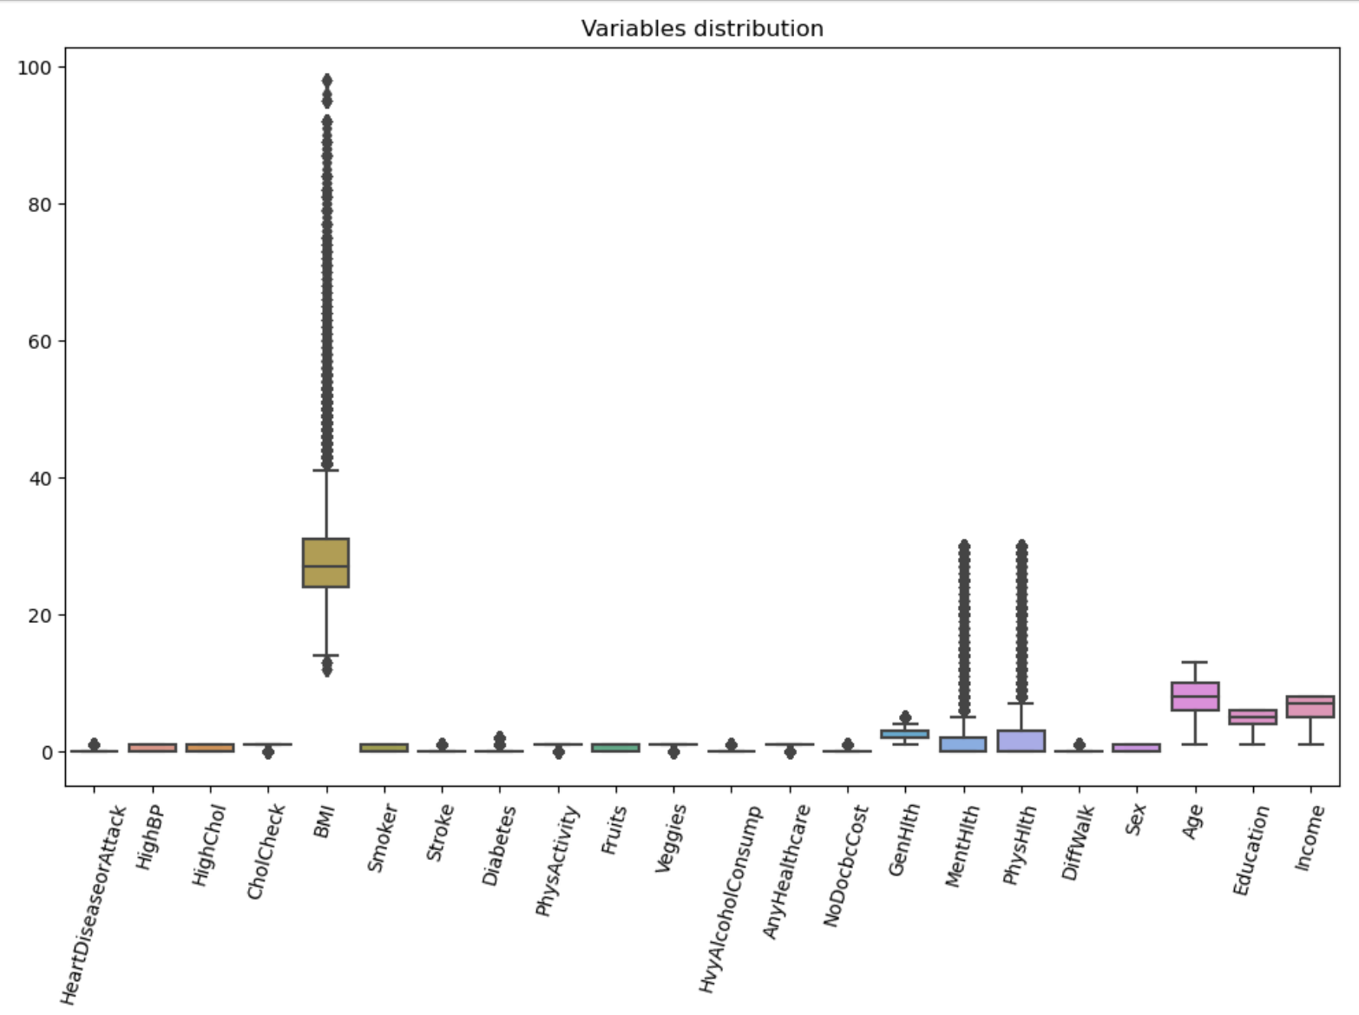
Study of the target variable and distributions
The first step is to study the dataset, including the target column as well as the different variables (21 columns).
When the target column contains a 0: the person did not develop heart disease
When the target column contains a 1: the person did develop heart disease
There is a clear imbalance: the number of people without heart disease is much higher. This needs to be taken into account to avoid misleading the model during training.
Then,
Study of Variable Distributions
2. Preliminary Analyses

Slide 7
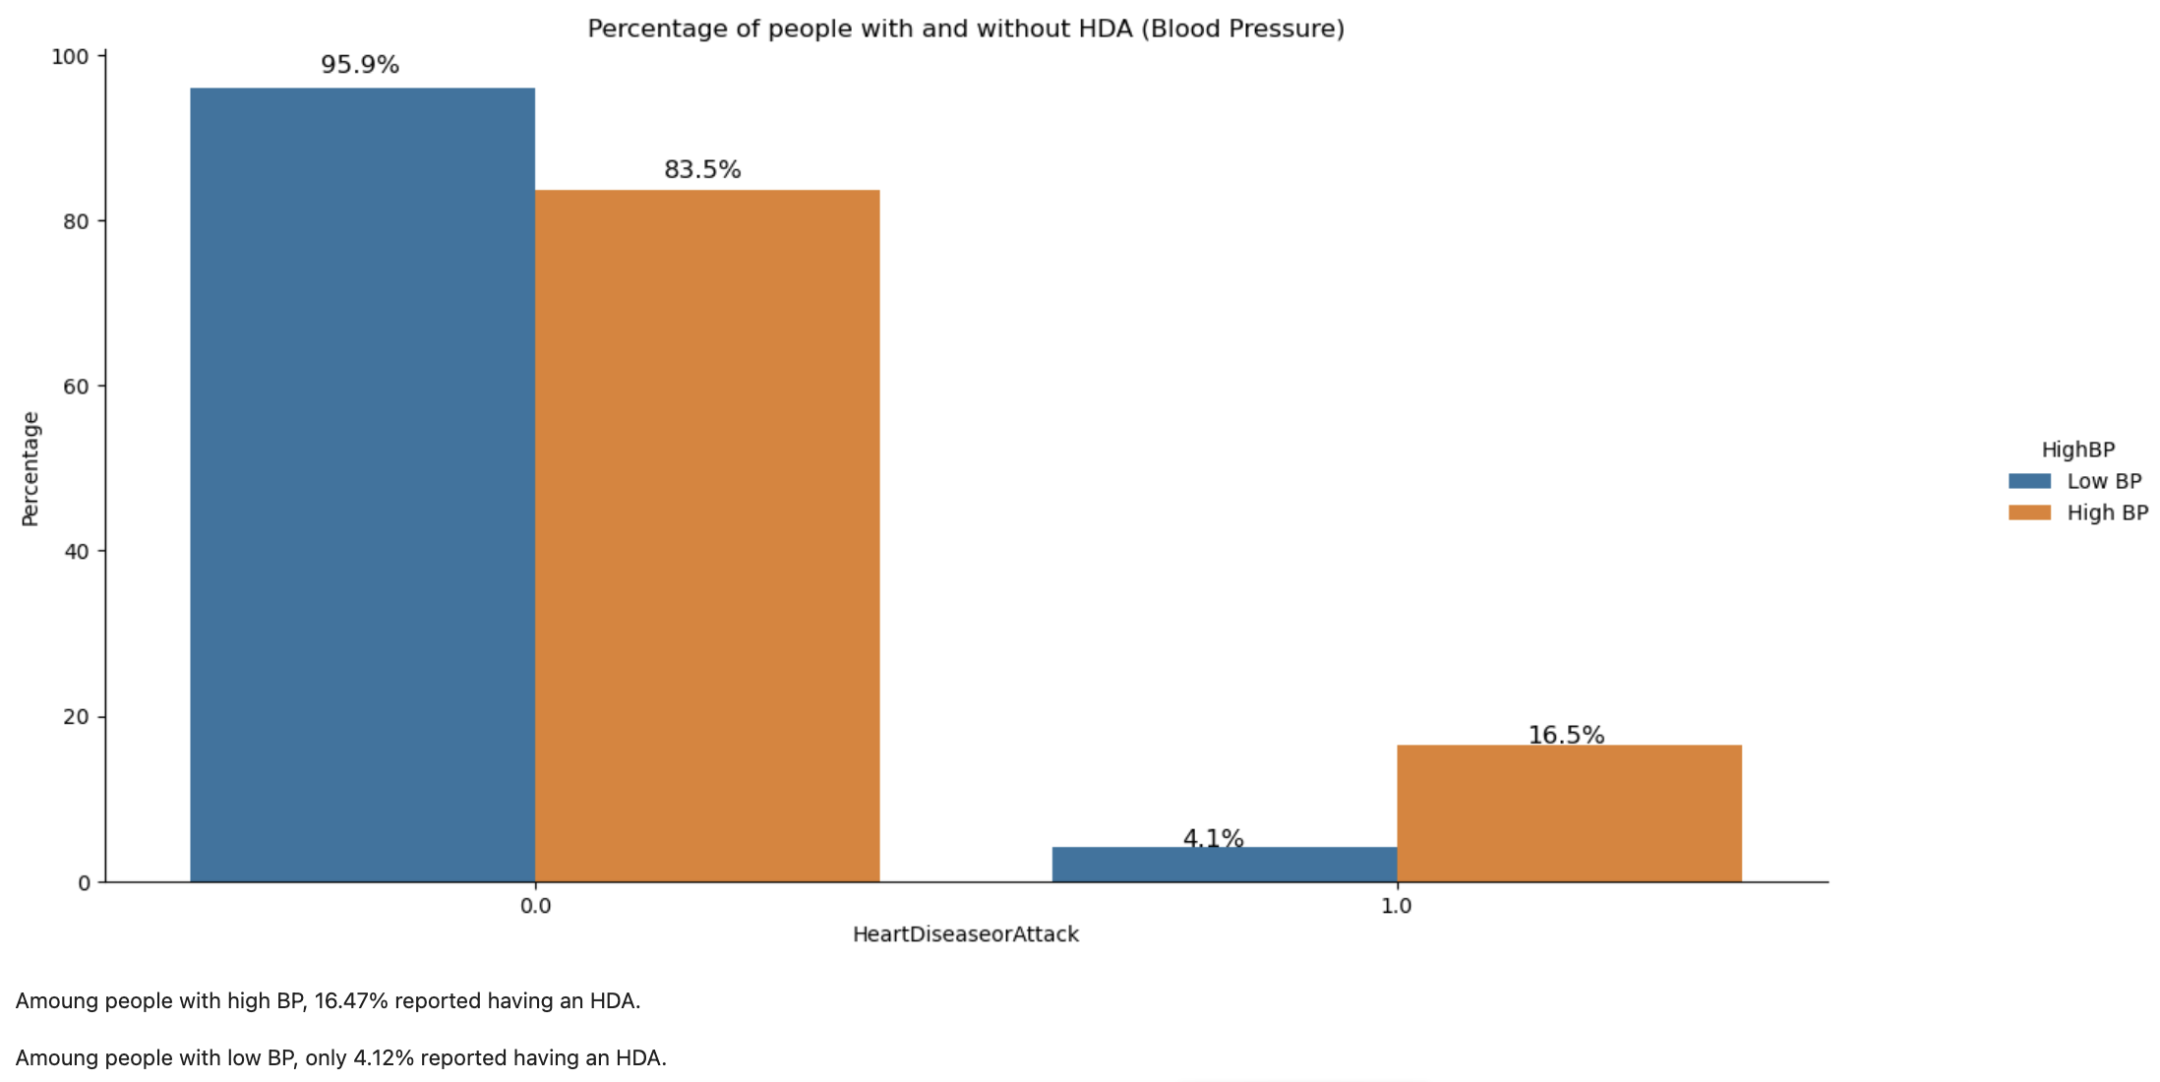
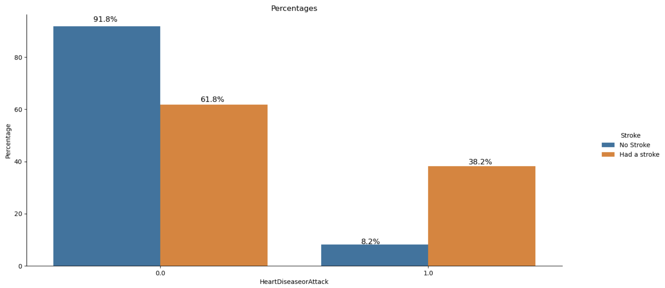
Study of non-target variables
Analysis of variable distributions and their relationship with the likelihood of developing heart disease, for example:
What percentage of people with high blood pressure developed heart disease? (16.5%)
What percentage of people who had a stroke developed heart disease? (38.2%)
2. Preliminary Analyses

Slide 8
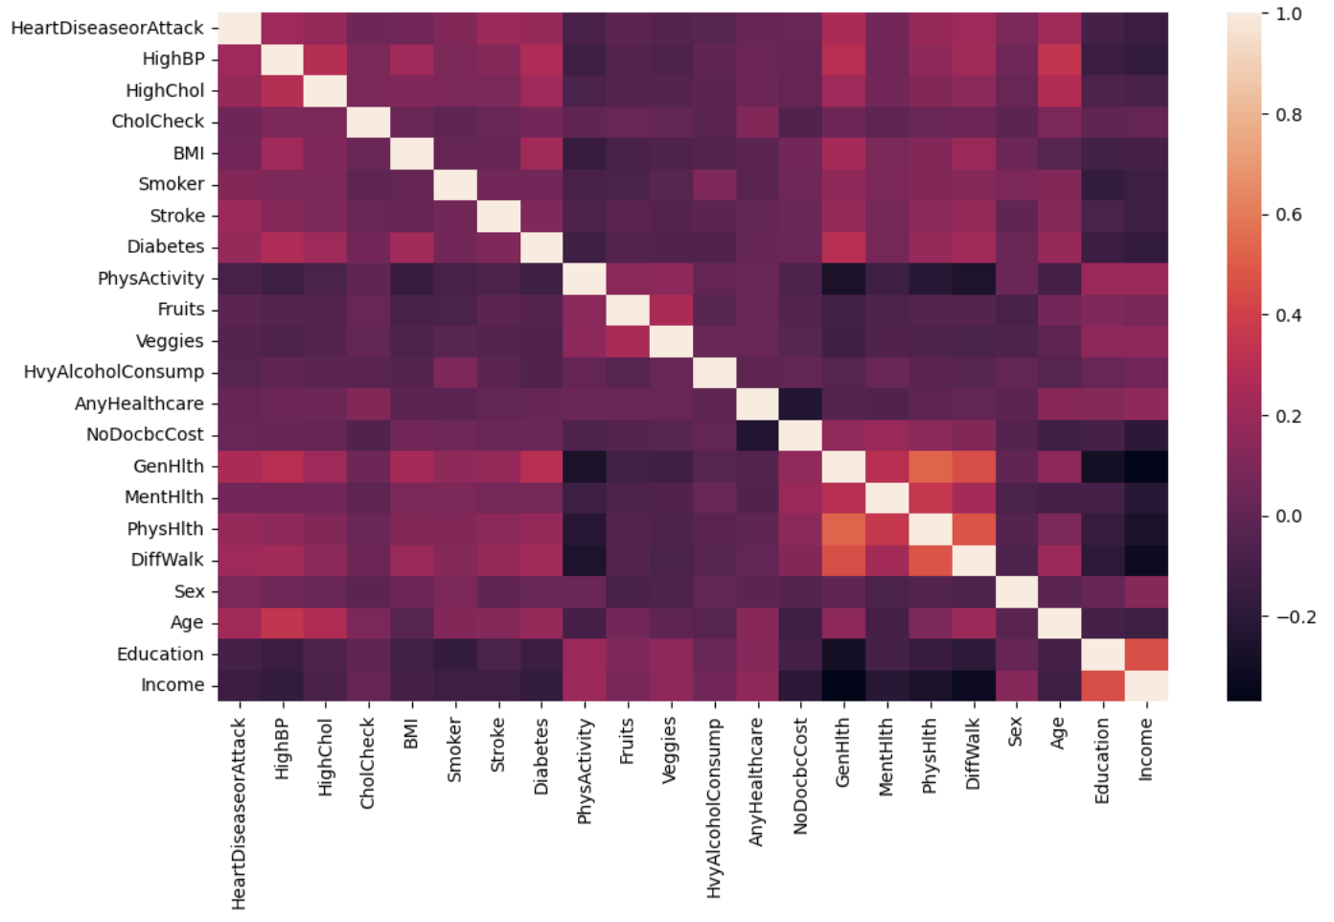
Study of correlations between variables
Quick analysis of Pearson correlation between variables:
Get an initial idea of which variables are likely to have the most influence on the prediction
Ensure that there is no strong linear correlation between two variables (apart from correlation with the target variable)
No variables appear to be strongly linearly correlated with the target
No variables are strongly correlated with each other (correlation > 0.7)
2. Preliminary Analyses

Slide 9
03
Model testing and final selection
* See ML_models_creation_with_all_variables file

Slide 10

Testing multiple types of models
 | KNN | LightGBM | CART | SVM
Model type | Classification | Classification | Classification | Classification
Cross validation | 5 folds Stratified | NA | 5 folds Stratified | NA
Training time | 1 187 seconds ( = 19 min) | Stopped at more than 83 minutes without results | 7 seconds | Stopped at more than 90 minutes without results
Searching for the best hyperparameters | Randomized | NA | Randomized | NA
Custom score | 22 598.4 | NA | 22 787.2 | NA
Accuracy | 0,91 | NA | 0,91 | NA
3. Model testing and final selection

Slide 11
Précision et Score personnalisé
Accuracy allows us to evaluate the model in a simple way: out of 100 individuals, how many are correctly classified after training the model?
However, in some cases, it may be useful to implement a custom score based on the context.
Why a custom score? A classification model has four possible outcomes:
True Positive (TP): Individual correctly classified as at risk (+1 point for the model)
True Negative (TN): Individual correctly classified as not at risk (+1 point for the model)
False Positive (FP): Individual incorrectly classified as at risk (–1 point for the model)
False Negative (FN): Individual incorrectly classified as not at risk (–3 points for the model)
In this case, the most serious situation is when the model indicates that a person is not at risk when they actually are (False Negative), which may result in someone at risk not consulting a doctor. Therefore, I created a custom score that penalizes the model more heavily in the case of FNs. False Positives are also penalized, but it is less serious to suggest someone see a doctor when they are not at risk.
3. Model testing and final selection

Slide 12
Selected model
 | CART
Model Type | Classification
Cross validation | 5 folds Stratified
Training time | 7 seconds
Searching for the best hyperparameters | Randomized
Custom score | 22 787.2
Accuracy | 0,91
Selected Model: Classification And Regression Trees – CART
Best training time
Best custom score
Accuracy similar to the KNN model
3. Model testing and final selection

Slide 13
04
Selection of fields to fill

Slide 14
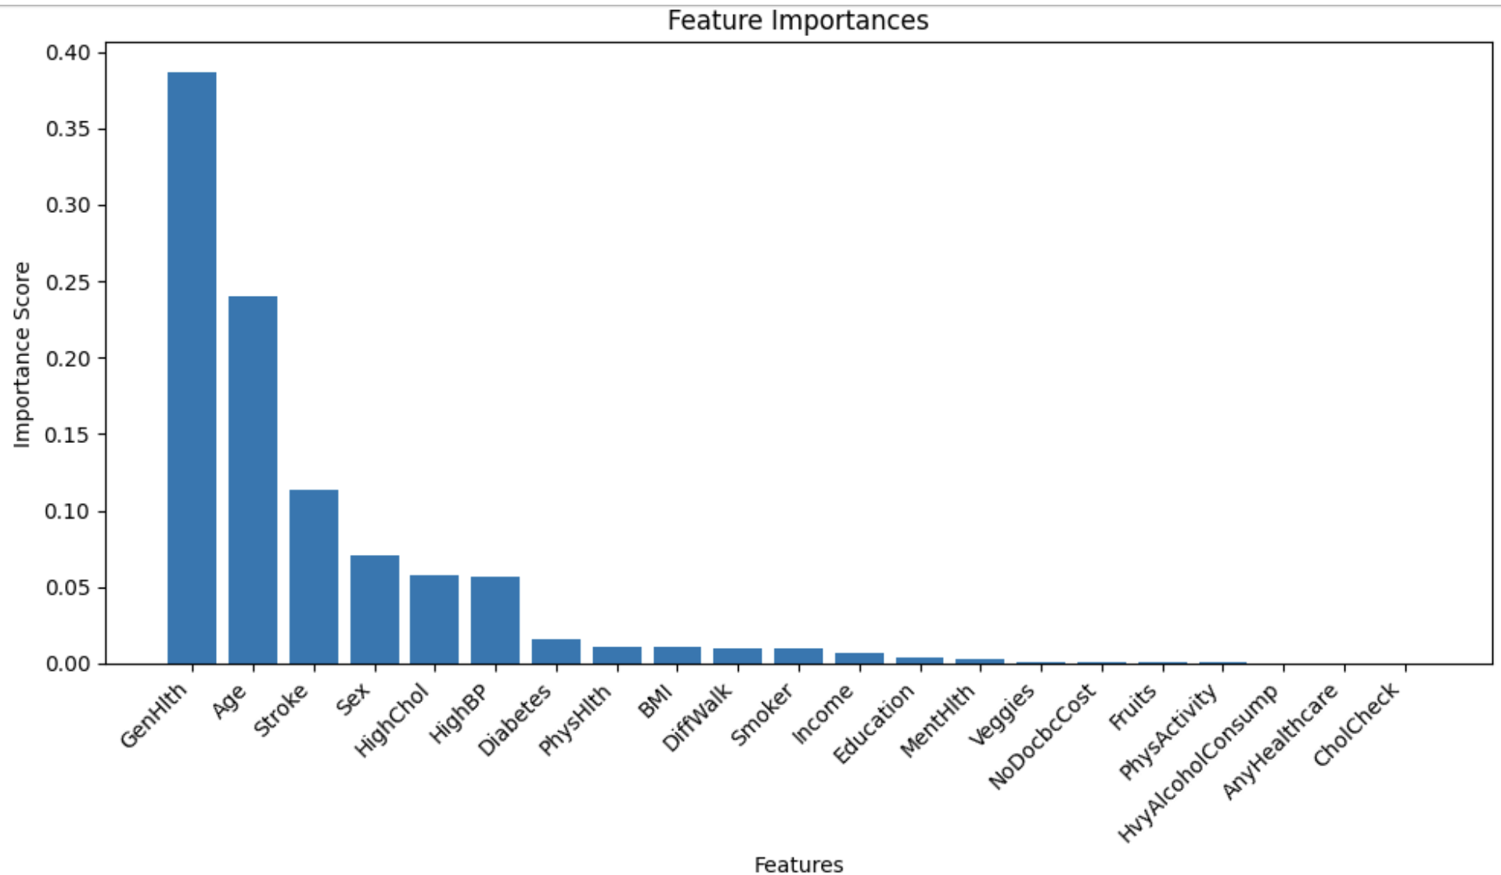

Selection of fields to be filled by model users
Following the model selection, I chose to analyze which variables had the most influence on the model's "decision" in order to avoid asking users to answer all 21 questions.
I identified the variables considered most important by the model and selected the top 10.
4. Selection of fields to fill

Slide 15
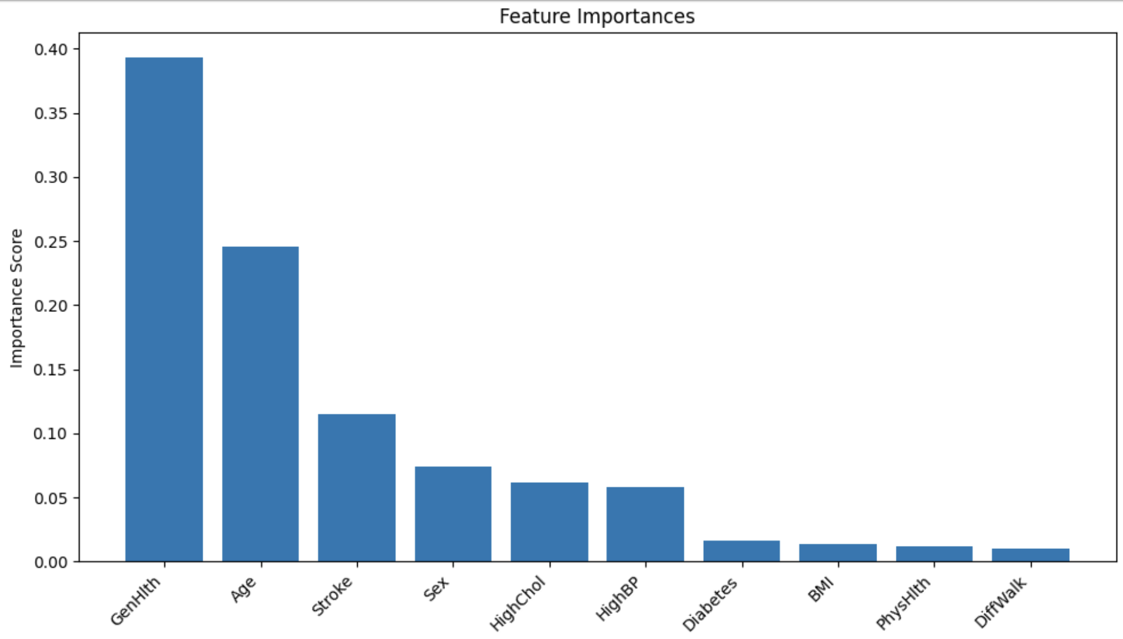
Selection of fields to be filled by model users
By using only these 10 variables:
Accuracy remains at 0.91
The custom score increases to 22 826
4. Selection of fields to fill

Slide 16
05
Conclusion

Slide 17
Final steps
The selected model and its hyperparameters are then saved in a pickle file.
It is then possible to send data to the model via the website using a POST method.
The pipeline associated with the model at the time of saving:
Applies the necessary preprocessing steps when receiving the data (e.g., value normalization when needed)
Passes the data through the model so that it returns a prediction
5. Conclusion

