Slide 1
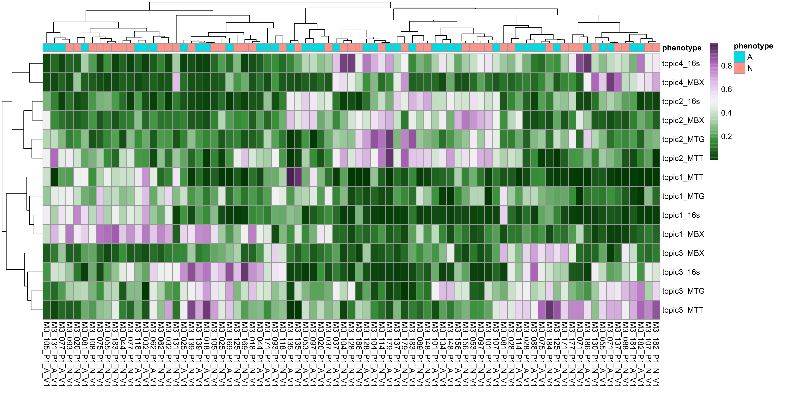
A
16s
MTG
MTT
MBX
 | ASV₁ | ASV₂ | ASV₃ | ASV₄ | ASV_{p}
S₁
…
S_{n}
 | KO₁ | KO₂ | KO₃ | KO₄ | KO_{p}
S₁
…
S_{n}
 | KO₁ | KO₂ | KO₃ | KO₄ | KO_{p}
S₁
…
S_{n}
 | KO₁ | KO₂ | KO₃ | KO₄ | KO_{p}
S₁
…
S_{n}
Topic modeling
Sample ~ topics
Topic ~ features
B
 | Topic_{A} | Topic_{B} | Topic_{C}
Sample₁
…
Sample_{n}
 | Topic_{D} | Topic_{E} | Topic_{F}
Sample₁
…
Sample_{n}
 | Topic_{G} | Topic_{H} | Topic_{I}
Sample₁
…
Sample_{n}
 | Topic_{J} | Topic_{K} | Topic_{L}
Sample₁
…
Sample_{n}
Correlate topics across omics
Arrange into matching topics
C
Topic₁
Topic₂
Topic₃
Topic_{A}
Topic_{B}
Topic_{C}
Topic_{E}
Topic_{D}
Topic_{F}
Topic_{G}
Topic_{I}
Topic_{H}
Topic_{L}
Topic_{J}
Topic_{K}
D
16S ASVs
MTG KOs
MTT KOs
MBX KOs
Each sample has 4 omic feature vectors and 12 topic vectors (3 topics per omic)
Samples
3
2
1
Topics
E
Topic distributions cluster samples into 2 groups

