Slide 1
Summarization Overview
Split sentences from collection of documents —>
—> Chunk sentences ? —>
—> (Ignore Misspellings) ? —>
—> (Split Sibling Sentences) ? —>
—> Lemmatization —>
—> Remove Stopword bigrams —>
—> [Word Count | Tfidf Vectorization] (n-gram range) —>
—> (Normalization) —>
—> SVD (k) —>
—> Semantic Volume Maximization (Yogotama et al.) —>
—> Return Summary Sentences
() — Locally implemented / untested
? — Optional step
Notes:
normalization will negligate importance of sentences with multiple counts of key phrases?
- possibly - could be considered redundant and not necessary,
- importance along additional latent dimensions will be increased √

Slide 2
SVD for text Summarization
Input: Tfidf-weighted or word count vectors for each sentence (after preprocessing)
1. Choose k, the dimension of the space onto which to map the vectorized sentences (e.g. the number of “topics”)
2. Vectorized sentences become jointly indexed by the singular vectors of this lower dimensional space
(e.g. each sentence vector becomes represented by a combination of the k singular vectors)
3. Magnitudes of the values of the mapped sentences represent their correspondence with each of these singular vectors
—> This result will be leveraged by the Semantic Volume Maximization algorithm
1. Steinberger, Josef, and Karel Ježek. 2004. Text summarization and singular value decomposition. International Conference on Advances in Information Systems. Springer Berlin Heidelberg.

Slide 3
Semantic Volume Maximization
SVD creates a representation of the sentences in terms of their correspondences to the top “topics” of the corpus (e.g. condenses the semantic space)
Now we seek to choose the sentences whose vectors will together maximize the volume of this condensed space:
Input: Summary length w (# of words or sentences)
Initialize basis vector set B, result sentence set S
Calculate mean vector c across all sentences
Choose first basis vector b1 as vector most distant from c
Choose second basis vector b2 as vector most distant from b1 —> add it to B
While total length of sentences in S < w:
Calculate sentence vector r most distant from subspace spanned by basis vectors in B
Add r to B
Add sentence corresponding to r to S

Slide 4
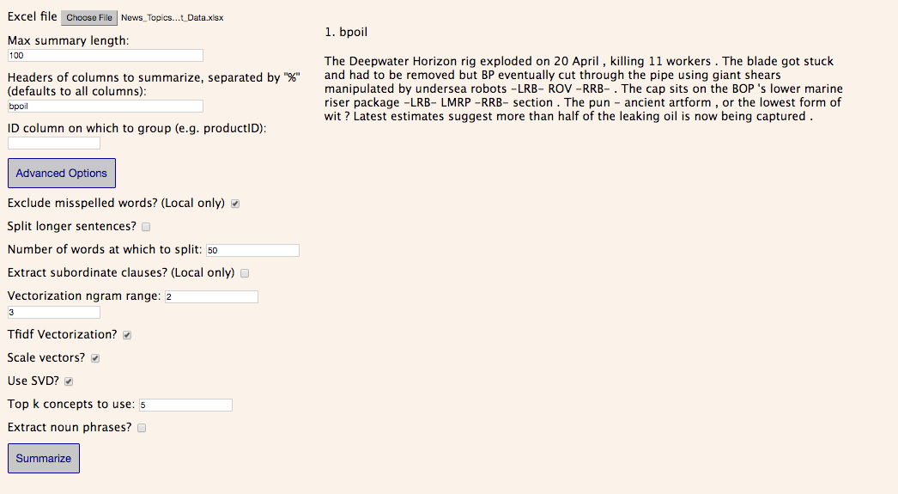
Summarization
Notes:
Show survey results w/ “What is Healthy Skin?”:
k=1 (“dry” topic)
k=5 (too much about soft)
k=50 (more topics covered)

Slide 5
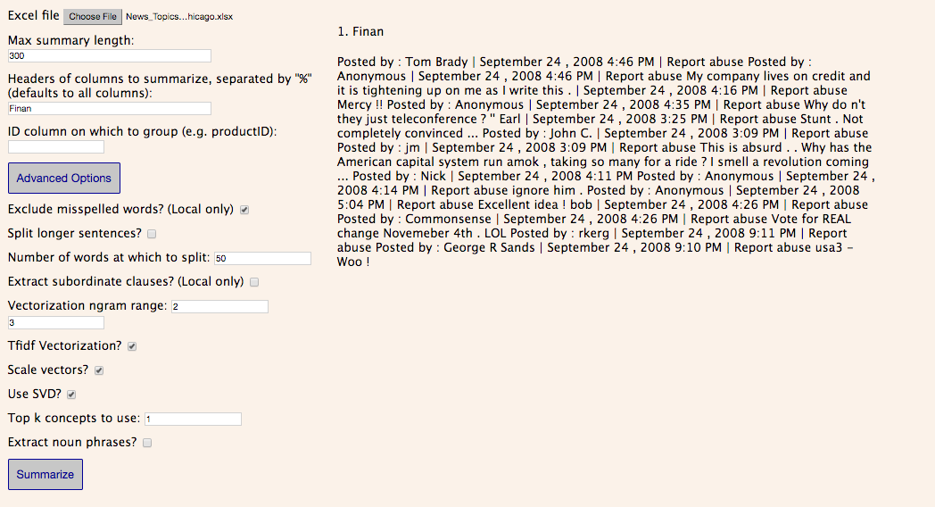
k = 1
Notes:
k=1
shows noise in datasets

Slide 6
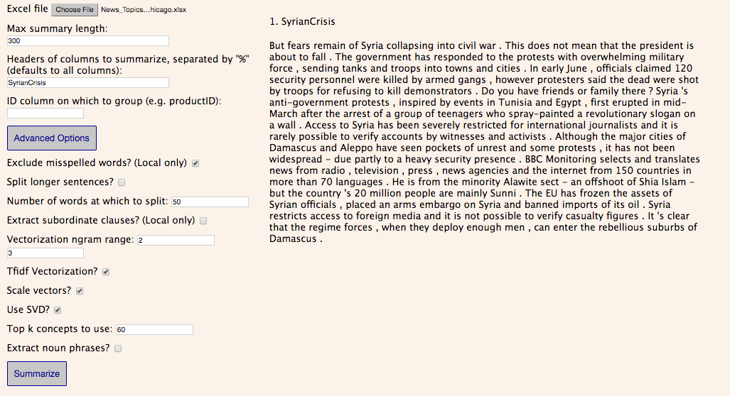

Slide 7
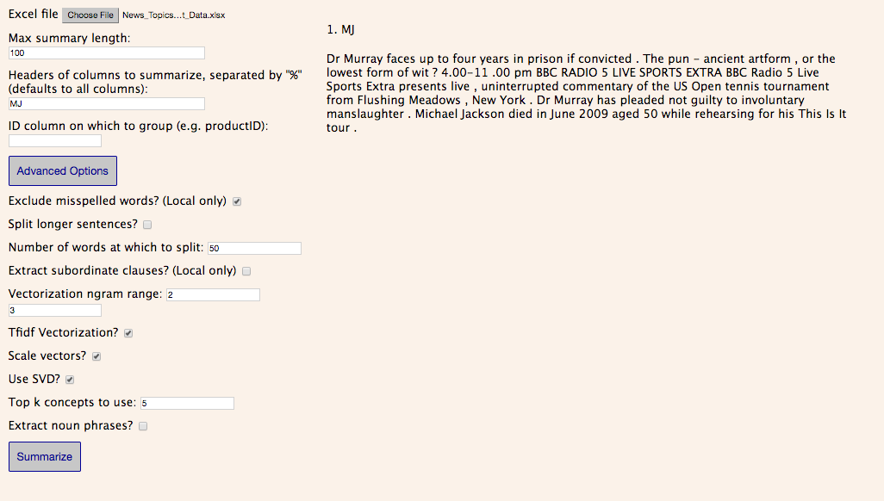

Slide 8


Slide 9
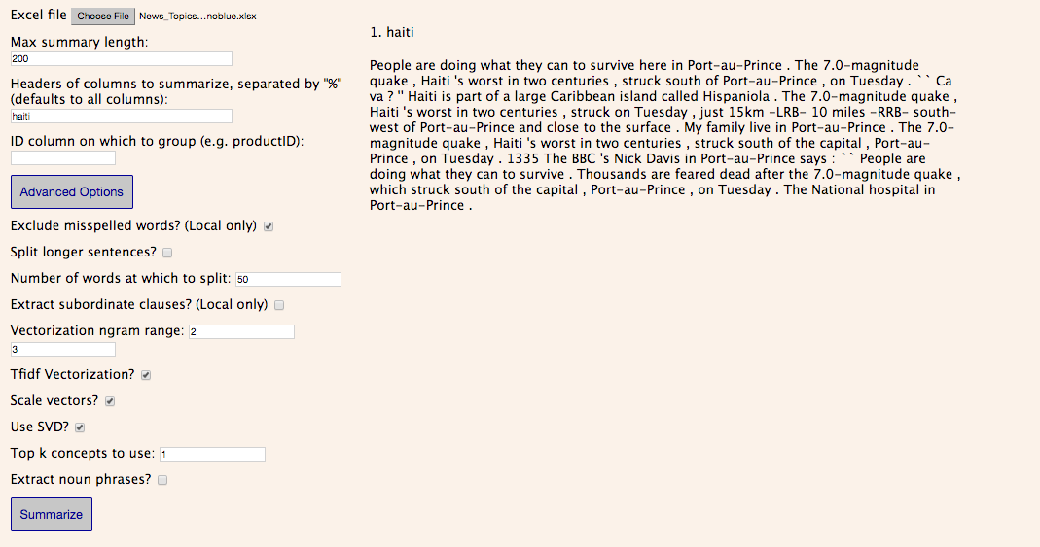

Slide 10
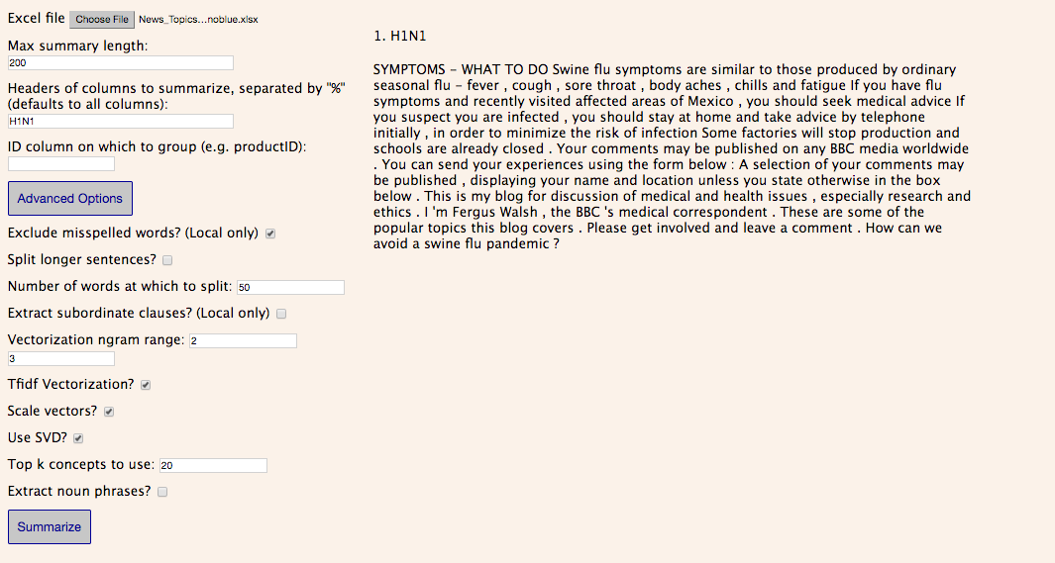

Slide 11
