Slide 1
Unilever Text Analysis
Julien Maudet, Ian Johnson

Slide 2
Achievements so far
Summarization
Keyphrase Extraction
Web Interface

Slide 3
Summarization
Lemmatization —>
—> N-grams —>
—> Stopwords —>
—> Vectorization —>
—> SVD —>
—> Semantic Volume Maximization (Yogotama et al.)
Todo
- Synonyms
- Tree parse - smart splitting on conjunctions / delimiters
Notes:
issue with long sentences having highest precedence?
broken with bigrams and SVD… memory issue?
spellcheck?
only concat with a period if sentence doesn’t already end in one
other algorithms
run on new data
takes a while
tests
how to measure performance?

Slide 4
Keyphrase extraction
RAKE Algorithm
Introduction
Source: Rose, Stuart, et al. "Automatic keyword extraction from individual documents." Text Mining (2010): 1-20.
Unsupervised & independent from the language at use
More computationally efficient than TextRank
Higher precision and comparable recall scores

Slide 5
Keyphrase extraction
RAKE Algorithm
First observation
keywords = multiple words but no punctuation or stop words (and, the…)
Input
document
list of stop words and phrase delimiters
parameters:
minimum length of a word in a keyphrase
minimum frequency for a word in the text
maximum number of words per keyphrase
Output
List of keyphrases and the associated relevance score

Slide 6
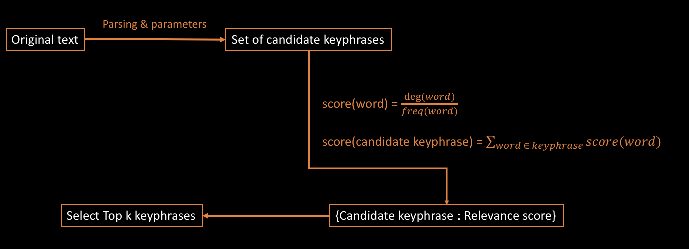
Keyphrase extraction
RAKE Algorithm
Pipeline

Slide 7
Web Interface
Technologies
Server side
Python (Algorithms)
Flask framework
User Interface
HTML
Javascript
CSS

Slide 8
Web Interface
LIVE DEMO

