Slide 1
Unilever Text Analysis
Julien Maudet, Ian Johnson

Slide 2
Context
Unilever looking for useful analysis of their reviews data for beauty products
End product to be an interface for analysts to gather quick summarization / insight into large numbers of reviews

Slide 3
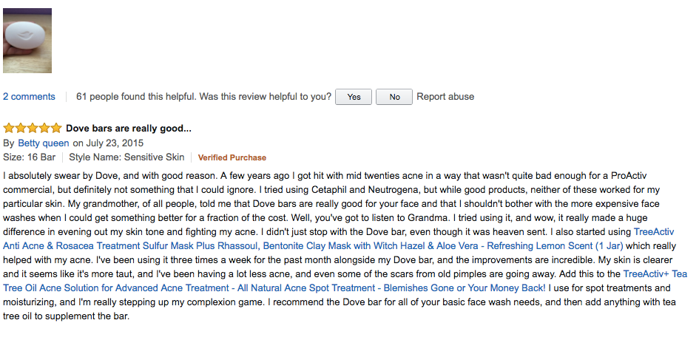
Data
198,502 Amazon Reviews

Slide 4
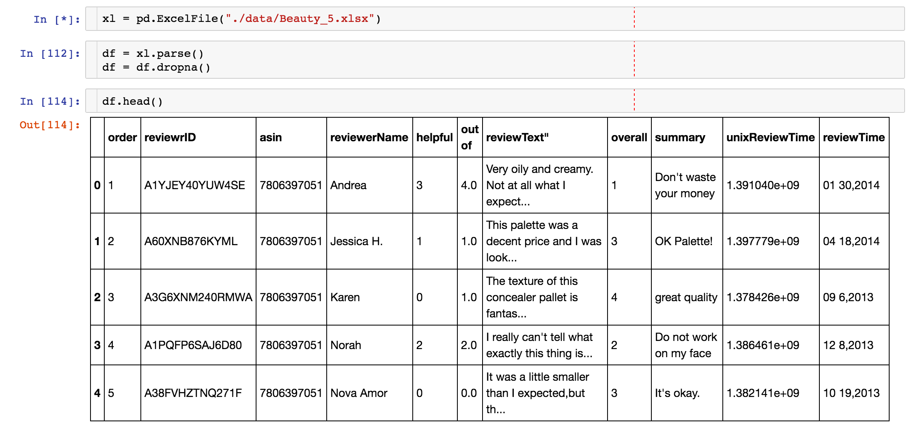
Data
198,502 Amazon Reviews

Slide 5
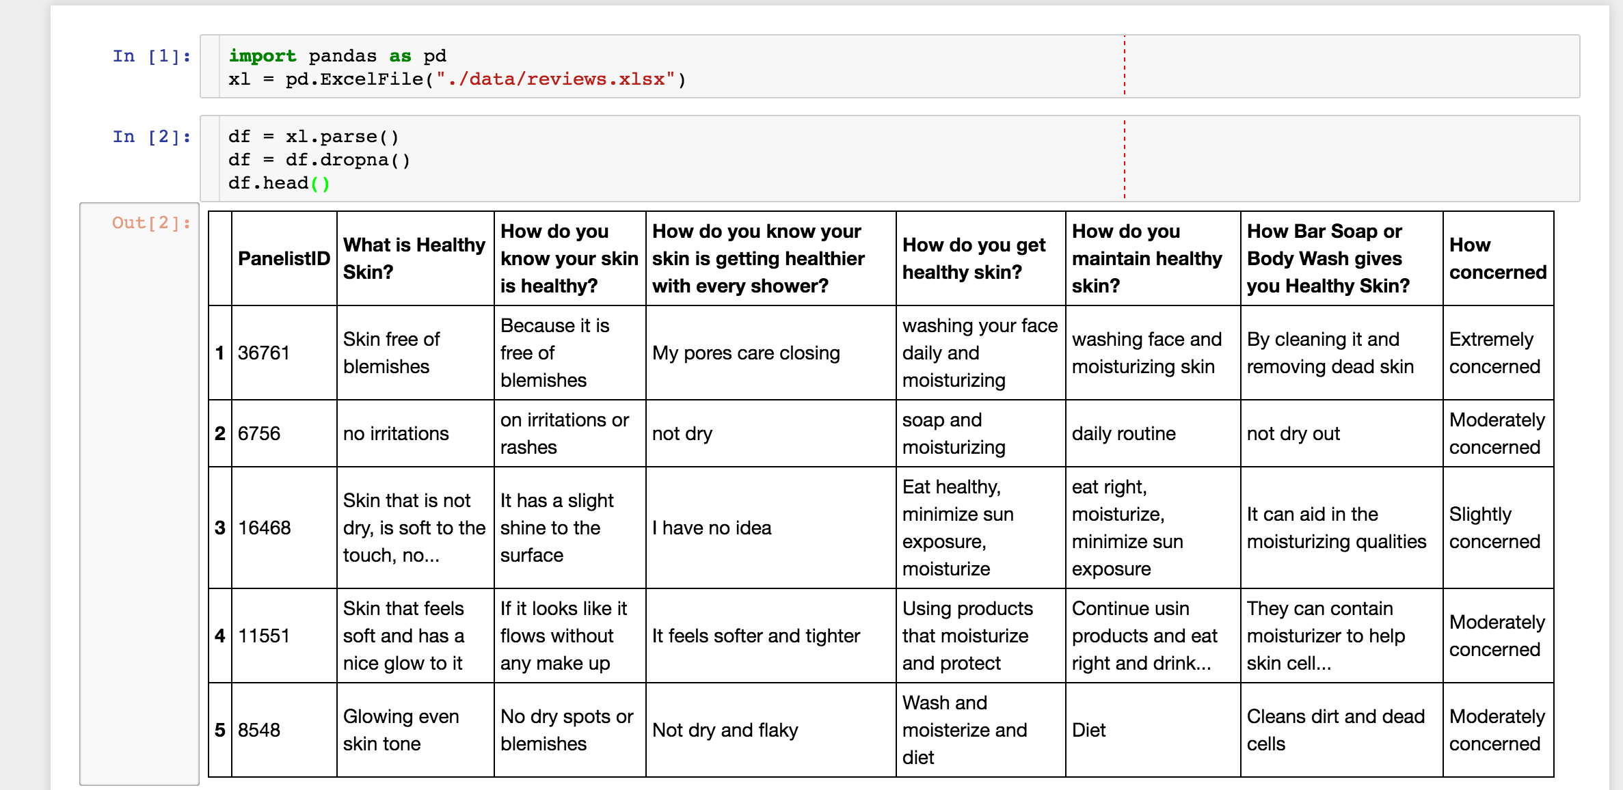
Data
198,468 Survey Answers

Slide 6
Proposed Methods
Explore packages:
Word2Vec
gensim, spacy, textacy
Keywords analysis
Reviews clustering
Simple webapp interface w/ API

Slide 7
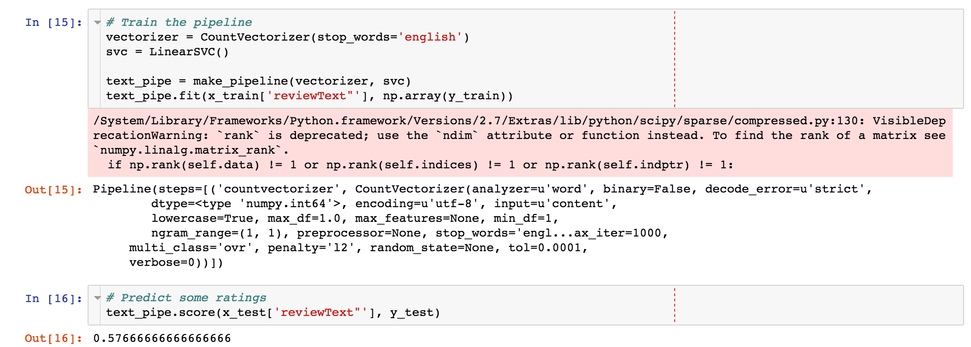
Preliminary Analysis

Slide 8
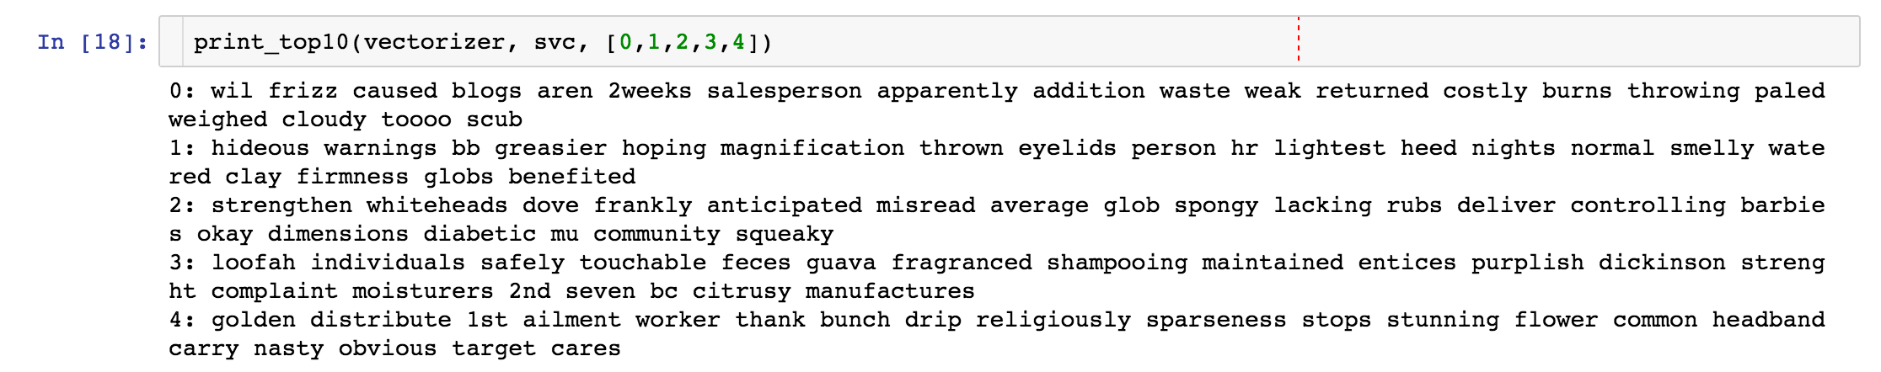
Preliminary Analysis

Slide 9
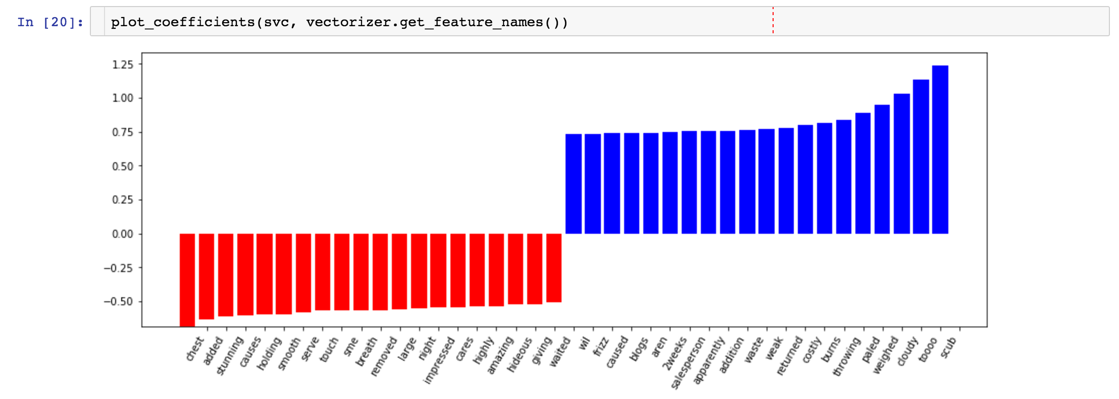
Preliminary Analysis

Slide 10
Stretch Goals
Topic Modeling (LDA)
Text Summarization
Advanced summarization methods
Integration with existing pipelines
Cleaner interface / design improvements

