Slide 1
Achievements so far
Summarization
Keyphrase Extraction
Web Interface

Slide 2
Keyphrase extraction
RAKE Algorithm
Introduction
Source: Rose, Stuart, et al. "Automatic keyword extraction from individual documents." Text Mining (2010): 1-20.
Unsupervised & independent from the language at use
More computationally efficient than TextRank
Higher precision and comparable recall scores

Slide 3
Keyphrase extraction
RAKE Algorithm
First observation
keywords = multiple words but no punctuation or stop words (and, the…)
Input
document
list of stop words and phrase delimiters
parameters:
minimum length of a word in a keyphrase
minimum frequency for a word in the text
maximum number of words per keyphrase
Output
List of keyphrases and the associated relevance score

Slide 4
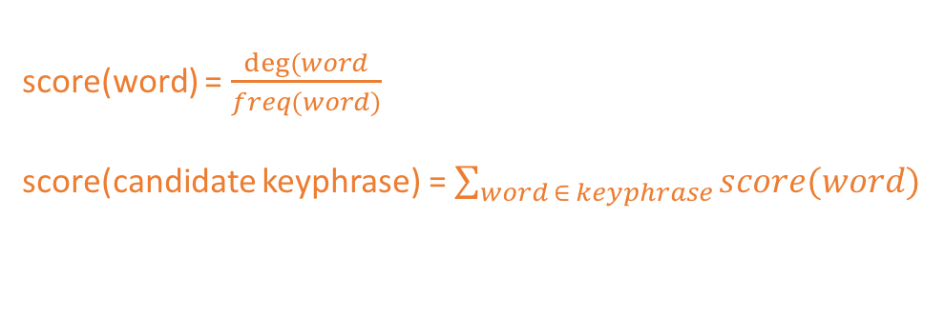
Keyphrase extraction
RAKE Algorithm
Pipeline
Parsing & parameters
Original text
Set of candidate keyphrases
score(word) = $\frac{deg⁡(word}{freq(word)}$
score(candidate keyphrase) = $\sum_{word ∈ keyphrase}{score(word)}$
Select Top k keyphrases
{Candidate keyphrase : Relevance score}

Slide 5
Web Interface
Technologies
Server side
Python (Algorithms)
Flask framework
User Interface
HTML
Javascript
CSS

Slide 6
Web Interface
LIVE DEMO

