Slide 1

UniClever Text Analysis Software
Ian Johnson, Julien Maudet

Slide 2
Context
Unilever looking for useful analysis of their survey and reviews data for beauty products
End product to be an interface for analysts to gather quick summarization / insight into large numbers of reviews or survey answers

Slide 3
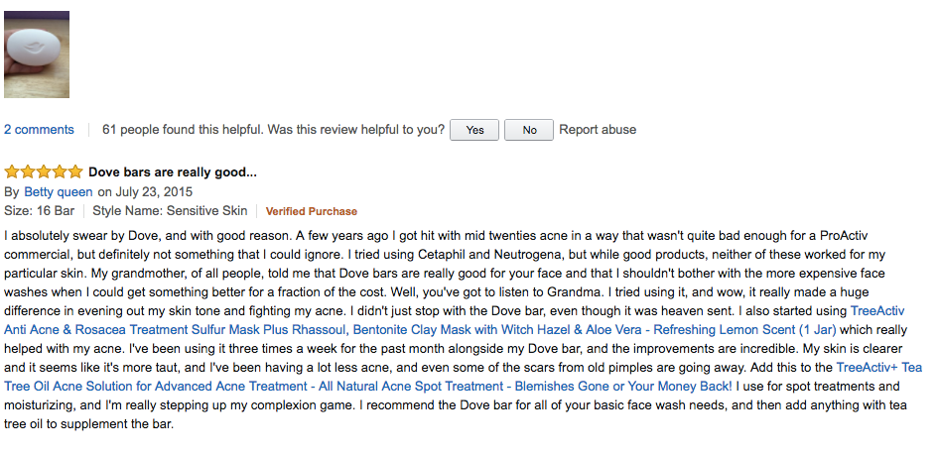
Data
198,502 Amazon Reviews

Slide 4
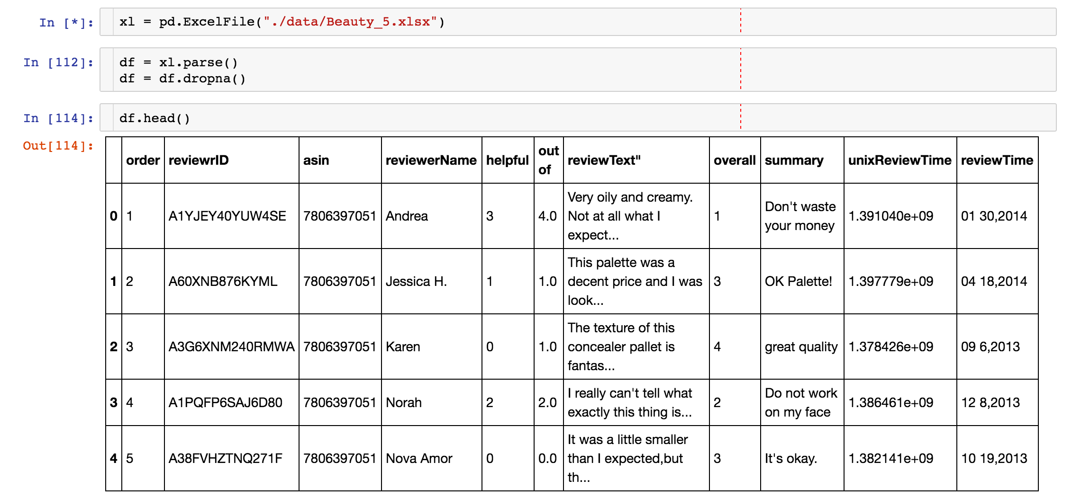
Data
198,502 Amazon Reviews

Slide 5
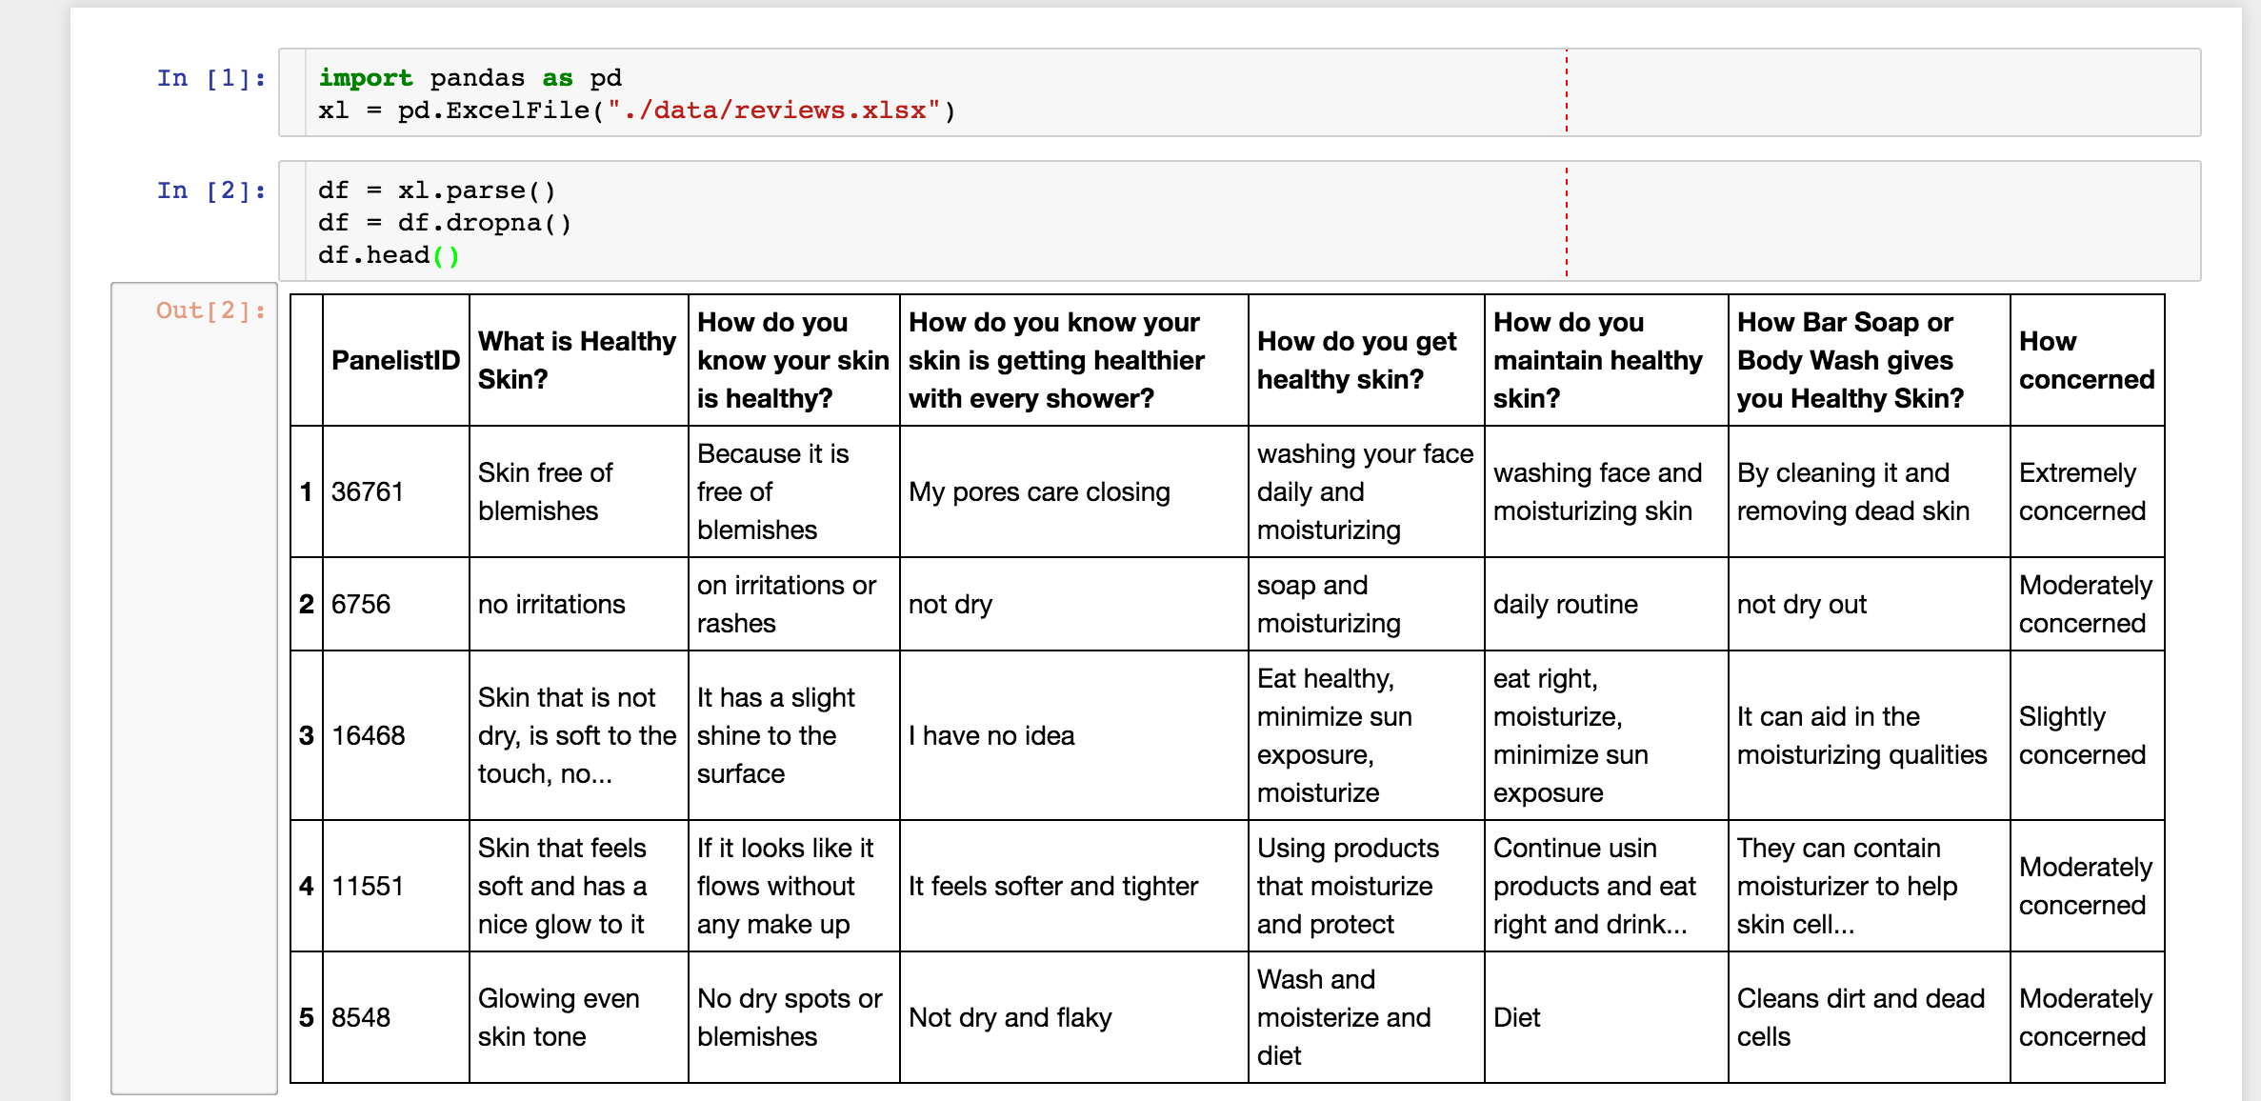
Data
198,468 Survey Answers
Notes:
198,468 Survey Answers

Slide 6
Summarization
Overview
Split sentences from collection of documents —>
—> Chunk sentences ? —>
—> (Ignore Misspellings) ? —>
—> (Split Sibling Sentences) ? —>
—> Lemmatization —>
—> Remove Stopword bigrams —>
—> [Word Count | Tfidf Vectorization] (n-gram range) —>
—> (Normalization) —>
—> SVD (k) —>
—> Semantic Volume Maximization (Yogotama et al.) —>
—> Return Summary Sentences
() — Locally implemented / untested
? — Optional step
Notes:
normalization will negligate importance of sentences with multiple counts of key phrases?
- possibly - could be considered redundant and not necessary,
- importance along additional latent dimensions will be increased √

Slide 7
Summarization
SVD for Text Summarization
Input: Tfidf-weighted or word count vectors for each sentence (after preprocessing)
1. Choose k, the dimension of the space onto which to map the vectorized sentences (e.g. the number of “topics”)
2. Vectorized sentences become jointly indexed by the singular vectors of this lower dimensional space
(e.g. each sentence vector becomes represented by a combination of the k singular vectors)
3. Magnitudes of the values of the mapped sentences represent their correspondence with each of these singular vectors
—> This result will be leveraged by the Semantic Volume Maximization algorithm
1. Steinberger, Josef, and Karel Ježek. 2004. Text summarization and singular value decomposition. Iternational Conference on Advances in Information Systems. Springer Berlin Heidelberg.

Slide 8
Summarization
Semantic Volume Maximization
SVD creates a representation of the sentences in terms of their correspondences to the top “topics” of the corpus (e.g. condenses the semantic space)
Now we seek to choose the sentences whose vectors will together maximize the volume of this condensed space:
Input: Summary length w (# of words or sentences)
Initialize basis vector set B, result sentence set S
Calculate mean vector c across all sentences
Choose first basis vector b1 as vector most distant from c
Choose second basis vector b2 as vector most distant from b1 —> add it to B
While total length of sentences in S < w:
Calculate sentence vector r most distant from subspace spanned by basis vectors in B
Add r to B
Add sentence corresponding to r to S

Slide 9
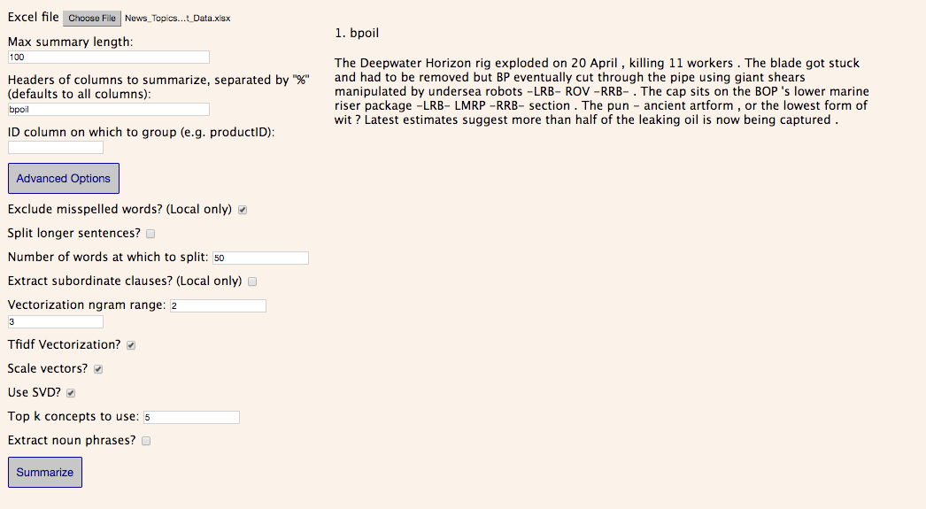
Summarization
Notes:
Show survey results w/ “What is Healthy Skin?”:
k=1 (“dry” topic)
k=5 (too much about soft)
k=50 (more topics covered)

Slide 10
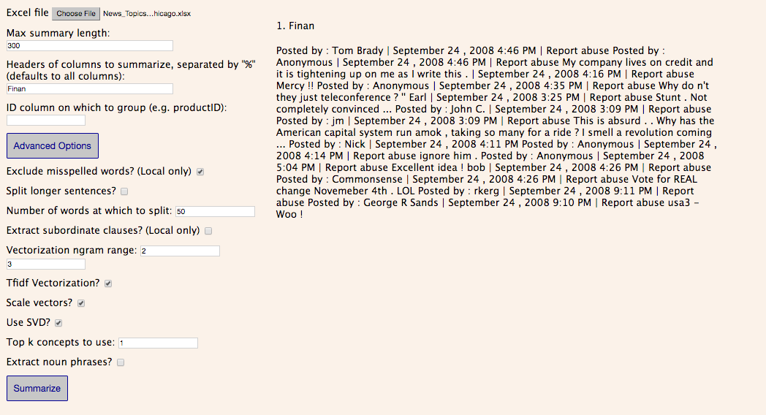
Summarization
k = 1
Notes:
k=1
shows noise in datasets

Slide 11
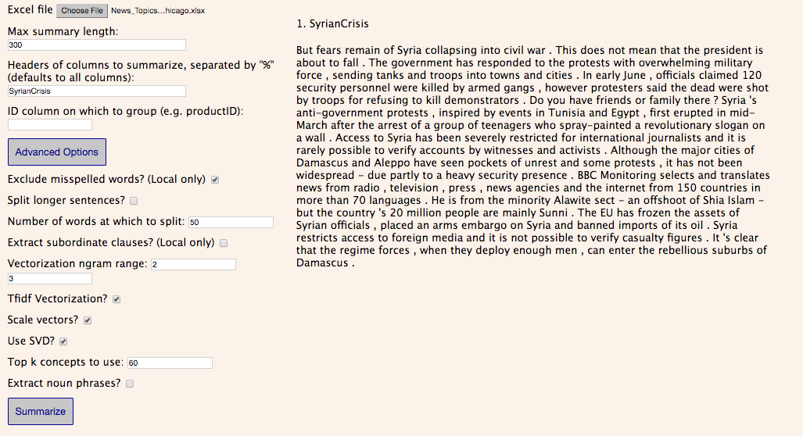
Summarization

Slide 12
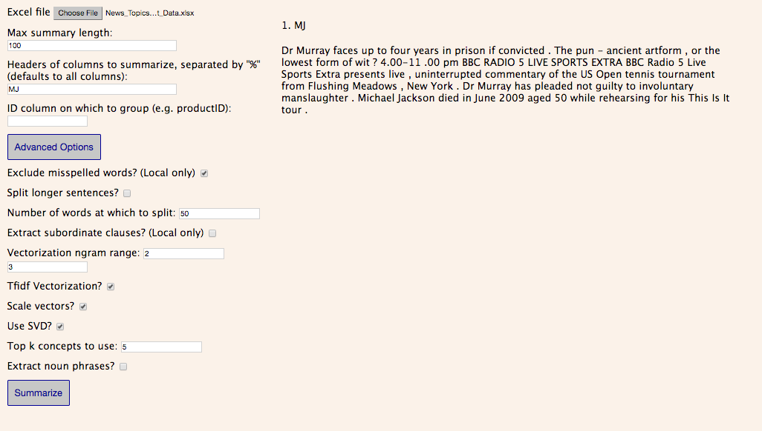
Summarization

Slide 13
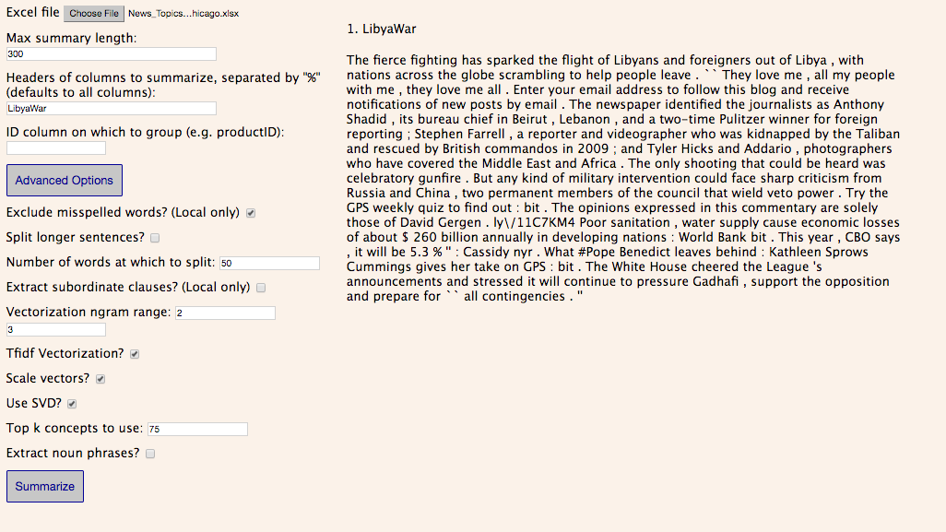
Summarization

Slide 14
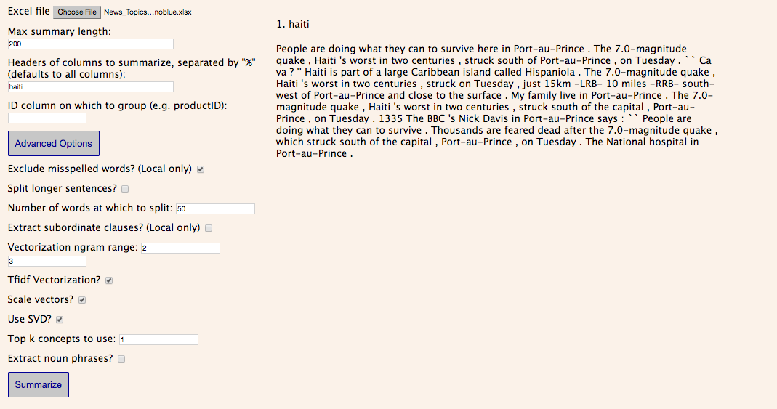
Summarization

Slide 15
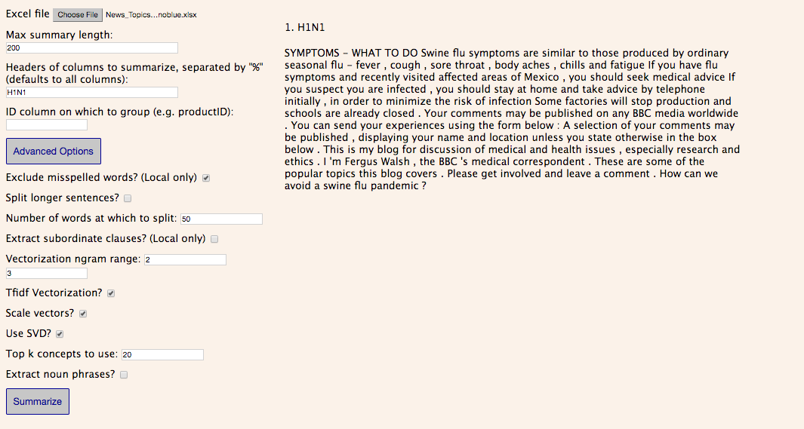
Summarization

Slide 16
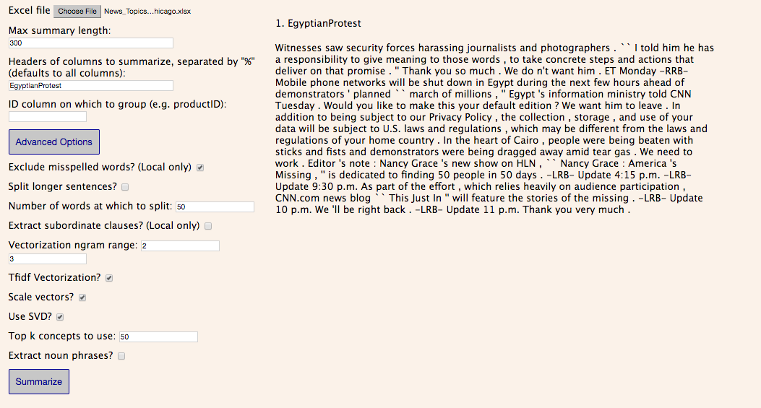
Summarization

Slide 17
Keyphrase extraction
RAKE algorithm
Source: Rose, Stuart, et al. "Automatic keyword extraction from individual documents." Text Mining (2010): 1-20.
Unsupervised & independent from the language at use
More computationally efficient than TextRank
Higher precision and comparable recall scores

Slide 18
Keyphrase extraction
RAKE algorithm
First observation
keywords = multiple words but no punctuation or stop words (and, the…)
Input
Document
List of stop words and phrase delimiters
Parameters:
minimum length of a word in a keyphrase
minimum frequency for a word in the text
maximum number of words per keyphrase
Output
List of keyphrases and the associated relevance score

Slide 19
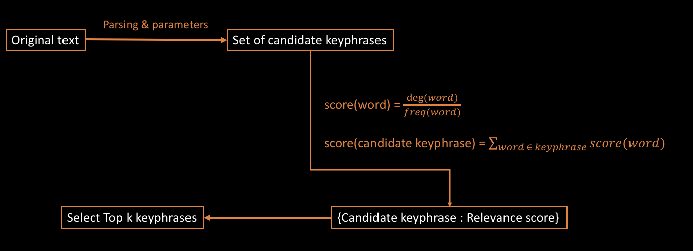
Keyphrase extraction
RAKE algorithm
Pipeline

Slide 20
Keyphrase extraction
Modifications and improvements
Spell check
mosturizd -> moisturized
Use of stemming to group similar keyphrases
{moisturized, moisturizing} -> moistur
Negations aggregation
not oily -> no_oily / 2 words -> 1 word
Added parameter
minimum length of a keyphrase
Score Scaling
New scoring function

Slide 21
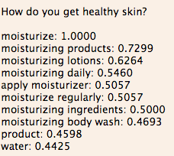
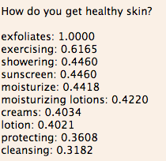
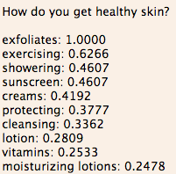



Keyphrase extraction
Modifications and improvements
New scoring function
score(word) = $freq\left(word\right)$
score(word) = $\frac{freq(word)}{{deg⁡(word)}^{0.8}}$
score(word) = $\frac{freq(word)}{deg⁡(word)}$

Slide 22
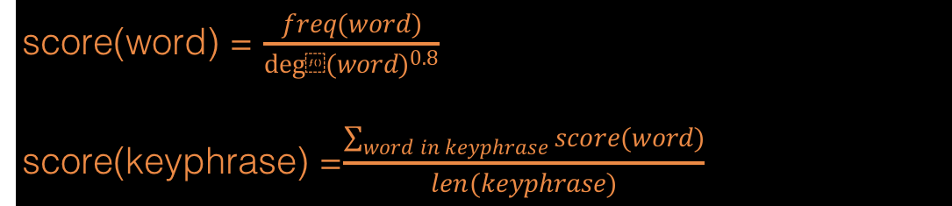
Keyphrase extraction
Final Pipeline
Parsing & parameters
Spell Check
Negation aggregation
Stemming
score(word) = $\frac{freq(word)}{{deg⁡(word)}^{0.8}}$
score(keyphrase) =$\frac{\sum_{word in keyphrase}{score(word)}}{len(keyphrase)}$
Keyphrase selection
top k or score > t

Slide 23
User Interface
Backend & algorithms
Python
Python Flask
Frontend
HTML & CSS
Javascript
Hosted on Heroku
Available at https://unilever-nlp.herokuapp.com/

Slide 24
Live Demo

Slide 25
Future developments
User-friendliness of the interface
Refine the algorithms
Other features
Display the original sentence by clicking on a keyphrase
More information per keyphrase: frequency, word scores…
Export function
Copy Paste input

Slide 26
Conclusion
Hard skills
Relationship with the mentors
Industry problem
Industry solution
Day at Unilever’s Office

Slide 27
Questions?
Contact Info
Ian Johnson: icj2103@columbia.edu
Julien Maudet: jm4418@columbia.edu

