Slide 1

Thrift IT
By Maukan Mir

Slide 2
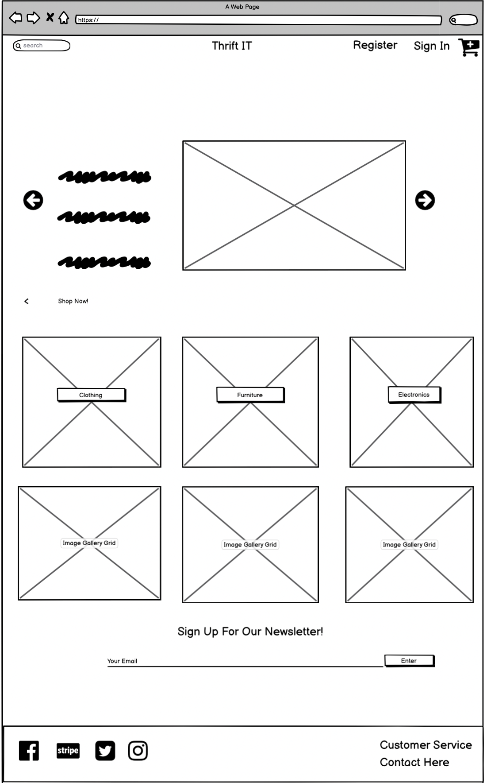
Home Page introduction
The use can navigate the home page to do the following: Look at Products. Register for an account.
Sign into an account.
Sign Up for a Newsletter
Use the Search bar to locate items
Stylistically, it starts off with a slide show of images followed by images based on products.

Slide 3
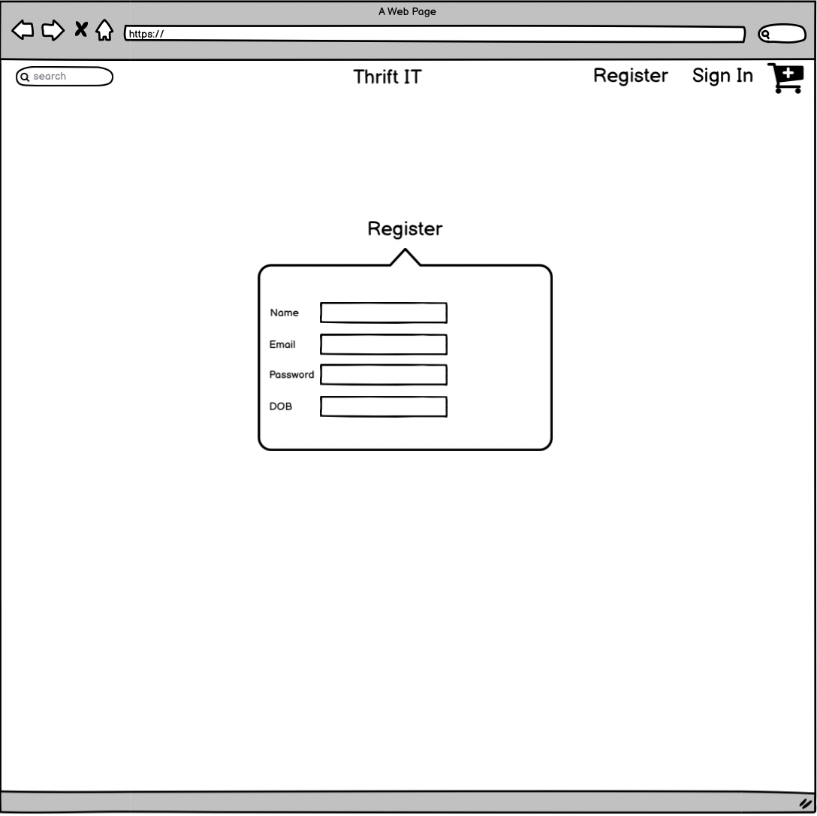
Register Page
Where the User can register for an account.

Slide 4
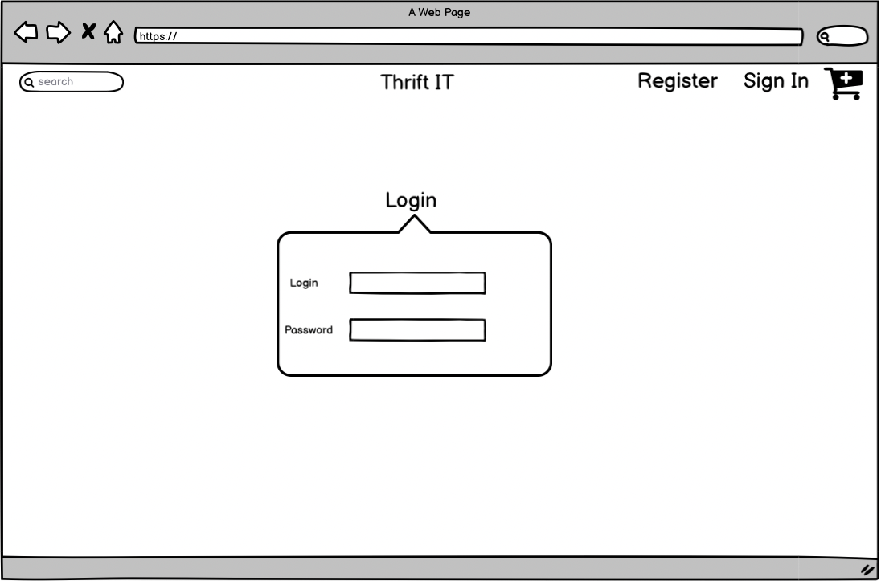
Login Page
Where the user logs into their account. They will see this option in the navbar.

Slide 5
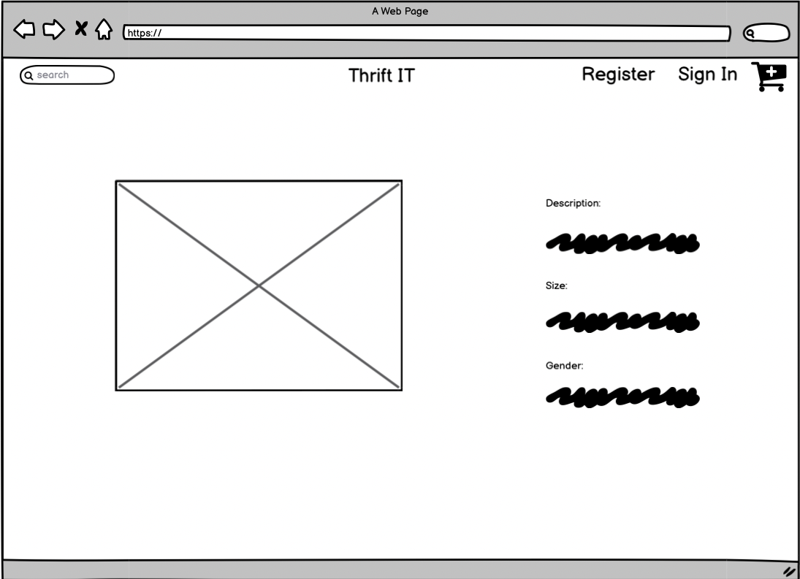
Product Page
When a user clicks on a product. It will take them to the product description page

Slide 6
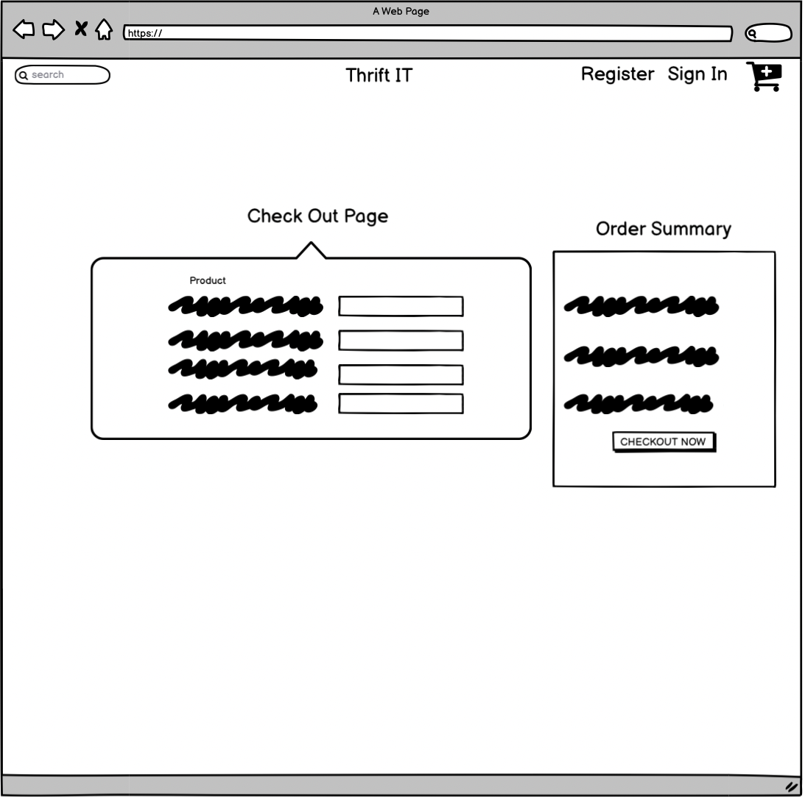
Cart Checkout
This Page will be the cart checkout page

Slide 7
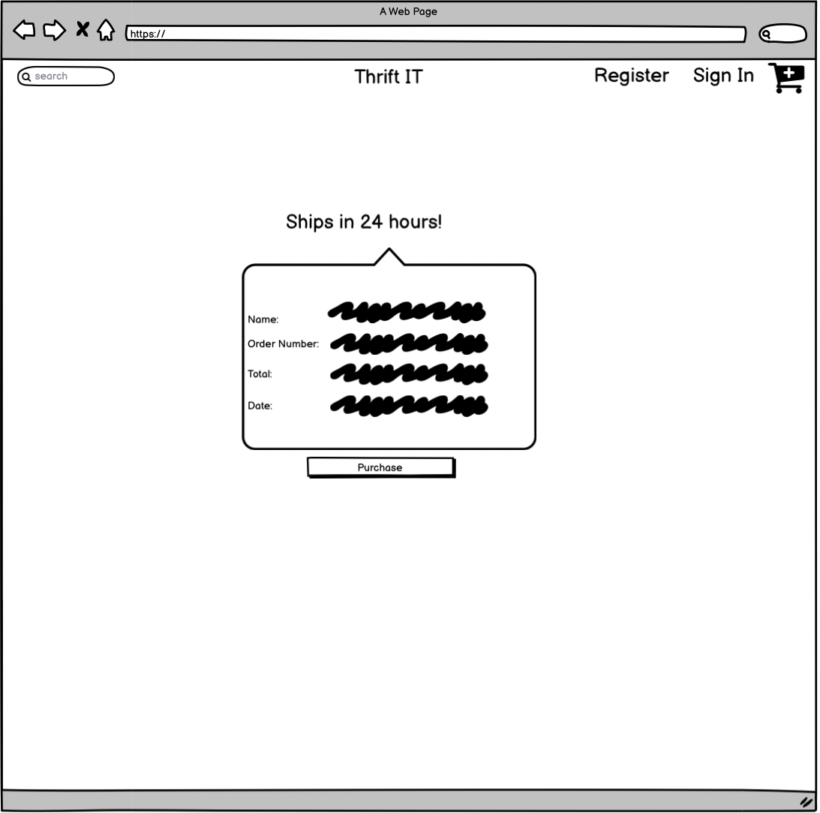
Payment Page
The Payment Page will ask the user to confirm the purchase.

Slide 8
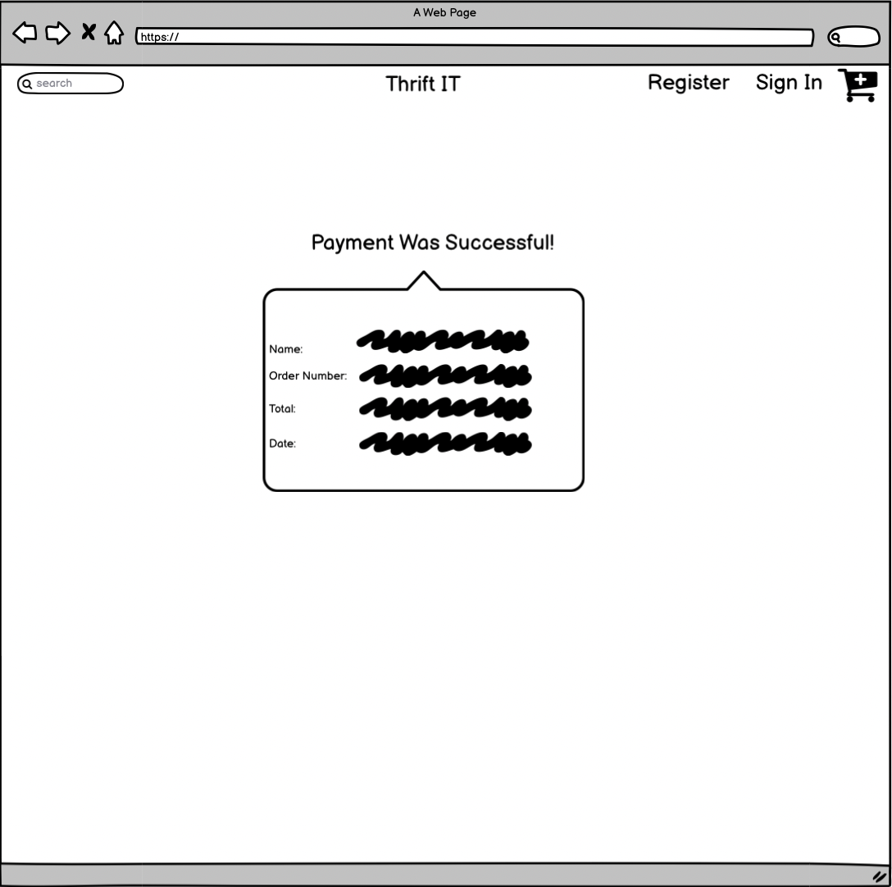
Payment was Successful Page
This lets the user know if the payment was successful.

Slide 9
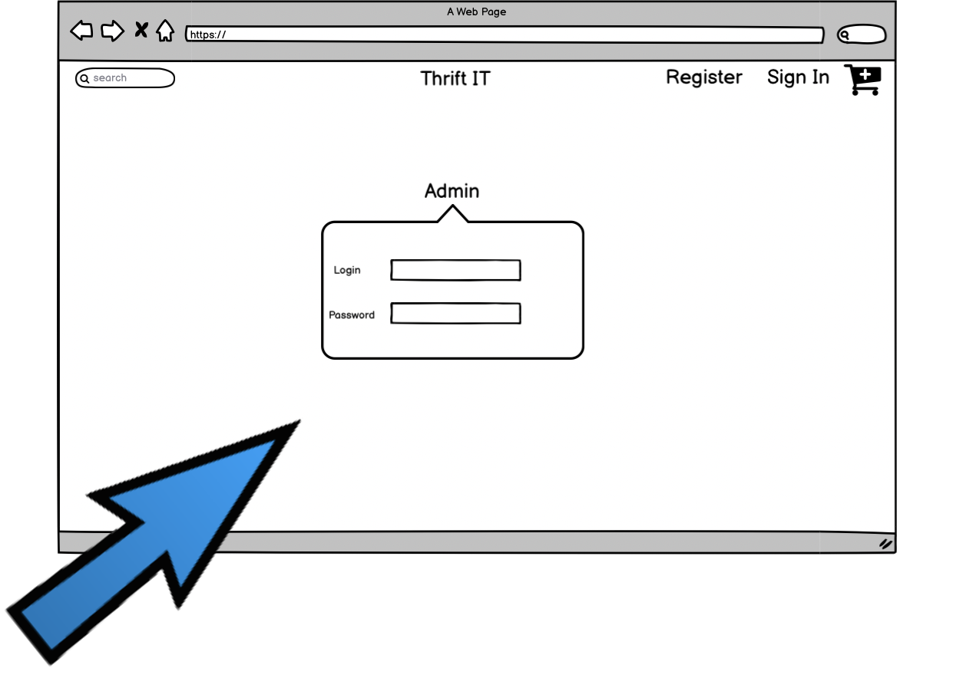
Admin Login Page

Slide 10
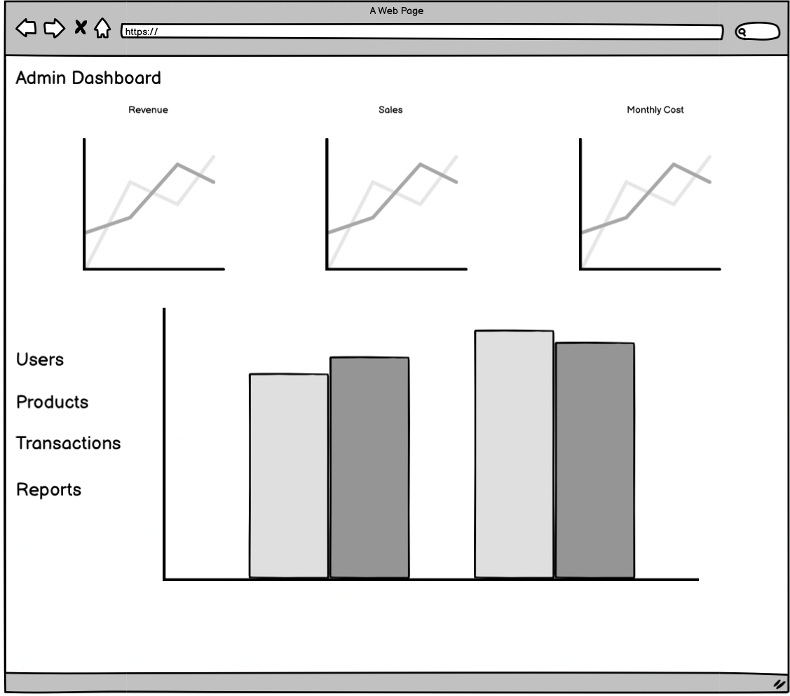
Admin Analytics Page

