Slide 1
Perhitungan Manual Sistem Fuzzy
Sistem Penilaian Kelayakan Kredit

Slide 2
Input dan Output
Input:
- Pendapatan (Income): 7000
- Hutang (Debt): 3000
- Riwayat Kredit (Credit History): 7
Output yang dicari:
- Nilai Crisp Kelayakan Kredit

Slide 3
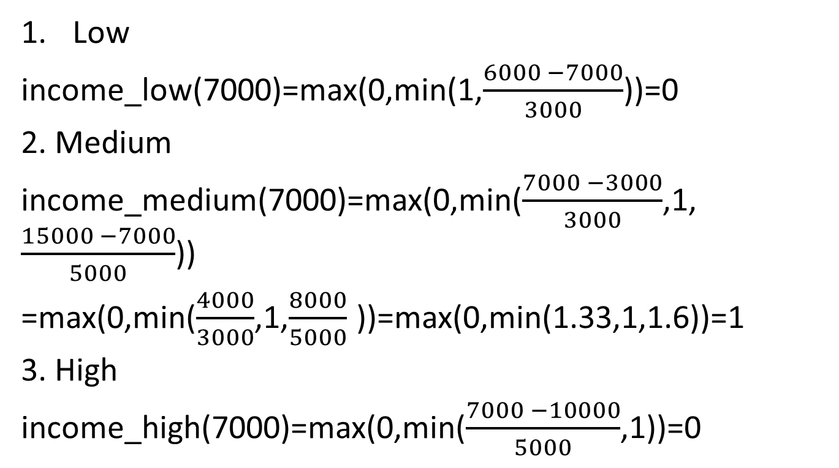
Derajat Keanggotaan
Low
income_low(7000)=max(0,min(1,$\frac{6000 −7000}{3000}$​))=0
2. Medium
income_medium(7000)=max(0,min($\frac{7000 −3000}{3000}$​,1,$\frac{15000 −7000}{5000}$​))
=max(0,min($\frac{4000}{3000}$​,1,$\frac{8000}{5000}$ ​))=max(0,min(1.33,1,1.6))=1
3. High
income_high(7000)=max(0,min($\frac{7000 −10000}{5000}$,1))=0

Slide 4
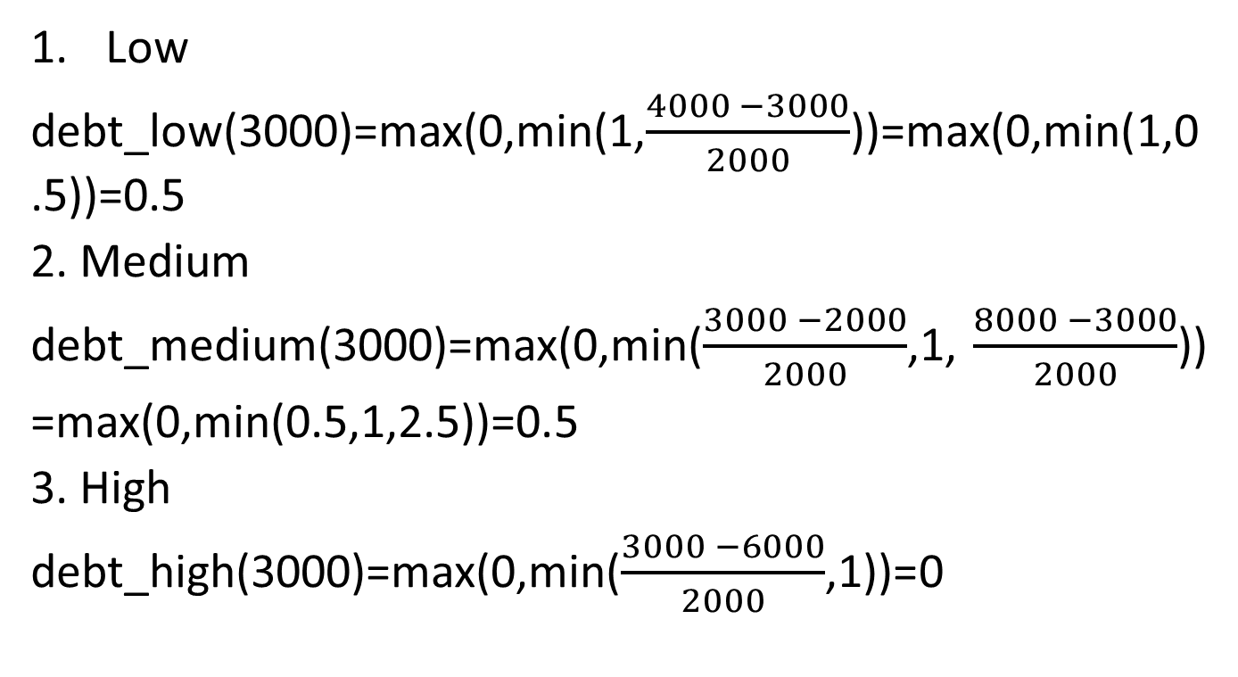
Hutang (Debt = 3000)
Low
debt_low(3000)=max(0,min(1,$\frac{4000 −3000}{2000}$​))=max(0,min(1,0.5))=0.5
2. Medium
debt_medium(3000)=max(0,min($\frac{3000 −2000}{2000}$​,1, $\frac{8000 −3000}{2000}$​))
=max(0,min(0.5,1,2.5))=0.5
3. High
debt_high(3000)=max(0,min($\frac{3000 −6000}{2000}$​,1))=0

Slide 5
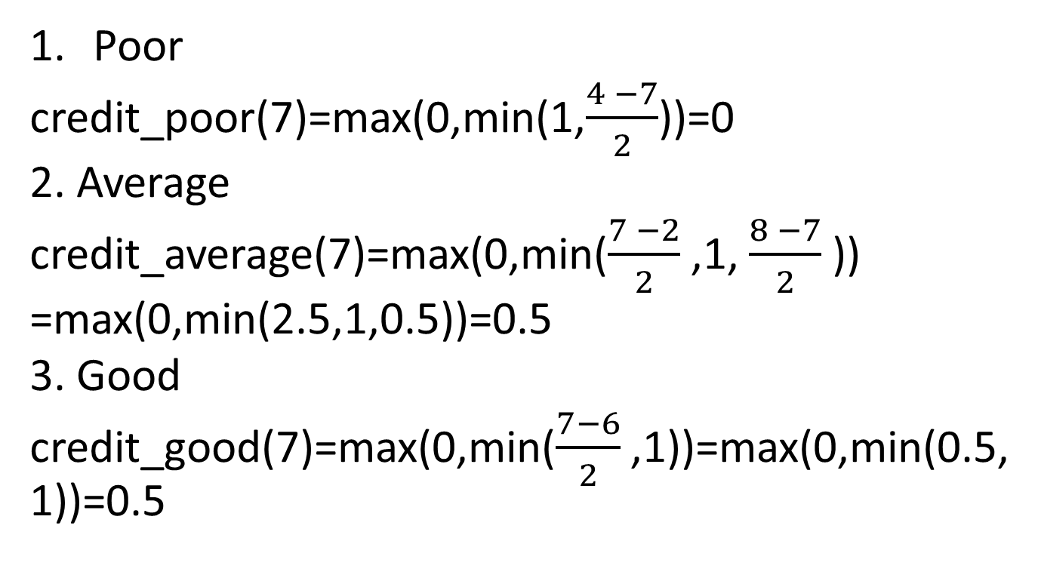
Riwayat Kredit (Credit History = 7)
Poor
credit_poor(7)=max(0,min(1,$\frac{4 −7}{2}$))=0
2. Average
credit_average(7)=max(0,min($\frac{7 −2}{2}$​,1, $\frac{8 −7}{2}$​))
=max(0,min(2.5,1,0.5))=0.5
3. Good
credit_good(7)=max(0,min($\frac{7−6}{2}$​,1))=max(0,min(0.5,1))=0.5

Slide 6
Terapkan Aturan Fuzzy
Jika Pendapatan Low dan Hutang High dan Riwayat Kredit Poor, maka Kelayakan Low. min(income_low(7000),debt_high(3000),credit_poor(7))=min(0,0,0)=0
Jika Pendapatan Medium dan Hutang Medium dan Riwayat Kredit Average, maka Kelayakan Medium. min(income_medium(7000),debt_medium(3000),credit_average(7))=min(1,0.5,0.5)=0.5

Slide 7
Jika Pendapatan High dan Hutang Low dan Riwayat Kredit Good, maka Kelayakan High. min(income_high(7000),debt_low(3000),credit_good(7))=min(0,0.5,0.5)=0
Jika Pendapatan Medium dan Hutang Low dan Riwayat Kredit Good, maka Kelayakan High. min(income_medium(7000),debt_low(3000),credit_good(7))=min(1,0.5,0.5)=0.5

Slide 8
Gabungkan Output
Hasil aturan fuzzy digabungkan untuk setiap kategori output (Low, Medium, High):
Low: max⁡(0)=0\max(0) = 0max(0)=0
Medium: max⁡(0.5)=0.5\max(0.5) = 0.5max(0.5)=0.5
High: max⁡(0,0.5)=0.5\max(0, 0.5) = 0.5max(0,0.5)=0.5

Slide 9
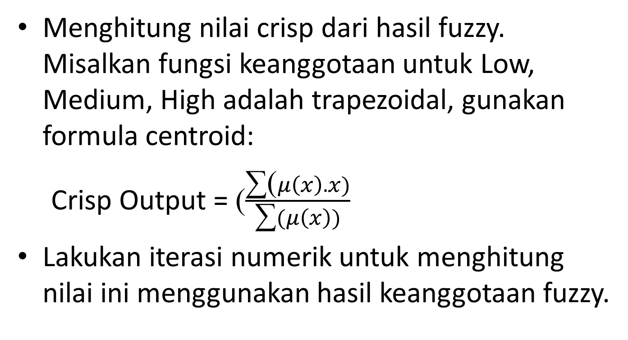
Defuzzifikasi
Menghitung nilai crisp dari hasil fuzzy. Misalkan fungsi keanggotaan untuk Low, Medium, High adalah trapezoidal, gunakan formula centroid:
Crisp Output = ($\frac{\text{∑}\text{(}μ\left(x\right).x)}{\text{∑}(μ\left(x\right))}$
Lakukan iterasi numerik untuk menghitung nilai ini menggunakan hasil keanggotaan fuzzy.

Slide 10
Hasil Akhir
Setelah defuzzifikasi, misalkan kita mendapatkan hasil akhir Crisp Output=65.\text{Crisp Output} = 65.Crisp Output=65. Interpretasi ini menunjukkan bahwa kelayakan kredit berada pada tingkat medium-to-high.

