Slide 1
How Powerful are Graph Neural Networks?
Team 29
Surabhi Jain (2021121004) Shruti Kolachana (2020102053)
Maulesh Gandhi (2020112009)
Deepthi Chandak (2020102013)

Slide 2
Aim
Graphs
GNNs
WL test
Preliminaries
Framework
GIN
Experimentations
Results
Conclusions
Datasets & Github repo
References
Contributions
Contents

Slide 3
AIM
The Objectives/main results summary from Paper[https://arxiv.org/abs/1810.00826]]
1.GNNs are at most as powerful as the WL test in distinguishing graph structures.
2. Developed a simple neural architecture, Graph Isomorphism Network (GIN), and showed that its discriminative/representational power is equal to the power of the WL test.
3.GIN is maximally powerful GNN
We validate the above results by training different GNN variants

Slide 4
Graphs
G = (V, E); V: set of nodes; E: set of edges
Adjacency matrix {A}: commonly used to depict a graph. If a graph has N nodes, then A has an NxN dimension.
Two graphs can be visually and structurally different. Still, when we convert them to their adjacency matrix representation, they can have the same adjacency matrix.
Graphs help cope with abstract notions like linkages and interactions by providing an intuitively visual method of thinking about them.
Traditional Graph Analysis techniques such as BFS, DFS, and Dijkstra have the limitation of requiring previous knowledge of the graph at a particular level of certainty before using the algorithm. Most notably, graph-level categorization is not possible.

Slide 5
GNNs
An effective framework for representation learning of graphs.
They follow a recursive neighborhood aggregation scheme, where each node aggregates feature vectors of its neighbors to compute its new feature vector.
After k iterations of aggregation, a node is represented by its transformed feature vector, which captures the structural information within the node’s k-hop neighborhood.
The representation of an entire graph can then be obtained through pooling, for example, by summing the representation vectors of all nodes in the graph.
Tasks: node classification, graph classification, link prediction
There is limited understanding of their representational properties and limitations.

Slide 6
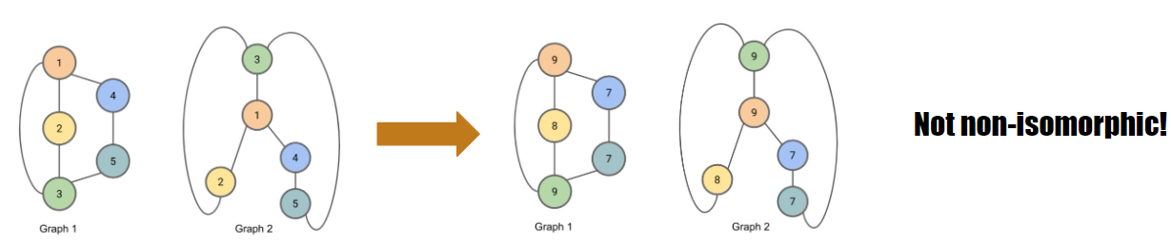
WL graph isomorphism Test
Graph isomorphism indicates if two graphs are topologically identical, no polynomial-time algorithm is known for it yet.
WL test is a powerful test known to distinguish a broad class of graphs because of its injective aggregation update that maps different node neighborhoods to different feature vectors.
The WL test iteratively
aggregates the labels of nodes and their neighborhoods
hashes the aggregated labels into unique new labels.
1-dimensional form of WL test, “naïve vertex refinement”, is analogous to neighbor aggregation in GNNs.
The algorithm decides that two graphs are non-isomorphic if at some iteration the labels of the nodes between the two graphs differ.

Slide 7
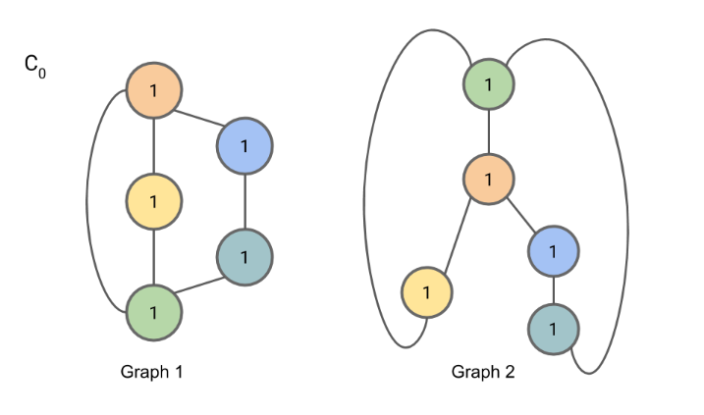
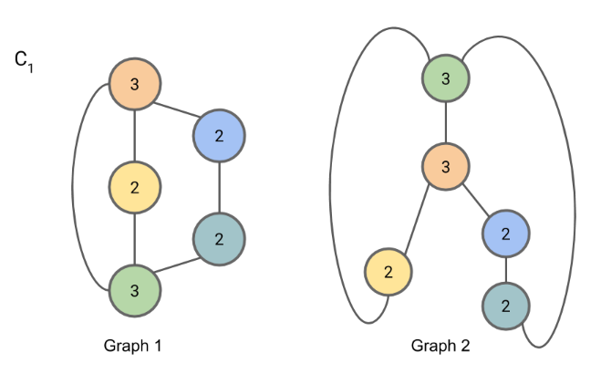
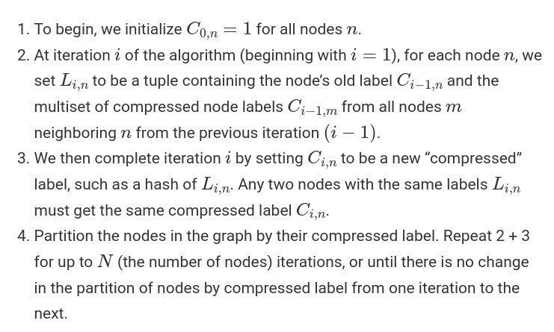
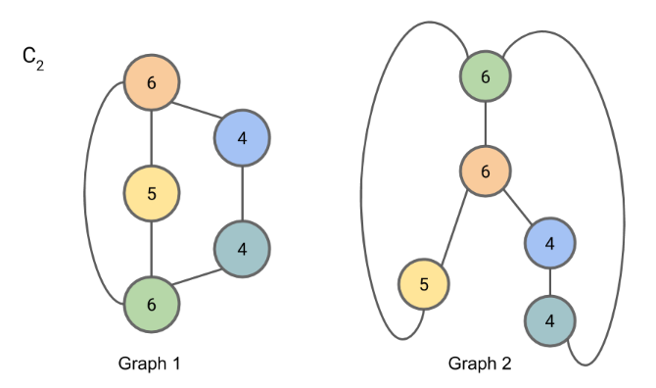
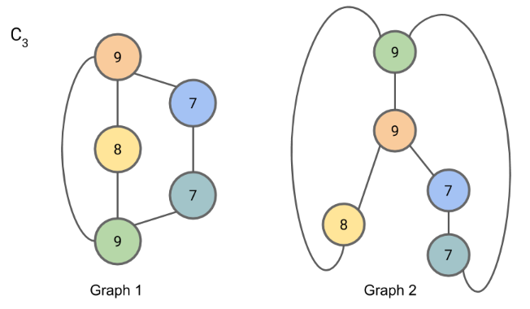
WL test Example
Since the partition of nodes by compressed label has not changed from C2 to C3, we may terminate the algorithm here.

Slide 8
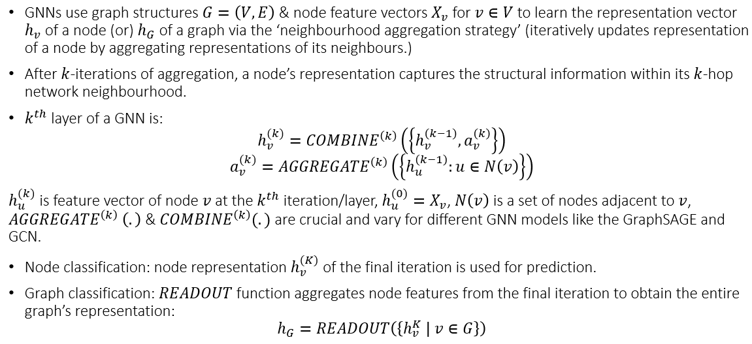
Preliminaries

Slide 9
Framework
Key: GNN can have as large discriminative power as the WL test if the GNN’s aggregation scheme is highly expressive and can model injective functions.
A multiset is a generalized concept of a set that allows multiple instances for its elements. More formally, a multiset is a 2-tuple X = (S, m) where S is the underlying set of X that is formed from its distinct elements, and m : S → N≥1 gives the multiplicity of the elements.
Hence, to have strong representational power, a GNN must be able to aggregate different multisets into different representations.
The more discriminative the multiset function is, the more powerful the representational power of the underlying GNN.
Therefore, we abstract a GNNs aggregation scheme as a class of functions over multisets that their neural networks can represent, and analyze whether they are able to represent injective multiset functions.

Slide 10
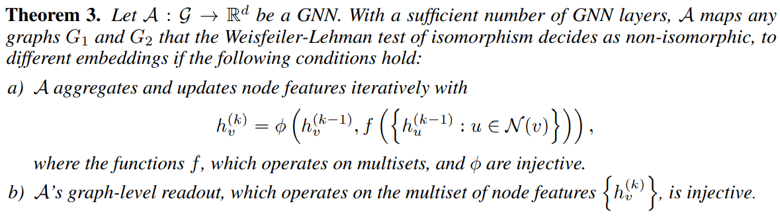
Conditions for a maximally powerful GNN
GNNs to not only discriminate different structures, but also to learn to map similar graph structures to similar embeddings and capture dependencies between graph structures. Capturing structural similarity of the node labels is shown to be helpful for generalization particularly when the co-occurrence of subtrees is sparse across different graphs or there are noisy edges and node features.

Slide 11

Graph Isomorphism Network
(GIN)
Generalizes the WL test and hence achieves maximum discriminative power among GNNs.
To model injective multiset functions for the neighbor aggregation, we develop a theory of “deep multisets”, i.e., parameterizing universal multiset functions with neural networks.
Sum aggregators can represent injective, in fact, universal functions over multisets.
GIN updates node representations as:
This gives the integration of an injective AGGREGATE and COMBINE functions.

Slide 12
Graph Level Readout of GIN
Node embeddings learned by GIN can be directly used for tasks like node classification and link prediction.
For graph classification tasks we propose the following “readout” function that, given embeddings of individual nodes, produces the embedding of the entire graph.
A sufficient number of iterations is key to achieving good discriminative power.
Yet, features from earlier iterations may sometimes generalize better. To consider all structural information, we use information from all depths/iterations of the model.
To overcome this issue, we will evaluate all node features:

Slide 13
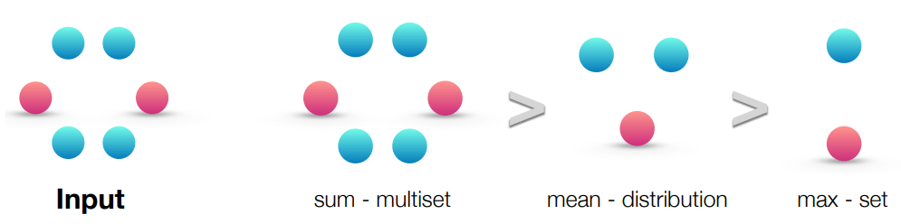
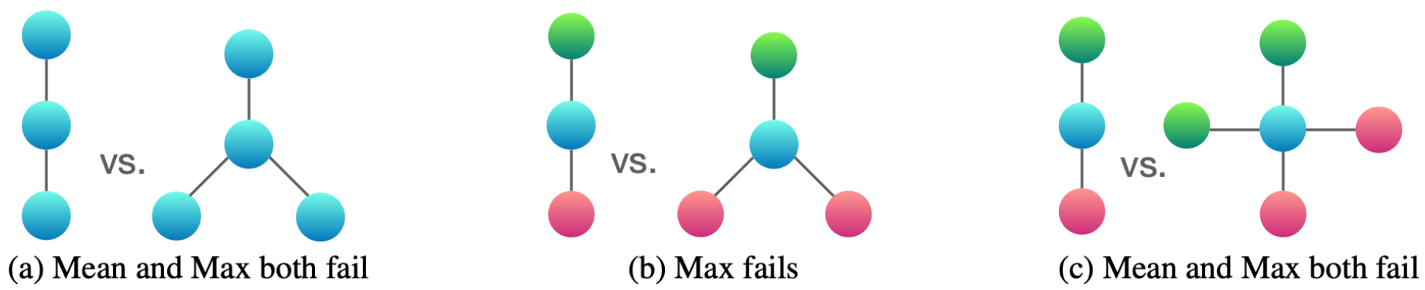
Other GNNs
Models with mean aggregators like GCN perform well for node classification tasks but get confused by surprisingly simple graphs and are less powerful than the WL test.
Conduct ablation studies on two aspects of the aggregator:
1-layer perceptrons instead of MLPs
1-layer perceptrons == linear mappings
GNN layers == summing over neighborhood features
bias term + sufficiently large output dimensionality, then might be able to distinguish different multisets
1-layer perceptron (even with the bias term) != universal approximator of multiset functions (unlike MLPs)
GNNs with 1-layer perceptrons can embed different graphs to different locations to some degree, such embeddings may not adequately capture structural similarity, and can be difficult for simple classifiers, e.g., linear classifiers, to fit.
There exists X₁ != X₂ so that for a linear mapping W,
mean or max-pooling instead of the sum
they are invariant under node permutation
can fail on some regular graphs particularly when the multiplicity/number of occurrence/counting of node features also matters.

Slide 14
Experimentations
We evaluated and compared the training and test performance of GIN, GraphSAGE with max pooling and GCN with mean pooling on the following three datasets:
PROTEINS: graphs-1113, classes-2, avg nodes-39.06, edges-72.82
MUTAG: graphs-118, classes-2, avg nodes-17.93, edges-19.97
NC1: graphs-4110, classes-2, avg nodes-29.87, edges-32.30
Training set performance allows us to compare different GNN models based on their representational power.
Test set performance quantifies generalization ability.

Slide 15
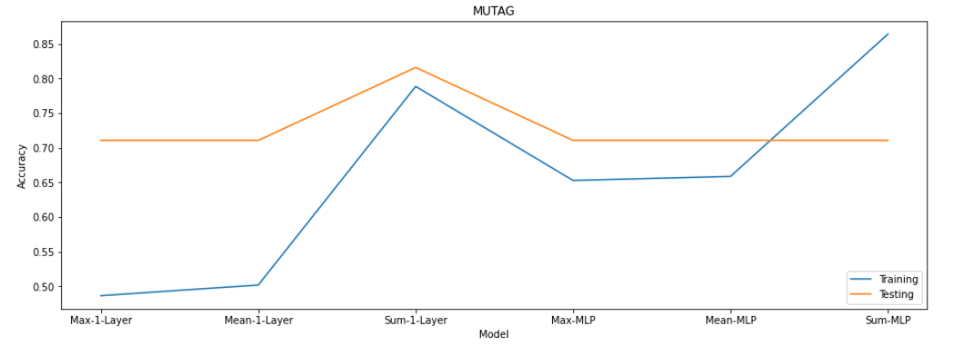
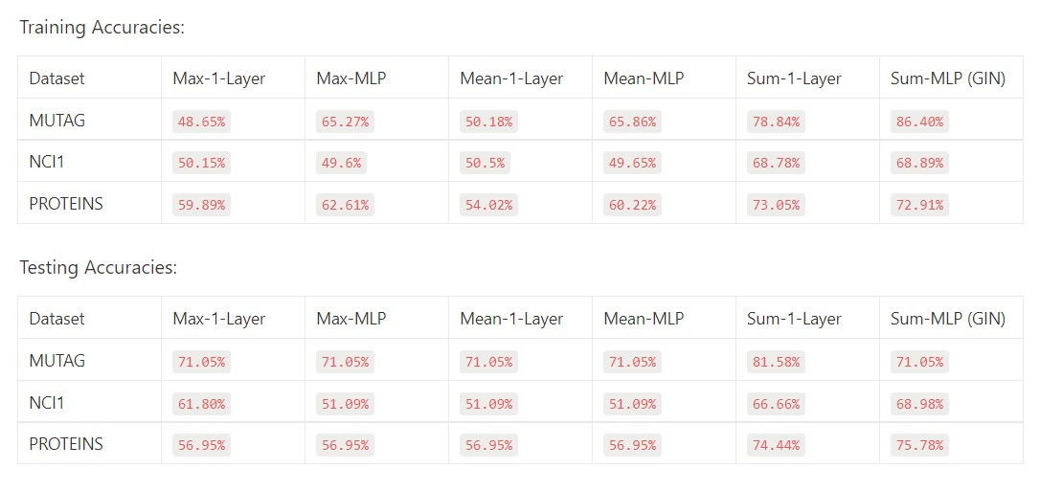
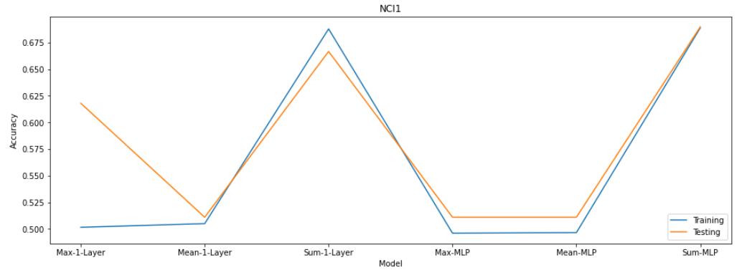
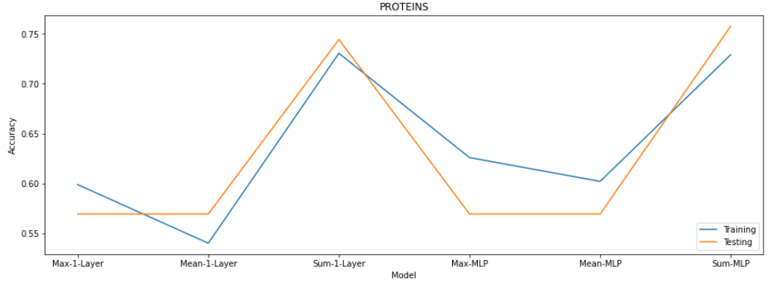
Results

Slide 16
Conclusion
We validated the theoretical analysis of the representational power of GNNs(https://arxiv.org/abs/1810.00826) by comparing their training and testing accuracies.
Models with higher representational power should have higher training set accuracy.
GIN gives the highest accuracies in all the datasets considered which thus validates the theory that GIN has the maximum representational power among all GNN variants.

Slide 17
GitHub Repo: https://github.com/MauleshGandhi/Graph_Neural_Networks_SMAI2022_G29.git
Datasets:
https://chrsmrrs.github.io/datasets/docs/datasets/
MUTAG, NCI1 and PROTEINS

Slide 18
References
Contributions
Thank You!
https://davidbieber.com/post/2019-05-10-weisfeiler-lehman-isomorphism-test/
https://arxiv.org/abs/1810.00826
Surabhi Jain & Shruti Kolachana : GNN & GIN models
Maulesh Gandhi & Deepthi Chandak : Datasets & training-testing

