Slide 1

Project Allocation Management System
A comprehensive system to efficiently allocate and manage projects and resources within an organization.
Presented By: 1. Harshwardhan Bichitkar (20220802149) 2. Yash Sakhare (20220802137) 3. Mauli Kangude (20220802149)

Slide 2

Introduction
Gain real-time insights into project status and resource availability.
1
Optimizing Resource Utilization
2
Improved Visibility
Ensure projects are staffed with the right people at the right time.
3
Enhanced Collaboration
Facilitate seamless teamwork and communication across projects.

Slide 3

Problem Statement and Solution Overview
Challenges
Solution
Key Benefits
Inefficient resource allocation, lack of project visibility, and poor collaboration.
Implement a centralized Project Allocation Management System to address these pain points.
Improved productivity, better decision-making, and increased project success rates.

Slide 4
lastname
gender
perhr
salary
Project name
Emp_id
Proj _id
firstname
password
Client address
Has assigned to
has
CreateProj
empinseart
Billing
Client name
Bills
Emp_id
Pro_id
start date
tothrs
Timesheet
empid
date
Database Design (ER Model)
totaltime
projectid

Slide 5
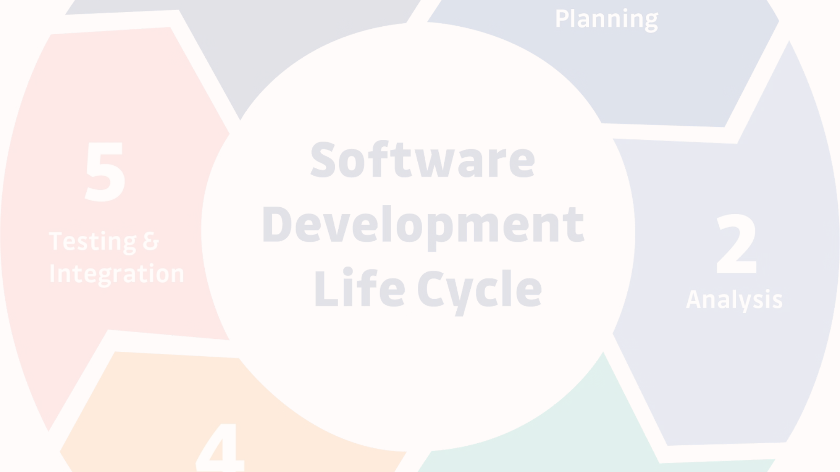
Implementation Details
Front-end
Back-end
Database
HTML, CSS for responsive and intuitive user interface.
C# and ASP.NET Core for efficient data processing and API integration.
SQL Server for secure and scalable data storage and management.

Slide 6
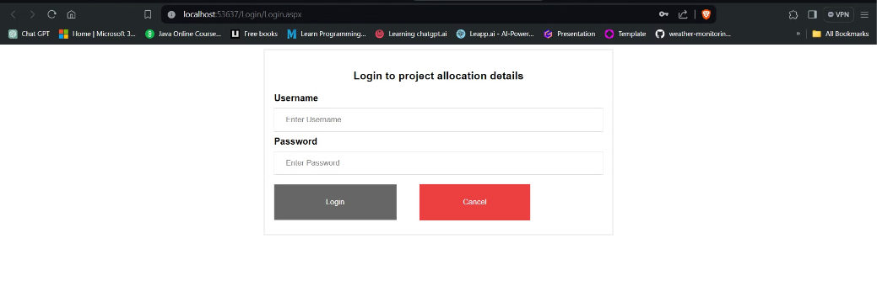
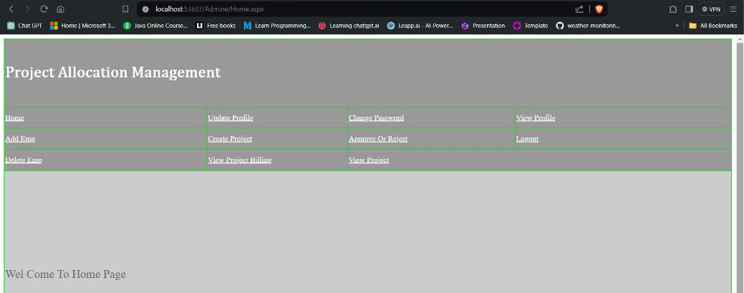
User Interface:

Slide 7
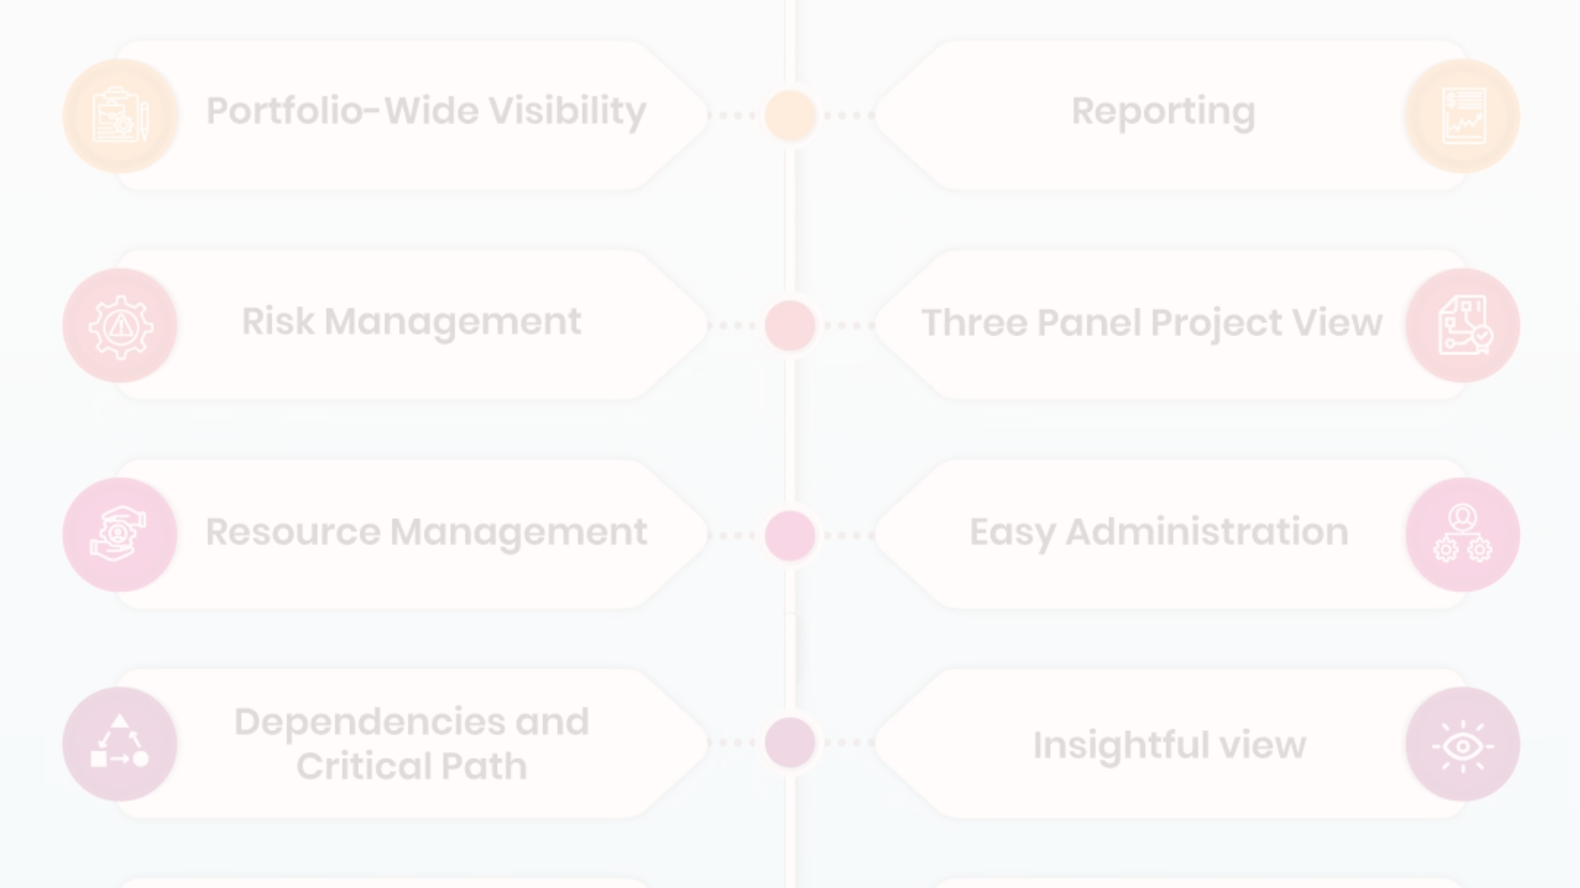



Key Features
Resource Allocation
Project Tracking
Collaboration Tools
Optimally assign employees to projects based on skills and availability.
Monitor project progress, milestones, and potential bottlenecks.
Enable seamless communication and document sharing among team members.

Slide 8
Future Aspects
Sustainability Integration
Advanced Analytics and Data Visualization
Integration Capabilities
Integrating sustainability metrics into project allocation decisions can promote environmentally responsible practices.
Seamlessly integrate with other business systems for a holistic view.
Leverage machine learning to predict resource needs and optimize allocation.

Slide 9
Conclusion
The Project Allocation Management System provides a comprehensive solution to streamline project management and resource utilization, driving increased productivity and project success.
REFRENCES

