Slide 1
Maulik Thakkar Project 5 Nexthike IT solutions Intern
1

Slide 2
TELLCO TELECOM
Acquisition Due Diligence
A data-driven view of user overview, engagement, network experience, and satisfaction
Prepared for the Investor Due-Diligence Team | Nexthikes IT Solutions | Republic of Pefkakia
1

Slide 3
BUSINESS CONTEXT
Why This Analysis Matters
Our investor specializes in acquiring undervalued assets and driving profitability by refocusing the business on its most valuable customers and products. TellCo's current owners have shared financial data but have never analyzed their own system-generated network data.
Precedent
On a prior engagement, this same investor used rich data analysis to identify that university-student delivery routes were the most profitable segment for a delivery company -- driving a 25% profit increase in 6 months after acquisition. The same rigor is applied here to TellCo.
One month of xDR (session-level) network data analyzed
106,857 unique subscribers, 150,001 sessions
Four analysis stages: Overview, Engagement, Experience, Satisfaction
Goal: identify growth levers and a buy/sell recommendation
2

Slide 4
EXECUTIVE SUMMARY
Conditional Buy
A large, actively engaged, premium-skewed subscriber base with clear monetization levers -- offset by network telemetry gaps and quality issues a buyer should price in.
106,857
150,001
58.7 TB
95%
Unique subscribers
xDR sessions analyzed
Gaming data volume (top app)
Satisfaction variance explained by usage
Premium device base (Apple/Samsung/Huawei) signals real spending power
Distinct fixed-wireless broadband segment (Huawei router users) is underexploited
Network quality varies materially by handset -- remediation opportunity
Recommend a price adjustment or escrow for network-infrastructure investment
3

Slide 5
APPROACH
Methodology & Data Notes
1
2
3
4
Clean
Aggregate
Model
Score
Missing values imputed with column mean/mode; extreme outliers capped at 3x IQR
Session-level xDR rows rolled up to per-subscriber (MSISDN) features
K-Means clustering, PCA, and linear regression applied to engagement & experience metrics
Engagement + experience distances combined into a satisfaction score per subscriber
Modeling used a dependency-free numpy toolkit (scikit-learn-API-compatible); see code repository README.
4

Slide 6
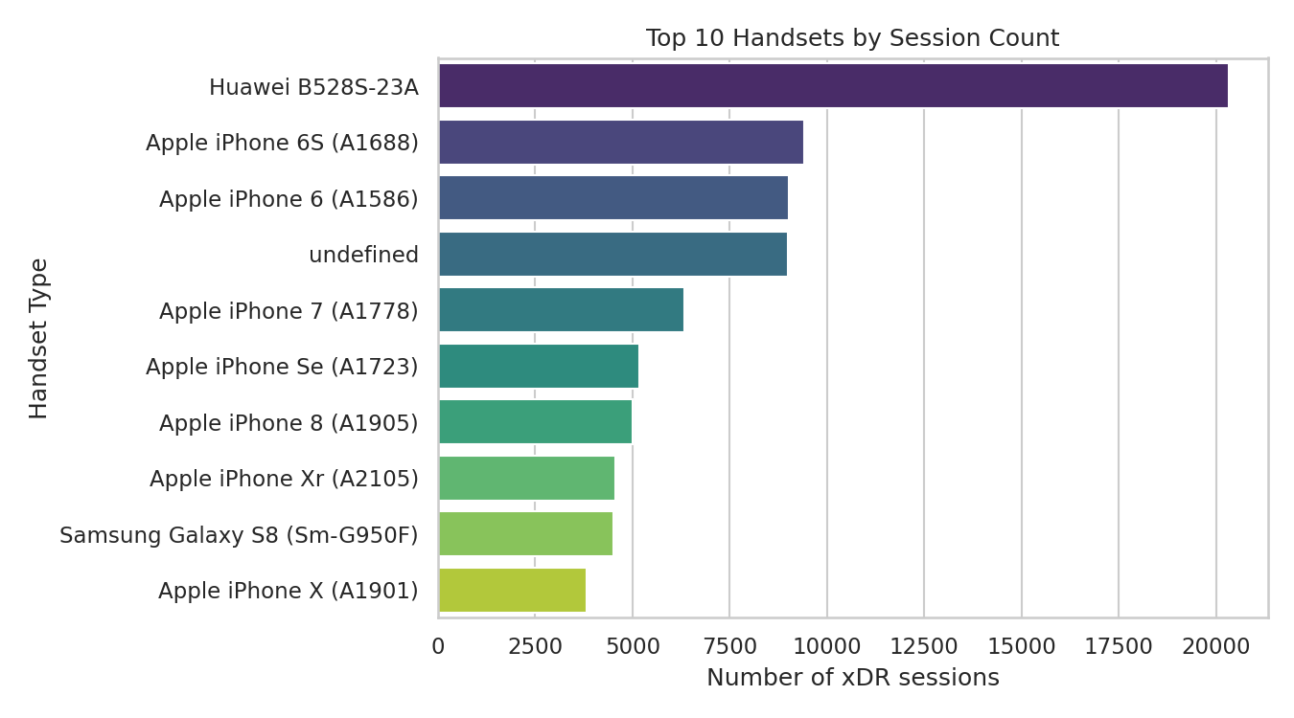
TASK 1 - USER OVERVIEW
Handset & Manufacturer Landscape
Top 3 Manufacturers
60,137
Apple
40,839
Samsung
34,423
Huawei
5

Slide 7
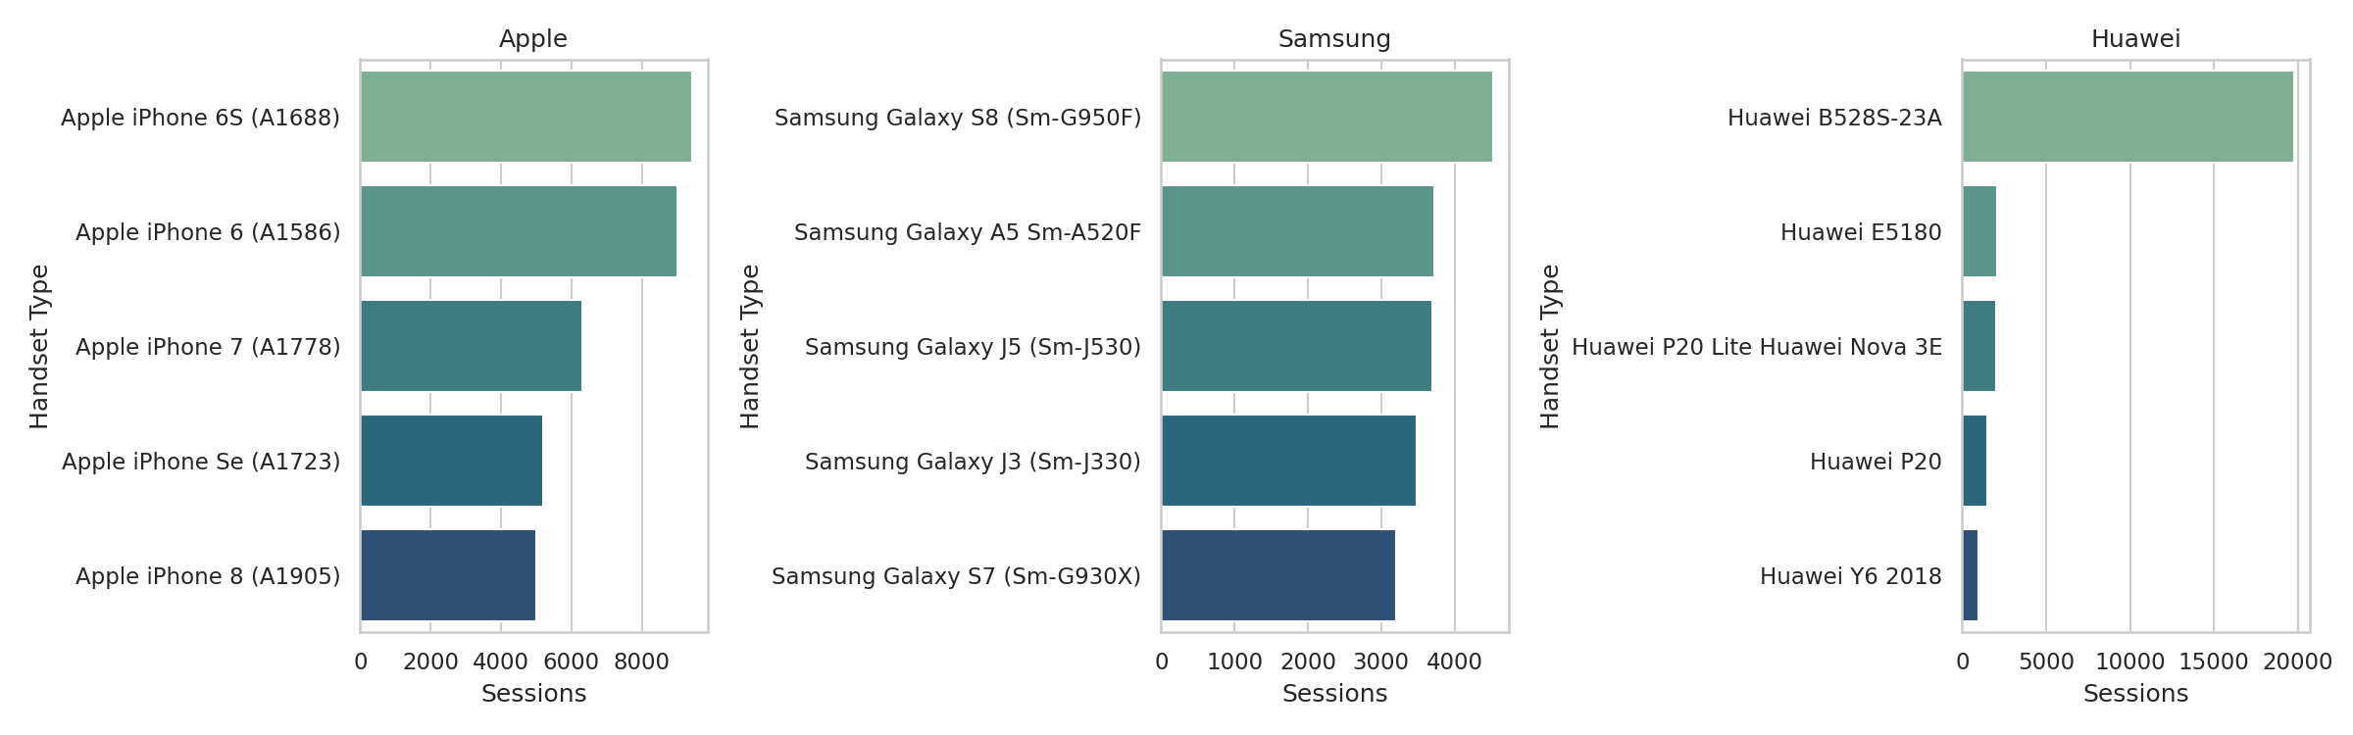
TASK 1 - USER OVERVIEW
Top 5 Handsets per Top-3 Manufacturer
The Huawei B528S-23A -- a fixed-wireless/home-broadband router, not a phone -- is TellCo's single most common device, pointing to a meaningful home-broadband customer segment alongside mobile handsets.
6

Slide 8
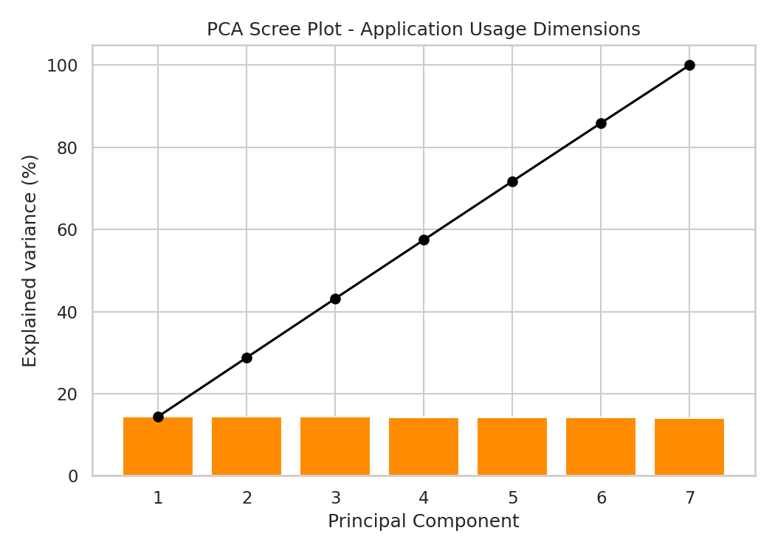
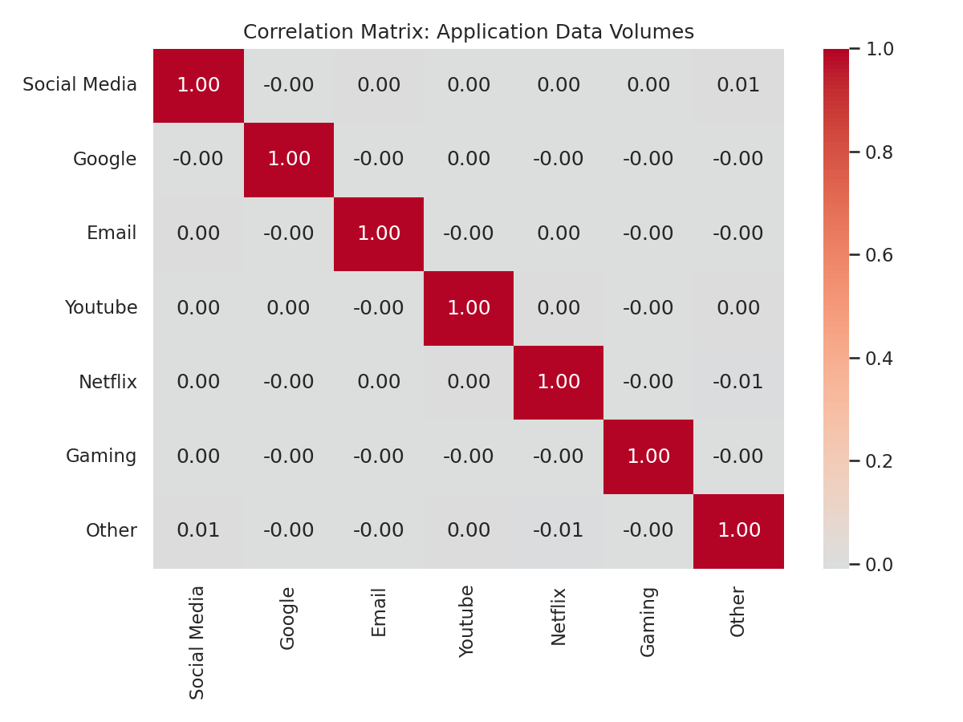
TASK 1 - USER OVERVIEW
Application Usage: Correlation & PCA
Application categories are essentially uncorrelated -- usage of one app tells you little about another
PCA variance is spread evenly (~14% per component) -- no single 'heavy user' axis
Total data volume is driven almost entirely by Gaming (r=0.998)
7

Slide 9
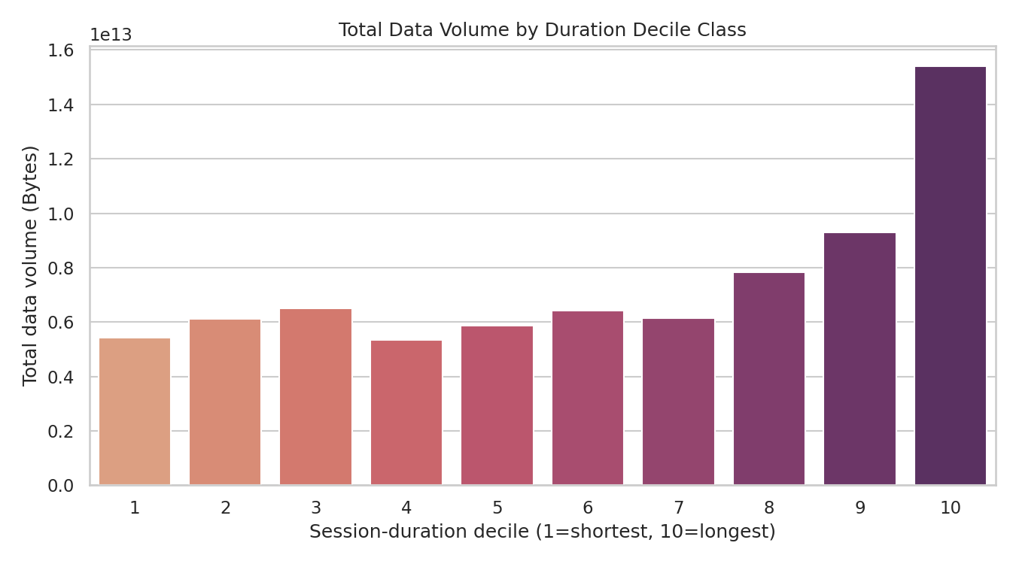
TASK 1 - USER OVERVIEW
Data Volume by Session-Duration Decile
Top decile alone accounts for
14.0 TB
of total network data volume
Long-session users are disproportionately valuable data consumers -- more than double the 6th decile's volume. These subscribers are prime candidates for premium/unlimited plan upsell.
8

Slide 10
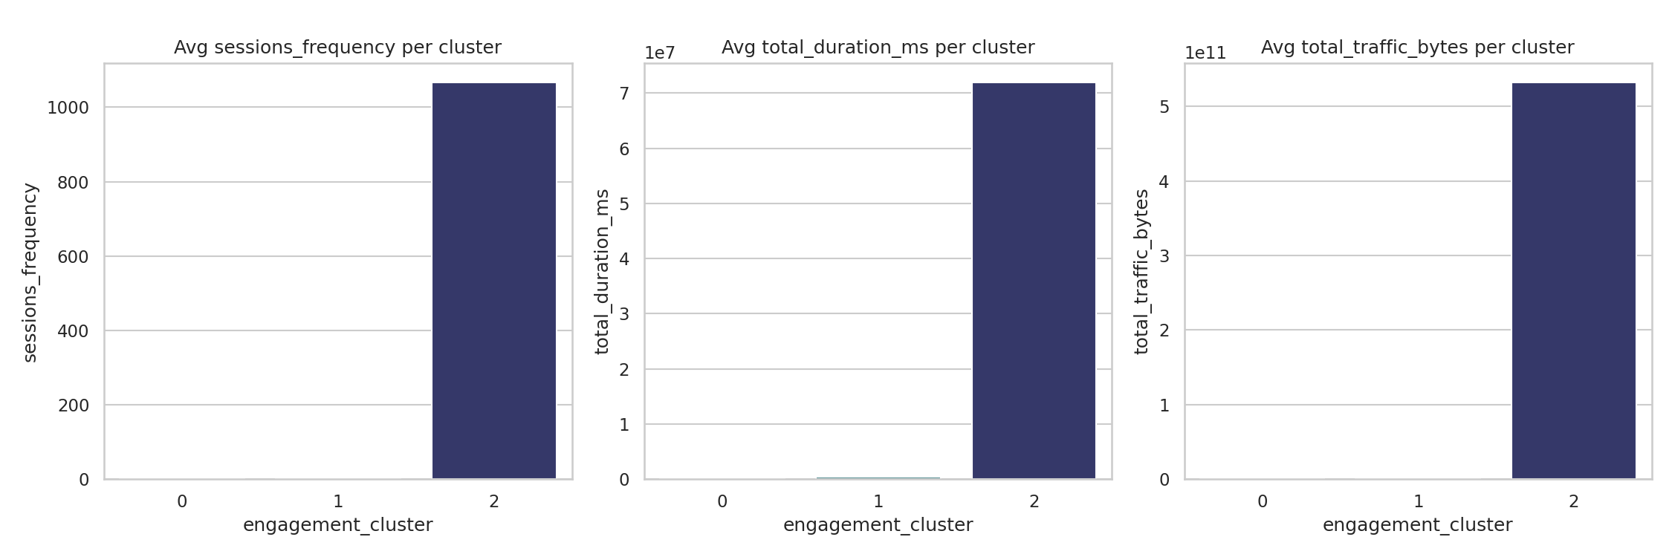
TASK 2 - USER ENGAGEMENT
Engagement Metrics & Top Customers
Engagement was measured per subscriber via three metrics: session frequency, total session duration, and total session traffic (DL+UL bytes).
What drives engagement
One subscriber logged 1,066 sessions in the month vs. a median of ~1 -- an extreme statistical outlier (likely M2M/aggregator line)
Excluding that outlier, the next-heaviest users show 12-18 sessions -- a natural 'power user' tier
Gaming and unclassified 'Other' traffic dominate total bytes network-wide
Cluster 2 (the single outlier) dwarfs the scale of clusters 0-1, visually flattening them -- see Slide 10 for the full 3-cluster breakdown.
9

Slide 11
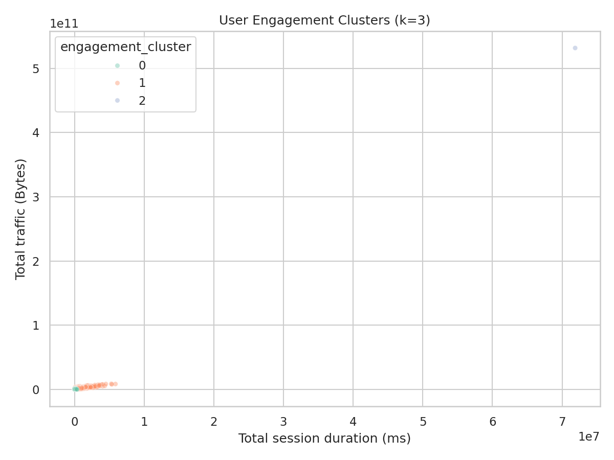
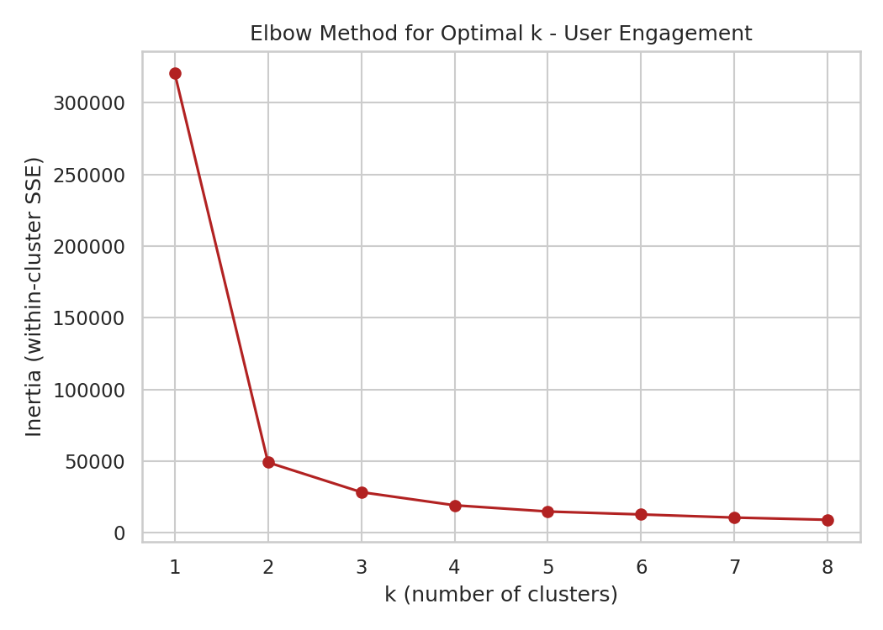
TASK 2 - USER ENGAGEMENT
Engagement Segmentation (K-Means, k=3)
The elbow method supports k=3: additional clusters yield diminishing returns. One cluster is a single extreme outlier that heavily skews centroid placement -- flagged as a data-quality limitation.
10

Slide 12
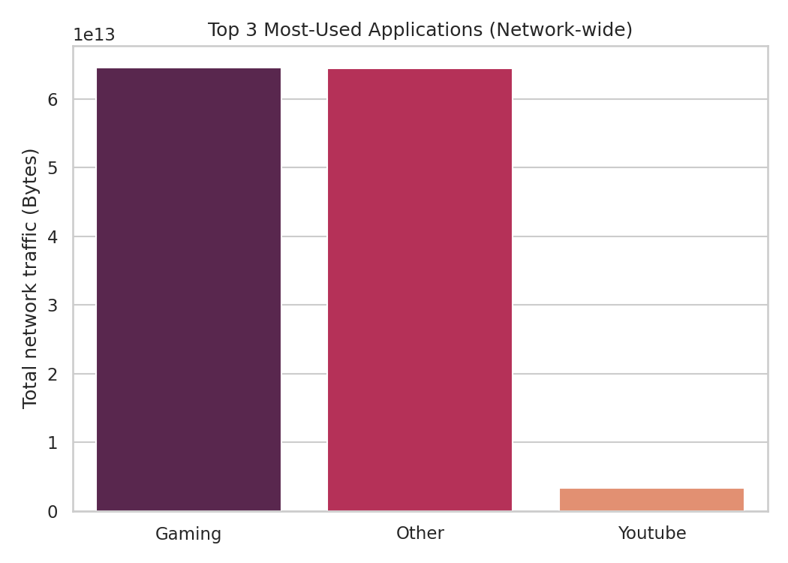
TASK 2 - USER ENGAGEMENT
Most-Used Applications, Network-Wide
58.7 TB
Gaming total volume
58.6 TB
Other total volume
3.1 TB
YouTube total volume
11

Slide 13
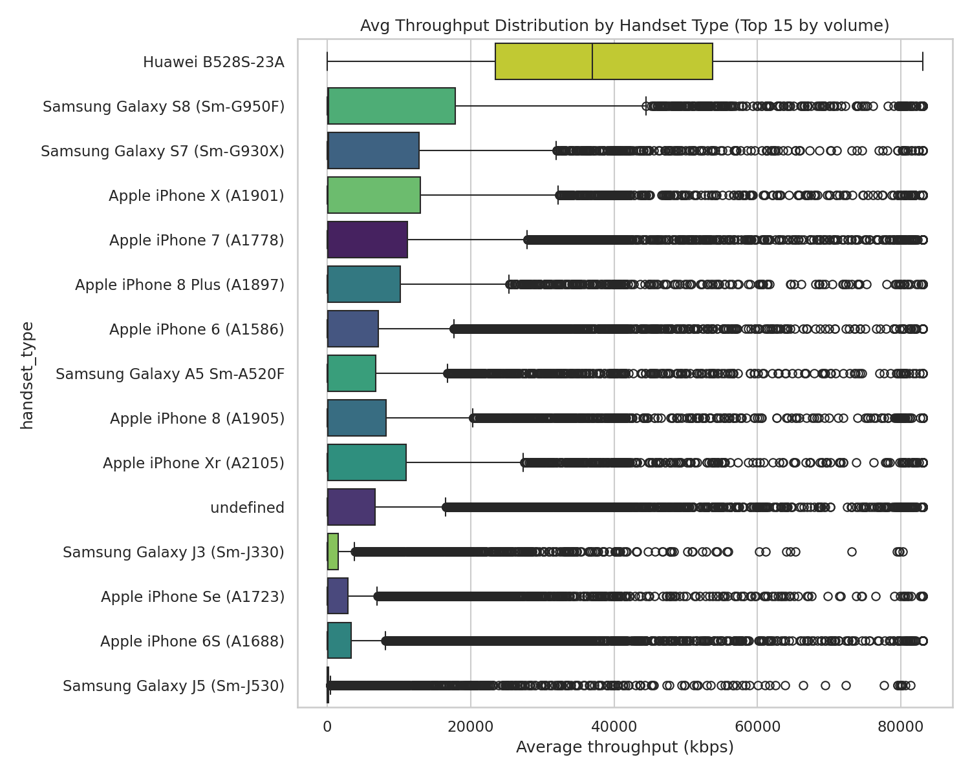
TASK 3 - USER EXPERIENCE
Average Throughput by Handset Type
Top 15 handsets by session volume. Spread within a single model suggests real network/coverage variance, not just device capability.
12

Slide 14
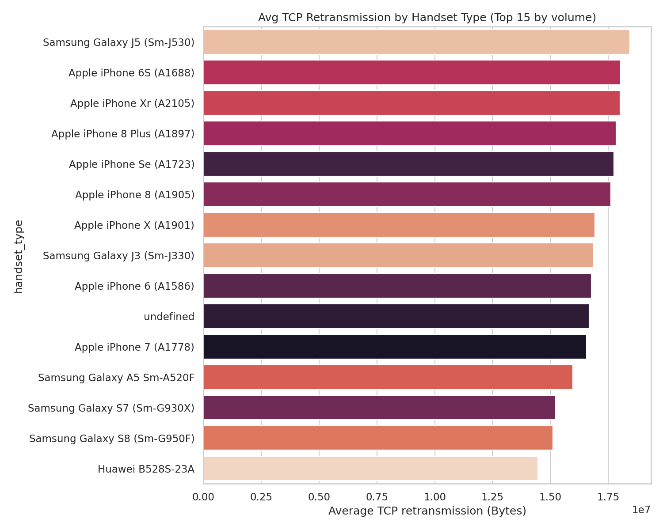
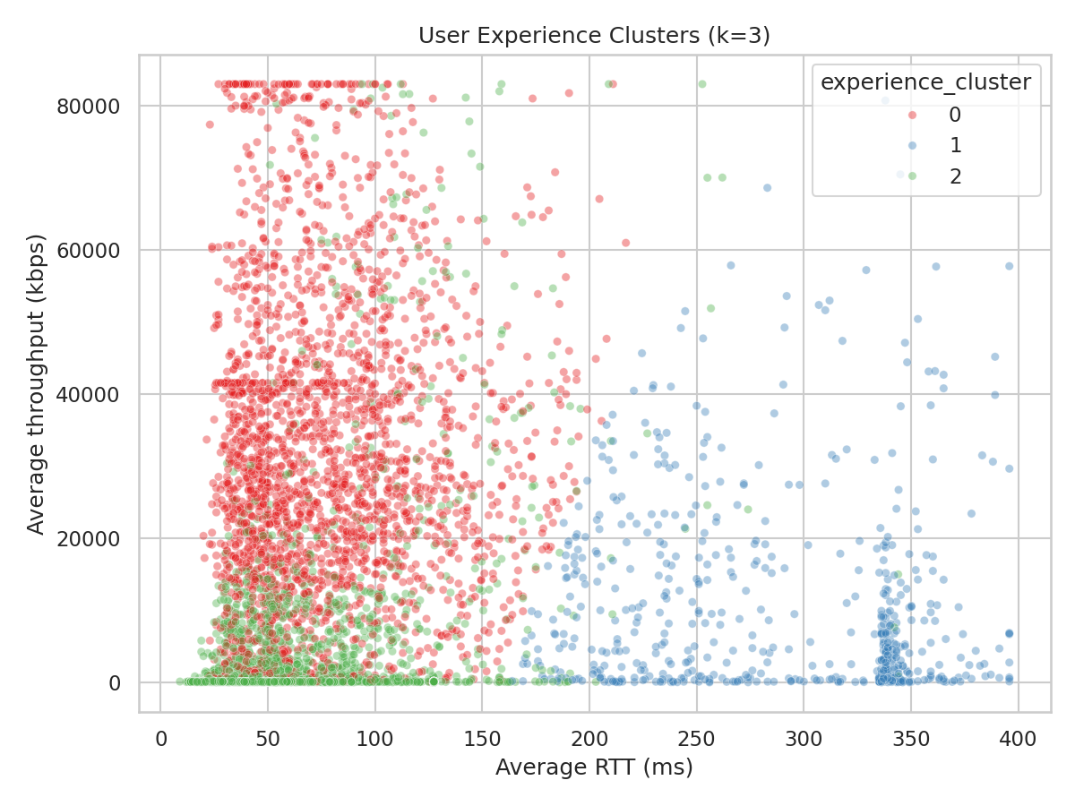
TASK 3 - USER EXPERIENCE
Network Quality: Retransmission & Experience Clusters
Three clean experience clusters emerge: good (low RTT/retrans, high throughput), moderate, and poor. The poor-experience cluster anchors the Task 4 satisfaction scoring.
13

Slide 15
TASK 4 - SATISFACTION
Scoring Customer Satisfaction
1
2
3
Engagement score
Experience score
Satisfaction score
Distance from each user to the LEAST-engaged cluster centroid
Distance from each user to the WORST-experience cluster centroid
Average of engagement score and experience score
Higher score = farther from the 'bad' reference cluster = more engaged / better experience / more satisfied.
14

Slide 16
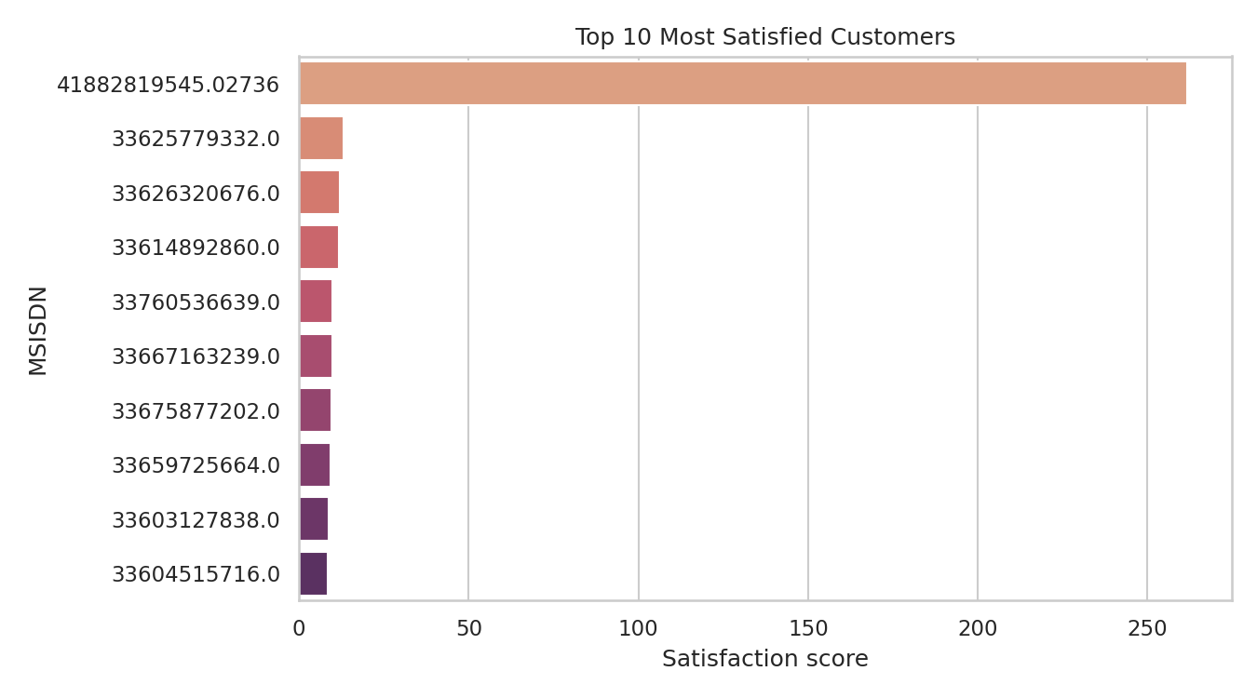
TASK 4 - SATISFACTION
Top Satisfied Customers & What Drives Satisfaction
Regression R² = 0.9509
Feature | Coefficient
sessions_frequency | 0.5424
avg_rtt_ms | -0.3039
total_duration_ms | 0.246
avg_throughput_kbps | 0.1948
avg_tcp_retrans_total_bytes | 0.1901
total_traffic_bytes | 0.0544
Session frequency and duration are the strongest positive drivers of satisfaction.
15

Slide 17
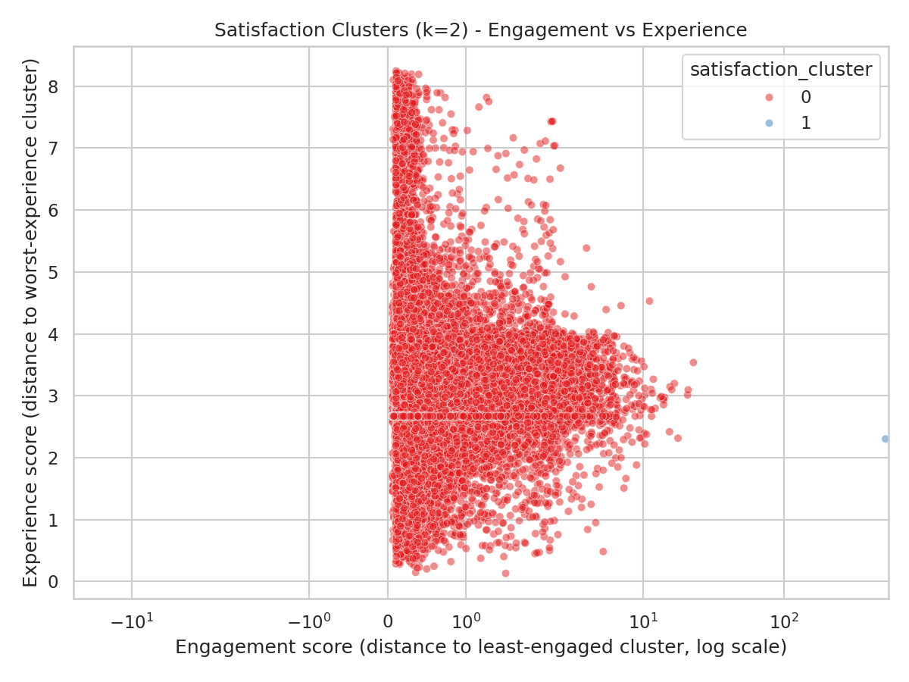
TASK 4 - SATISFACTION
Satisfaction Clusters (k=2)
Cluster 0
Avg satisfaction: 1.8376
Avg experience: 3.246
Avg engagement: 0.4292
Cluster 1
Avg satisfaction: 261.7622
Avg experience: 2.3027
Avg engagement: 521.2216
16

Slide 18
DEPLOYMENT
MLOps: Model Deployment & Tracking
1
2
3
4
Versioned runs
Tracked metrics
Artifacts saved
Database export
Each training run logs code version, start/end time, and parameters
Train/test R² and RMSE recorded per run in model_tracking_log.csv
Coefficients and full run records archived to reports/model_runs/
Final scored table (engagement, experience, satisfaction) exported for SQL access
17

Slide 19
CAVEATS
Analysis Limitations
Single-month snapshot -- trend, seasonality, and churn cannot be assessed
55-87% missingness in key network-quality columns (TCP retransmission, HTTP bytes), imputed per brief
One extreme outlier subscriber dominates engagement/satisfaction clustering and rankings
No revenue or pricing data provided -- engagement/experience used as value proxies, not profitability
Custom numpy modeling toolkit used (no scikit-learn/scipy in this environment) -- unit-tested but not cross-validated against scikit-learn
Database export used SQLite as a stand-in for MySQL (no local MySQL server available)
18

Slide 20
RECOMMENDATION
Buy, With Conditions
Positive: large, engaged subscriber base with a premium device mix and an underexploited fixed-wireless broadband segment
Risk: immature network telemetry and measurable per-handset quality variance should be priced into the deal
Recommended next step: negotiate a network-infrastructure remediation allowance into the purchase price
Recommended next step: commission a multi-month follow-up analysis to confirm trends before final close
Bottom line: the data supports proceeding with the acquisition, conditioned on a network-quality remediation plan.
19

Slide 21
APPENDIX
References
TellCo xDR session-level export (source dataset), Nexthikes IT Solutions
Field Descriptions.xlsx -- field dictionary accompanying the source dataset
Project code repository: tellco-analysis/ (src/tellco package, scripts/, tests/, dashboard/app.py)
Full written report: TellCo_Investor_Report.docx
Interactive dashboard: dashboard/app.py (Streamlit)
20

