Slide 1
DTMF CODER DECODER
Group:4
ENROLLMENT NUMBER | NAME
AU1940121 | Jinil Chandarana
AU1940174 | Umang Patel
AU1940206 | Maulikkumar Bhalani
AU1940207 | Keyur Nagar

Slide 2
Objective
DTMF is used to transfer data/message through signals using DTMF encoder and decoder.
The main objective of this project is to automate home appliances through remote control using DTMF.
specific signals which are generated from the dial pad are used to trigger certain functions.
This project lets you operate your home appliances such as lights, AC, fan, etc. using such signals from remote places with just a single switch.

Slide 3
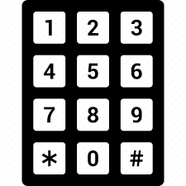
User interface-Input
user can provide input using two types of interface.
1) input through a computer/laptop keyboard to perform a definite function.
2) a keypad will be generated through the python graphical library, the user can click on this virtual keypad to perform the required function.

Slide 4
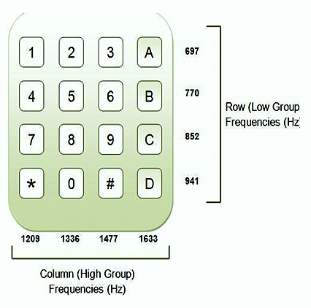
Processing techniques
Encoding:
Each digit or symbol represented in figure has 2 distinct high and low frequency components.
Each key in the Dial pad generates two tones of specific frequencies. The 16 keys of Dial pad is arranged in the form of 4×4 matrix in which each row generates Low-frequency component and each column generates high-frequency component.
The resultant tone of the single digit is the convolution of the two frequencies. So the decoder will not be confused by any single frequency voice tone.
When key ‘2’ is pressed, superimposition of tones (frequencies) 697 Hz and 1336 Hz produces a tone.

Slide 5
Processing techniques
Decoding:
DTMF receiver decodes dial tone and identifies which key is pressed by the user.
Decoder has Band split filter (FIR) which is centered at the frequencies of interest for decoding each key pressed.
Band split filter section separates lower frequency tone and higher frequency tone and provides it to digital decoder section.
Digital decoder verifies the frequency and duration of received tones and provides 4-bit output.

Slide 6
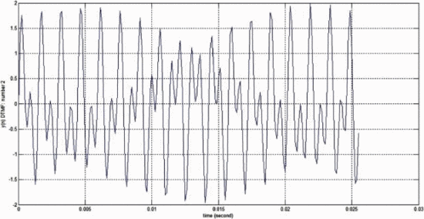
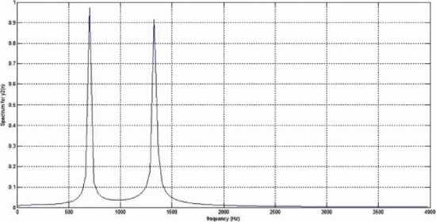
Results layout
DTMF tone wave of numeric 2
DTMF tone spectrum of numeric 2

