Slide 1
GANDHINAGAR INSTITUTE OF TECHNOLGY
Information Technology Department
Data Mining & Business Intelligence (2170715)
HDFS
Prepared By:
Patel Maulik Satishkumar (150124116006)
Guided By: Prof. Rahul A. Vaghela

Slide 2
Content
Introduction to Big Data - Hadoop
What is HDFS ?
Features of HDFS
HDFS Architecture
Elements of HDFS
Goals of HDFS
HDFS Operations (Commands)
Reference

Slide 3









Introduction to Big Data - Hadoop
What is Big Data ?
  Collection of large datasets.
  Produced by different devices and applications. →
  Can’t be processed using traditional computing techniques.
  The data in it will be of three types.
    ( Structured , Semi Structured , Unstructured )
What is Hadoop ?
  Developed by Doug Cutting & Mike Cafarella.
  Apache open source framework for Linux/UNIX & written in java.
  Hadoop is named after Cutting's son's yellow toy.
  Designed for storage & processing of large datasets across clusters of computers(Commodity hardware).

Slide 4
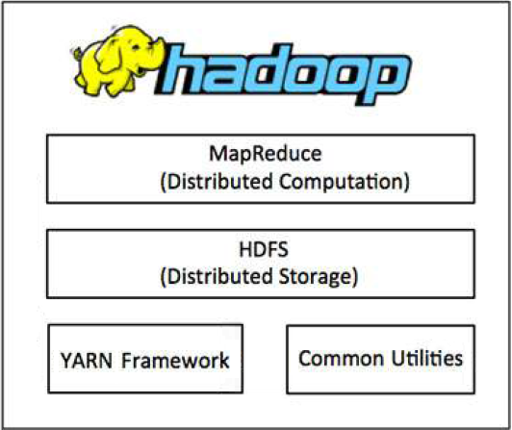

Introduction to Big Data - Hadoop
Hadoop MapReduce :
This is YARN-based system for parallel processing of large data sets.
HDFS :
A distributed file system that provides high throughput access to application data.
Hadoop YARN :
This is a framework for job scheduling and cluster resource management.
Hadoop Common :
These are Java libraries and utilities required by other Hadoop modules.

Slide 5
What is HDFS ?
Hadoop Distributed File System.
Developed using Distributed File System design based on (GFS).
Runs on commodity hardware.
HDFS is highly fault-tolerant and designed using low-cost hardware.
Holds very large amount of data and provides easier access.
The files are stored across multiple machines.
Rescue the system from possible data losses in case of failure by making Replicas.
HDFS also makes applications available to parallel processing.

Slide 6
Features of HDFS
Suitable for the distributed storage & processing.
Hadoop provides a command interface to interact with HDFS.
The built-in servers of namenode & datanode.
Fast access to file system data.
HDFS provides file permissions and authentication.
HDFS is Master-Slave architecture , so processing speed is very high & system failure rate is very low.

Slide 7
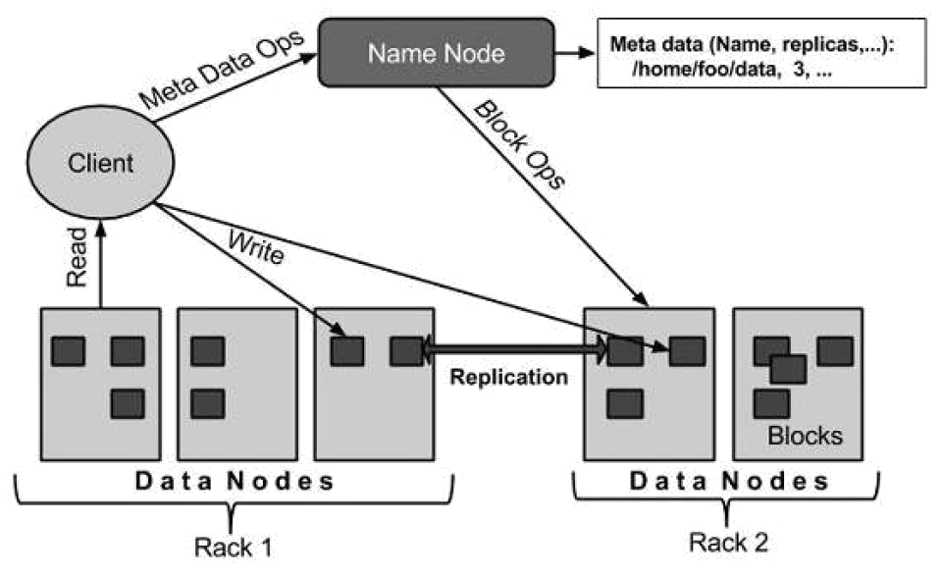
HDFS Architecture (master-slave architecture)

Slide 8
Elements of HDFS
Namenode:
Commodity hardware that contains the GNU/Linux operating system and the namenode software.
Run on commodity hardware.
The system having the namenode acts as the master server and it does the following tasks:
  Manages the file system namespace.
  Regulates client’s access to files.
  It also executes file system operations such as renaming, closing , and opening files anddirectories.

Slide 9
Elements of HDFS
Datanode:
Commodity hardware having the GNU/Linux operating system and datanode software.
The system having the datanode acts as the slave.
For every node Commodity hardware/System in a cluster, there will be a datanode. These nodes manage the data storage of their system.
  Datanodes perform read-write operations on the file systems, as per client request.
  They also perform operations such as block creation, deletion , and replication according to the instructions of the namenode.

Slide 10
Elements of HDFS
Block:
Generally the user data is stored in the files of HDFS.
The file in a file system will be divided into one or more segments and/or stored in individual data nodes. These file segments are called as blocks.
In other words, the minimum amount of data that HDFS can read or write is called a Block.
The default block size is 64MB, but it can be increased as per the need to change in HDFS configuration. (128MB in latest version)

Slide 11
Goals of HDFS
Fault detection and recovery: Since HDFS includes a large number of commodity hardware , failure of components is frequent. Therefore HDFS should have mechanism for quick and automatic fault detection and recovery.
Huge datasets: HDFS should have hundreds of nodes per cluster to manage the applications having huge datasets.
Hardware at data: A requested task can be done efficiently , when the computation takes place near the data. Especially where huge datasets are involved , it reduces the network traffic and increases the throughput.

Slide 12
HDFS Operations (Commands)
Starting HDFS
Listing files in HDFS
Inserting Data into HDFS
$ hadoop namenode –format
$ start-dfs.sh or $ start-all.sh
$ $ HADOOP_HOME/bin/hadoop fs -ls <args>
$ $ HADOOP_HOME/bin/hadoop fs –mkdir /user/dir_name
$ $ HADOOP_HOME/bin/hadoop fs -put /home/file.txt /user/dir_name
$ $ HADOOP_HOME/bin/hadoop fs -ls /user/dir_name

Slide 13
HDFS Operations (Commands)
Retrieving Data from HDFS
Shutting Down the HDFS
$ $ HADOOP_HOME/bin/hadoop fs -cat /user/dir_name/file
$ $ HADOOP_HOME/bin/hadoop fs -get /user/output/ /home/hadoop_tp/
$ stop-dfs.sh or $ stop-all.sh

Slide 14
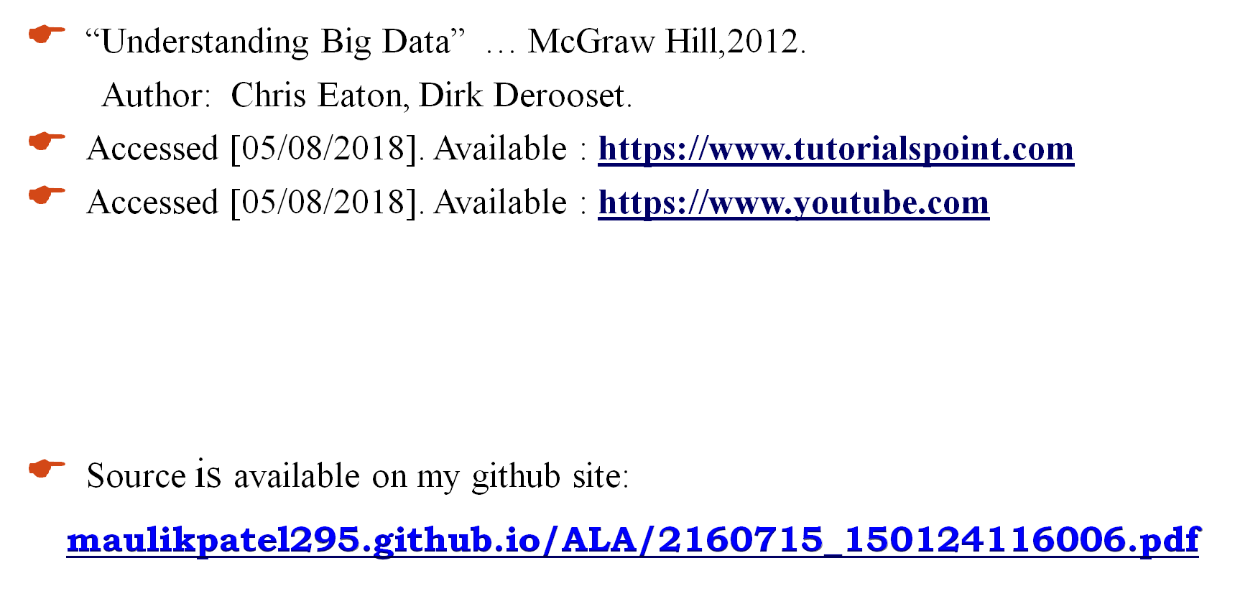
Reference

Slide 15




