Slide 1
GANDHINAGAR INSTITUTE OF TECHNOLGY
Information Technology Department
Data Compression & Data Retrival (2161603)
Applications of Huffman Coding
Prepared by :
Patel Maulik Satishkumar (150124116006)
Guided By: Prof. Krunal J. Shah

Slide 2
Content
  What is Huffman Coding ?
  Example
  Applications
    Image Compression
    Text Compression
    Audio Compression

Slide 3
What is Huffman Coding ?
Huffman coding is a coding algorithm developed by David A. Huffman in 1952.
Huffman code is a type of optimal prefix code which is used for lossless data techniques or data compression.
Huffman algorithm works on binary tree technique.

Slide 4
What is Huffman Coding ?
These codes are prefix codes and are optimum for a given model (set of probabilities).
The Huffman procedure is based on two observations regarding optimum prefix codes:
  In an optimum code, symbols that occur more frequently (have a higher probability of occurrence) will have shorter code words than symbols that occur less frequently.
  In an optimum code, the two symbols that occur least frequently will have the same length.

Slide 5
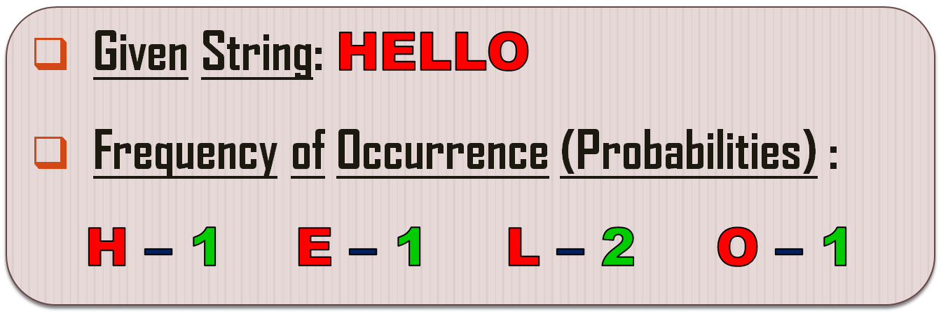
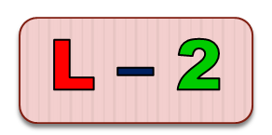
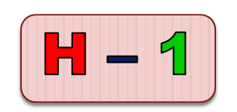
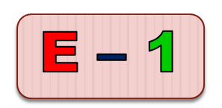
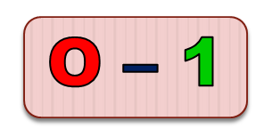
Example
Step 1 : Arrange frequencies in descending order…

Slide 6

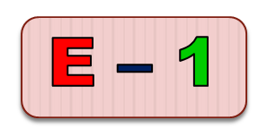
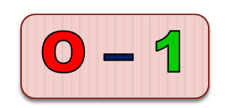
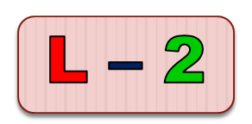
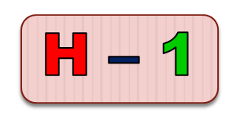
Example
Step 2 : Merge least two frequencies…
Step 3 : Arrange frequencies in descending order…

Slide 7


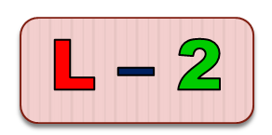
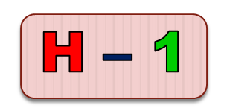
Example
Step 4 : Merge least two frequencies…

Slide 8



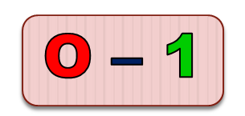
Example
Step 5 : Arrange frequencies in descending order…

Slide 9



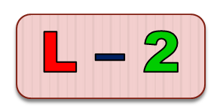

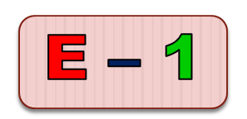
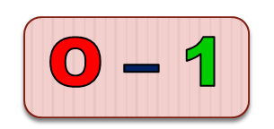
Example
Step 6 : Merge least two frequencies…

Slide 10
Example
Step 7 : Assign 0 and 1 to left and right branch of each node respectively…
0
1
0
1
0
1

Slide 11
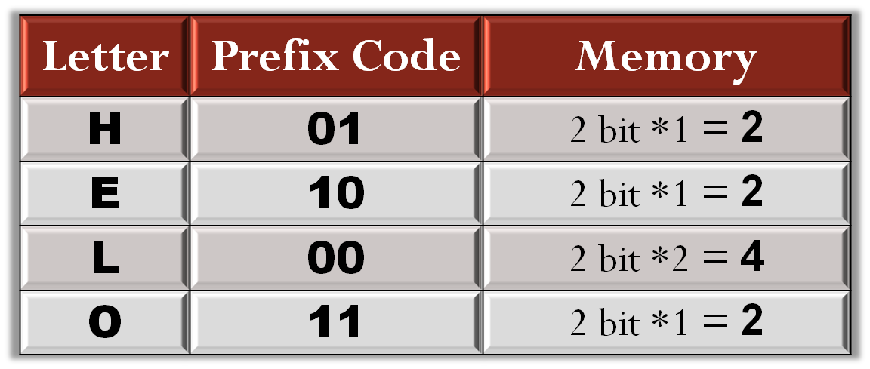

Example
Step 8 : Write prefix code for each letters…
Original Memory: 3 bits * (5 letters) = 15 bits
Memory by Huffman Coding: 2 + 2 + 4 + 2 = 10 bits

Slide 12
Applications
Huffman coding is very useful in many lossless data compression ...
  Image Compression
  Text Compression
  Audio Compression
Huffman coding is also used in other places ...
  Computer Security
  Fax Machine
  Secure Data Transfer

Slide 13
Applications
Image Compression :
A simple application of Huffman coding to image( .jpg , .jpeg ) compression would be to generate a Huffman Code for the set of values that any pixel may take.
For monochrome images, this set usually consist of integers from 0 to 255.

Slide 14
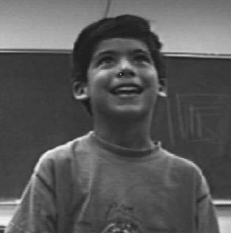
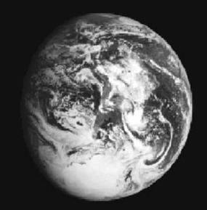
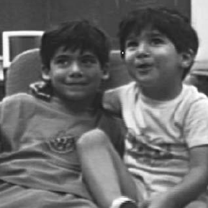
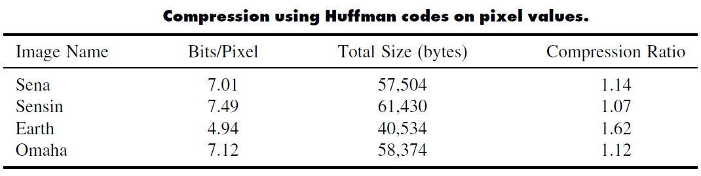
Applications

Slide 15
Applications
Text Compression :
Text Compression using Huffman Coding is done using the given probabilities or frequencies of each letters.
We had seen earlier the example of text compression. (e.g. HELLO)

Slide 16
Applications
Audio Compression :
Audio Compression using Huffman Coding is done using the entropy and bitrates of audio file(.mp3).
Huffman coding does not affect the quality of original audio file.

Slide 17
Applications
Huffman coding is a technique which is used to compress file for transmission.
Huffman Coding also provides security for transmission of file.
Huffman coding is useful in text and fax transmission.

Slide 18
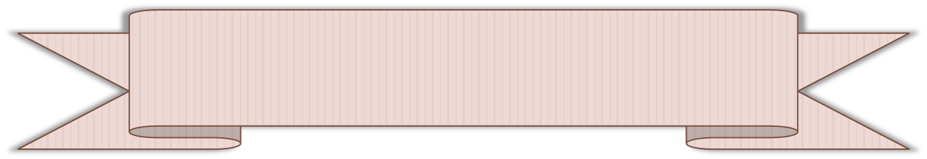
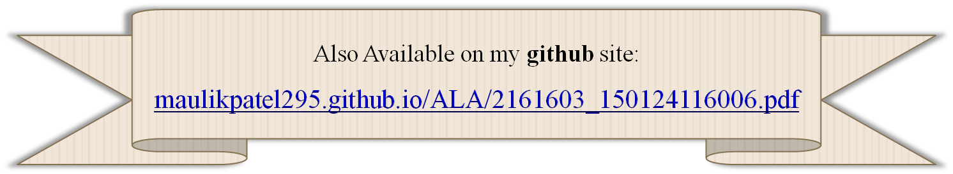
References
Accessed [15/02/2018]. Available :
  https://www.tutorialspoint.com/

Slide 19


