Slide 1
GANDHINAGAR INSTITUTE OF TECHNOLGY
Information Technology Department
Information and Network Security (2170709)
DES
Prepared By:
Patel Maulik Satishkumar (150124116006)
Guided By: Prof. Akash K. Mehta

Slide 2
Content
What is DES ?
Structure of DES
Initial and final permutation
Key Generation
Round function
Expansion Permutation Box
XOR
S-Box Substitution
Straight Permutation
DES Analysis
2

Slide 3
What is DES ?
DES stands for Data Encryption Standard.
The Data Encryption Standard (DES) is a symmetric-key block cipher.
DES is published by NIST (National Institute of Standards and Technology).
DES is an implementation of a Feistel Cipher.
DES uses 16 round Feistel structure.
The block size is 64-bit and key length is 56-bit.
3

Slide 4
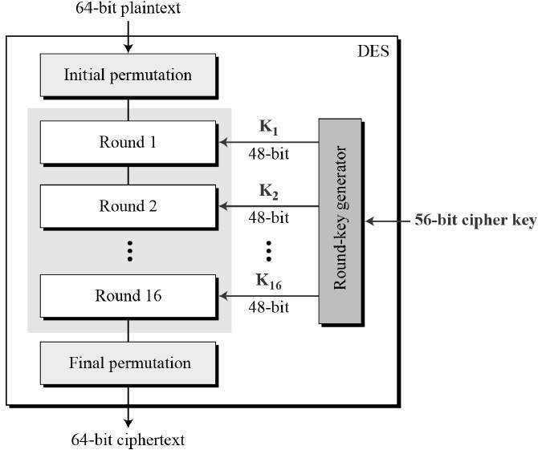
Structure of DES
4

Slide 5
Structure of DES
Encryption function has two inputs −
Plaintext (64 bits)
Key (56 bits)
Since DES is based on the Feistel Cipher, so it has three phase for Encryption −
Initial and final permutation
Key Generation
Round function
5

Slide 6
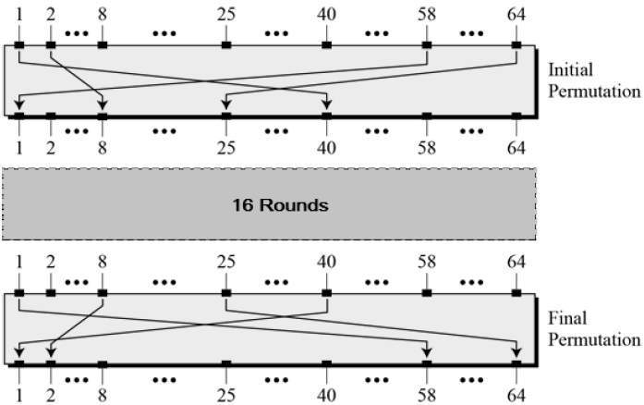
Initial and Final Permutation
The Initial & Final are straight Permutation boxes (P-boxes) that are inverses of each other. They have no cryptography significance in DES.
6

Slide 7
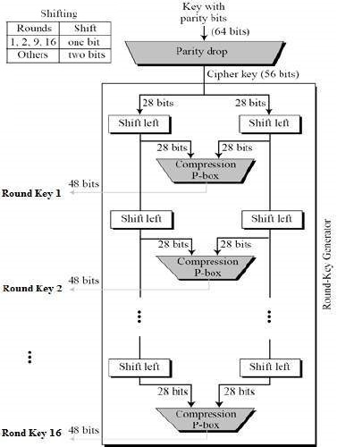
Key Generation
The round-key generator creates sixteen 48-bit keys out of a 56-bit cipher key.
The logic for Parity drop, shifting, and Compression P-box is given in the DES description.
The process of key generation is depicted in the following figure.
7

Slide 8
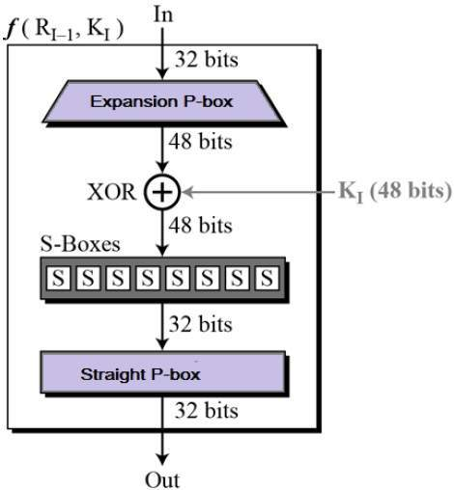
Round Function
The heart of this cipher is the DES function f.
The DES function applies a 48-bit key to the rightmost 32 bits to produce a 32-bit output.
8

Slide 9

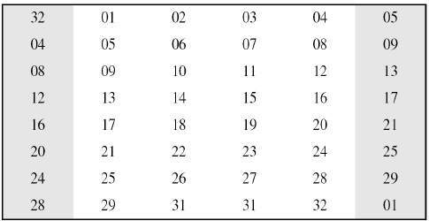
Expansion Permutation Box
Since right input is 32-bit and round key is a 48-bit, we first need to expand right input to 48 bits. Permutation logic is graphically depicted in the following illustration −
9

Slide 10
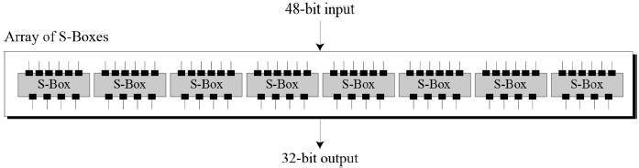
XOR & S-Box Substitution
XOR(Whitener) : After the expansion permutation, DES does XOR operation on the expanded right section and the round key. The round key is used only in this operation.
Substitution Boxes : The S-boxes carry out the real mixing confusion. DES uses 8 S-boxes, each with a 6-bit input and a 4-bit output.
10

Slide 11
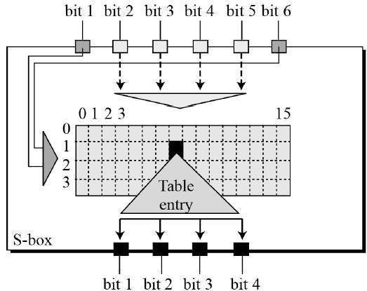
S-Box Substitution
There are a total of eight S-box tables. The output of all eight s-boxes is then combined in to 32 bit section. The S-box rule is illustrated below −
11

Slide 12
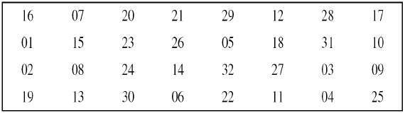
Straight Permutation
The 32 bit output of S-boxes is then subjected to the straight permutation with rule shown in the following illustration:
12

Slide 13
DES Analysis
The DES satisfies both the desired properties of block cipher. These two properties make cipher very strong.
Avalanche effect : A small change in plaintext results in the very grate change in the cipher text.
Completeness : Each bit of cipher text depends on many bits of plaintext.
During the last few years, cryptanalysis have found some weaknesses in DES when key selected are weak keys. These keys shall be avoided.
DES has proved to be a very well designed block cipher. There have been no significant cryptanalytic attacks on DES other than exhaustive key search.
13

Slide 14

THANK
YOU

