Slide 1
GANDHINAGAR INSTITUTE OF TECHNOLGY
Department of Information Technology
Mobile Computing and Wireless Communication (2170710)
Switching Techniques
Group ID: IT_B3_09
Student Name(Enrollment No):
PATEL MAULIK SATISHKUMAR
(150124116006)
Name of Faculty: Prof. Anirudhdha Nayak

Slide 2
Content
Introduction
Definition
Types of Switching
Circuit Switching
Message Switching
Packet Switching

Slide 3
Introduction
For transmission of data beyond a local area, communication is typically achieved by transmitting data from source to destination through a network of intermediate switching nodes.
Switching is used - When there are many devices, it is necessary to develop suitable mechanism for communication between any two devices.
This switched network design is sometimes used to implement LANs MANs as well.

Slide 4
Definition
Switching is the process of forwarding packets coming from one port to another port.
It defines the connection of different network segment together and the process to transmit the data packets across the network.
In large networks there might be multiple path linking sender and receiver. Information may be switched as it travels through various communication channels.

Slide 5


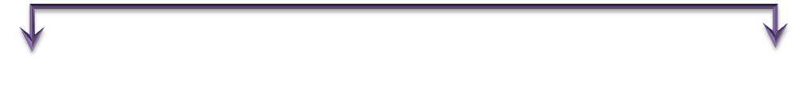
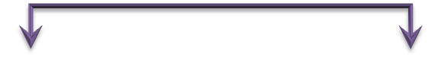
Types of Switching
Switched Networks
Circuit-Switched Networks
Message-Switched Networks
Packet-Switched Networks
Datagram
Networks
Virtual-Circuit
Networks

Slide 6
Circuit Switching
A circuit-switched network is made of a set of switches connected by physical links, in which each link is divided into n channels.
A circuit-switched network consists of a set of switches connected by physical links.
A connection between two stations is a dedicated path made of one or more links.
However, each connection uses only one dedicated channel on each link. Each link is normally divided into n channels.

Slide 7
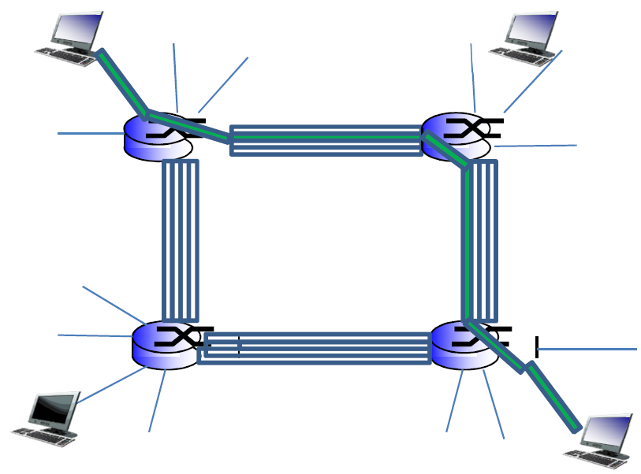
Circuit Switching

Slide 8
Circuit Switching
Advantages:
The communication channel (once established) is dedicated.
Disadvantages:
Possible long wait to establish a connection, (10 seconds, more on long- distance or international calls.) during which no data can be transmitted.
More expensive than any other switching techniques, because a dedicated path is required for each connection.
Inefficient use of the communication channel, because the channel is not used when the connected systems are not using it.

Slide 9
Message Switching
With message switching there is no need to establish a dedicated path between two stations.
When a station sends a message, the destination address is appended to the message.
The message is then transmitted through the network, in its entirety, from node to node.
Each node receives the entire message, stores it in its entirety on disk, and then transmits the message to the next node.
This type of network is called a store-and-forward network.

Slide 10
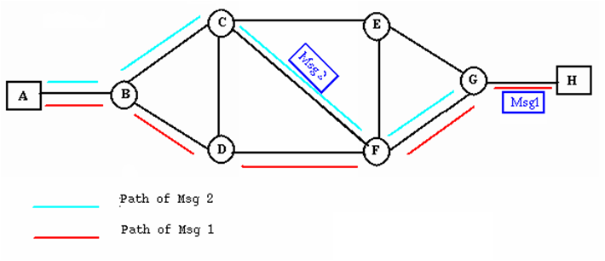
Message Switching
A message-switching node is typically a general-purpose computer. The device needs sufficient secondary-storage capacity to store the incoming messages, which could be long. A time delay is introduced using this type of scheme due to store- and-forward time, plus the time required to find the next node in the transmission path.

Slide 11
Message Switching
Advantages:
Channel efficiency can be greater compared to circuit- switched systems, because more devices are sharing the channel.
Traffic congestion can be reduced, because messages may be temporarily stored in route.
Message priorities can be established due to store-and-forward technique.
Message broadcasting can be achieved with the use of broadcast address appended in the message.
Disadvantages:
Message switching is not compatible with interactive applications.
Store-and-forward devices are expensive, because they must have large disks to hold potentially long messages.

Slide 12
Packet Switching
The basic approach is not much different from message switching. It is also based on the same ‘store-and-forward’ approach.
Messages are divided into subsets of equal length called Packets.
In packet switching approach, data are transmitted in short packets (few Kbytes). A long message is broken up into a series of packets.
Each packet is tagged with appropriate source and destination addresses.(e.g. for reassembling).

Slide 13
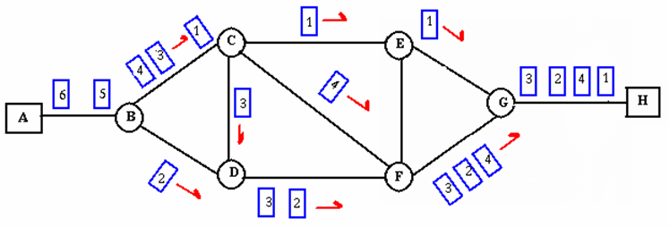
Packet Switching
Message
Packet
1
Packet
2
Packet
N

Slide 14
Packet Switching
Advantages:
Packet switching is cost effective, because switching devices do not need massive amount of secondary storage.
Packet switching offers improved delay characteristics, because there are no long messages in the queue (maximum packet size is fixed).
Packet can be rerouted if there is any problem, such as, busy or disabled links.
The advantage of packet switching is that many network users can share the same channel at the same time.
Packet switching can maximize link efficiency by making optimal use of link bandwidth.
Disadvantages:
Protocols for packet switching are typically more complex. It can add some initial costs in implementation. If packet is lost, sender needs to retransmit the data.
Another disadvantage is that packet-switched systems still can’t deliver the same quality as dedicated circuits in applications requiring very little delay - like voice conversations or moving images.

Slide 15
THANK YOU

