Slide 1
GANDHINAGAR INSTITUTE OF TECHNOLGY
Information Technology Department
Web Technology (2160708)
Introduction to XML, uses of XML
Prepared by-
Patel Maulik Satishkumar (150124116006)
Guided By: Prof. Rohan C. Prajapati

Slide 2
Content
  What is XML?
  What is Markup?
  Characteristics of XML
  Is XML a Programming Language?
  Difference between XML & HTML
  XML Document
  XML Declaration
  XML Tags/Elements
  Example
  Uses of XML
  XML Tools

Slide 3
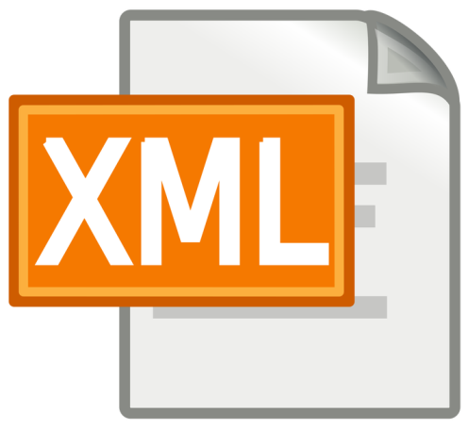
What is XML?
XML stands for EXtensible Markup Language.
XML is a text-based mark-up language derived from Standard Generalized Markup Language (SGML).
XML is a meta-language, which can be used to store data & act as a mechanism to transfer information between dissimilar systems.
XML was designed to describe data.
XML is self describing.
XML file is saved with .xml extention.

Slide 4
What is XML?
XML uses a DTD (Document Type Definition) to formally describe the data.
XML is a markup language much like HTML, but XML tags are not predefined in XML. You must define your own tags.
XML tags identify the data and are used to store and organize the data, rather than specifying how to display it like HTML tags, which are used to display the data.
XML is not going to replace HTML in the near future, but it introduces new possibilities by adopting many successful features of HTML.

Slide 5
What is Markup?
XML is a markup language that defines set of rules for encoding documents in a format that is both human-readable and machine-readable.
What exactly is a markup language?
  Markup is information added to a document that enhances its meaning in certain ways, in that it identifies the parts and how they relate to each other.
  More specifically, a markup language is a set of symbols that can be placed in the text of a document to demarcate and label the parts of that document.

Slide 6
Characteristics of XML
XML is extensible −
XML allows you to create your own self-descriptive tags, or language, that suits your application.
XML carries the data, does not present it −
XML allows you to store the data irrespective of how it will be presented.
XML is a public standard −
XML was developed by an organization called the World Wide Web Consortium (W3C) and is available as an open standard.

Slide 7
Is XML a Programming Language?
NO
XML does not qualify to be a programming language, because it does not perform any computation or algorithms.
A programming language consists of grammar rules and its own vocabulary which is used to create computer programs.
These programs instruct the computer to perform specific tasks.
It is usually stored in a simple text file and is processed by special software that is capable of interpreting XML.

Slide 8
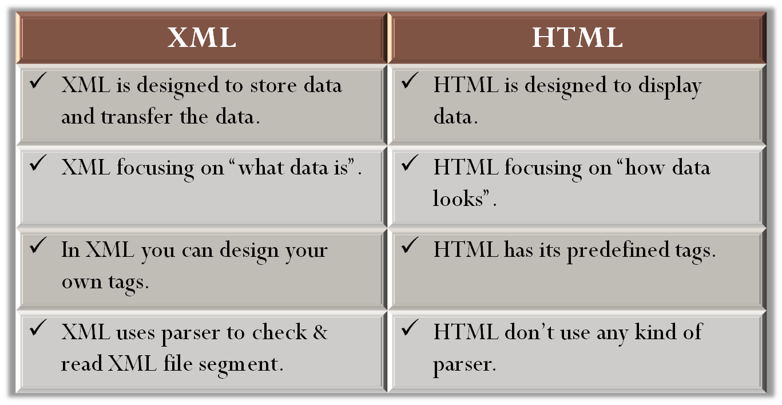
Difference between XML & HTML

Slide 9

XML Document
A simple document is shown in the following example −
Any XML document contain to sections:
  Document Prolog
  Document Elements
<?xml version = "1.0"?>
<contact-info>
<name> Maulik Patel </name>
<company> TutorialsPoint </company>
<phone> (011) 123-4567 </phone>
</contact-info>
Document Prolog
Document Elements

Slide 10
XML Document
Document Prolog : It comes at the top of the document, before the root element. This section contains −
    XML Declaration
    Document type declaration
Document Elements : Document Elements are the building blocks of XML. These divide the document into a hierarchy of sections, each serving a specific purpose. You can separate a document into multiple sections so that they can be rendered differently, or used by a search engine. The elements can be containers, with a combination of text and other elements. This section contains −
    XML Tags/Elements

Slide 11
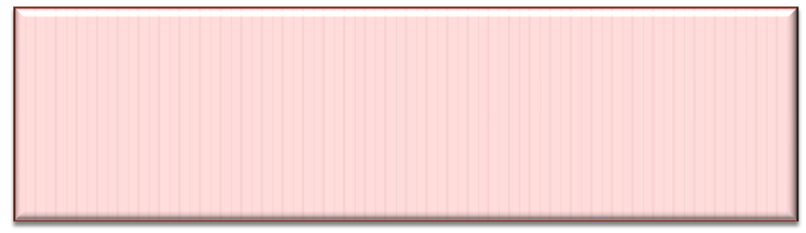
XML Declaration
XML Declaration:
  The XML document can optionally have an XML declaration. It is written as follows −
  Where version is the XML version and encoding specifies the character encoding used in the document.
<?xml
version = "version_number"
encoding = "encoding_declaration“
standalone = "standalone_status"
?>
<?xml version = "1.0" encoding = "UTF-8"?>

Slide 12
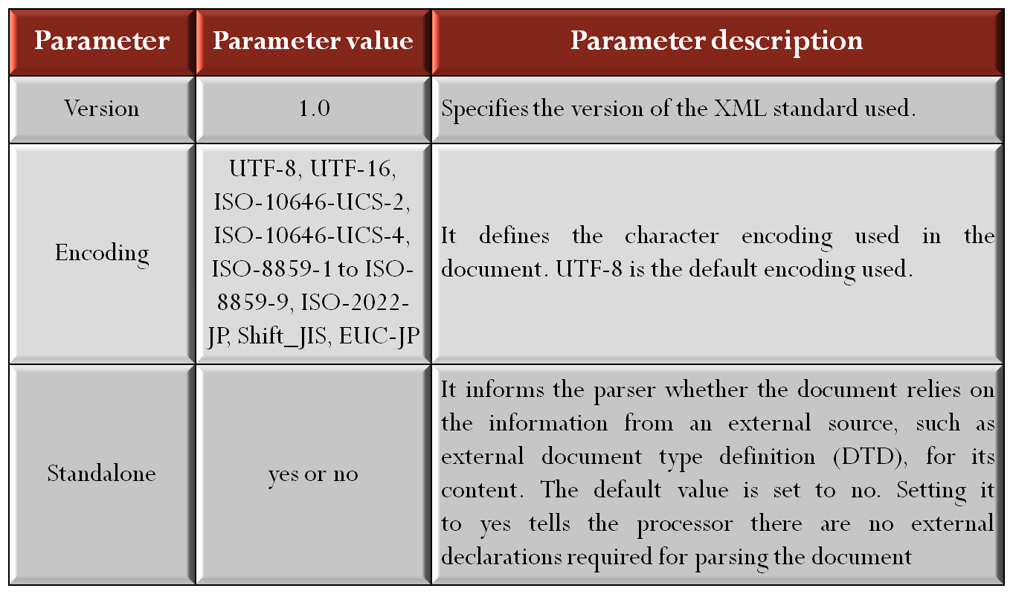
XML Declaration
Attributes of XML Declaration Tag

Slide 13
XML Declaration Rules
An XML declaration should abide with the following rules −
  If the XML declaration is present in the XML, it must be placed as the first line in the XML document.
  If the XML declaration is included, it must contain version number attribute.
  The Parameter names and values are case-sensitive.
  The names are always in lower case.
  The order of placing the parameters is important. The correct order is: version, encoding and standalone.
  Either single or double quotes may be used.
  The XML declaration has no closing tag i.e. </?xml>

Slide 14


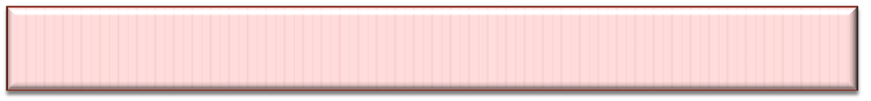
XML Declaration Rules
XML Declaration Examples :
XML declaration with no parameters −
XML declaration with version definition −
XML declaration with all parameters defined −
XML declaration with all parameters defined in single quotes −
<?xml >
<?xml version = "1.0">
<?xml version = " 1.0 " encoding = " UTF-8 " standalone = "no" ?>
<?xml version = '1.0' encoding = 'iso-8859-1' standalone = 'no' ?>

Slide 15
XML Tags/Elements
An XML file is structured by several XML-elements, also called XML-nodes or XML-tags. The names of XML-elements are enclosed in triangular brackets < > as shown below −
Element Syntax − Each XML-element needs to be closed either with start or with end elements as shown below −
Case Sensitivity − The names of XML-elements are case-sensitive. That means the name of the start and the end elements need to be exactly in the same case.
For example,
<element>
<element>.....</element>
<contact-info> is different from <Contact-Info>

Slide 16
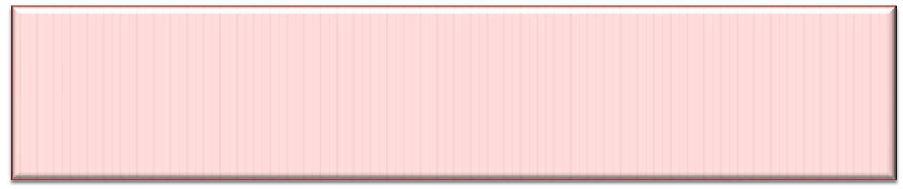

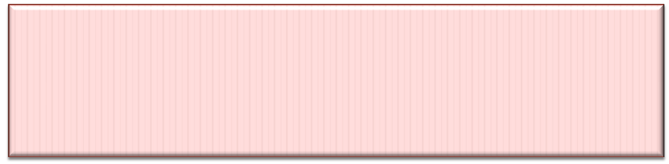
XML Tags/Elements
Nesting of Elements − An XML-element can contain multiple XML-elements as its children, but the children elements must not overlap.
i.e., an end tag of an element must have the same name as that of the most recent unmatched start tag.
<?xml version = "1.0"?>
<contact-info>
<company>
TutorialsPoint </contact-info>
</company>
<?xml version = "1.0"?>
<contact-info>
<company>
TutorialsPoint
</company>
</contact-info>

Slide 17
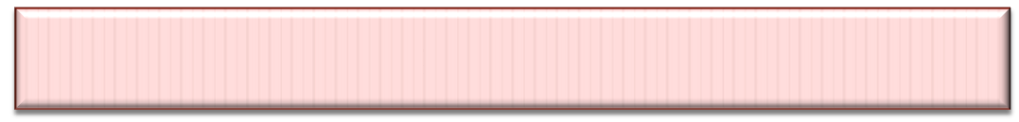
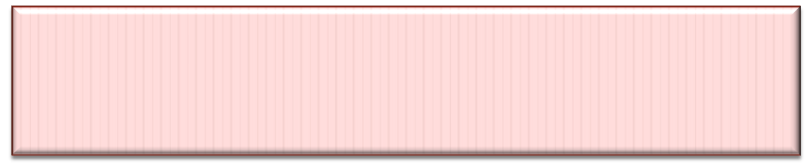
XML Tags/Elements
Root Element − An XML document can have only one root element.
For example,
Following is not a correct XML document, because both the x and y elements occur at the top level without a root element −
Following is a correct XML document, because both the x and y elements occur with a root element −
<x>...</x>
<y>...</y>
<root>
<x>...</x>
<y>...</y>
</root>

Slide 18

XML Tags/Elements
XML Attributes − Attribute names in XML (unlike HTML) are case sensitive. That is, HREF and href are considered two different XML attributes.
  Same attribute can not have two values in a syntax. The following example shows incorrect syntax because the attribute b is specified twice−
  Attribute names are defined without quotation marks, whereas attribute values must always appear in quotation marks. Following example demonstrates incorrect xml syntax−
<a b = "x" c = "y" b = "z">....</a>
<a b = "x" c = "y">....</a>
<a b = x>....</a
<a b = "x">....</a

Slide 19
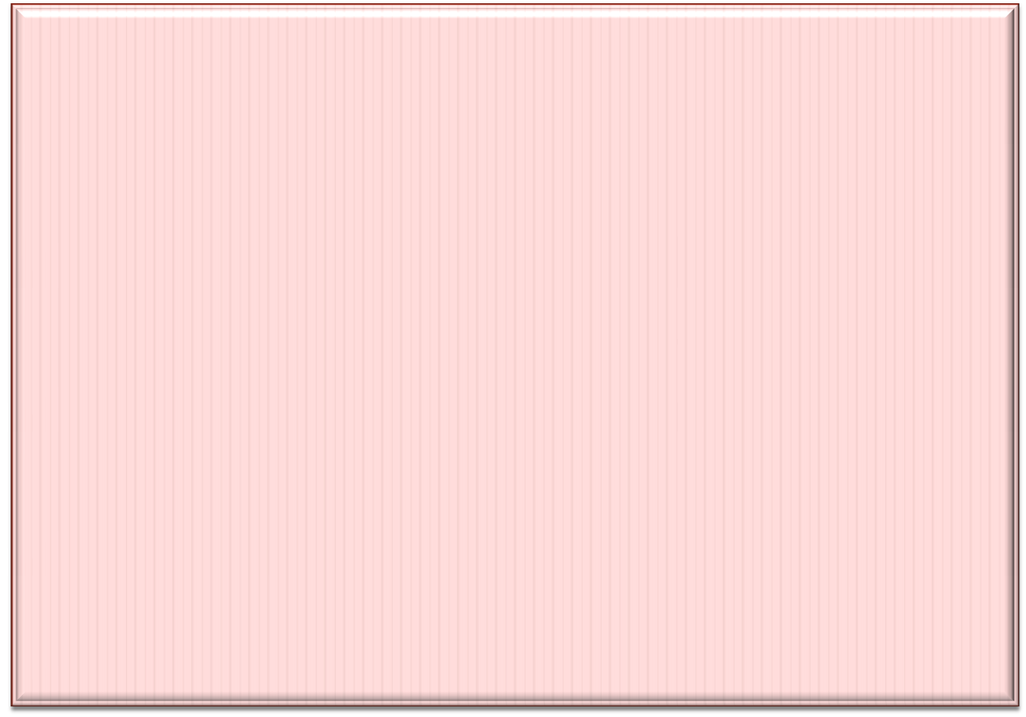
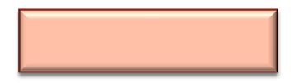
Example
<?xml version="1.0“ encoding="UTF-8“standalone="no"?>
<Students>
<Student>
<Name>MAULIK PATEL </Name>
<Enroll_No>150124116006</Enroll_No>
<Branch>IT</Branch>
<Semester>6th</Semester>
<College>Gandhinagar</College>
</Student>
<Student>
<Name>URVIL PATEL</Name>
<Enroll_No>150124116005</Enroll_NO>
<Branch>IT</Branch>
<Semester>6th</Semester>
<College>Gandhinagar</College>
</Student>
</Students>
Students.xml

Slide 20
Uses of XML
XML can work behind the scene to simplify the creation of HTML documents for large web sites.
XML is used to describe the content of document.
XML is used to Exchange data between dissimilar system.
XML can be used to exchange the information between organizations and systems.
XML can be used as database to store data.

Slide 21
Uses of XML
XML can be used for offloading and reloading of databases.
XML can be used to store and arrange the data, which can customize your data handling needs.
XML can easily be merged with style sheets to create almost any desired output.
Virtually, any type of data can be expressed as an XML document.

Slide 22
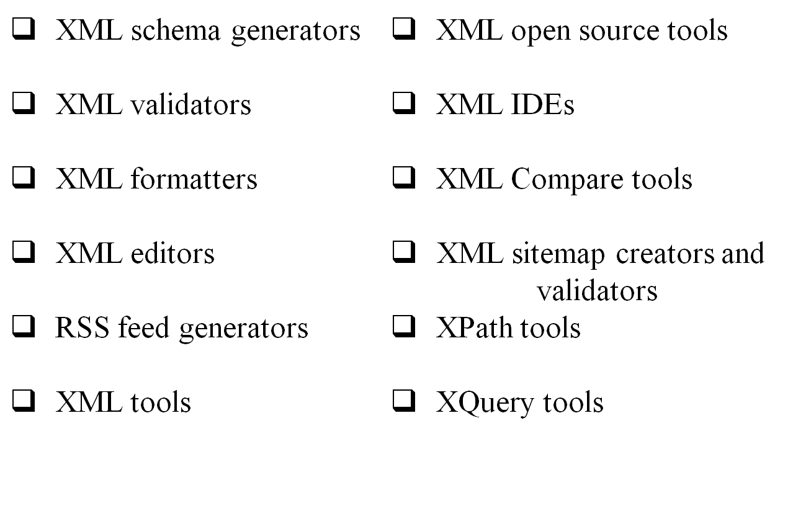
XML tools

Slide 23
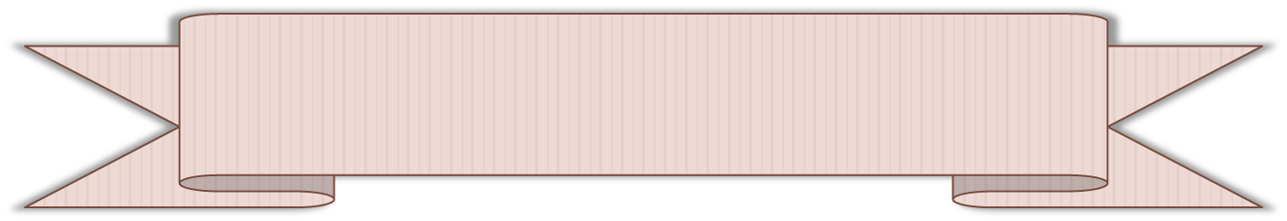
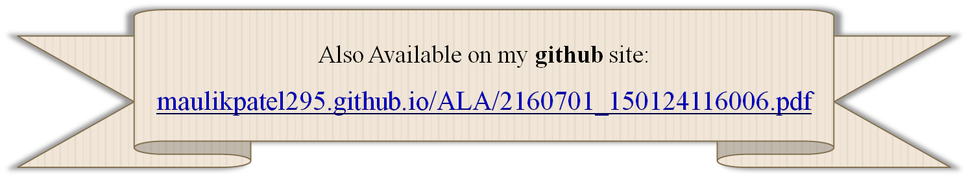
References
Accessed [30/01/2018]. Available :
  https://www.tutorialspoint.com/XML/

Slide 24


